Slide 1
Grade 4
Unit 2: Whole Numbers & Place Value

Slide 2
$ 500
What value does the underlined number represent in 1476
4
40
A:
B:
4000
400
C:
D:

Slide 3
$ 500
$ 500
What value does the underlined number represent in 1476
4
40
A:
B:
4000
400
C:
D:

Slide 4
14
13
12
11
10
9
8
7
6
5
4
3
2
1
$ 1 MILLION
$ 500,000
$ 250,000
$ 100,000
$ 50,000
$ 30,000
$ 20,000
$ 10,000
$ 7,000
$ 5,000
$ 3,000
$ 2,000
$ 1,000
$ 500

Slide 5
$ 1000
Order from least to greatest: 5078, 5708, 785, 5008, 5870
785, 5008, 5078, 5708, 5870
785, 5078, 5008, 5708, 5870
A:
B:
5870, 5708, 5078, 5008, 785
None of the above
C:
D:

Slide 6
$ 1000
Order from least to greatest: 5078, 5708, 785, 5008, 5870
785, 5008, 5078, 5708, 5870
785, 5078, 5008, 5708, 5870
A:
B:
5870, 5708, 5078, 5008, 785
None of the above
C:
D:

Slide 7
14
13
12
11
10
9
8
7
6
5
4
3
2
1
$ 1 MILLION
$ 500,000
$ 250,000
$ 100,000
$ 50,000
$ 30,000
$ 20,000
$ 10,000
$ 7,000
$ 5,000
$ 3,000
$ 2,000
$ 1,000
$ 500

Slide 8
$ 2000
Round these numbers to the nearest ten and add:
567 + 449 = _____
570 + 450 = 1000
600 + 400 = 1000
A:
B:
570 + 450 = 1020
565 + 450 = 1015
C:
D:

Slide 9
$ 2000
Round these numbers to the nearest ten and add:
567 + 449 = _____
570 + 450 = 1000
600 + 400 = 1000
A:
B:
570 + 450 = 1020
565 + 450 = 1015
C
D:

Slide 10
14
13
12
11
10
9
8
7
6
5
4
3
2
1
$ 1 MILLION
$ 500,000
$ 250,000
$ 100,000
$ 50,000
$ 30,000
$ 20,000
$ 10,000
$ 7,000
$ 5,000
$ 3,000
$ 2,000
$ 1,000
$ 500

Slide 11
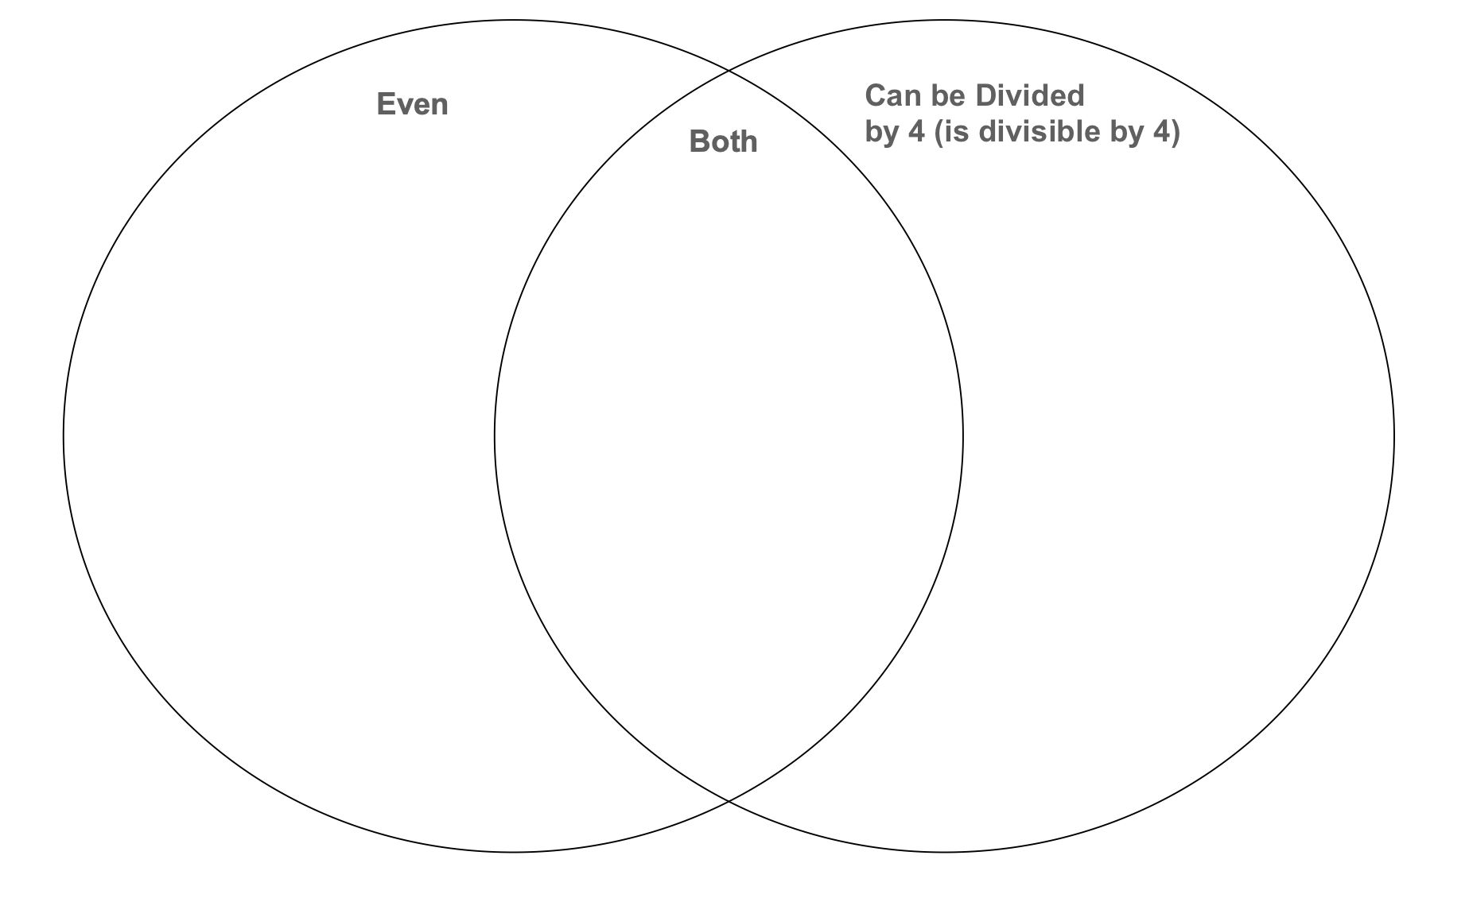
$ 3000
Where does the number 2 go in this Venn diagram?
Left Circle (Even)
Right Circle (Div. by 5)
A:
B:
Both: In the middle
Outside the Circles
C:
D:

Slide 12
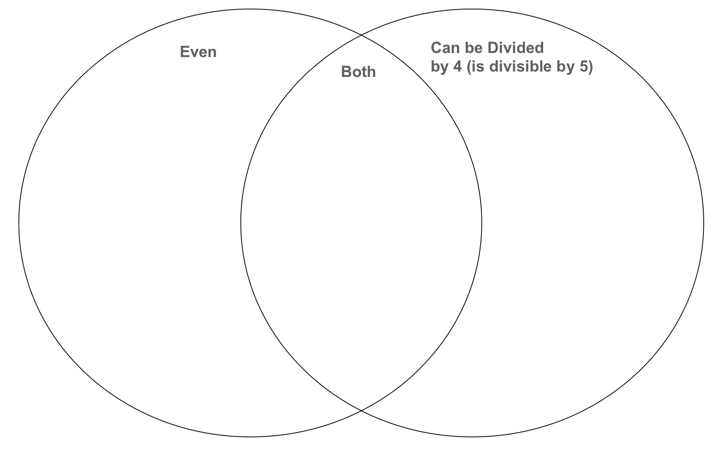
Audience results are shown here if you use SlideLizard
$ 3000
Where does the number 2 go in this Venn diagram?
Left Circle (Even)
Right Circle (Div. by 5)
A:
B:
Both: In the middle
Outside the Circles
C:
D:

Slide 13
14
13
12
11
10
9
8
7
6
5
4
3
2
1
$ 1 MILLION
$ 500,000
$ 250,000
$ 100,000
$ 50,000
$ 30,000
$ 20,000
$ 10,000
$ 7,000
$ 5,000
$ 3,000
$ 2,000
$ 1,000
$ 500

Slide 14
$ 3000
Where does the number 28 go in this Venn diagram?
Left Circle (Even)
Right Circle (Div. by 5)
A:
B:
Both: In the middle
Outside the Circles
C:
D:

Slide 15
Audience results are shown here if you use SlideLizard
$ 5000
Where does the number 28 go in this Venn diagram?
Left Circle (Even)
Right Circle (Div. by 5)
A:
B:
Both: In the middle
Outside the Circles
C:
D:

Slide 16
14
13
12
11
10
9
8
7
6
5
4
3
2
1
$ 1 MILLION
$ 500,000
$ 250,000
$ 100,000
$ 50,000
$ 30,000
$ 20,000
$ 10,000
$ 7,000
$ 5,000
$ 3,000
$ 2,000
$ 1,000
$ 500

Slide 17
$ 3000
What is 5778 in standard form, expanded form, and written form?
A:
Standard: 5000 + 700 + 70 + 8
Expanded: 5778
Written: five thousand seven hundred seventy-eight
B:
Standard: 5778
Expanded: 500 + 700 + 70 + 8
Written: five thousand seven
C:
Standard: 5778
Expanded: 5000 + 700 + 70 + 8
Written: five thousand seven hundred seventy-eight
D:
Standard: 5778
Expanded: 5000 + 700 + 78
Written: five thousand seven hundred seventy-eight

Slide 18
$ 5000
What is 5778 in standard form, expanded form, and written form?
A:
Standard: 5000 + 700 + 70 + 8
Expanded: 5778
Written: five thousand seven hundred seventy-eight
B:
Standard: 5778
Expanded: 500 + 700 + 70 + 8
Written: five thousand seven
C:
Standard: 5778
Expanded: 5000 + 700 + 70 + 8
Written: five thousand seven hundred seventy-eight
D:
Standard: 5778
Expanded: 5000 + 700 + 78
Written: five thousand seven hundred seventy-eight

Slide 19
14
13
12
11
10
9
8
7
6
5
4
3
2
1
$ 1 MILLION
$ 500,000
$ 250,000
$ 100,000
$ 50,000
$ 30,000
$ 20,000
$ 10,000
$ 7,000
$ 5,000
$ 3,000
$ 2,000
$ 1,000
$ 500

Slide 20
$ 3000
Where does the number 47 go in this Venn diagram?
Left Circle (Even)
Right Circle (Div. by 5)
A:
B:
Both: In the middle
Outside the Circles
C:
D:

Slide 21
Audience results are shown here if you use SlideLizard
$ 5000
Where does the number 47 go in this Venn diagram?
Left Circle (Even)
Right Circle (Div. by 5)
A:
B:
Both: In the middle
Outside the Circles
C:
D:

Slide 22
14
13
12
11
10
9
8
7
6
5
4
3
2
1
$ 1 MILLION
$ 500,000
$ 250,000
$ 100,000
$ 50,000
$ 30,000
$ 20,000
$ 10,000
$ 7,000
$ 5,000
$ 3,000
$ 2,000
$ 1,000
$ 500

Slide 23
$ 20,000
Add: 1234 + 9987 =
11 000
11 221
A:
B:
12 011
10 221
C:
D:

Slide 24
$ 20,000
Add: 1234 + 9987 =
11 000
11 221
A:
B:
12 011
10 221
C:
D:

Slide 25
14
13
12
11
10
9
8
7
6
5
4
3
2
1
$ 1 MILLION
$ 500,000
$ 250,000
$ 100,000
$ 50,000
$ 30,000
$ 20,000
$ 10,000
$ 7,000
$ 5,000
$ 3,000
$ 2,000
$ 1,000
$ 500

Slide 26
$ 30,000
Round to the nearest hundred & subtract: 4334 - 2222
4330 – 2000 = 2330
4300 – 2200 = 2100
A:
B:
4330 + 2000 = 6330
4000 – 2000 = 2000
C:
D:

Slide 27
$ 30,000
Round to the nearest hundred & subtract: 4334 - 2222
4330 – 2000 = 2330
4300 – 2200 = 2100
A:
B:
4330 + 2000 = 6330
4000 – 2000 = 2000
C:
D:

Slide 28
14
13
12
11
10
9
8
7
6
5
4
3
2
1
$ 1 MILLION
$ 500,000
$ 250,000
$ 100,000
$ 50,000
$ 30,000
$ 20,000
$ 10,000
$ 7,000
$ 5,000
$ 3,000
$ 2,000
$ 1,000
$ 500

Slide 29
$ 50,000
Subtract: 2017 – 938 = _____
1079
2955
A:
B:
1080
1000
C:
D:

Slide 30
$ 50,000
Subtract: 2017 – 938 = _____
1079
2955
A:
B:
1080
1000
C:
D:

Slide 31
14
13
12
11
10
9
8
7
6
5
4
3
2
1
$ 1 MILLION
$ 500,000
$ 250,000
$ 100,000
$ 50,000
$ 30,000
$ 20,000
$ 10,000
$ 7,000
$ 5,000
$ 3,000
$ 2,000
$ 1,000
$ 500

Slide 32
$ 100,000
John climbed 535 m on Monday, a mystery amount on Tuesday, and 837 m on Wednesday. If he climbed a total of 1914 m in all three days combined, how far did he climb on Tuesday?
60 m
500 m
A:
B:
600 m
542 m
C:
D:

Slide 33
$ 100,000
John climbed 535 m on Monday, a mystery amount on Tuesday, and 837 m on Wednesday. If he climbed a total of 1914 m in all three days combined, how far did he climb on Tuesday?
60 m
500 m
A:
B:
600 m
542 m
C:
D:

Slide 34
14
13
12
11
10
9
8
7
6
5
4
3
2
1
$ 1 MILLION
$ 500,000
$ 250,000
$ 100,000
$ 50,000
$ 30,000
$ 20,000
$ 10,000
$ 7,000
$ 5,000
$ 3,000
$ 2,000
$ 1,000
$ 500

Slide 35
$ 250,000
If Jenny starts out with 674 jellybeans and she gives 400 to James, she forgets how much she gives to Jimmy, and she gives 42 to Pam and she has 117 left, how many did she give to Jimmy?
100
115
A:
B:
232
None of the Above
C:
D:

Slide 36
$ 250,000
If Jenny starts out with 674 jellybeans and she gives 400 to James, she forgets how much she gives to Jimmy, and she gives 42 to Pam and she has 117 left, how many did she give to Jimmy?
100
115
A:
B:
232
None of the above
C:
D:

Slide 37
14
13
12
11
10
9
8
7
6
5
4
3
2
1
$ 1 MILLION
$ 500,000
$ 250,000
$ 100,000
$ 50,000
$ 30,000
$ 20,000
$ 10,000
$ 7,000
$ 5,000
$ 3,000
$ 2,000
$ 1,000
$ 500

Slide 38
$ 500,000
Lily has twice as many jellybeans as Brandon. Brandon has 245 jellybeans. How many do they have altogether?
1000
490
A:
B:
735
700
C:
D:

Slide 39
$ 500,000
Lily has twice as many jellybeans as Brandon. Brandon has 245 jellybeans. How many do they have altogether?
1000
490
A:
B:
735
700
C:
D:

Slide 40
14
13
12
11
10
9
8
7
6
5
4
3
2
1
$ 1 MILLION
$ 500,000
$ 250,000
$ 100,000
$ 50,000
$ 30,000
$ 20,000
$ 10,000
$ 7,000
$ 5,000
$ 3,000
$ 2,000
$ 1,000
$ 500

Slide 41
$ 1 MILLION
Penny and Jeff collect stuffies. Altogether, they have 57 stuffies. Jeff has 17 more stuffies than Penny. How many stuffies do Penny and Jeff each have?
Penny: 57
Jeff: 57
Penny: 30
Jeff: 27
A:
B:
Penny: 57
Jeff: 1
Penny: 20
Jeff: 37
C:
D:

Slide 42
$ 1 MILLION
Penny and Jeff collect stuffies. Altogether, they have 57 stuffies. Jeff has 17 more stuffies than Penny. How many stuffies do Penny and Jeff each have?
Penny: 57
Jeff: 57
Penny: 30
Jeff: 27
A:
B:
Penny: 57
Jeff: 1
Penny: 20
Jeff: 37
C:
D:

Slide 43
14
13
12
11
10
9
8
7
6
5
4
3
2
1
$ 1 MILLION
$ 500,000
$ 250,000
$ 100,000
$ 50,000
$ 30,000
$ 20,000
$ 10,000
$ 7,000
$ 5,000
$ 3,000
$ 2,000
$ 1,000
$ 500

