Slide 1
What is a ‘lifespan’?

Slide 2
A lifespan is the average range that a species (animal, plant, etc.) can be expected to live.
This can be influenced by different variables (ex: access to food), but gives us a rough idea/estimate.

Slide 3
What are the oldest living organisms on Earth?

Slide 4
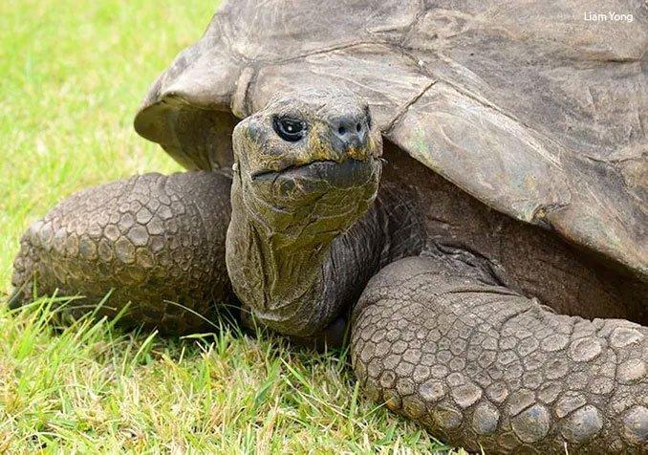
Jonathan the Tortoise, approx. 190 years old

Slide 5
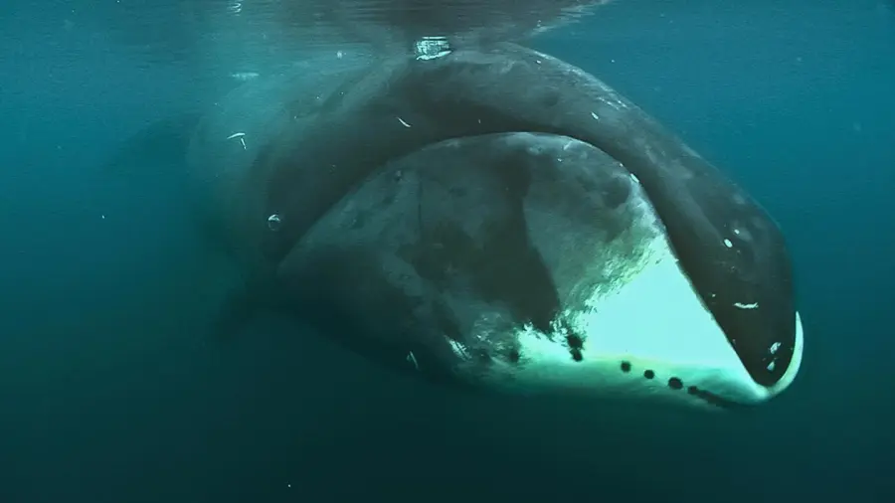
Bowhead whales, several recorded at 210+ years old

Slide 6
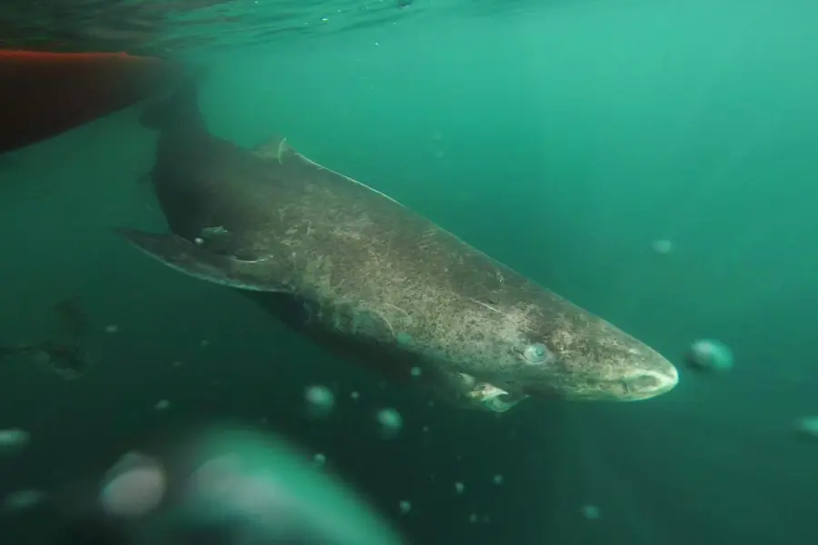
A greenland shark, discovered to be 400+ years old

Slide 7
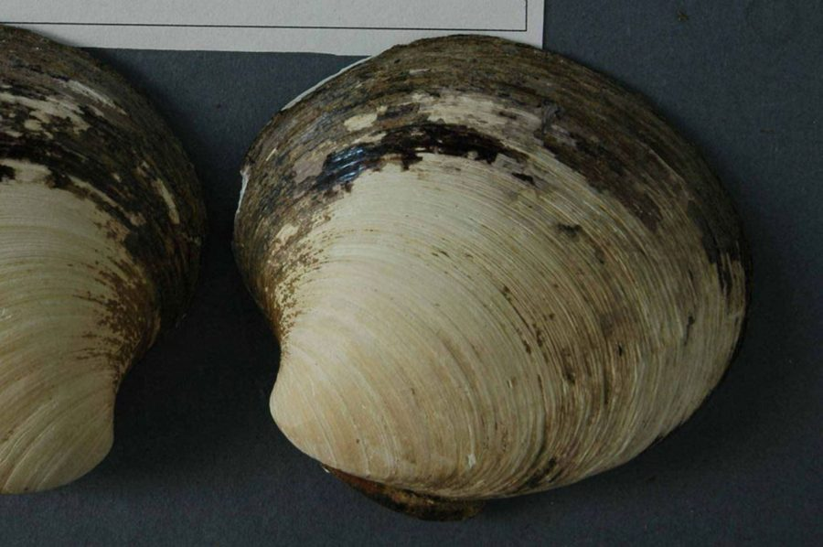
‘Ming’ the clam, estimated to be 500+ years old

Slide 8
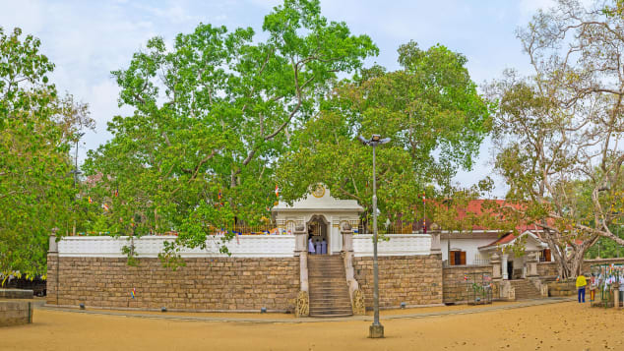
A (human-planted) fig tree in Sri Lanka, some say it could be over 2000 years old

Slide 9
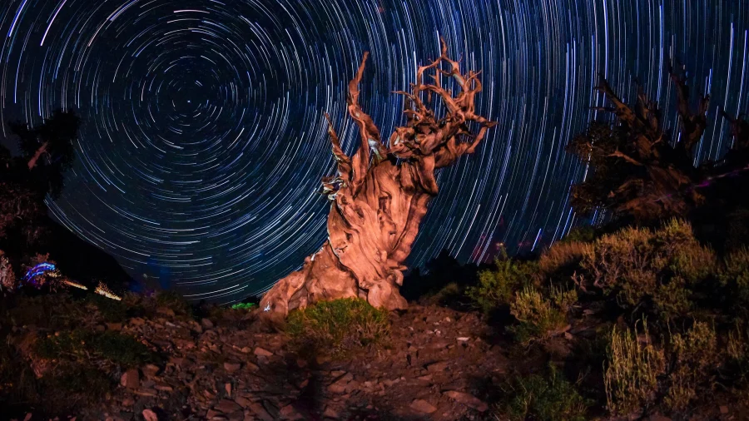
Baobab trees are the longest living species of tree, with an estimated 1000-3000 year lifespan

Slide 10
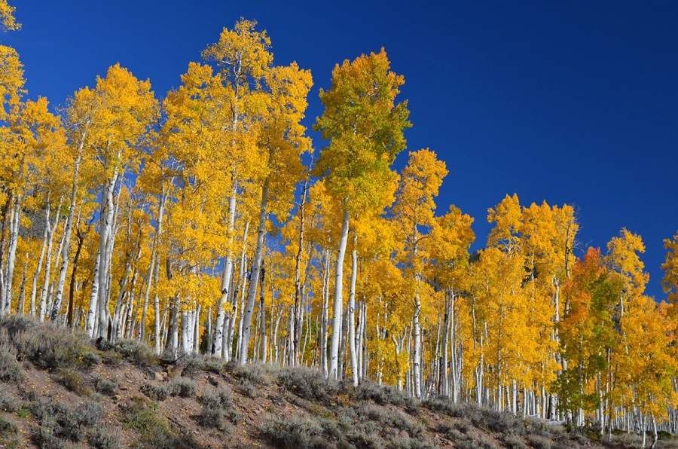
‘Pando’, a tree superorganism, that scientists think is the oldest living thing on Earth (root systems could be up to 80,000 years old)

Slide 11
Freewrite (5+ sentences/ideas):
Imagine you live to be 100 years old (a centurion).
What would your life be like? How would the world have changed?

Slide 12
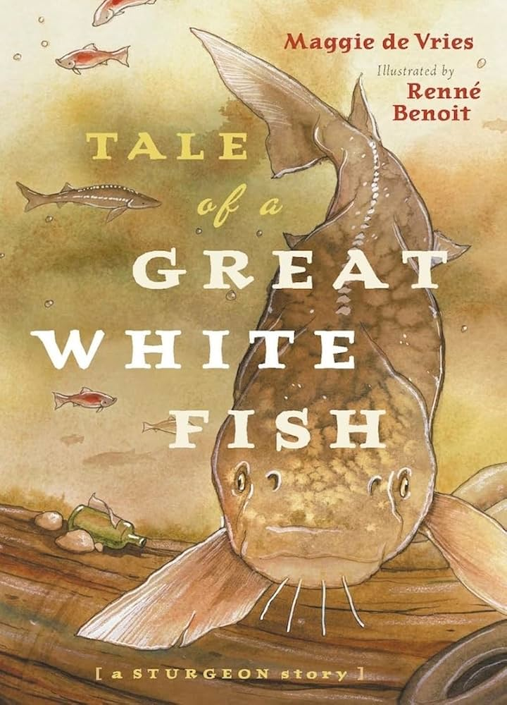

Slide 13
How did the world around Great White Fish change during her lifespan?
What changes were influenced/impacted by humans?

