Slide 1
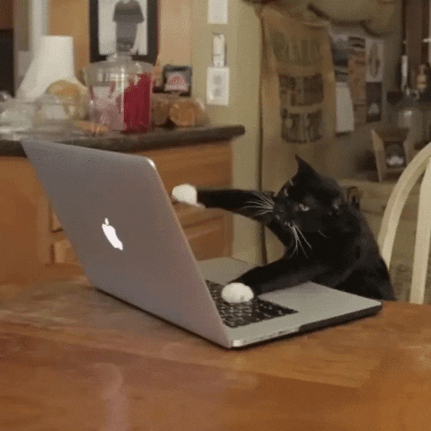
Email Etiquette:

Slide 2
Who (and when) would you send a more formal, professional email?
What are some differences between a formal, professional email and a casual, informal email?

Slide 3
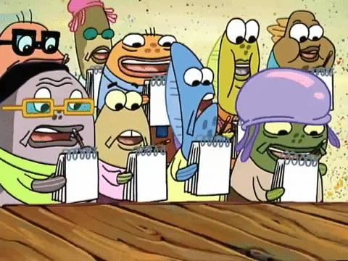
Time to take notes on FORMAL emails!

Slide 4
Rule #1: Pay Attention to the Subject Line
The subject line is the most important part of your email
Helps determine if it is spam or not
Vague subject lines also make email hard to find later

Slide 5
Rule #2: Consider Your Greeting
Start with a salutation (greeting) that is appropriate
“Hey” or “Hi” or even “Dear” can be too casual or familiar
Instead, you can use “Hello” or “To”
When possible, use the person’s name (usually a simple Google search/website investigation)
Is it appropriate to use Mr., Ms., Dr., Professor? Be overly formal to start, then tone it down after (ex: “Please call me ________”)

Slide 6
Rule #3: Stay Formal
Similar rules with formal writing apply here!
No slang, abbreviations, emojis
ALL CAPITALS = yelling at the reader
Try to stay on one topic per email if possible. You can use bullet points or a list!
Clear, concise, and easy-to-follow emails are best

Slide 7
Rule #4: Attachments
If you are attaching a document, include the words: please see attached
Describe what you have attached (ex: resume, photo of a shark)
Name the attachment appropriately (ex: 2024 budget, grocery list)
Make sure you actually attach the file!

Slide 8
Rule #5: Closing/Sign-Off
Stay formal here as well, keep a more professional tone
Consider wishing the person well, thanking them for their time, or promoting a follow-up
“Thank you for your time”
“Have a great day”
“Looking forward to talking soon”
Sign your name at the bottom (just like a letter)

Slide 9
Rule #6: Proofread + Check Recipient!
Before sending your email, double check for spelling, grammar, and correctness
Ensure your attachment is, in fact, attached
Is the email address to the correct person
Do you need to CC anyone else on the email?

Slide 10
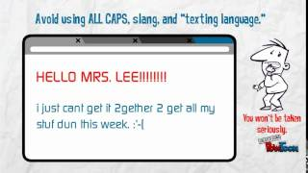

Slide 11
Let’s look at some examples! What do we notice?

Slide 12
Your task: send Ms. Ward a formal email
Find Ms. Ward’s email on Lochdale’s school website (kim.ward@burnabyschools.ca)
Write a formal email including the tips/tricks we learned
Your topic: what type of cuisine/food should we serve at the Grade 7 event
Attach a picture of the food you chose
Send it!

Slide 13
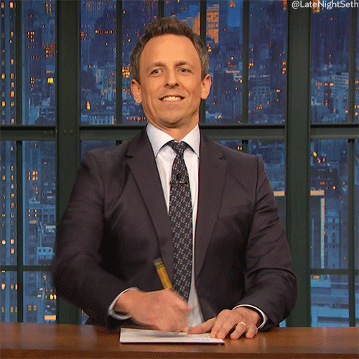
Notes from our emails yesterday:
The good:
-excellent use of “subject” line
-clear and focused messages
-everyone had relevant images
-very polite
The not-so-good:
-editing for easy mistakes such as capitalization, periods, spelling
-formatting and spacing

Slide 14
Your task part 2: send Ms. Ward a formal email
We need some more practice self-editing when sending a formal email! For your 2nd assignment, you must:
Email Ms. Ward using the formal guidelines we discussed. It must include an attached picture.
PROOFREAD and EDIT your email before sending!
Your topic is: what species of animal should we get as a class pet

Slide 15
What is a Cover Letter?
To be considered for almost any job/volunteering/opportunity, you will need to write a cover letter.
This introduces you, explains your purpose for writing, highlights a few of your experiences or skills, and requests an opportunity to meet personally with the potential employer.
Think of it as an “introduction” that makes the person want to read your resume!

Slide 16
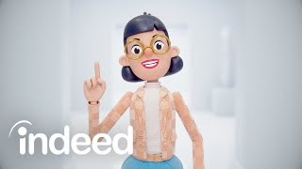

Slide 17
Writing a Cover Letter:
-Limit to 1 page
-Highlight your strengths and your connection/interest in the company
-Be confident, clear, and to the point — avoid flashy, showy, or overly complex language; “convey confidence, optimism, and enthusiasm coupled with respect and professionalism”
-Arrange points in a logical way
-As always, stay formal!

