Slide 2
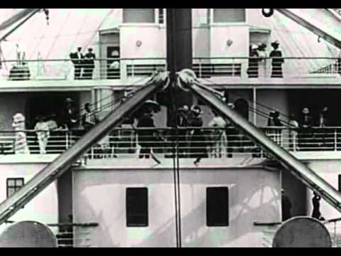
Evidence A: Primary Source

Slide 3
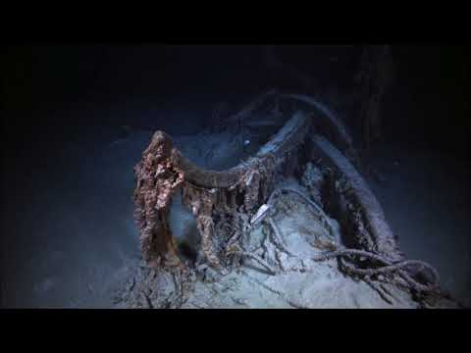
Evidence A: the shipwreck

Slide 4
The fate of the titanic
A History Mystery

Slide 5
On your paper, please brainstorm:
-What do you already know about the Titanic? Have you heard of it before? Have you seen the movie?
-What questions do you have about the sinking of the Titanic? What do you want to know more about?
-Why do you think we are learning about an event that happened over 100 years ago? Why is it important?

Slide 6
Evidence C: (answer/take notes on your paper)
-What do you notice about this advertisement?
-Why do you think so many people were persuaded to buy a ticket for the Titanic?
-Do you think you would have wanted to go on the Titanic?

Slide 7
Evidence D, E, F:
-What do you notice about the number of First class and Third class passengers?
-What similarities and differences do you notice between First and Third class?
-Why do you think the passengers were treated differently? Does this still happen today?
-

Slide 8
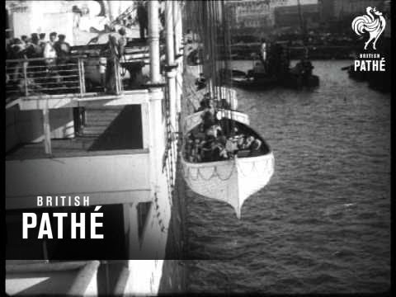

Slide 9
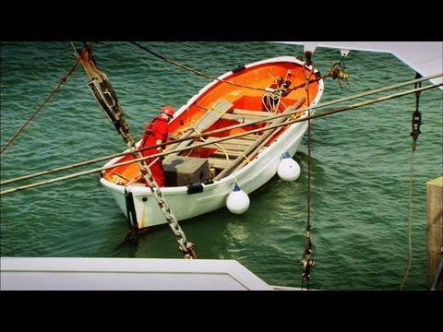

Slide 10
Quote from a Historian
“TheTitanic sinking really showed the differences between how wealthy and poor people were treated in the 1900s. The highest loss of life came from the second and third class passengers while the wealthy, first class had the best chance of escaping death. In other words, those with money were in the best location on the ship for survival (upper decks near lifeboats) and those with the least amount were located on the lower decks and were literally locked-down by gates in the third class compartments, so they could not escape to the top where the lifeboats were stored. It makes me wonder if we are not cruising upon a Titanic today. I feel like the wealthiest people are up at the top, while everyone else is ‘stuck’ at the bottom of society.”

Slide 11
So far, we’ve seen several pieces of evidence (including primary sources).
On your sheet, write down the MOST important pieces of information and evidence.
You will be creating an argument for WHO or WHAT is most to blame for the disaster!

Slide 12
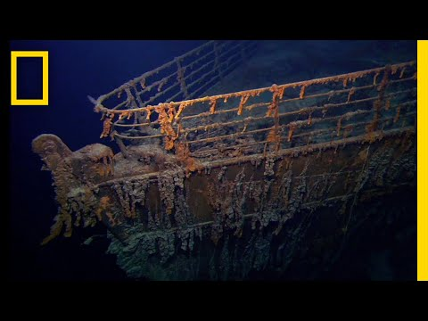

Slide 13
