Slide 1
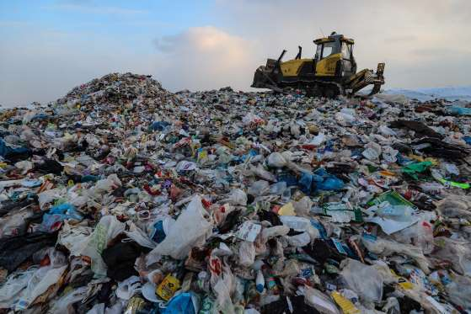
HOW PLASTIC POLLUTING OUR PLANET

Slide 2
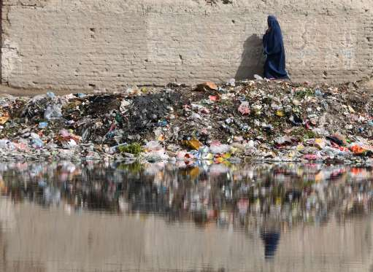
AFGANISTAN

Slide 3
INDONESIA

Slide 4
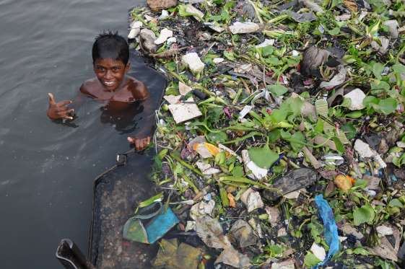
AN ISLAND MADE OF TRASH

Slide 5
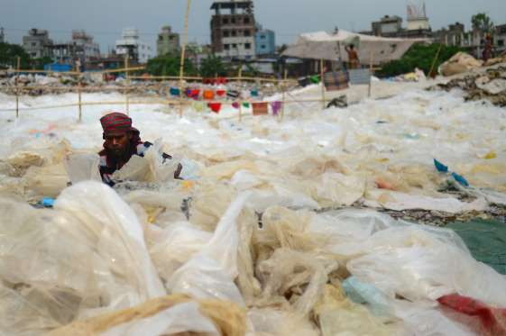
BANGLADESH

Slide 6
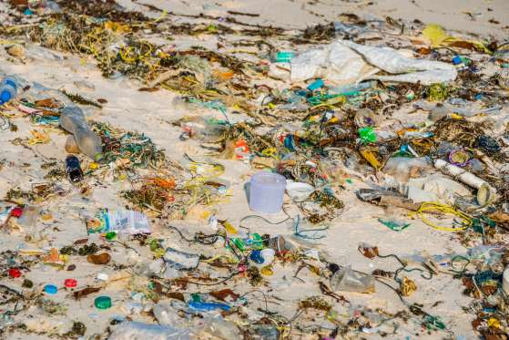
CAMBODIA

Slide 7
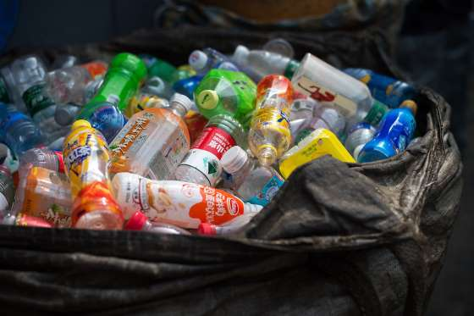
Your Recycling Gets Recycled, Right?
CHINA

Slide 8
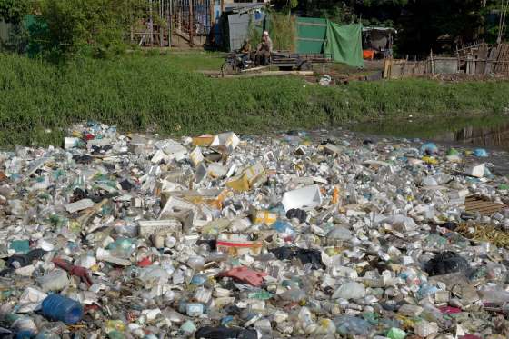
Your Recycling Gets Recycled, Right?
CAMBODIA

Slide 9
CHINA HAD ENOUHG OF EVERYBODY ELSE’S JUNK

Slide 10
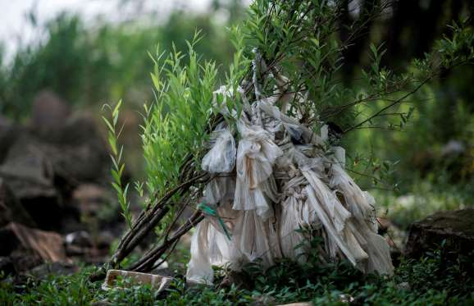
Your Recycling Gets Recycled, Right?
China stopped recycling most “foreign garbage.”

Slide 11
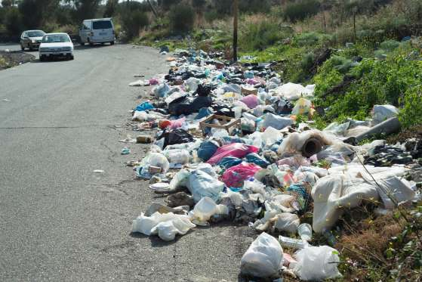
Your Recycling Gets Recycled, Right?
China stopped recycling most “foreign garbage.”
ITALY

Slide 12
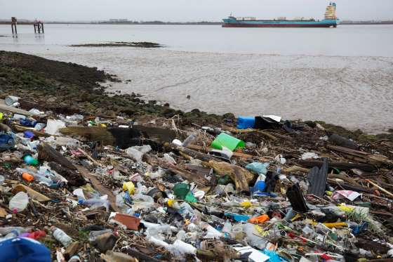
Your Recycling Gets Recycled, Right?
ENGLAND
China stopped recycling most “foreign garbage.”
“Choking” coral reefs
ITALY

Slide 13
GERMANY

Slide 14
GREECE

Slide 15
HONG KONG

Slide 16
VANCOUVER

Slide 18
MICROBEADS

Slide 19
INDISTRUCTIBLE PLASTIC EVERYWHERE

Slide 20
OVERTAKING BEACHES

Slide 21
POLLUTING WATER

Slide 22
PHILIPINNES

Slide 23
PAKISTAN

Slide 24
GHOAST NETS

Slide 25
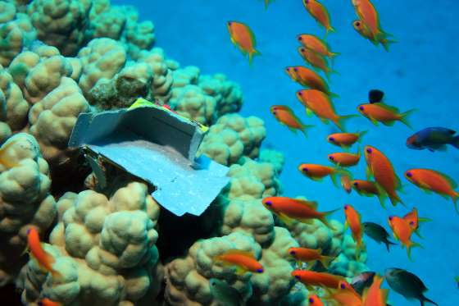
Your Recycling Gets Recycled, Right?
China stopped recycling most “foreign garbage.”
ITALY
Choking coral reefs

Slide 26
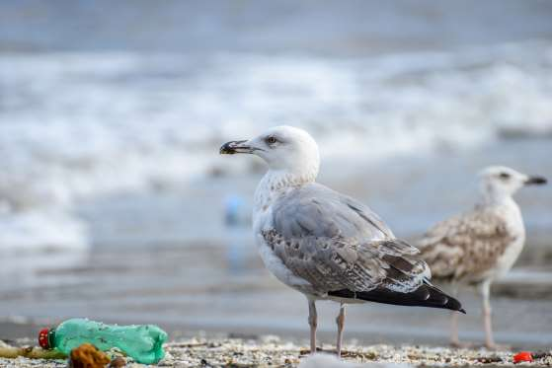
Choking seabirds
Your Recycling Gets Recycled, Right?
China stopped recycling most “foreign garbage.”
“Choking” coral reefs
ITALY

Slide 28
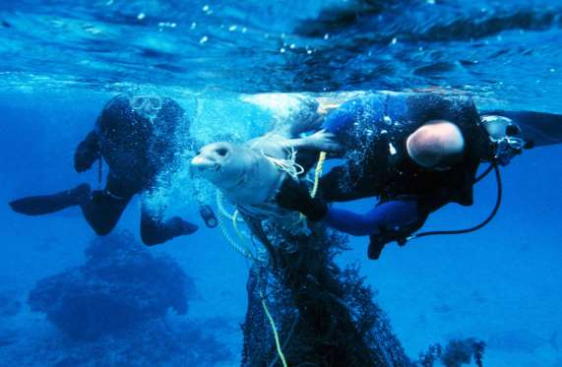
Entangling sea mammals
You have to reduce and reuse first
Your Recycling Gets Recycled, Right?
China stopped recycling most “foreign garbage.”
“Choking” coral reefs
ITALY

Slide 29
FOUND INSIDE THE FISH

Slide 30
FOUND IN FOOD WE EAT

Slide 31
MICROPLASTIC IN SHELL FISH

Slide 32
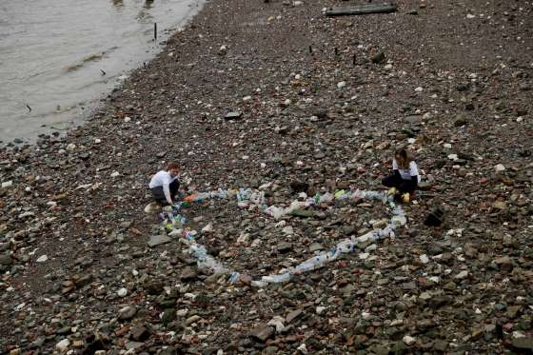
You have to reduce and reuse first
Your Recycling Gets Recycled, Right?
China stopped recycling most “foreign garbage.”
“Choking” coral reefs
ITALY

Slide 33
ONE FAMILY ONE WEEK`S WORTH OF PLASTIC AFTER REDUCTION

Slide 34
HOW TO REDUCE/REUSE?

Slide 35
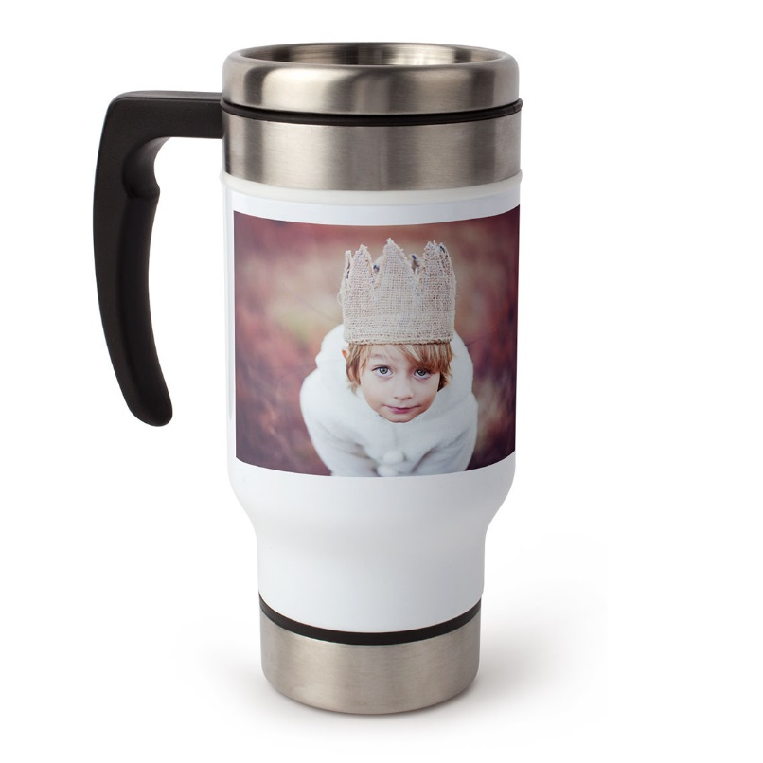
REDUCE: SHAMPOO BARS VS SHAPOO BOTTLES BRING YOUR OWN COFFEE MUG BUY MINIMUM AMOUNT OF STAFF, PRODUCTS WITH MINIMUM PACKAGING CURB THE DESIRE TO SHOP FOR NEW AND UNNESSARY ITEMS LOOK OUT FOR ALTERNATIVES TO PLASTIC

Slide 36
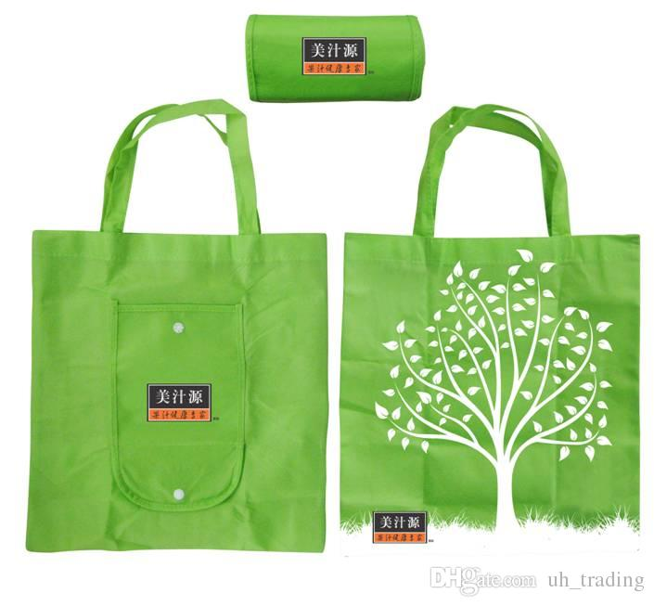
REUSABLE WATER BOTTLES REUSABLE SHOPPING BAGS REUSABLE CUTTLERY BUY SECOND HAND STAFF

Slide 37
AVOID “ASPIRATIONAL RECYCLING”
Greasy pizza boxes
a small amount of food scraps or other rubbish can ruin a batch of recycling
25 percent of all recycling picked up is contaminated to the point that it is sent to landfills
Disposable coffee cups — which are usually lined with a thin film that makes them liquid-proof but challenging and expensive to reprocess
Unwashed plastics can also cause contamination.

