Slide 1
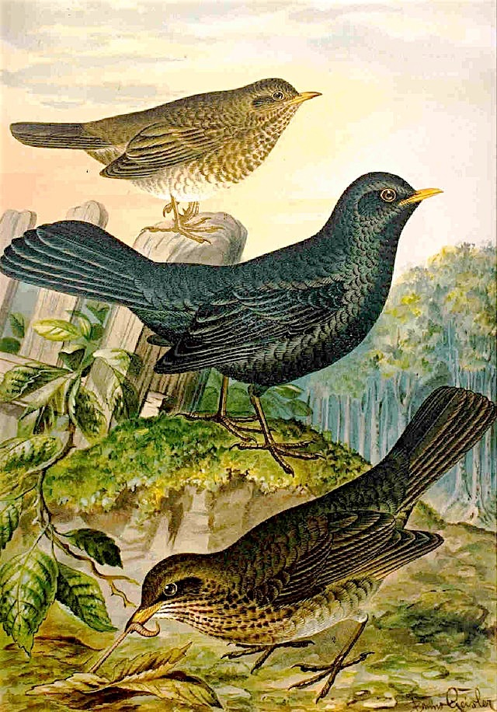
ORGANISM NAME
Latin name
First nation name
IMAGE AT THE BACK
CLICK TO SELECT
AND THEN DELETE.
Kingdom, Phylum, Class
FACTS:
History:
Use:
Image by
From URL
HOT
WARM
COOL
COLD

