Slide 1
Winter Vocabulary

Slide 2
boots

Slide 3
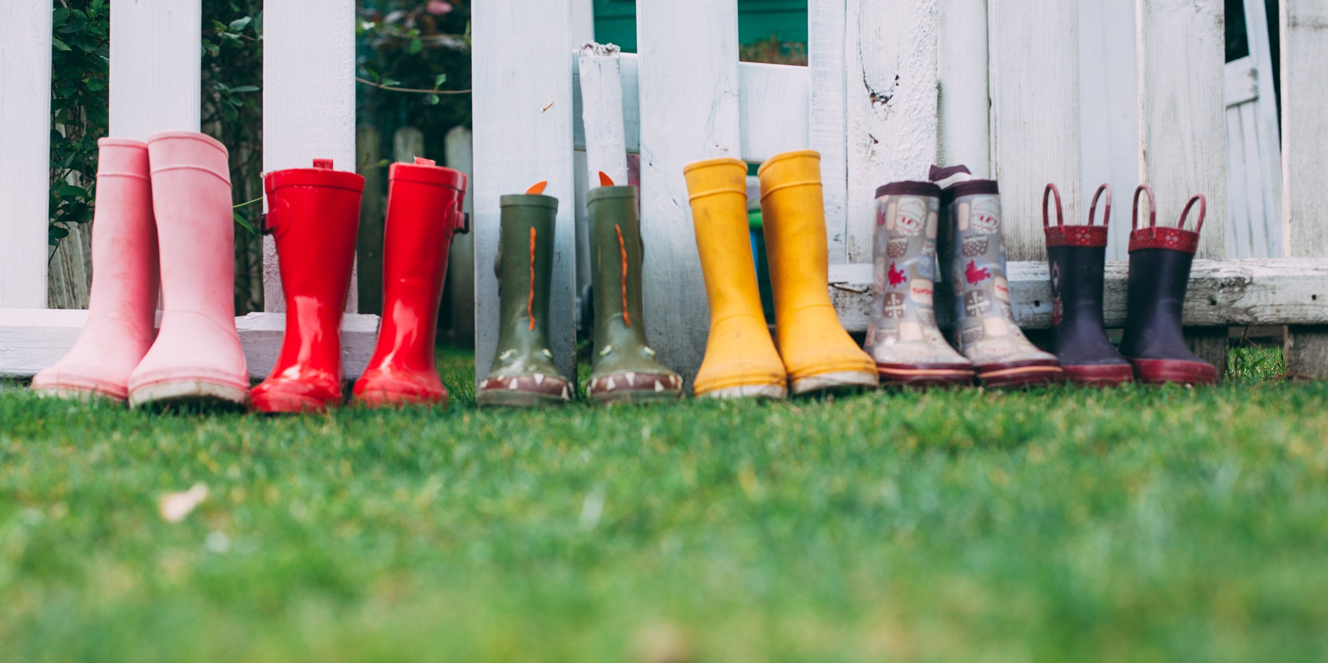
boots

Slide 4
coat

Slide 5
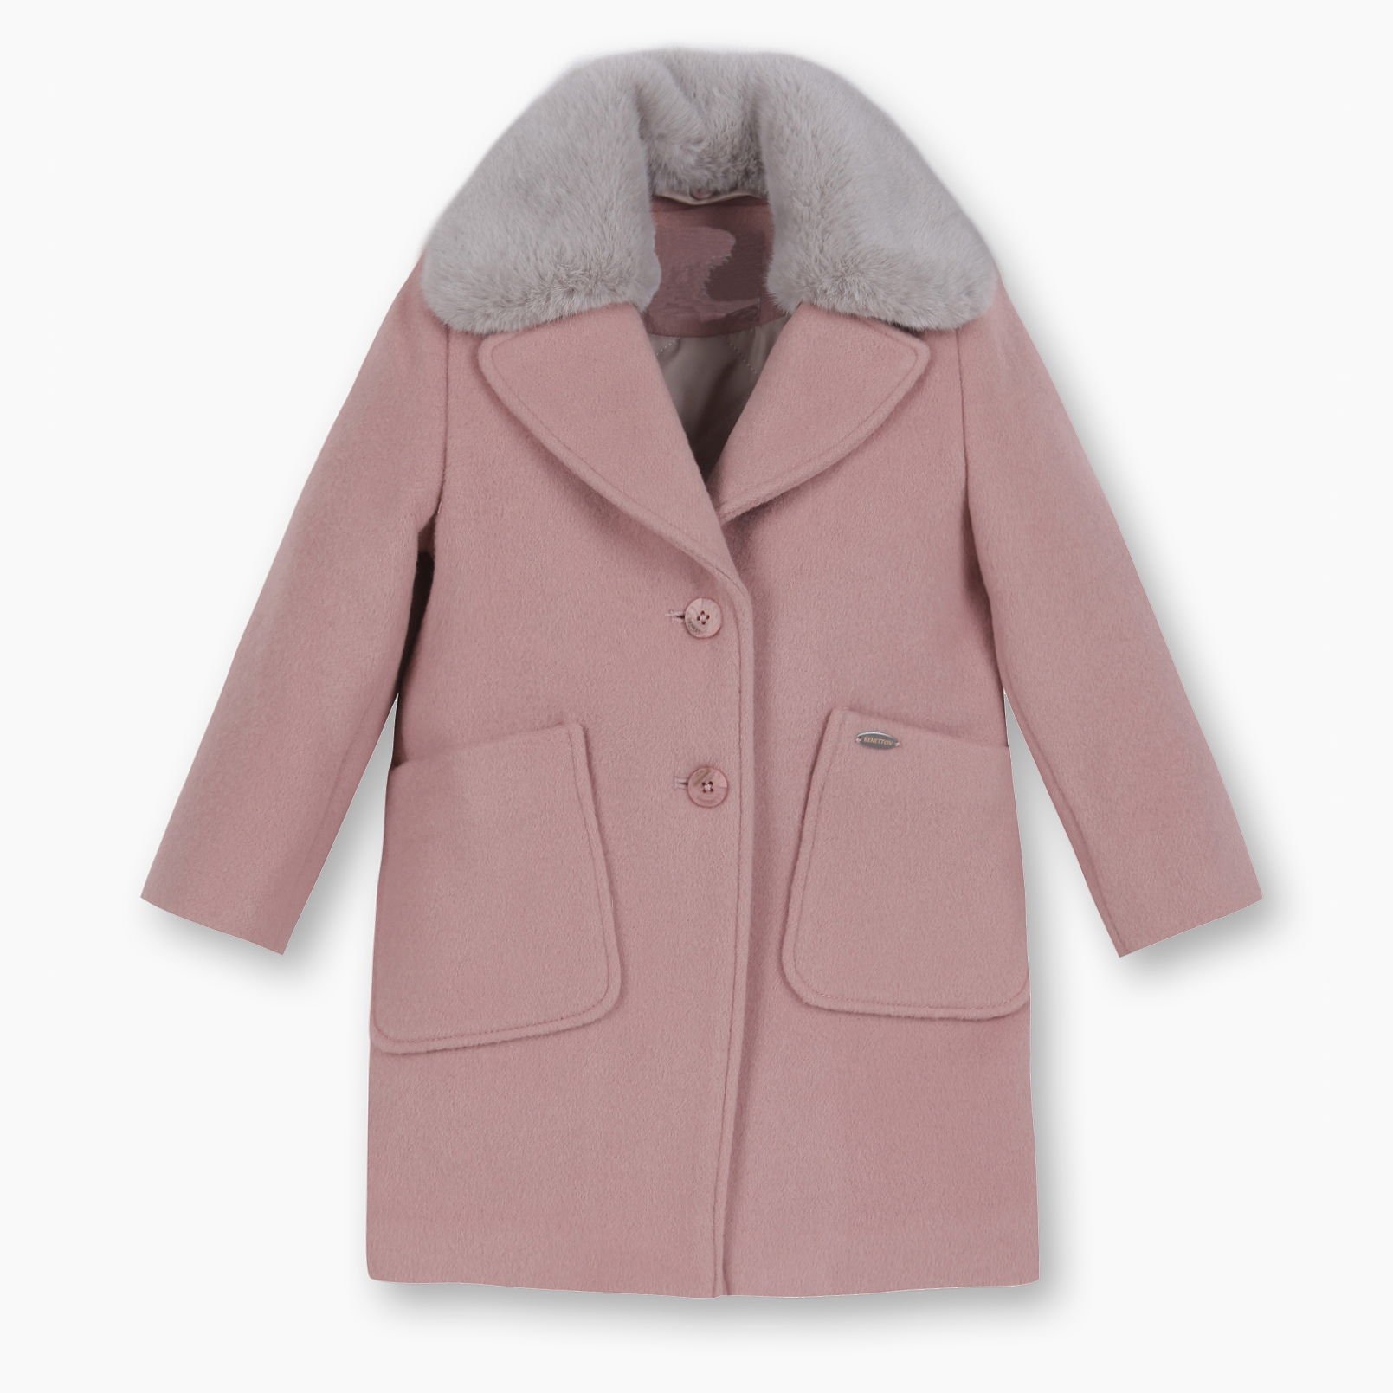
coat

Slide 6
cold

Slide 7
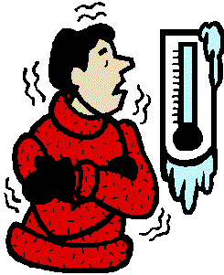
cold

Slide 8
December

Slide 9
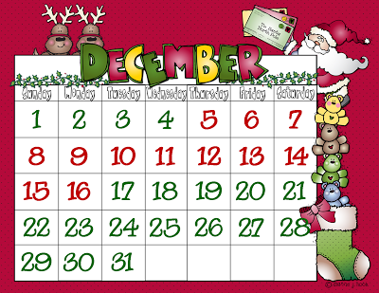
December

Slide 10
February

Slide 11
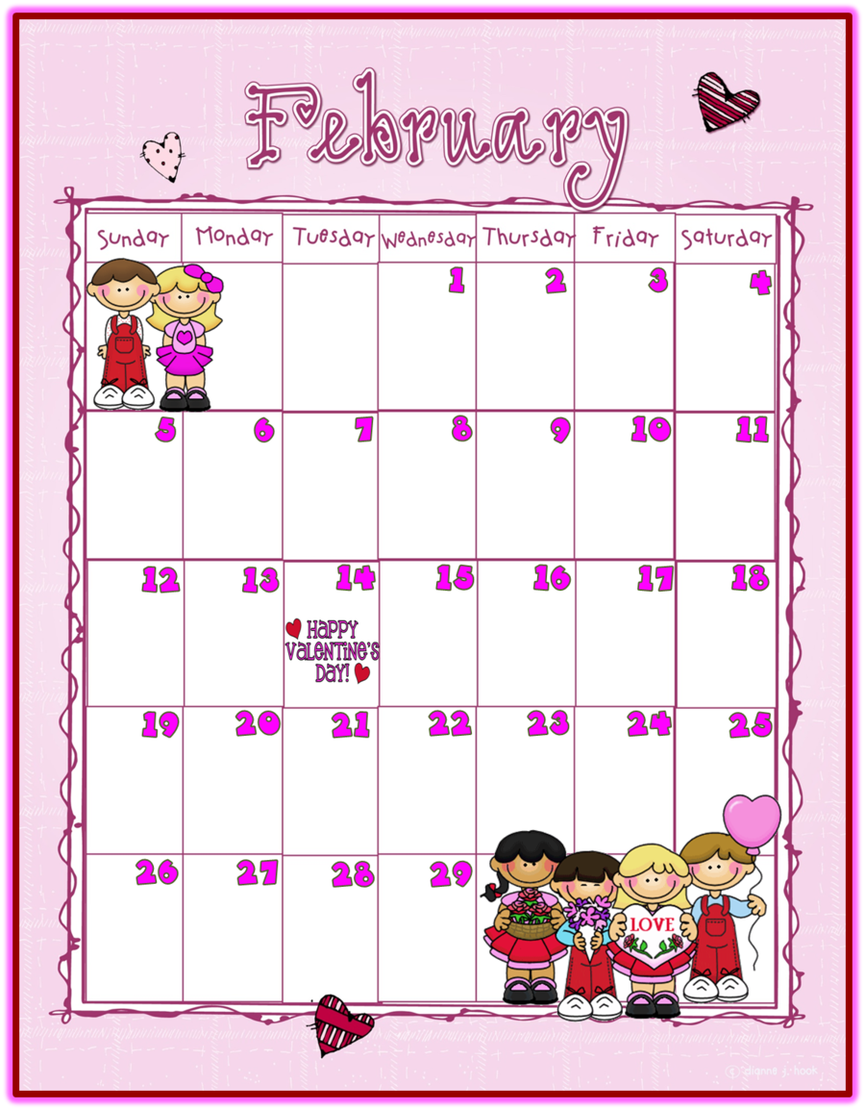
February

Slide 12
gloves

Slide 13
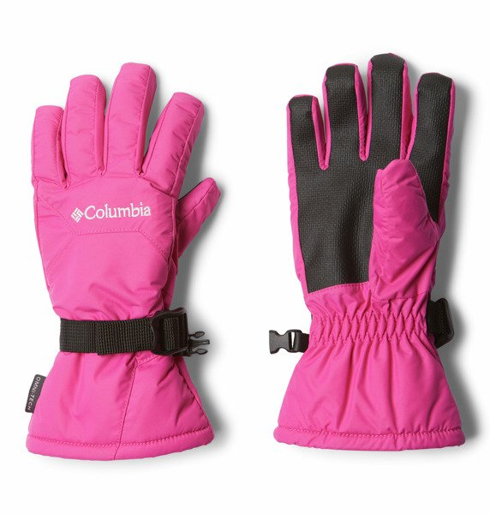
gloves

Slide 14
hat

Slide 15
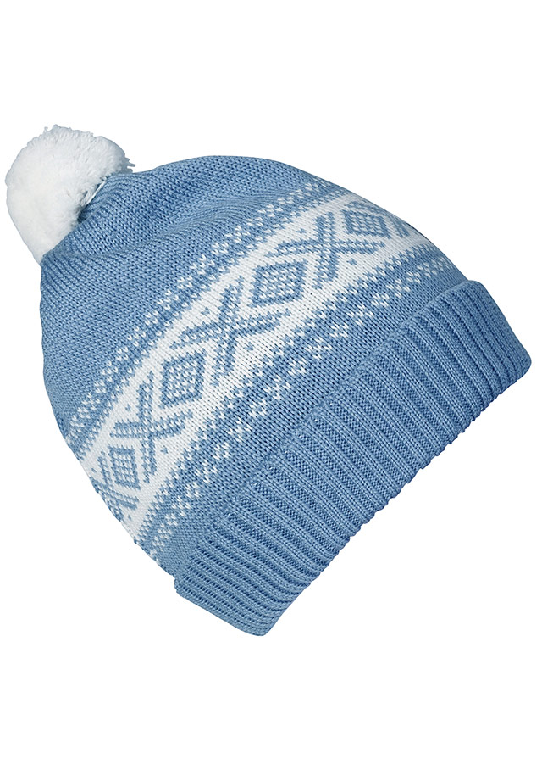
hat

Slide 16
ice

Slide 17
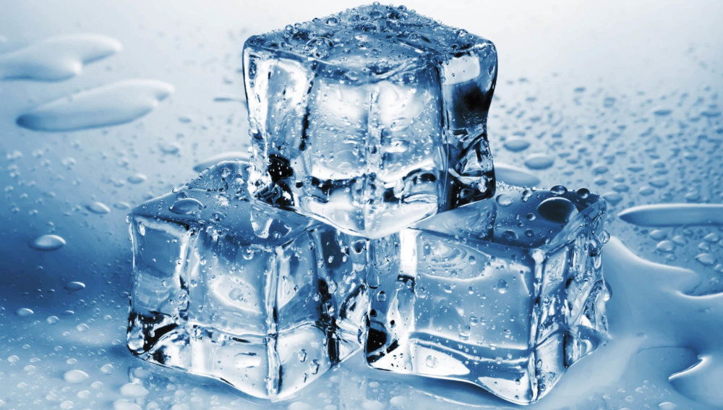
ice

Slide 18
jacket

Slide 19
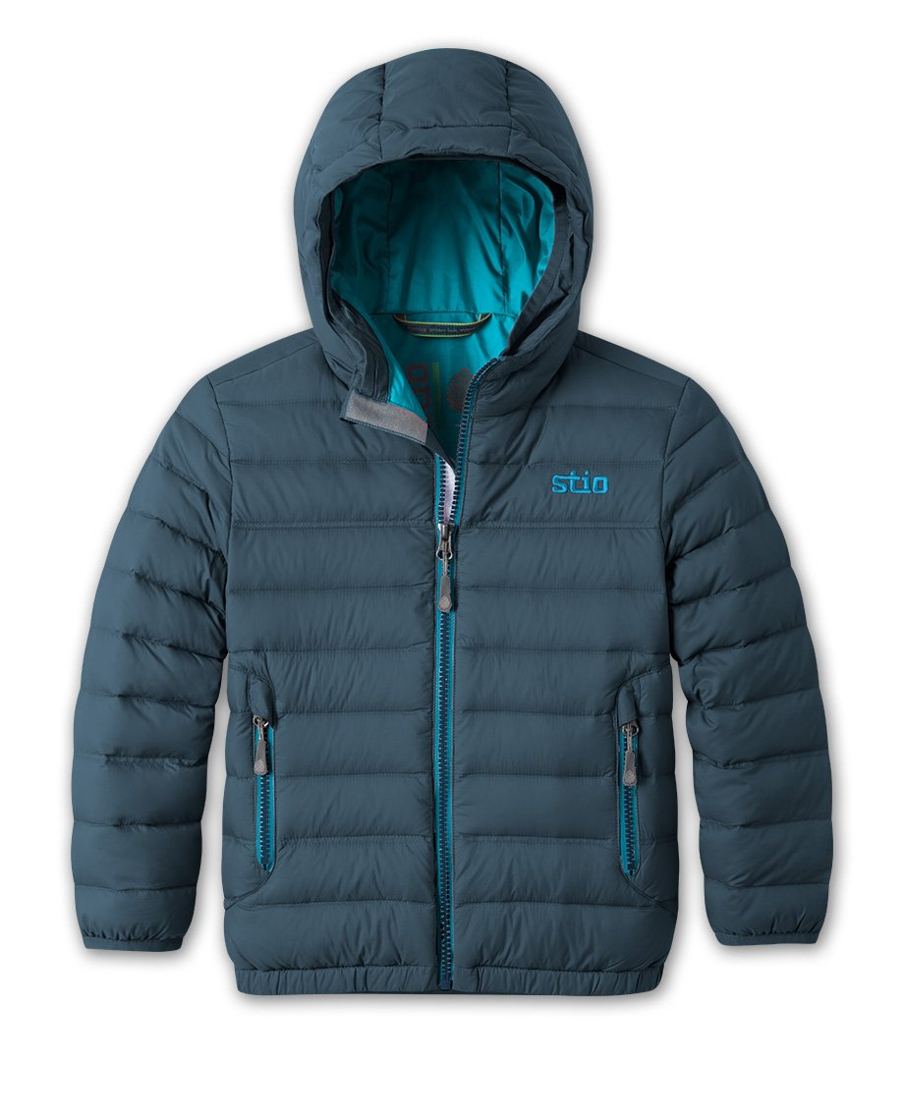
jacket

Slide 20
January

Slide 21
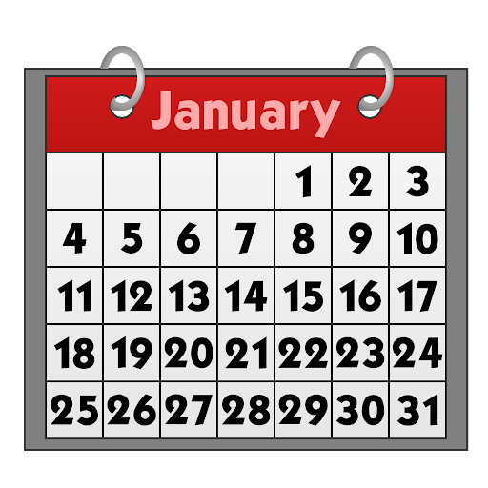
January

Slide 22
mittens

Slide 23
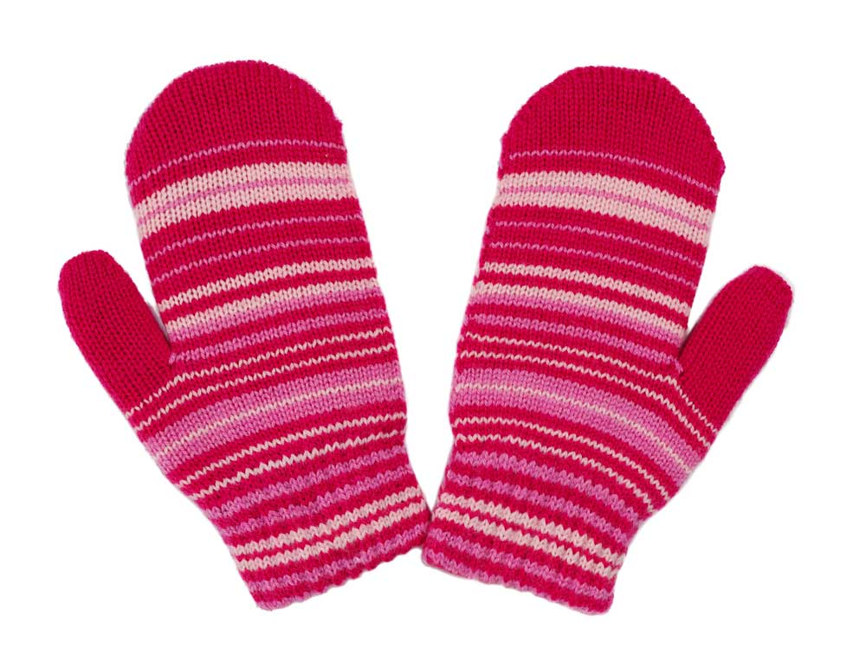
mittens

Slide 24
skates

Slide 25
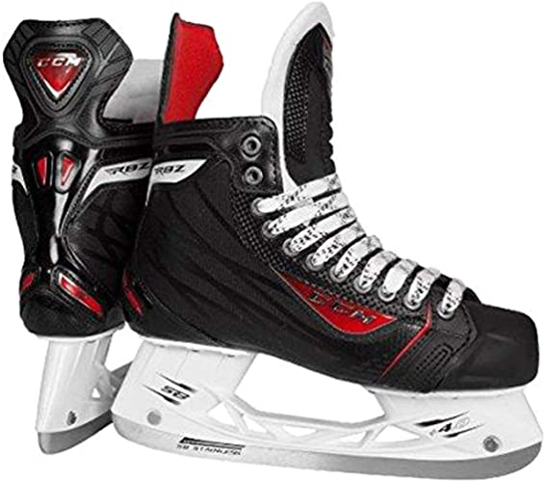
skates

Slide 26
snow

Slide 27
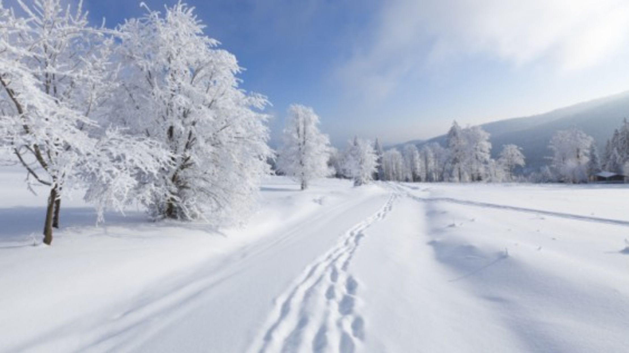
snow

Slide 28
snowman

Slide 29
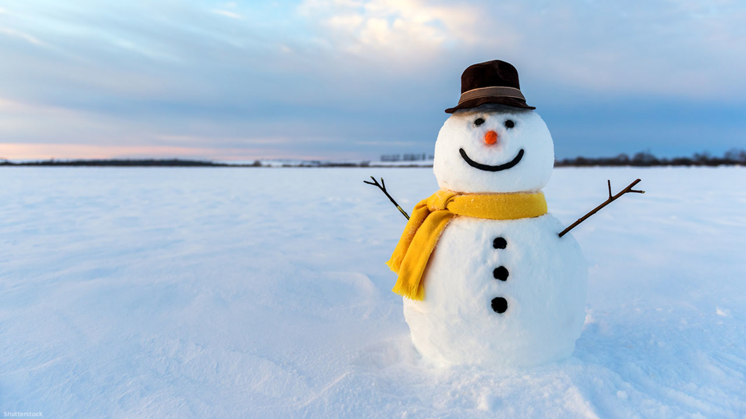
snowman

Slide 30
socks

Slide 31
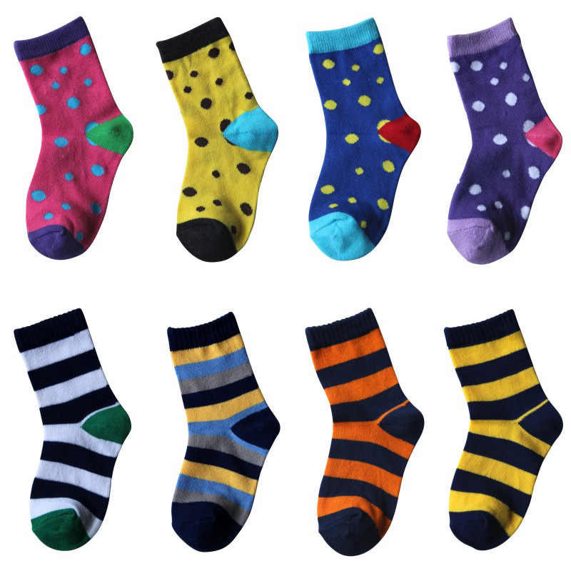
socks

Slide 32
white

Slide 33

white

Slide 34
Boxing Day

Slide 35

Boxing Day

Slide 36
candy cane

Slide 37
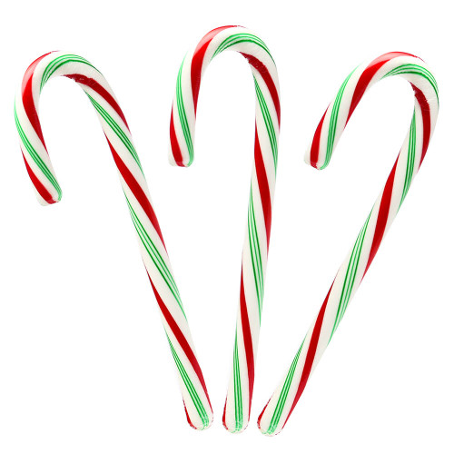
candy cane

Slide 38
Christmas

Slide 39
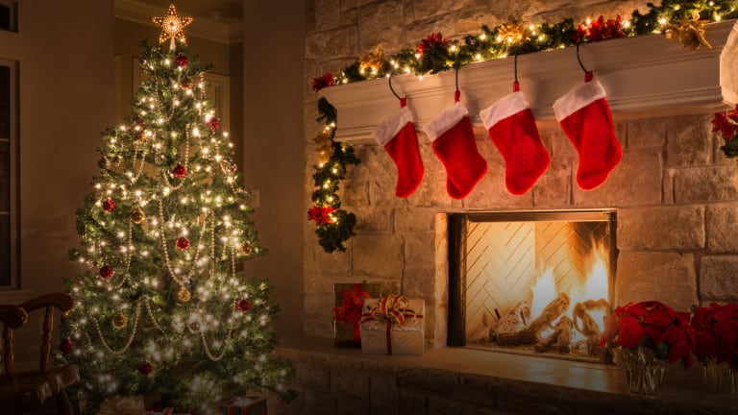
Christmas

Slide 40
fireplace

Slide 41
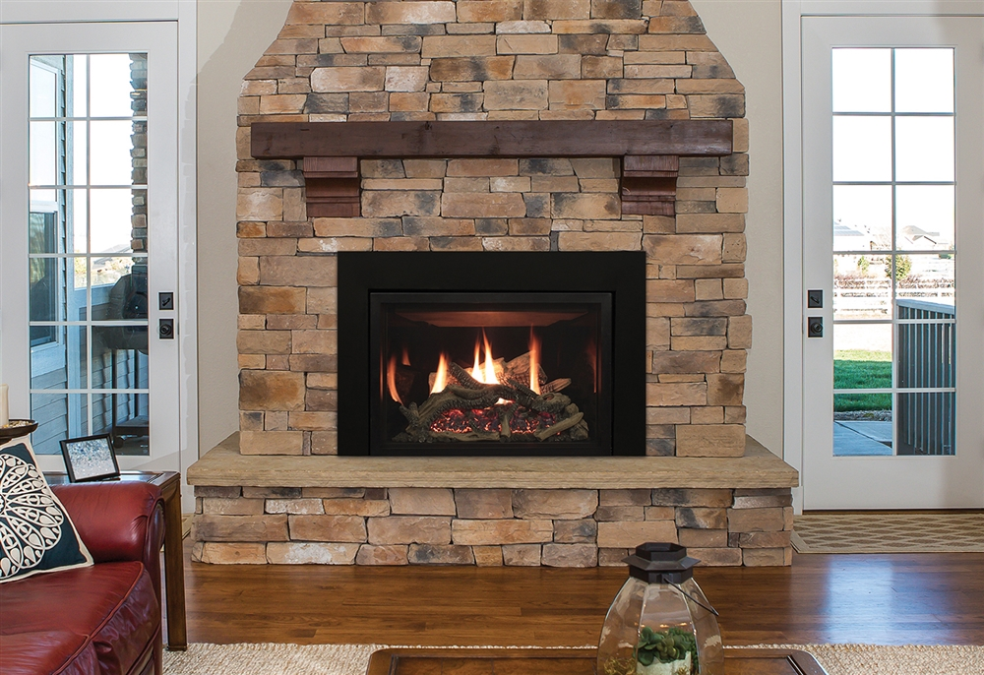
fireplace

Slide 42
freeze

Slide 43
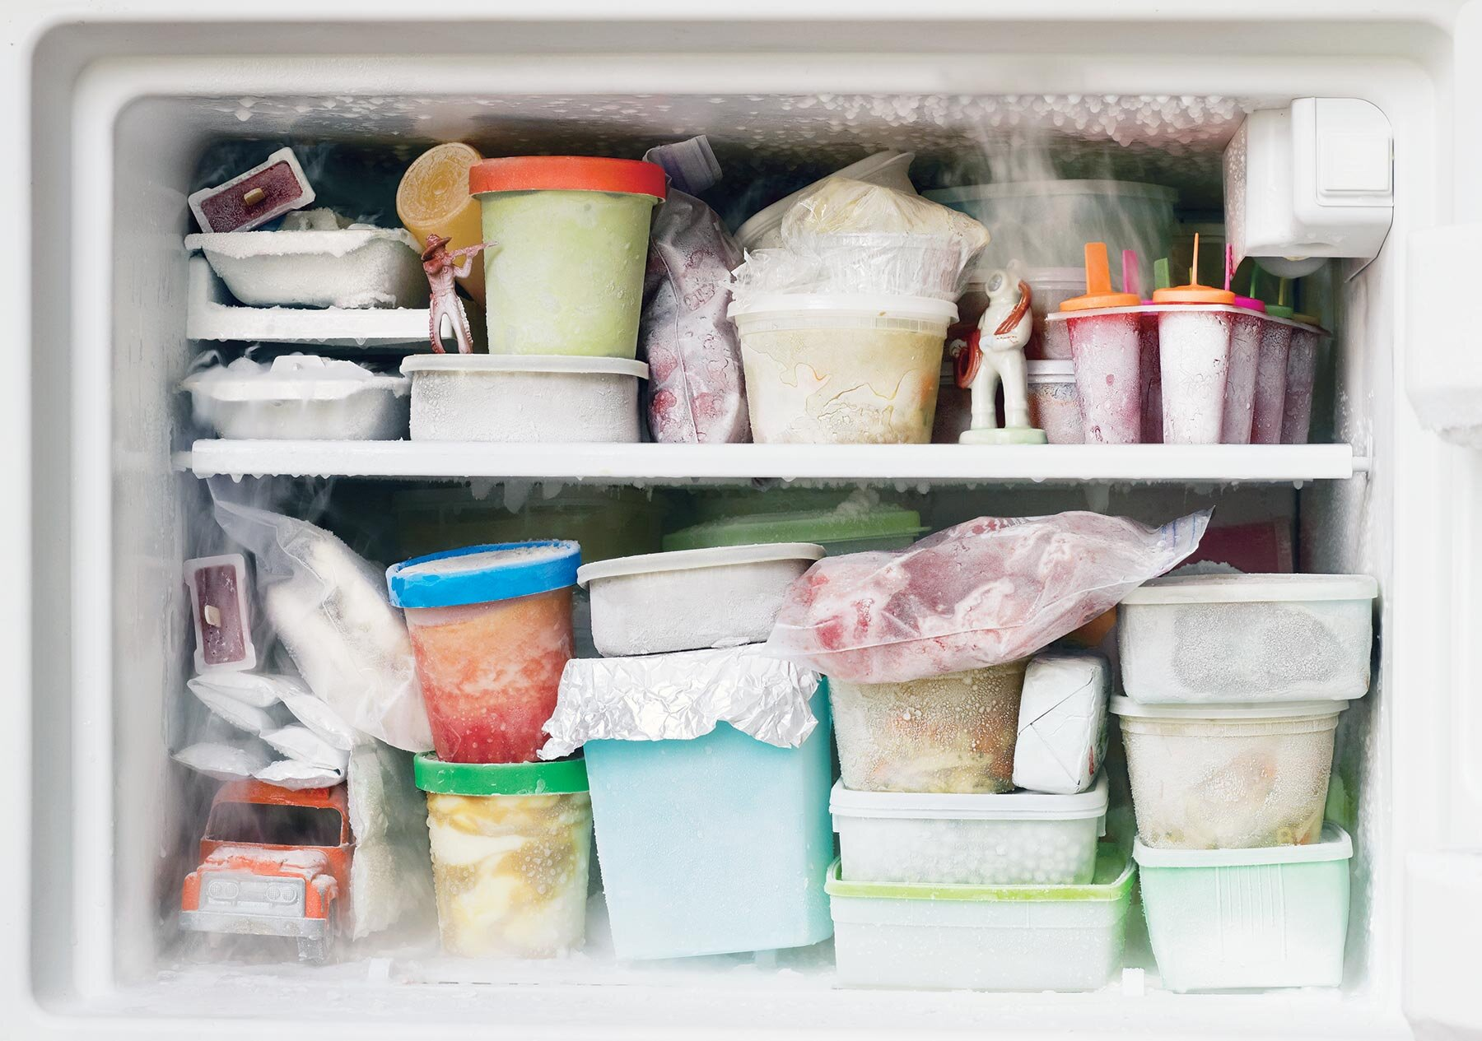
freeze

Slide 44
frost

Slide 45
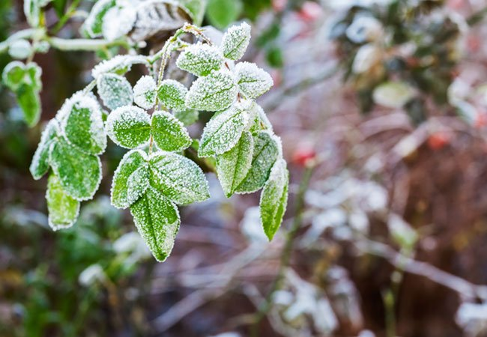
frost

Slide 46
heater

Slide 47
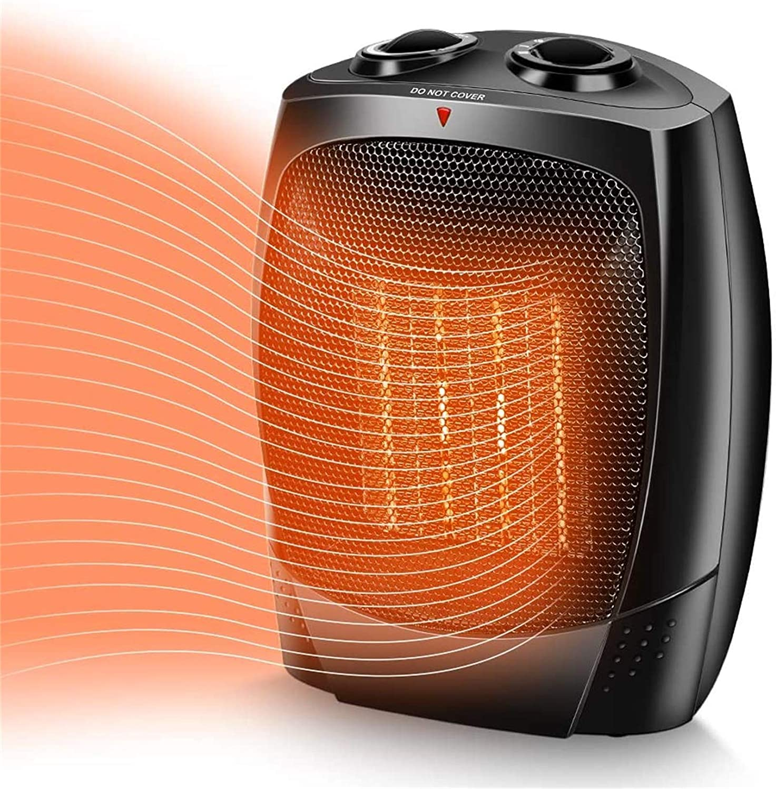
heater

Slide 48
holidays

Slide 49
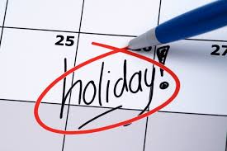
holidays

Slide 50
hot chocolate

Slide 51
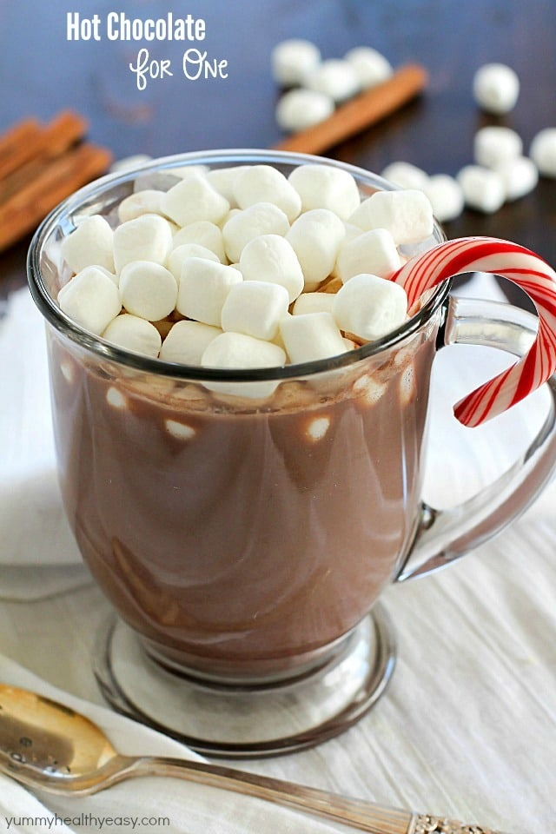
hot chocolate

Slide 52
icicle

Slide 53
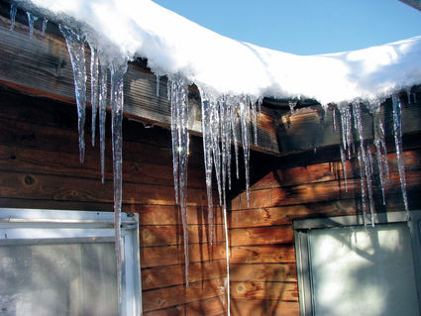
icicle

Slide 54
igloo

Slide 55
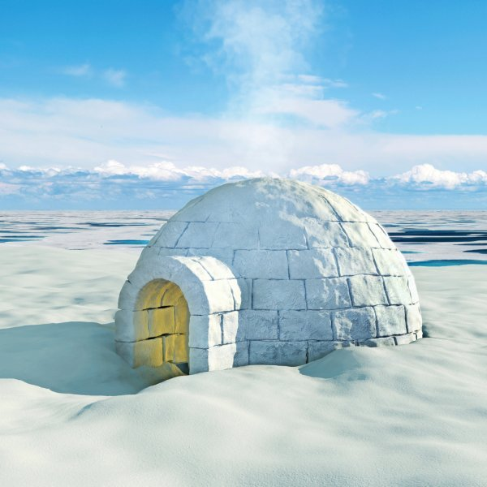
igloo

Slide 56
melt

Slide 57
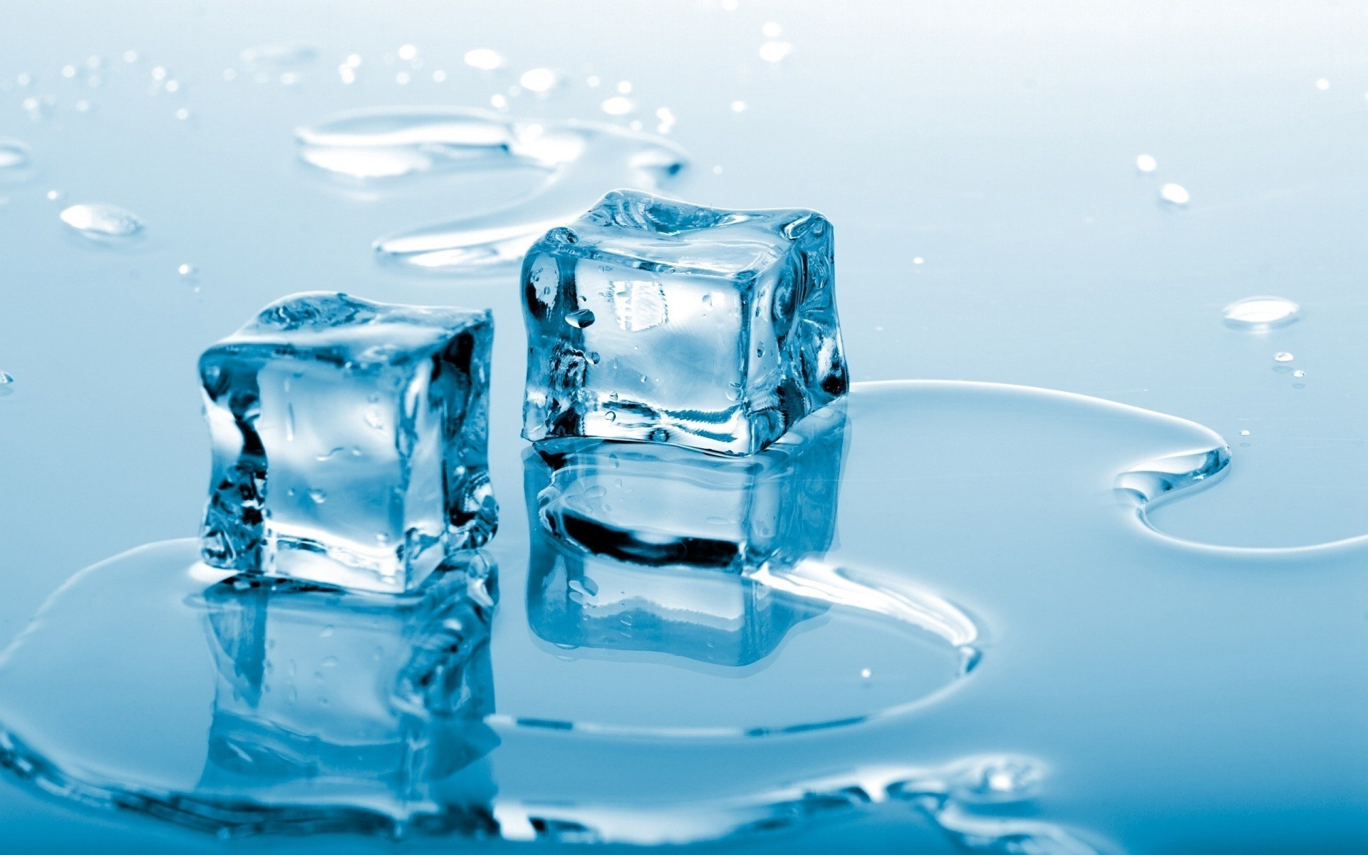
melt

Slide 58
New Years

Slide 59
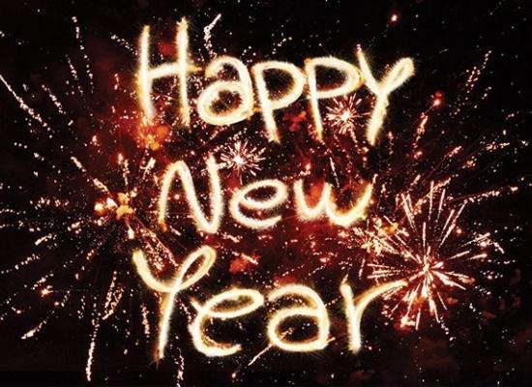
New Years

Slide 60
present

Slide 61
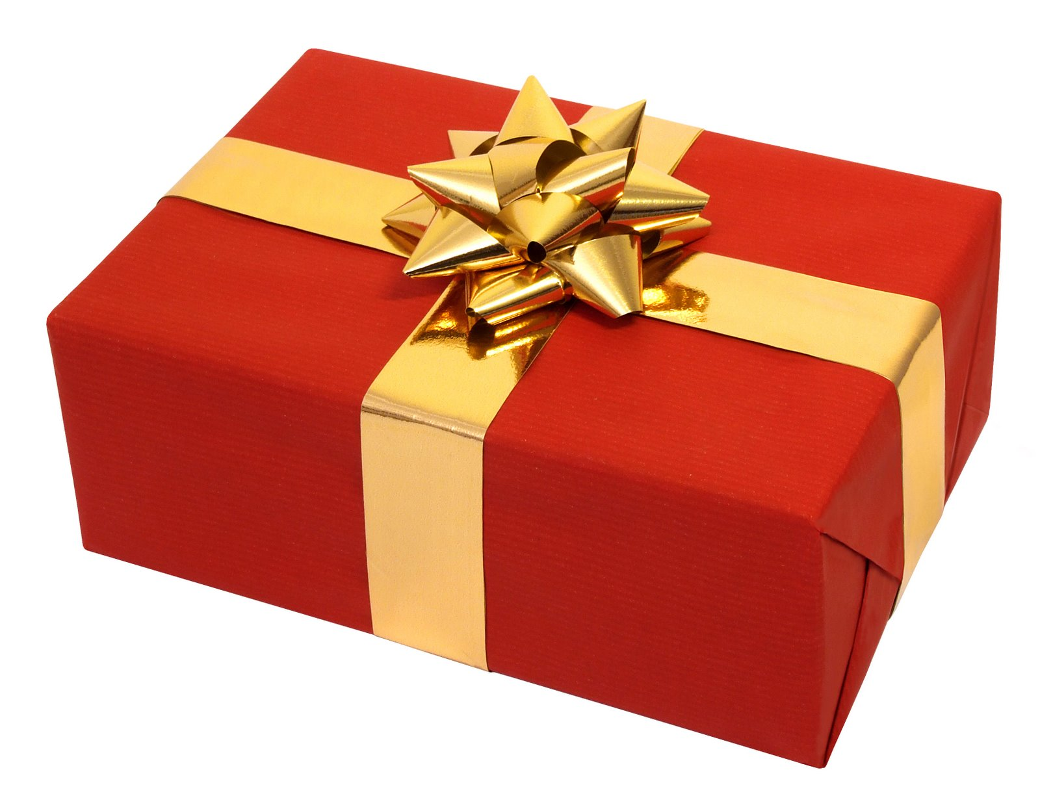
present

Slide 62
reindeer

Slide 63
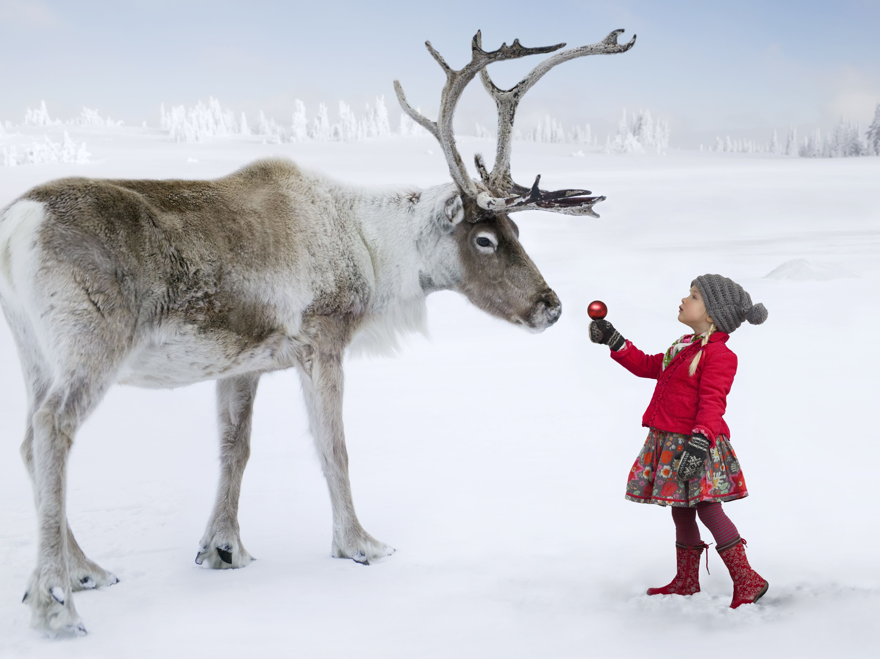
reindeer

Slide 64
Santa Claus

Slide 65
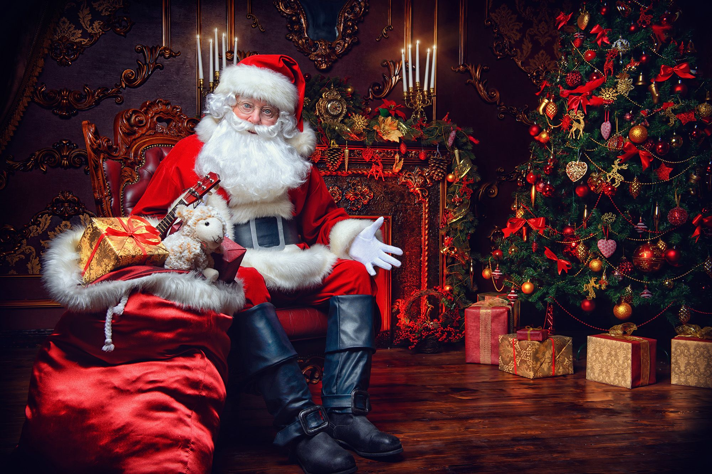
Santa Claus

Slide 66
scarf

Slide 67
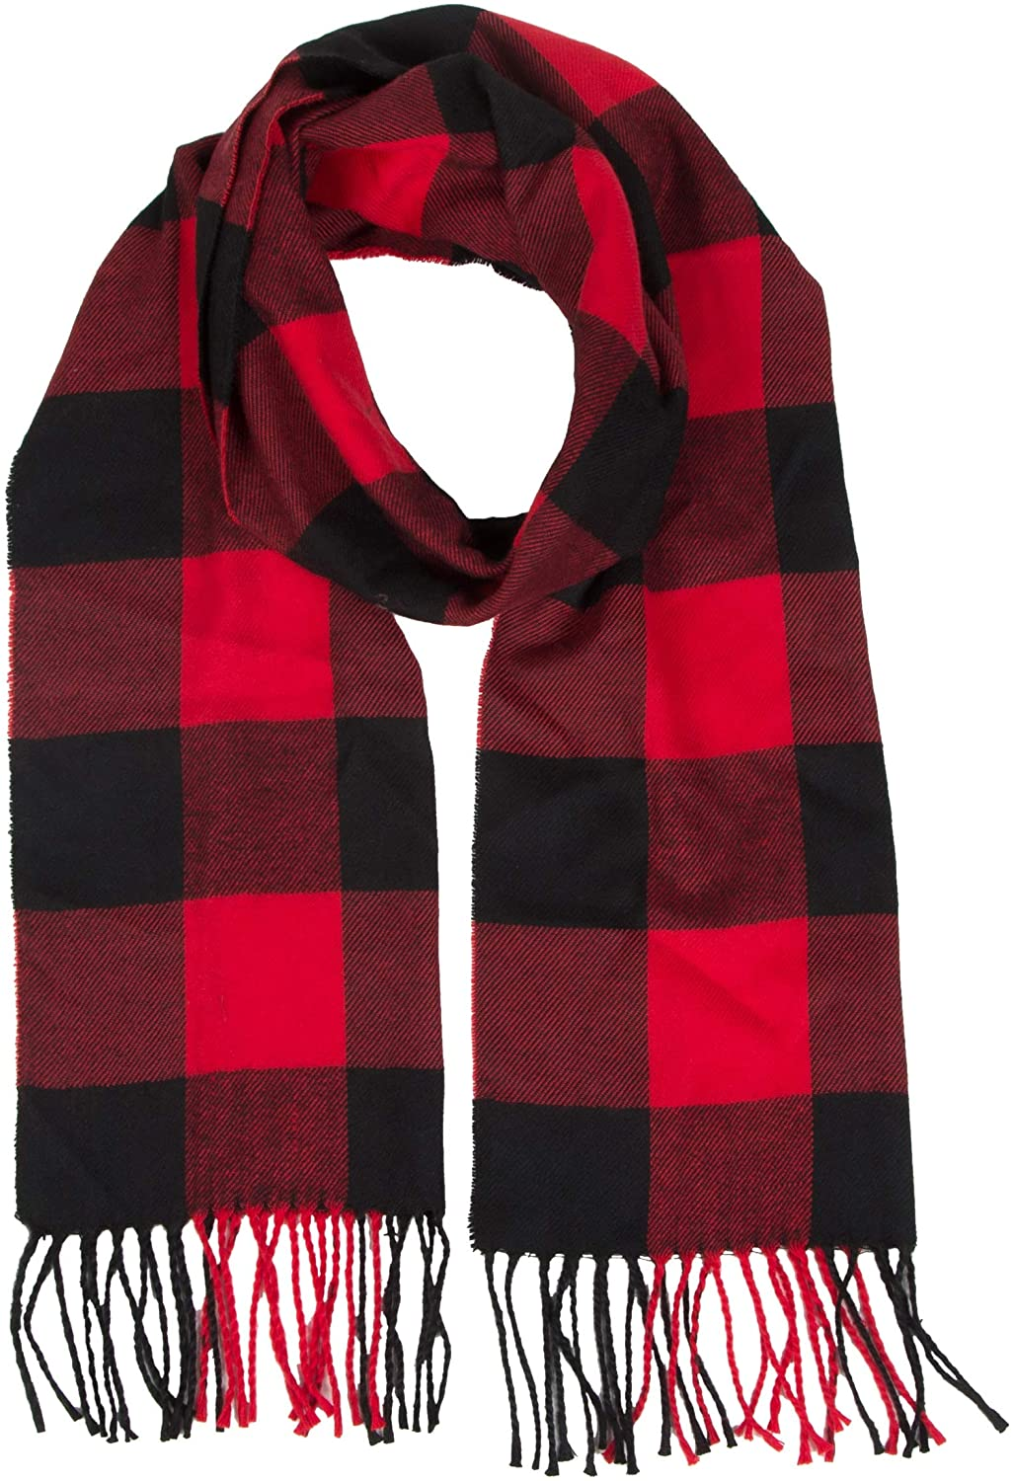
scarf

Slide 68
ski

Slide 69
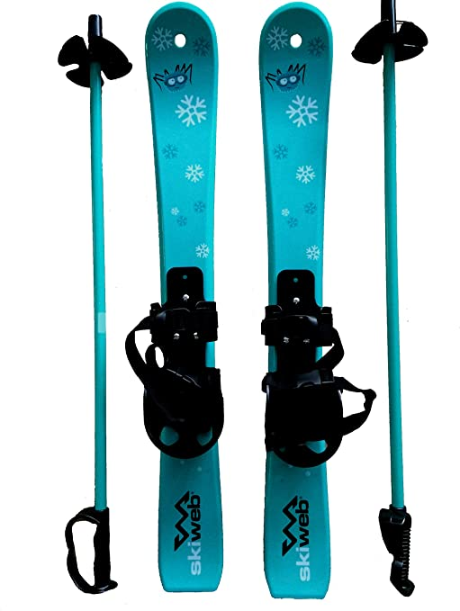
ski

Slide 70
sled

Slide 71
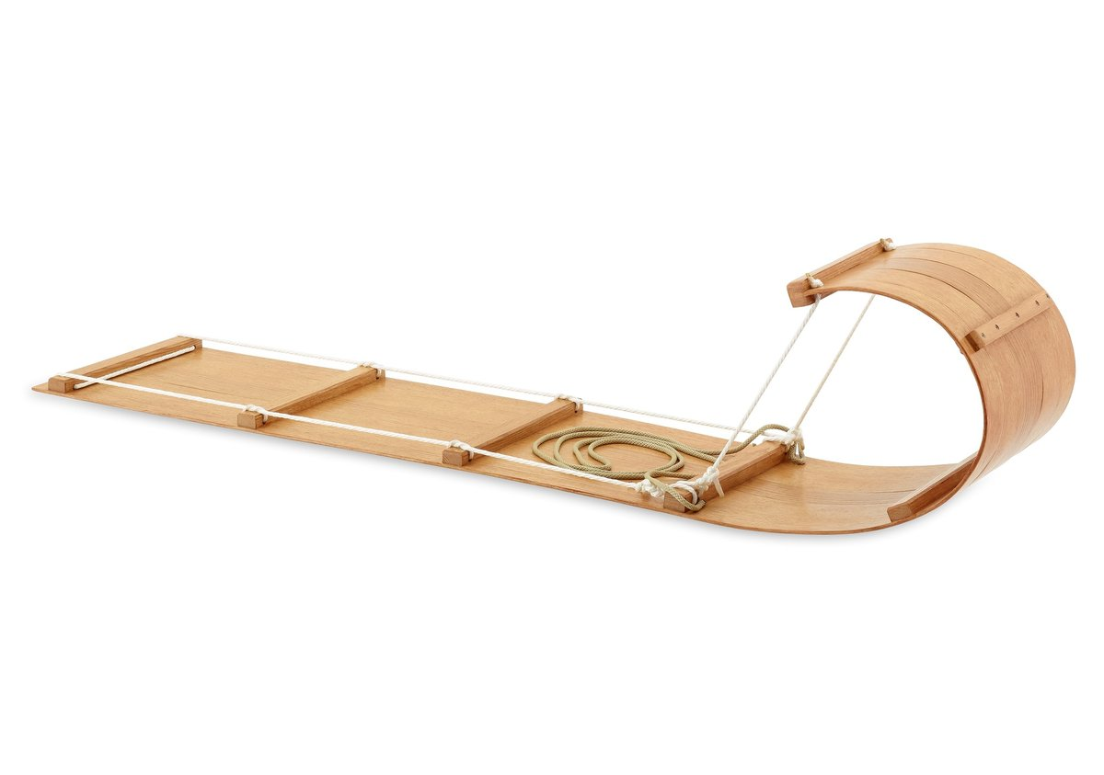
sled

Slide 72
sleigh

Slide 73
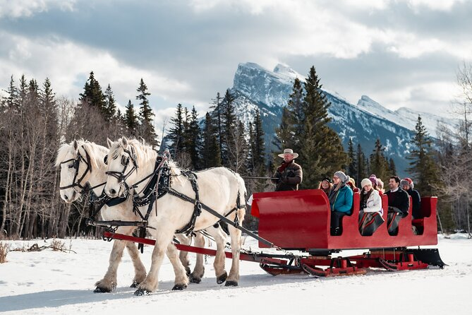
sleigh

Slide 74
slippery

Slide 75
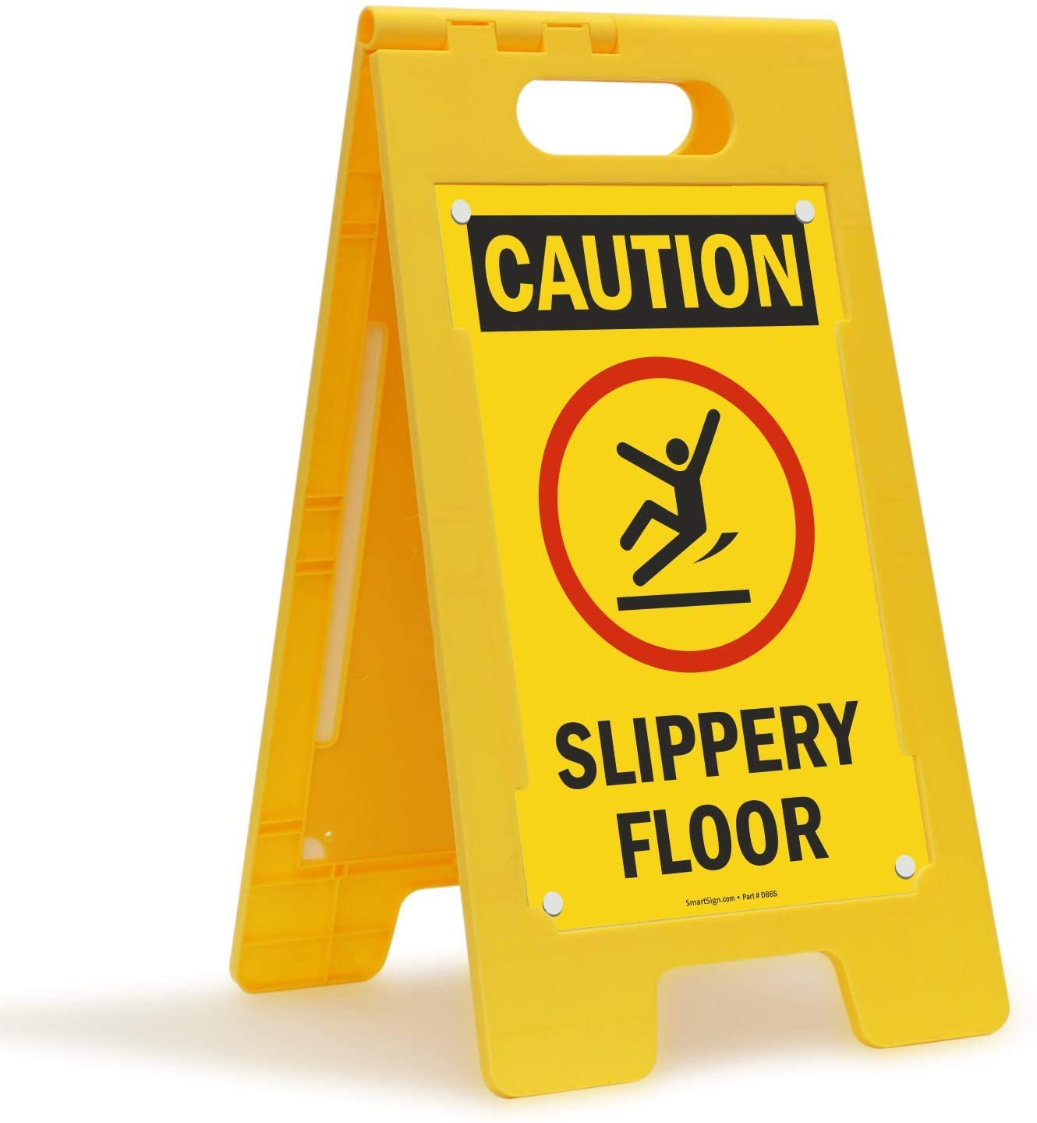
slippery

Slide 76
snowball

Slide 77
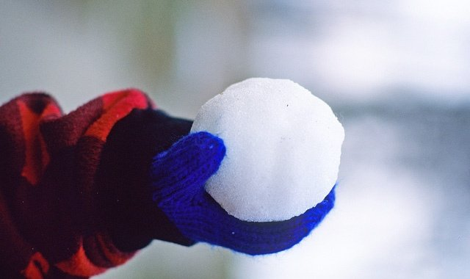
snowball

Slide 78
snowboard

Slide 79
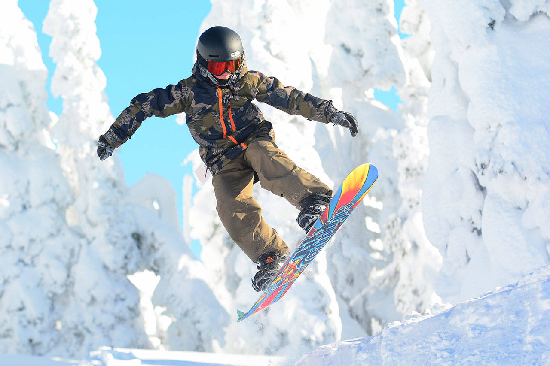
snowboard

Slide 80
snowflake

Slide 81
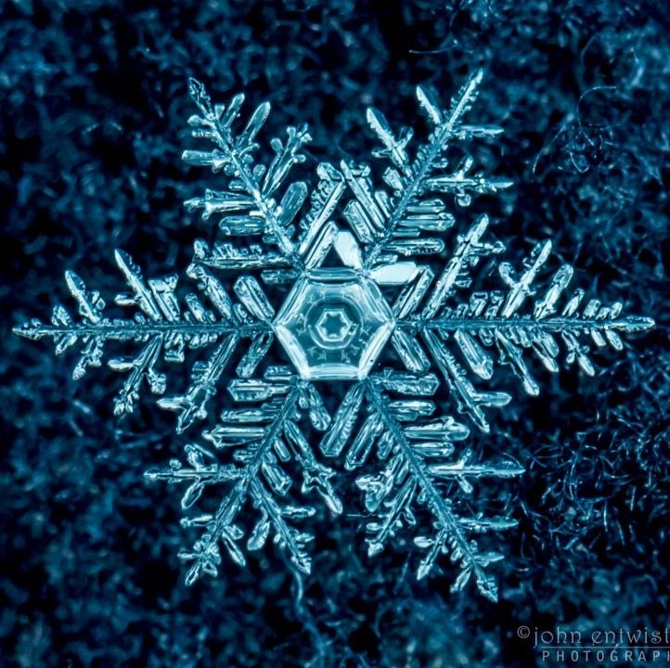
snowflake

Slide 82
sweater

Slide 83
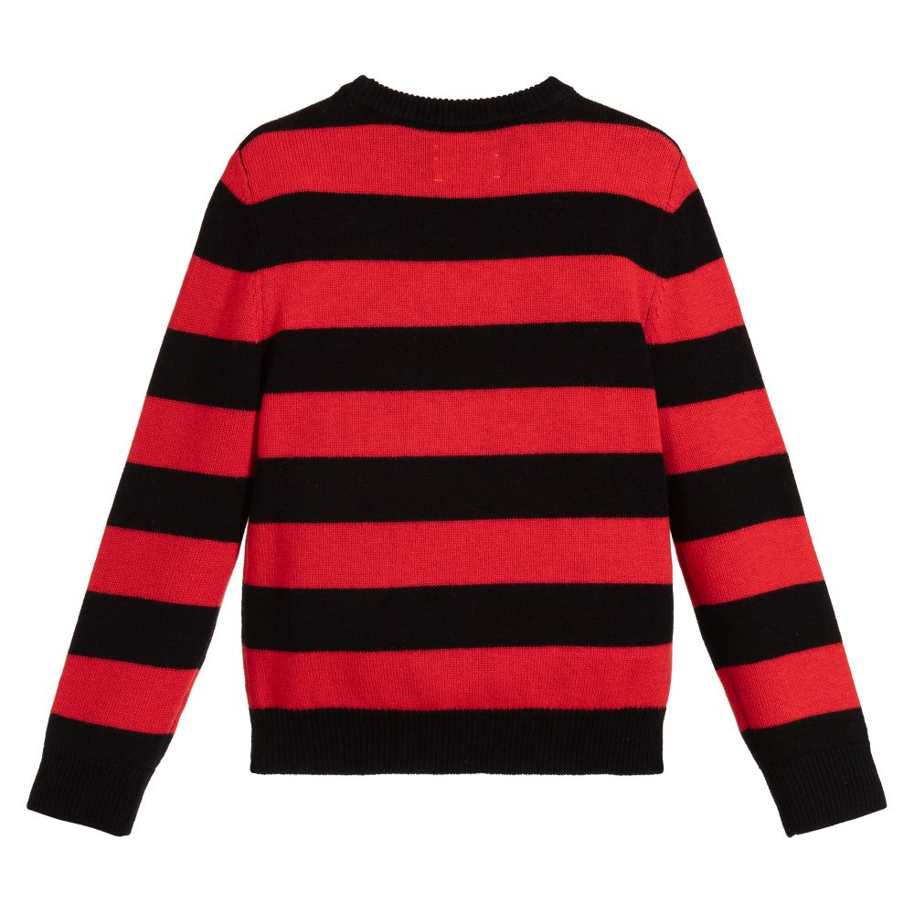
sweater

Slide 84
weather

Slide 85
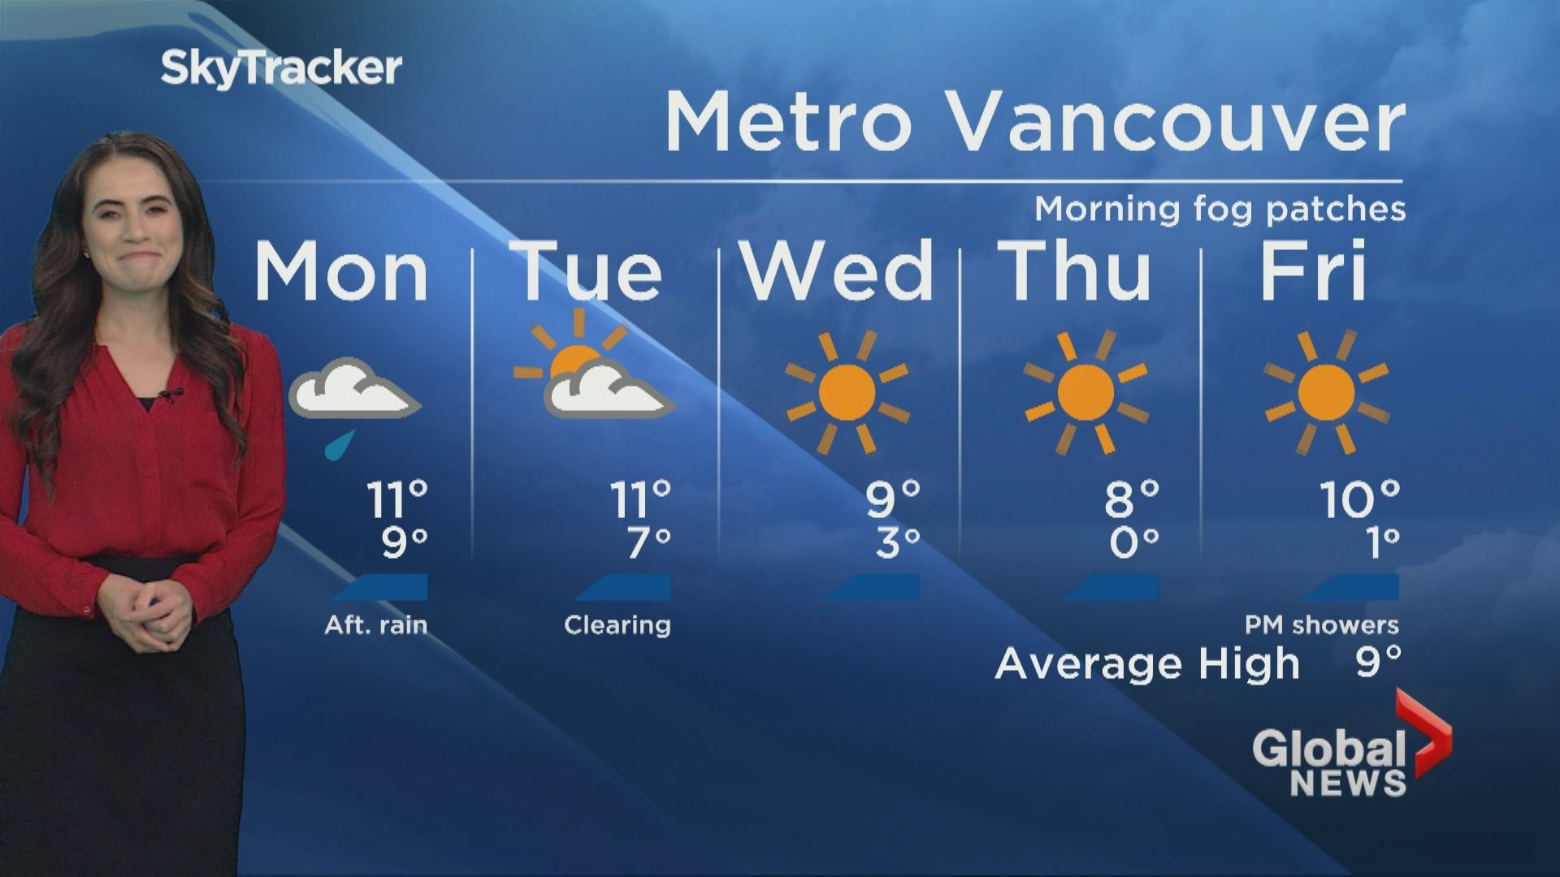
weather

Slide 86
Winter Break

Slide 87
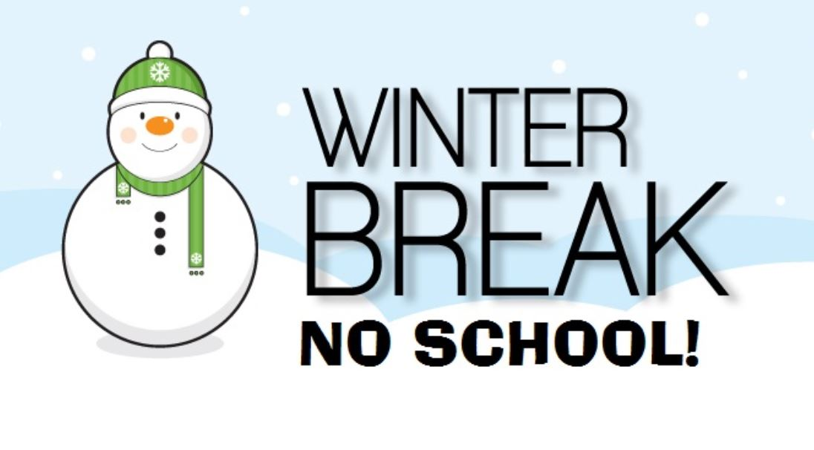
Winter Break

