Slide 1
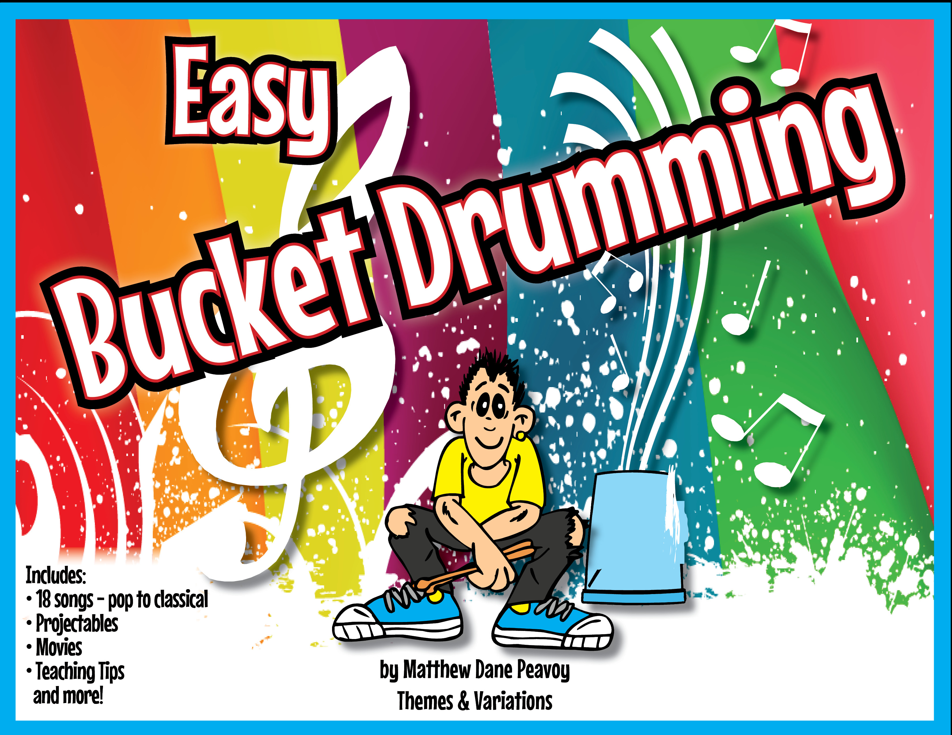

Slide 2
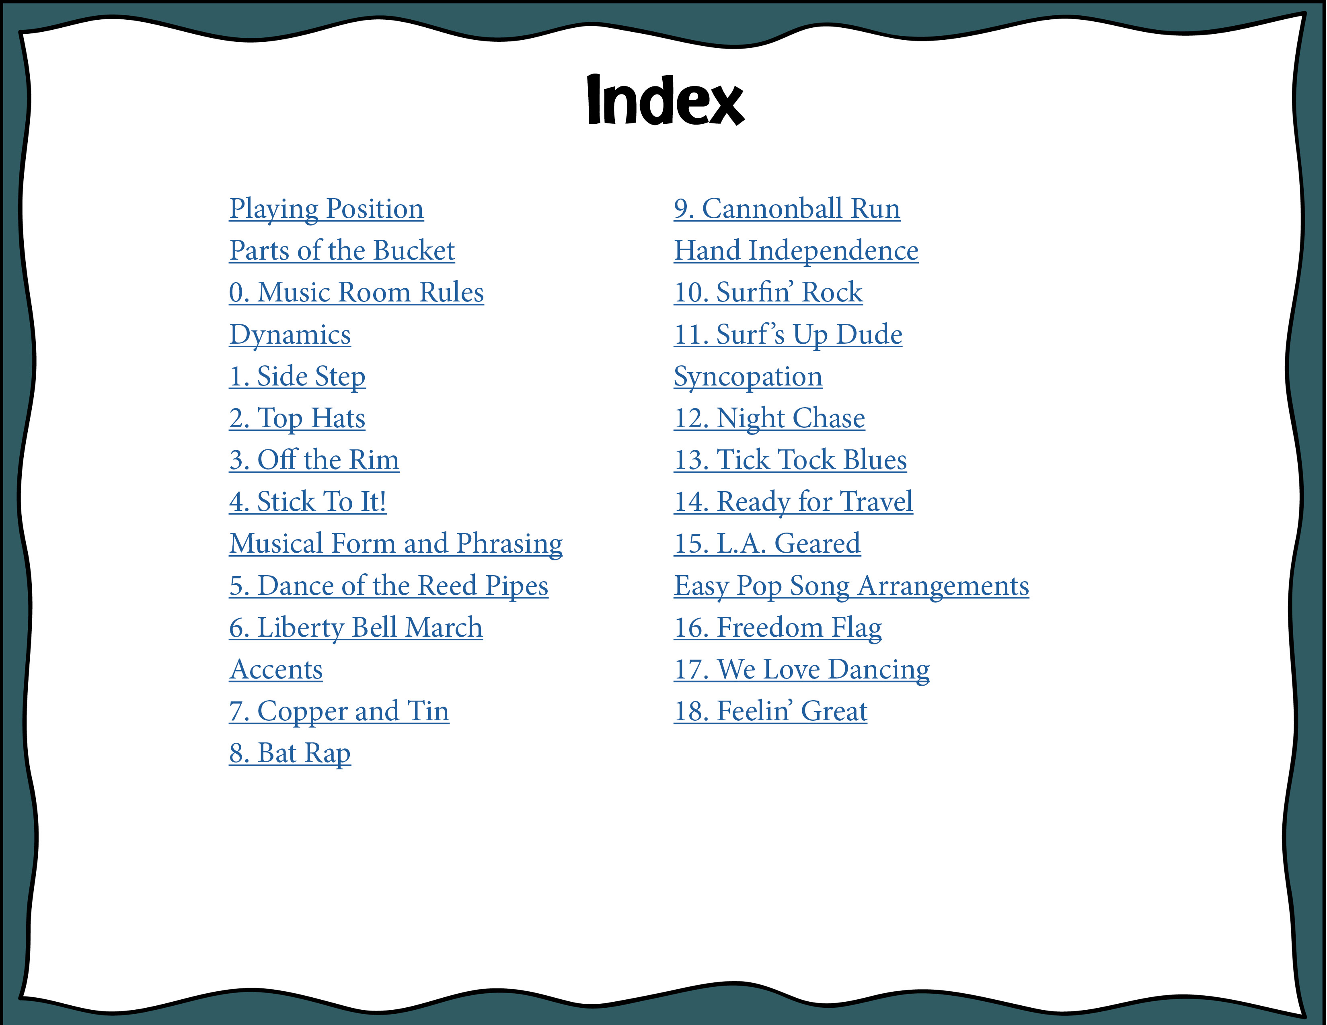
Playing
Playing Position
Parts of the Bucket
0. Music Room Rules
Dynamics
1. Side Step
2. Top Hats
3. Off the Rim
4. Stick To It!
Musical Form and Phrasing
5. Reed Pipes
6. Liberty Bell March
Accents
7. Copper and Tin
8. Bat Rap
9. Cannonball Run
Hand Independence
10. Surfin’ Rock
11. Surf’s Up Dude
Syncopation
12. Night Chase
13. Tick Tock Blues
14. Ready for Travel
15. L.A. Geared
Easy Pop Song Arrangements
16. Freedom Flag
17. We Love Dancing
18. Feelin’ Great

Slide 3
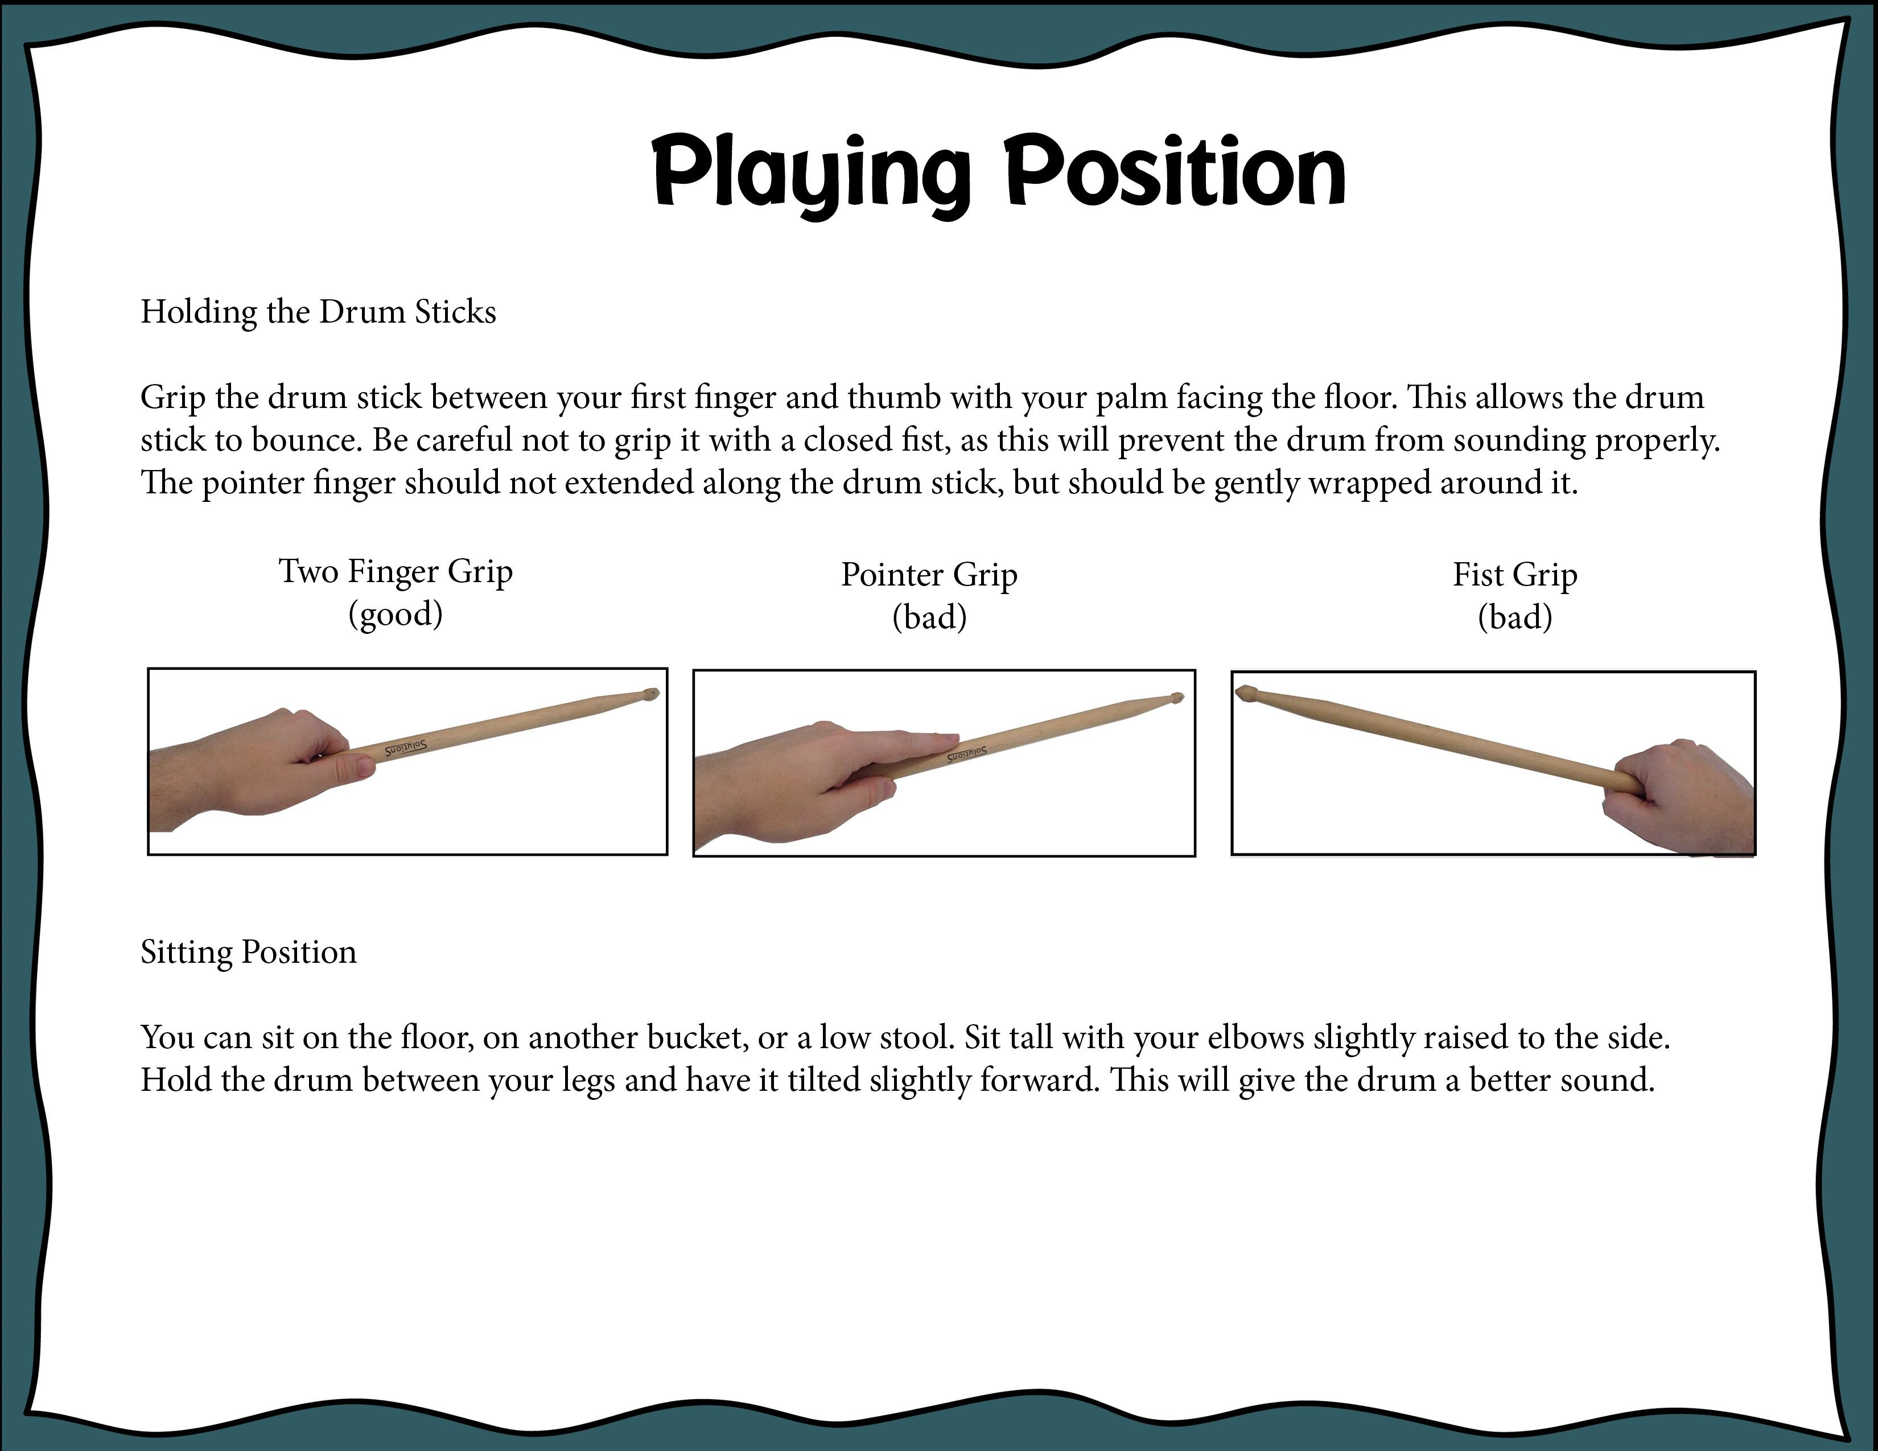
Index

Slide 4
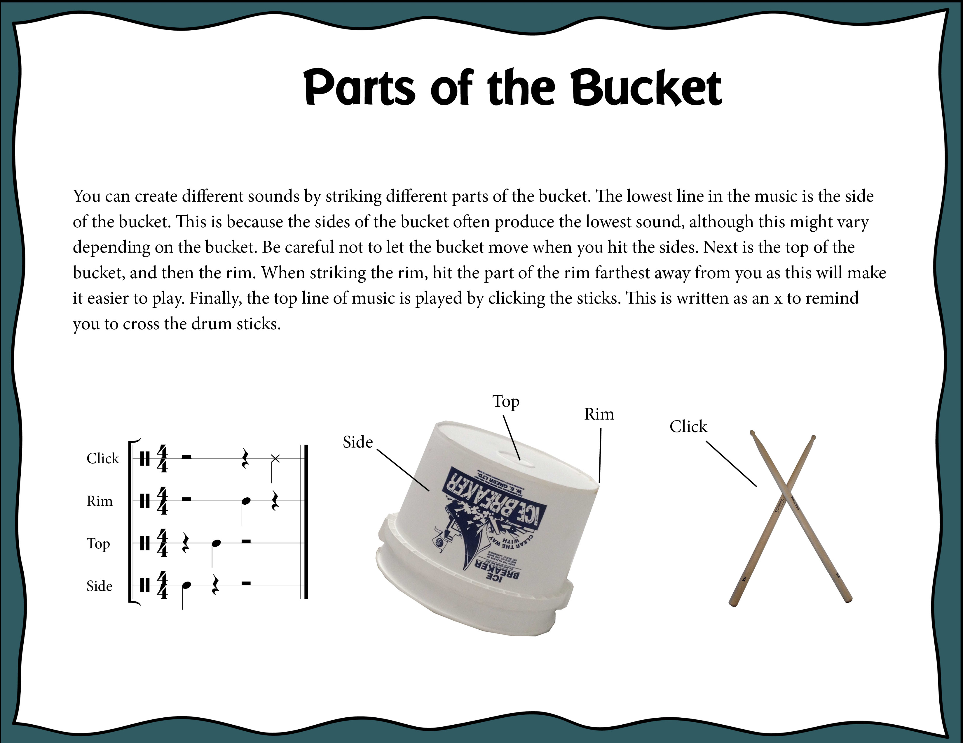
Index

Slide 5
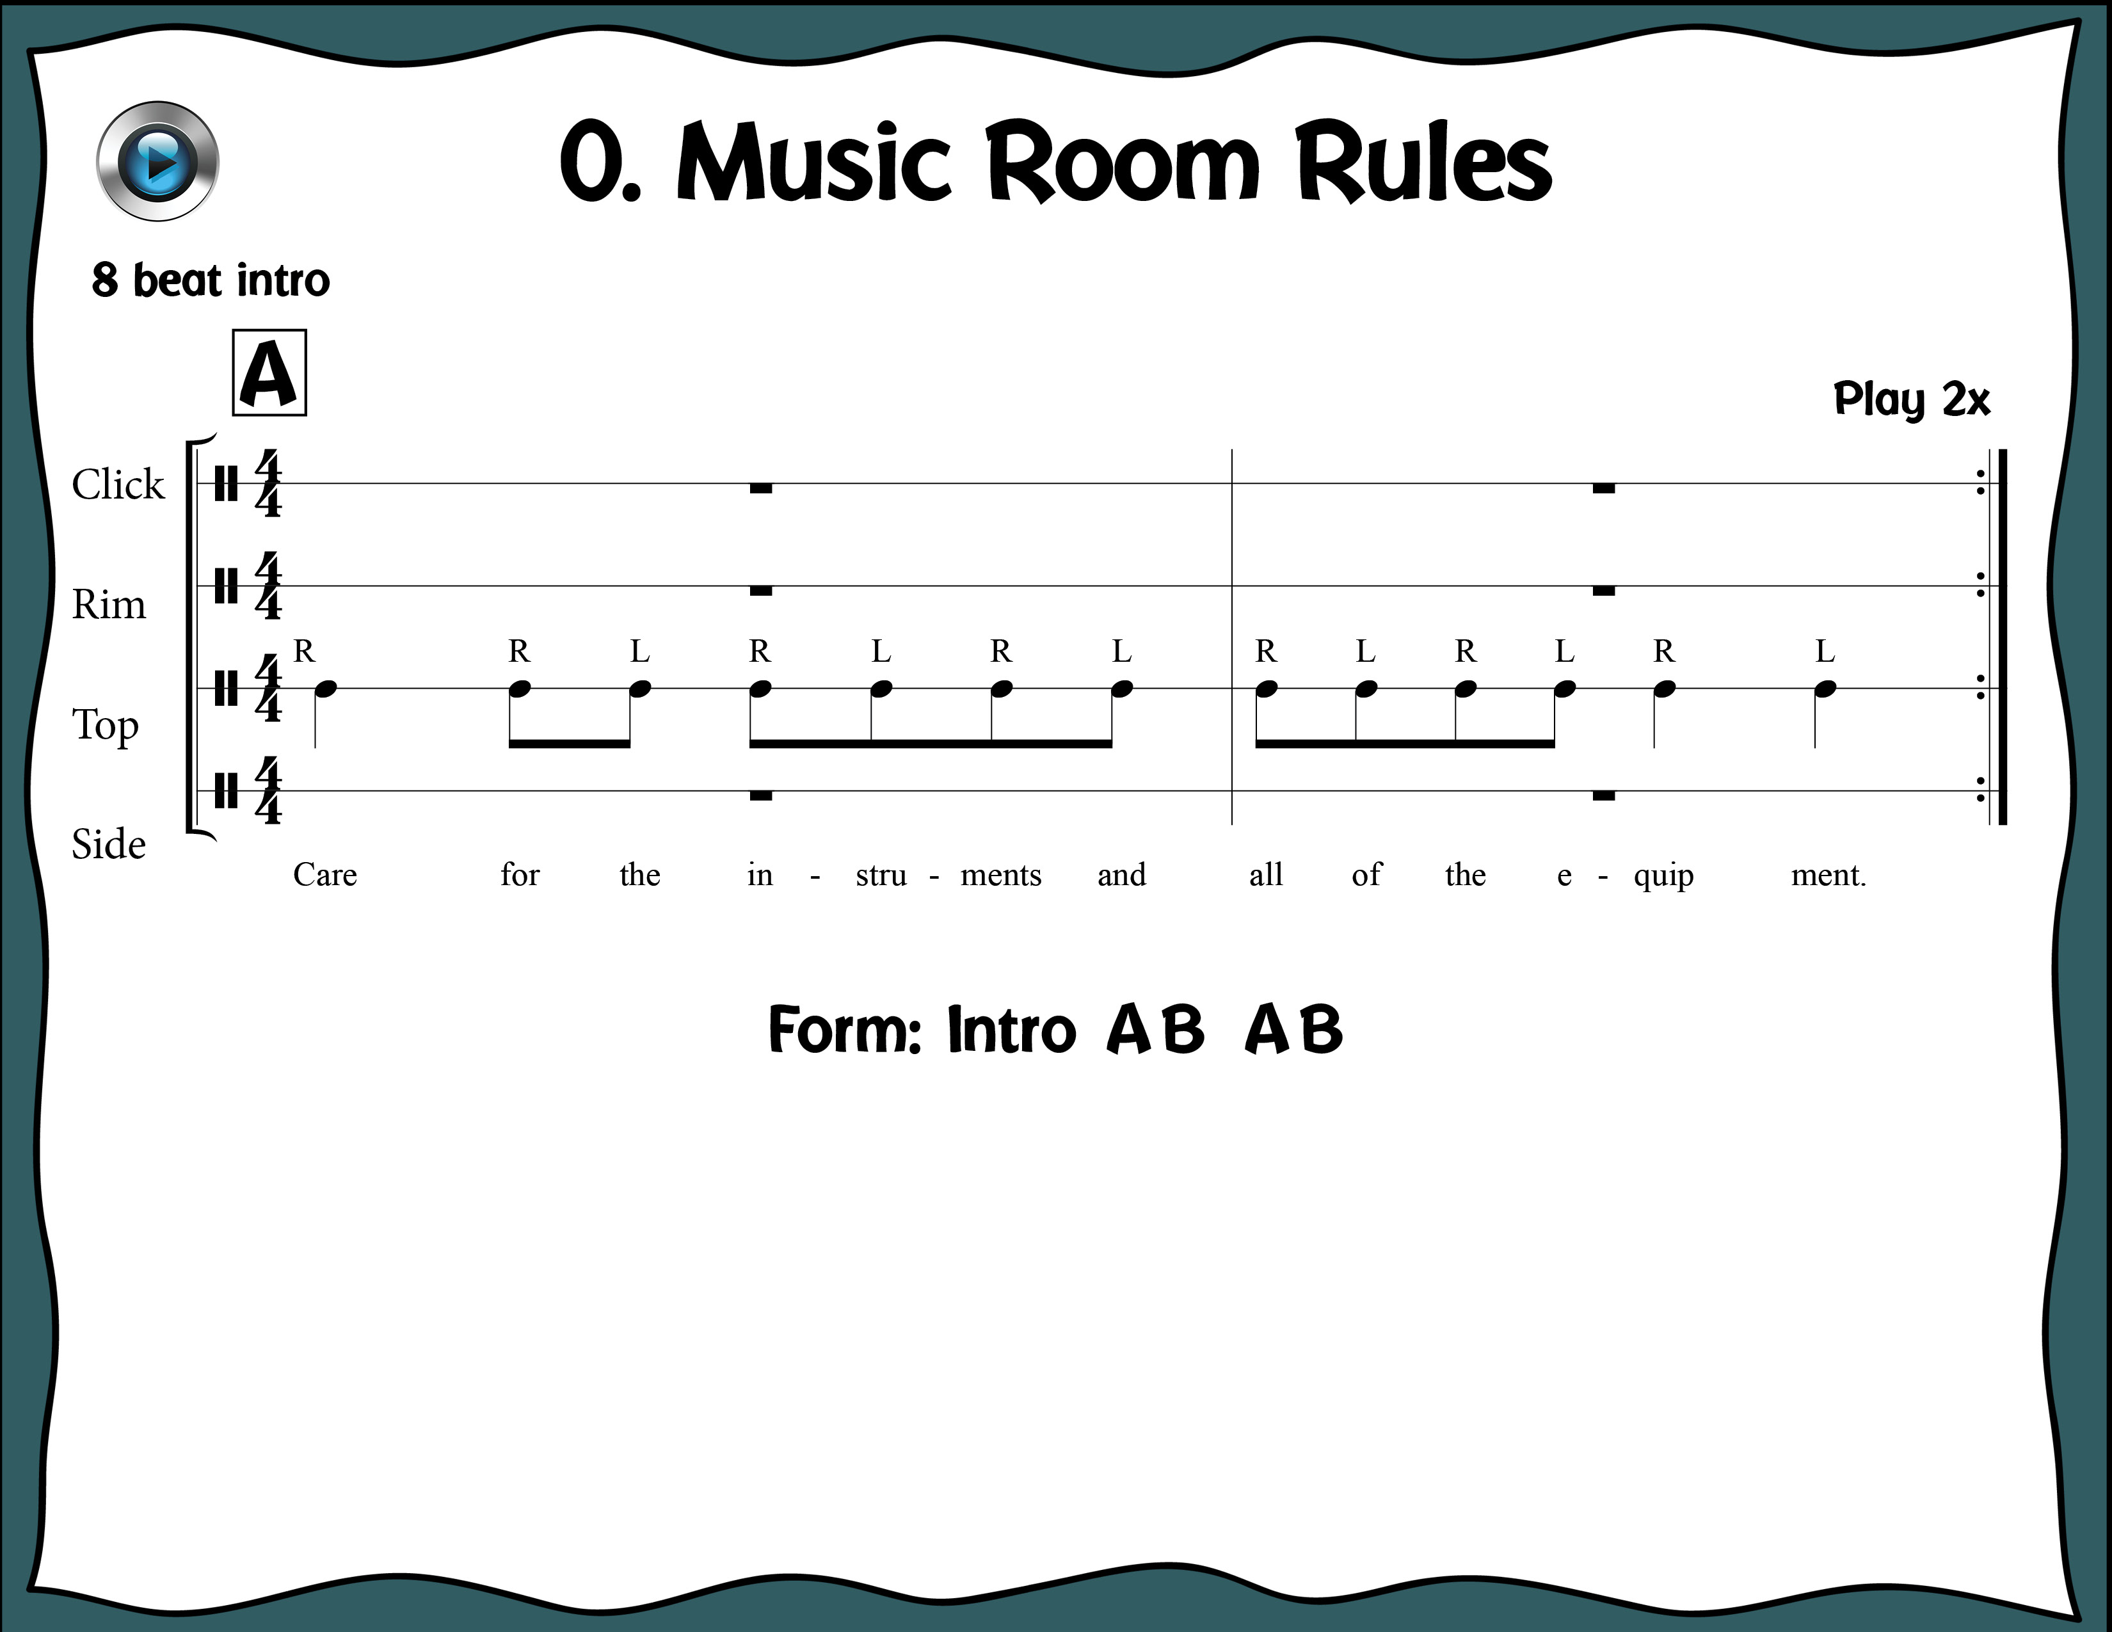

Index

Slide 6
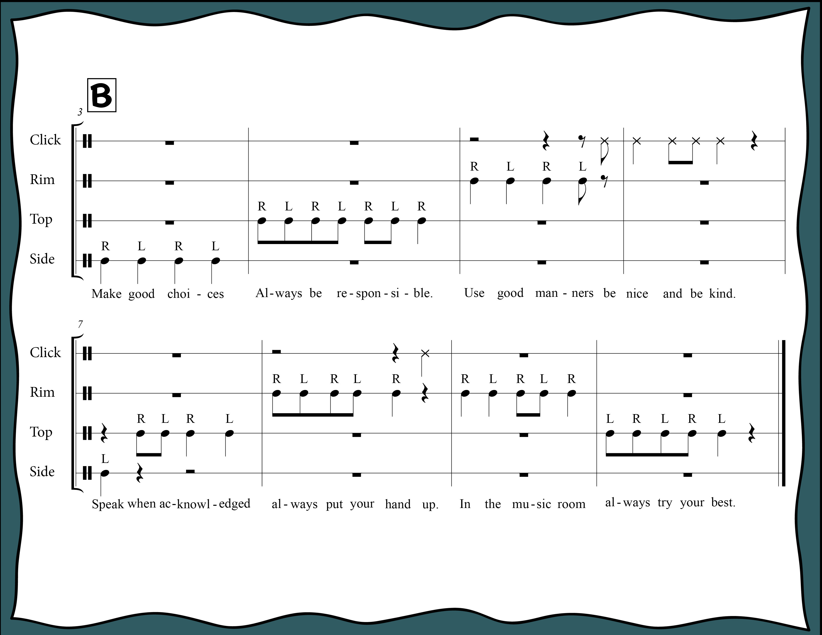
Index

Slide 7
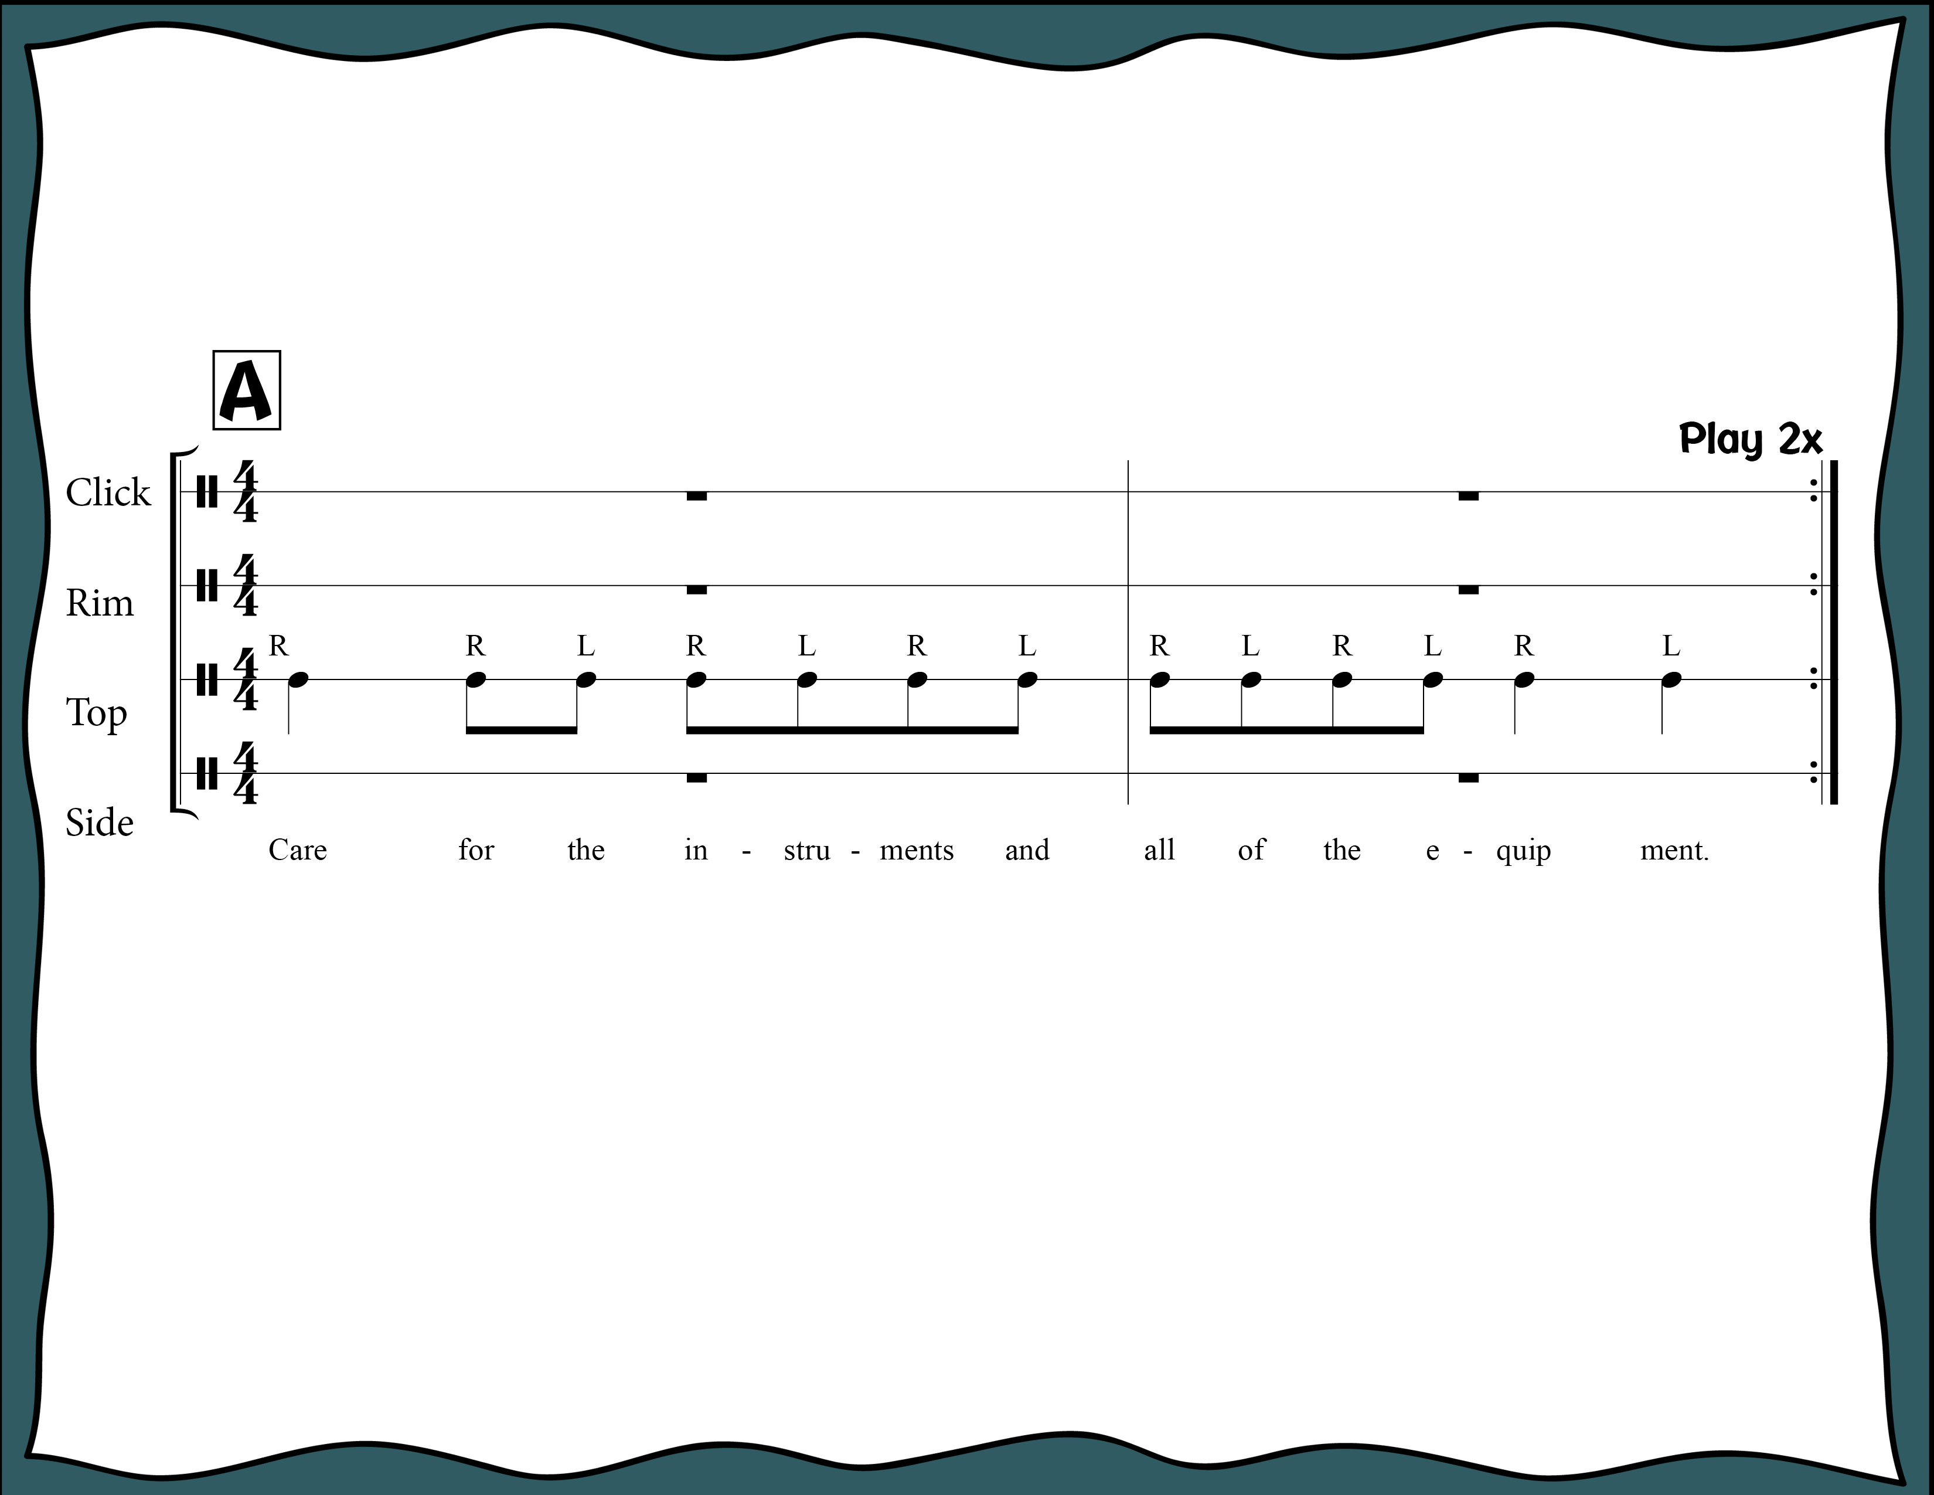
Index

Slide 8
Index

Slide 9
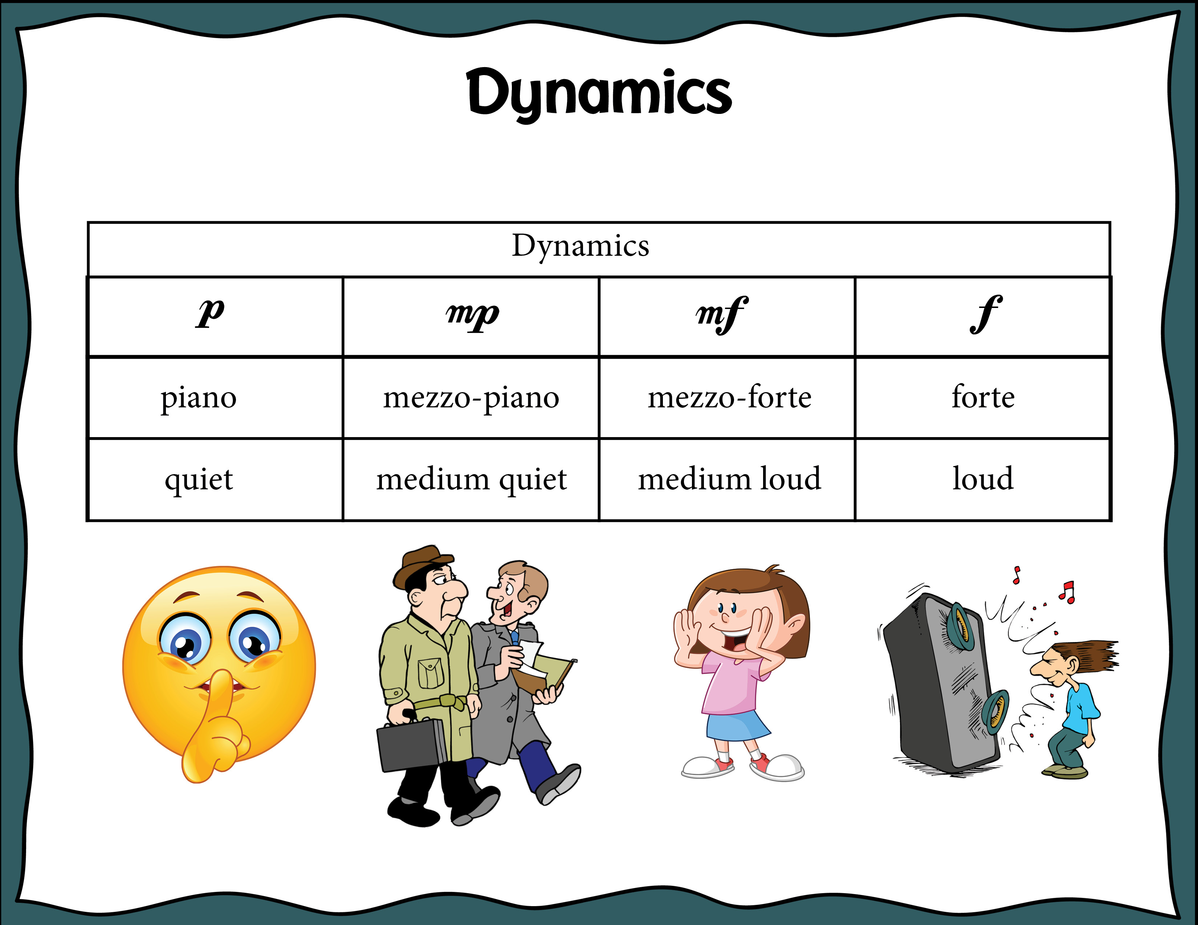
Index

Slide 10
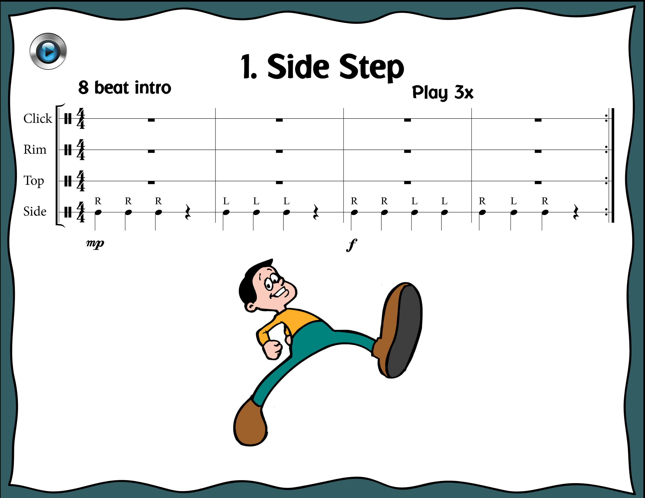
Index

Slide 11
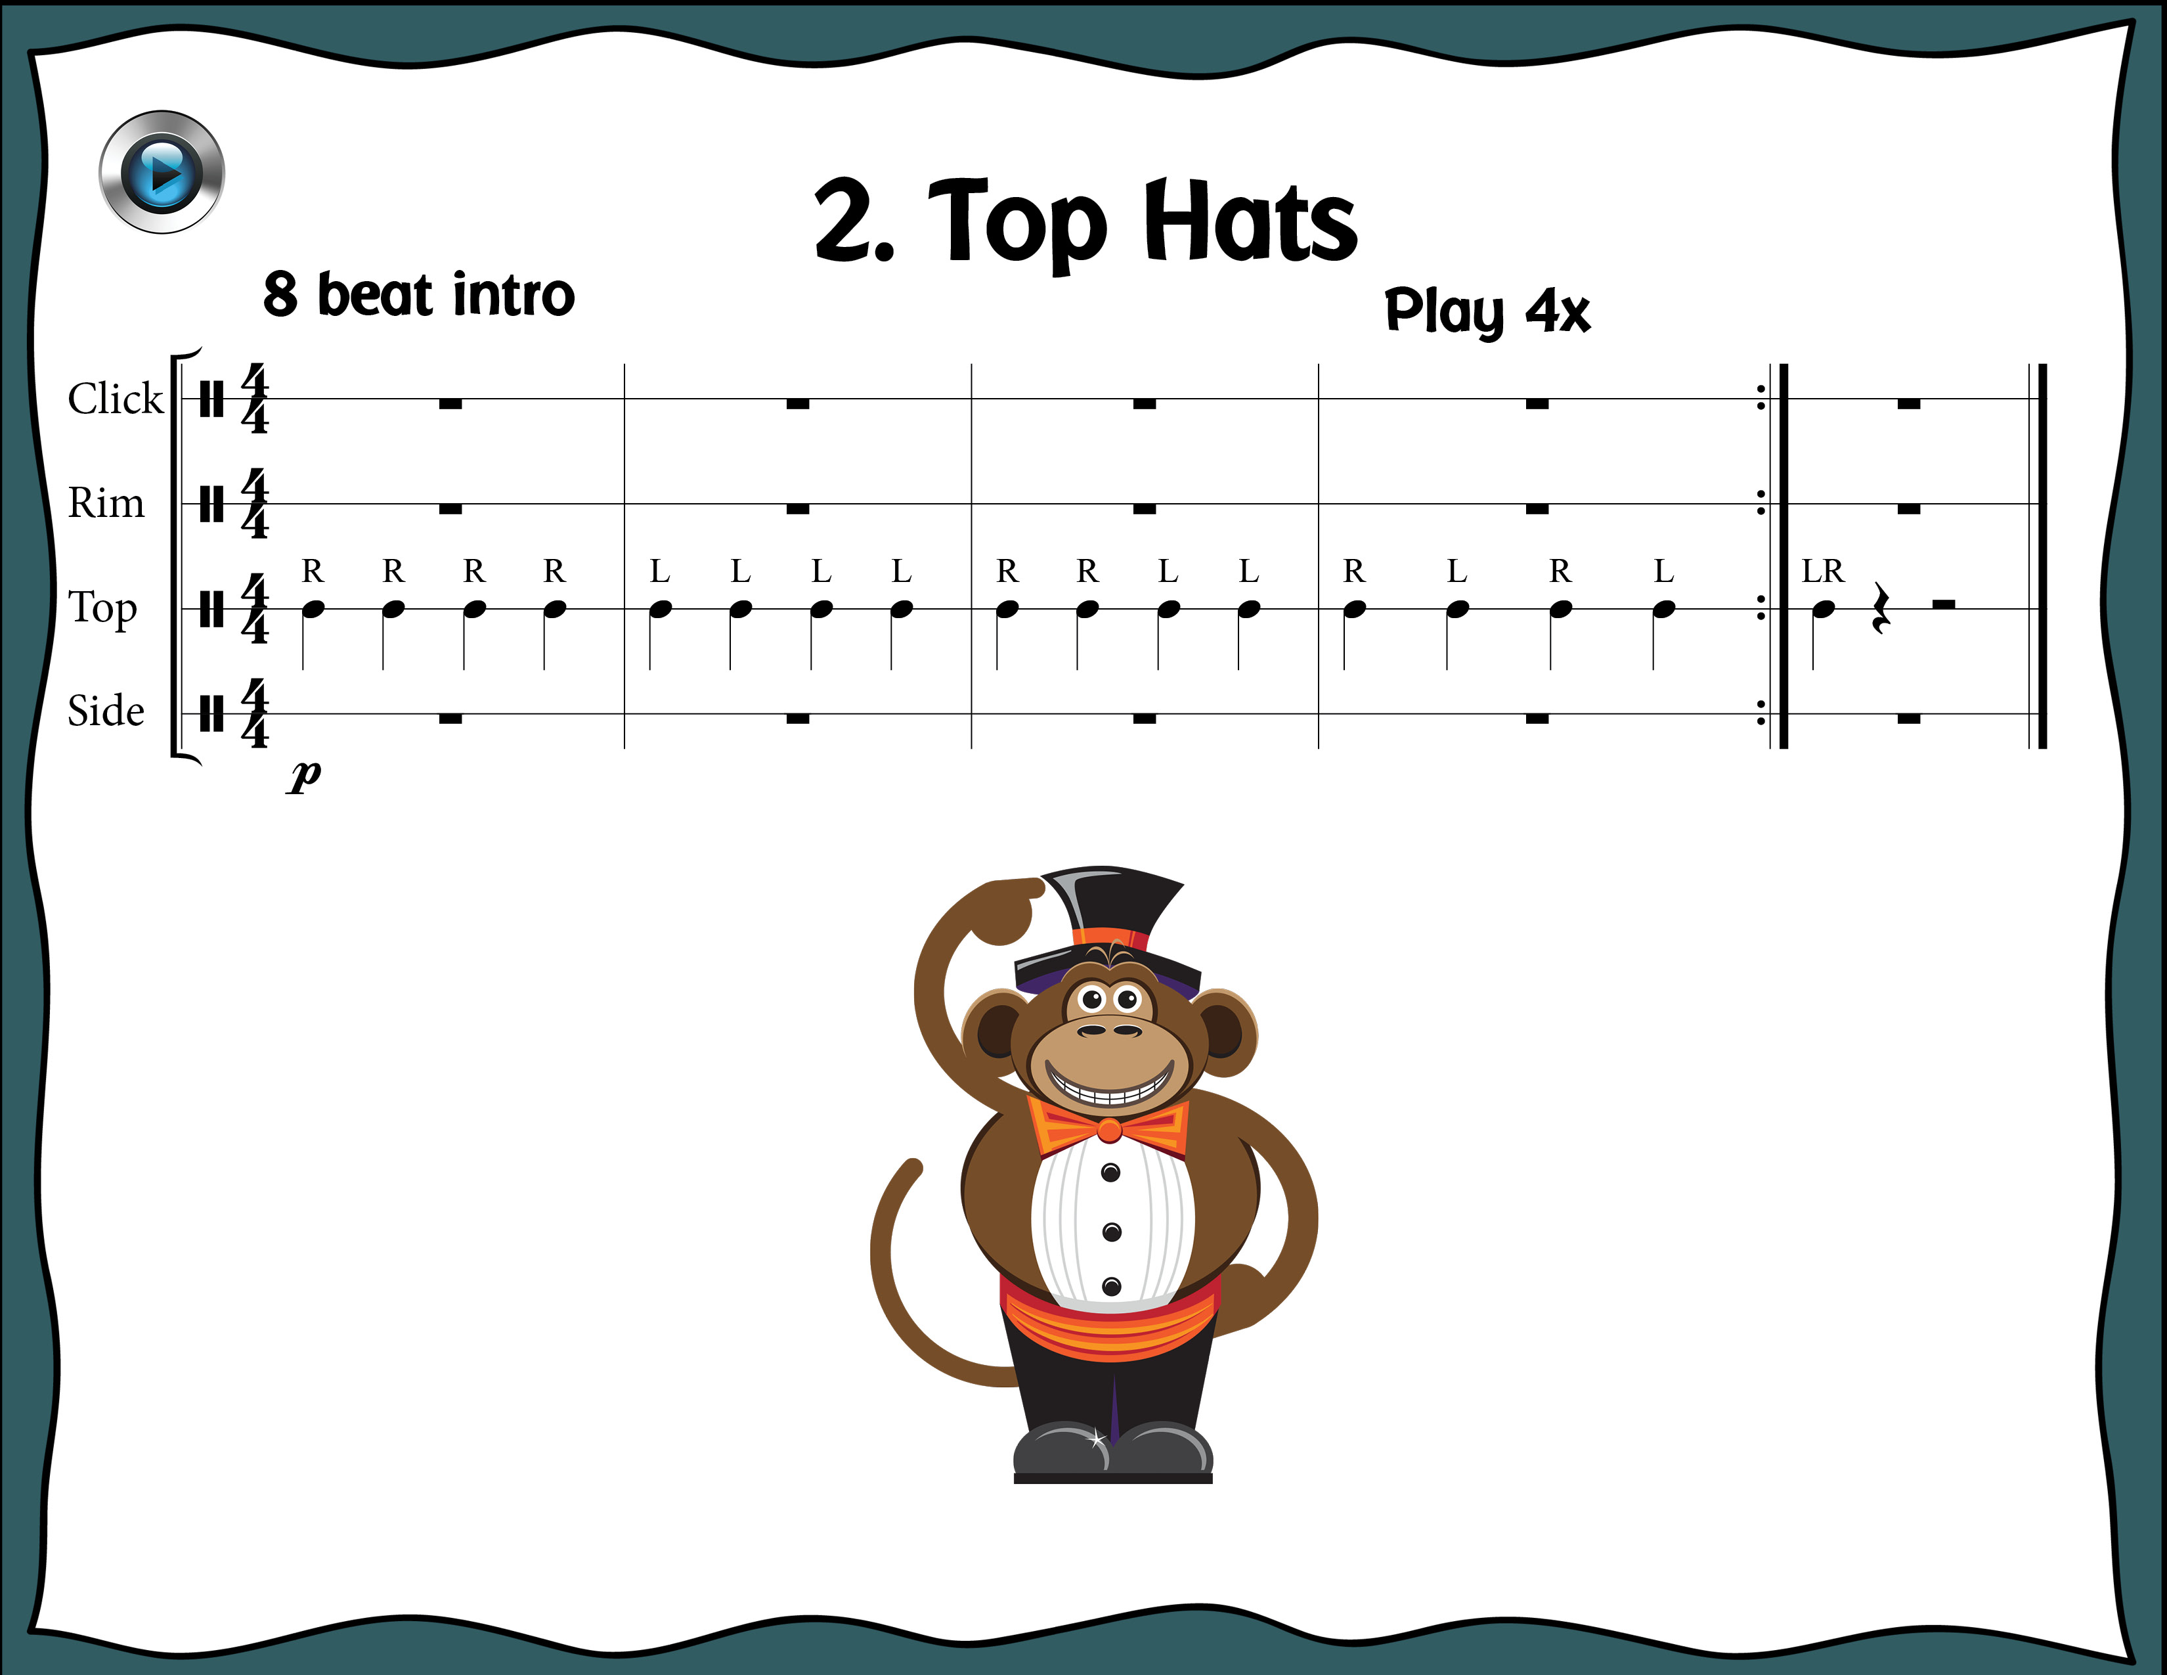
Index

Slide 12
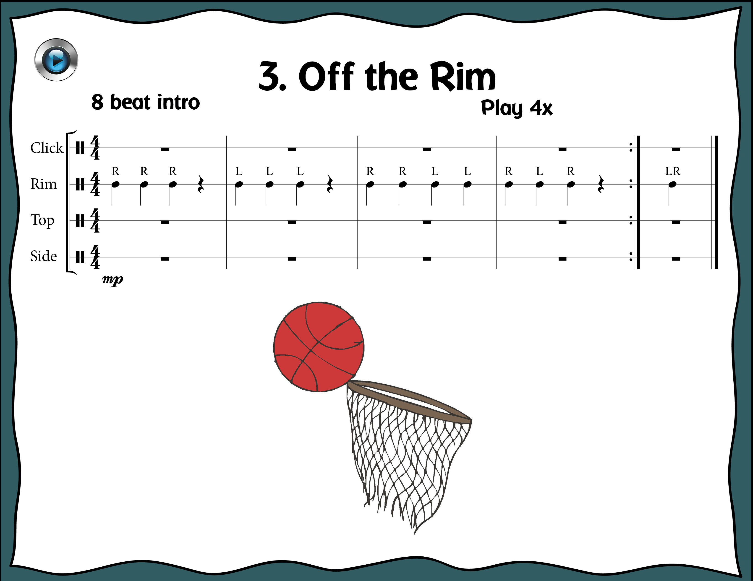
Index

Slide 13
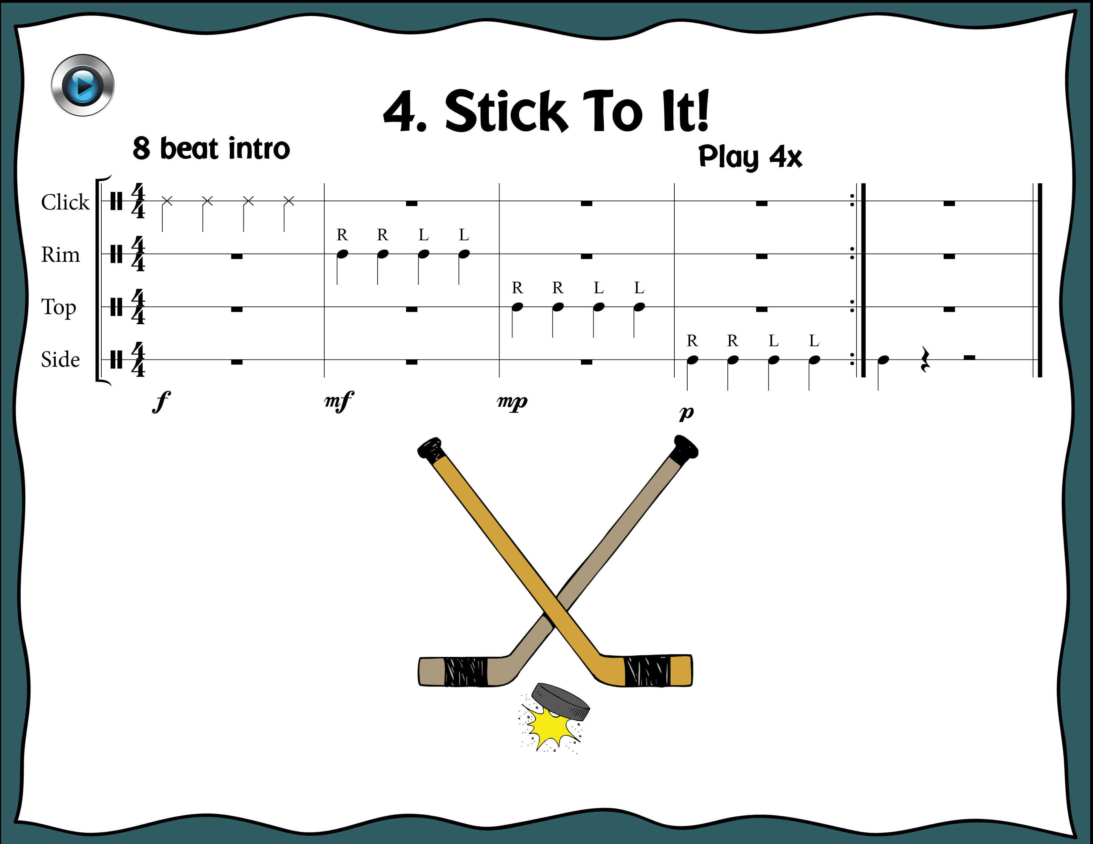
Index

Slide 14
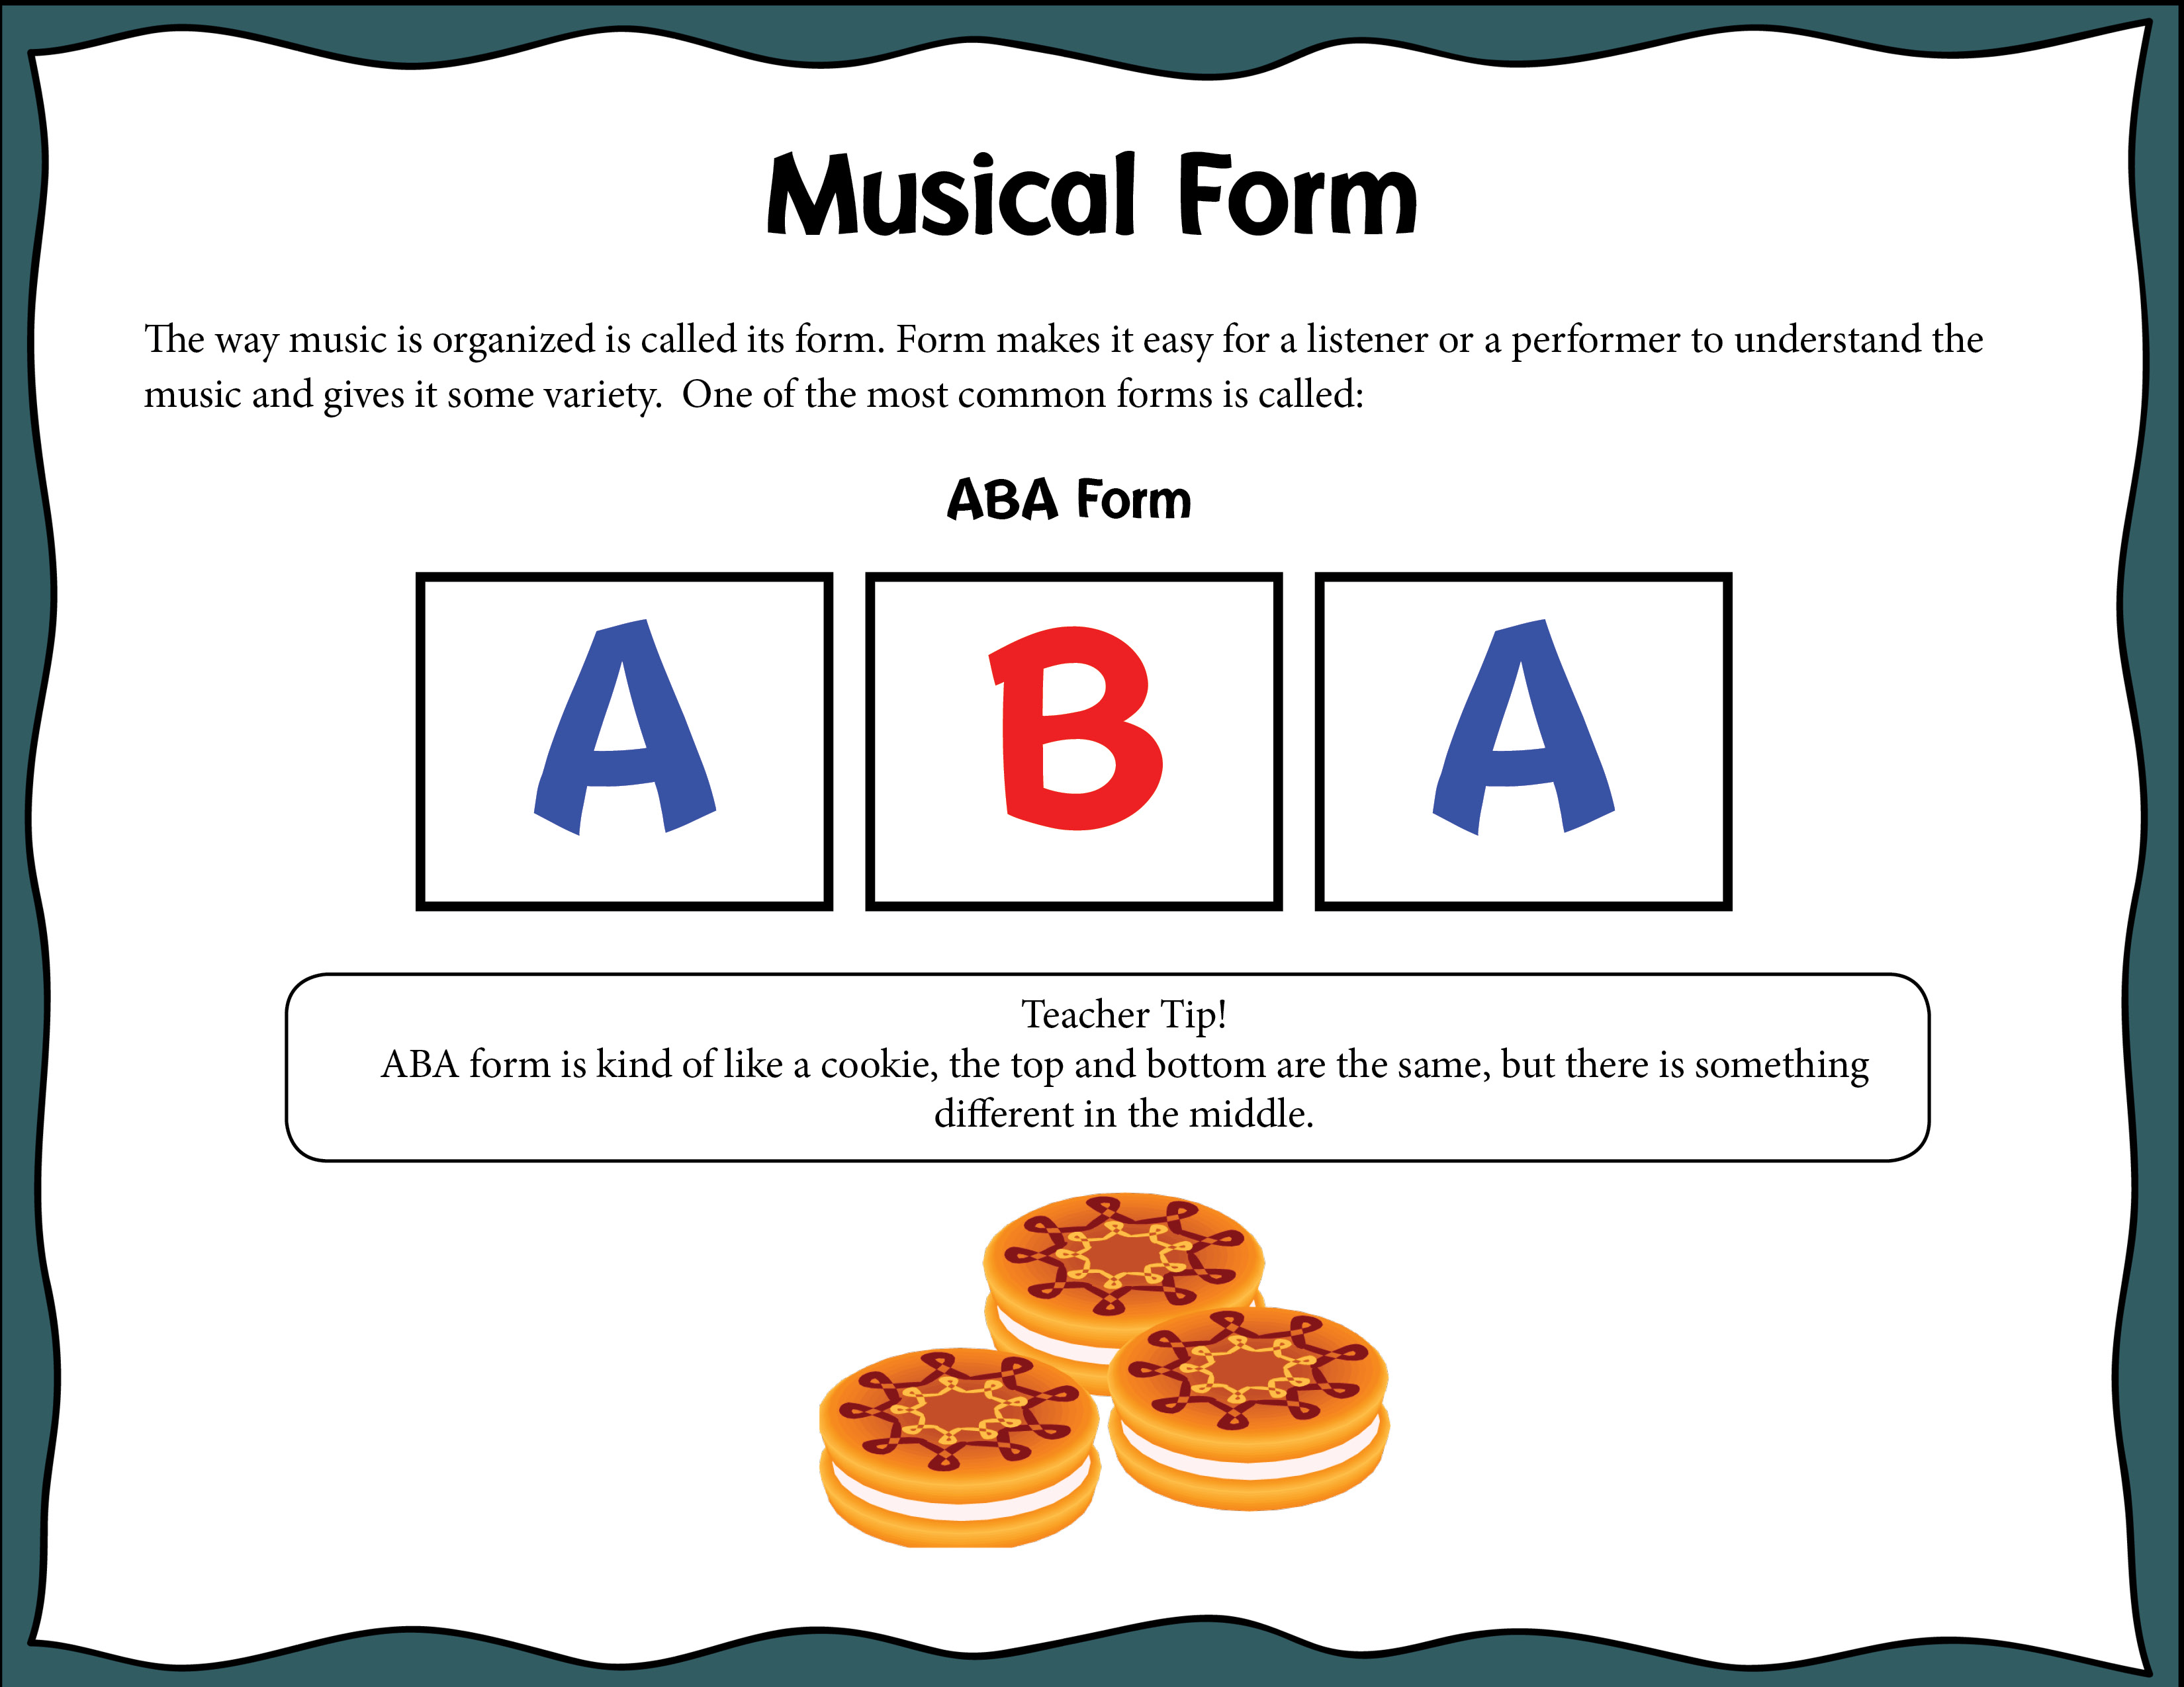
Index

Slide 15
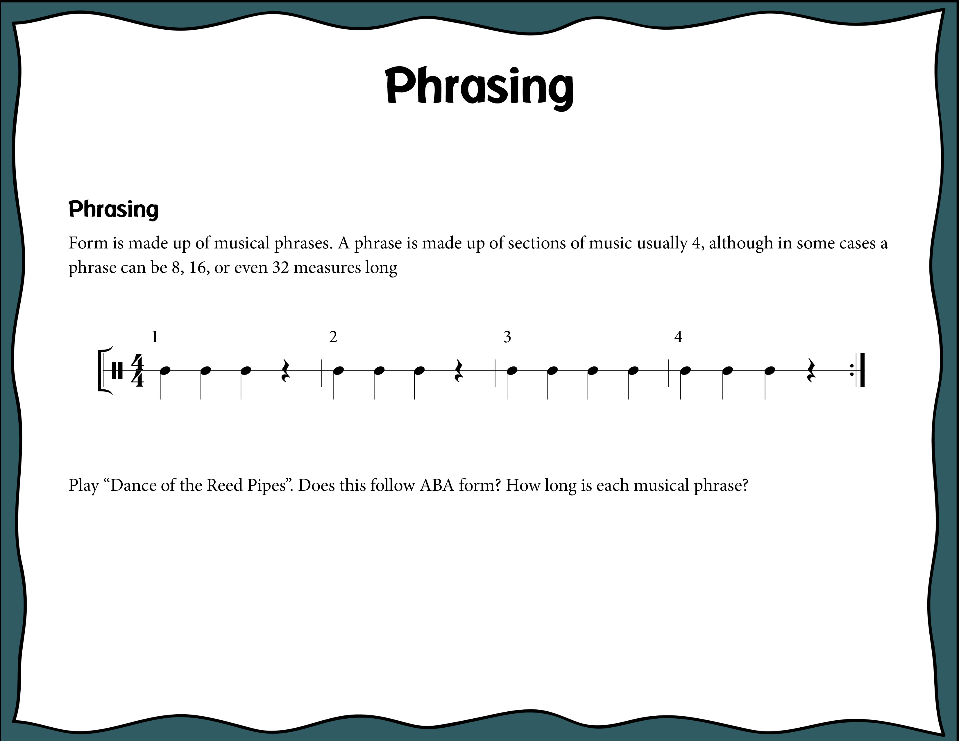
Index

Slide 16
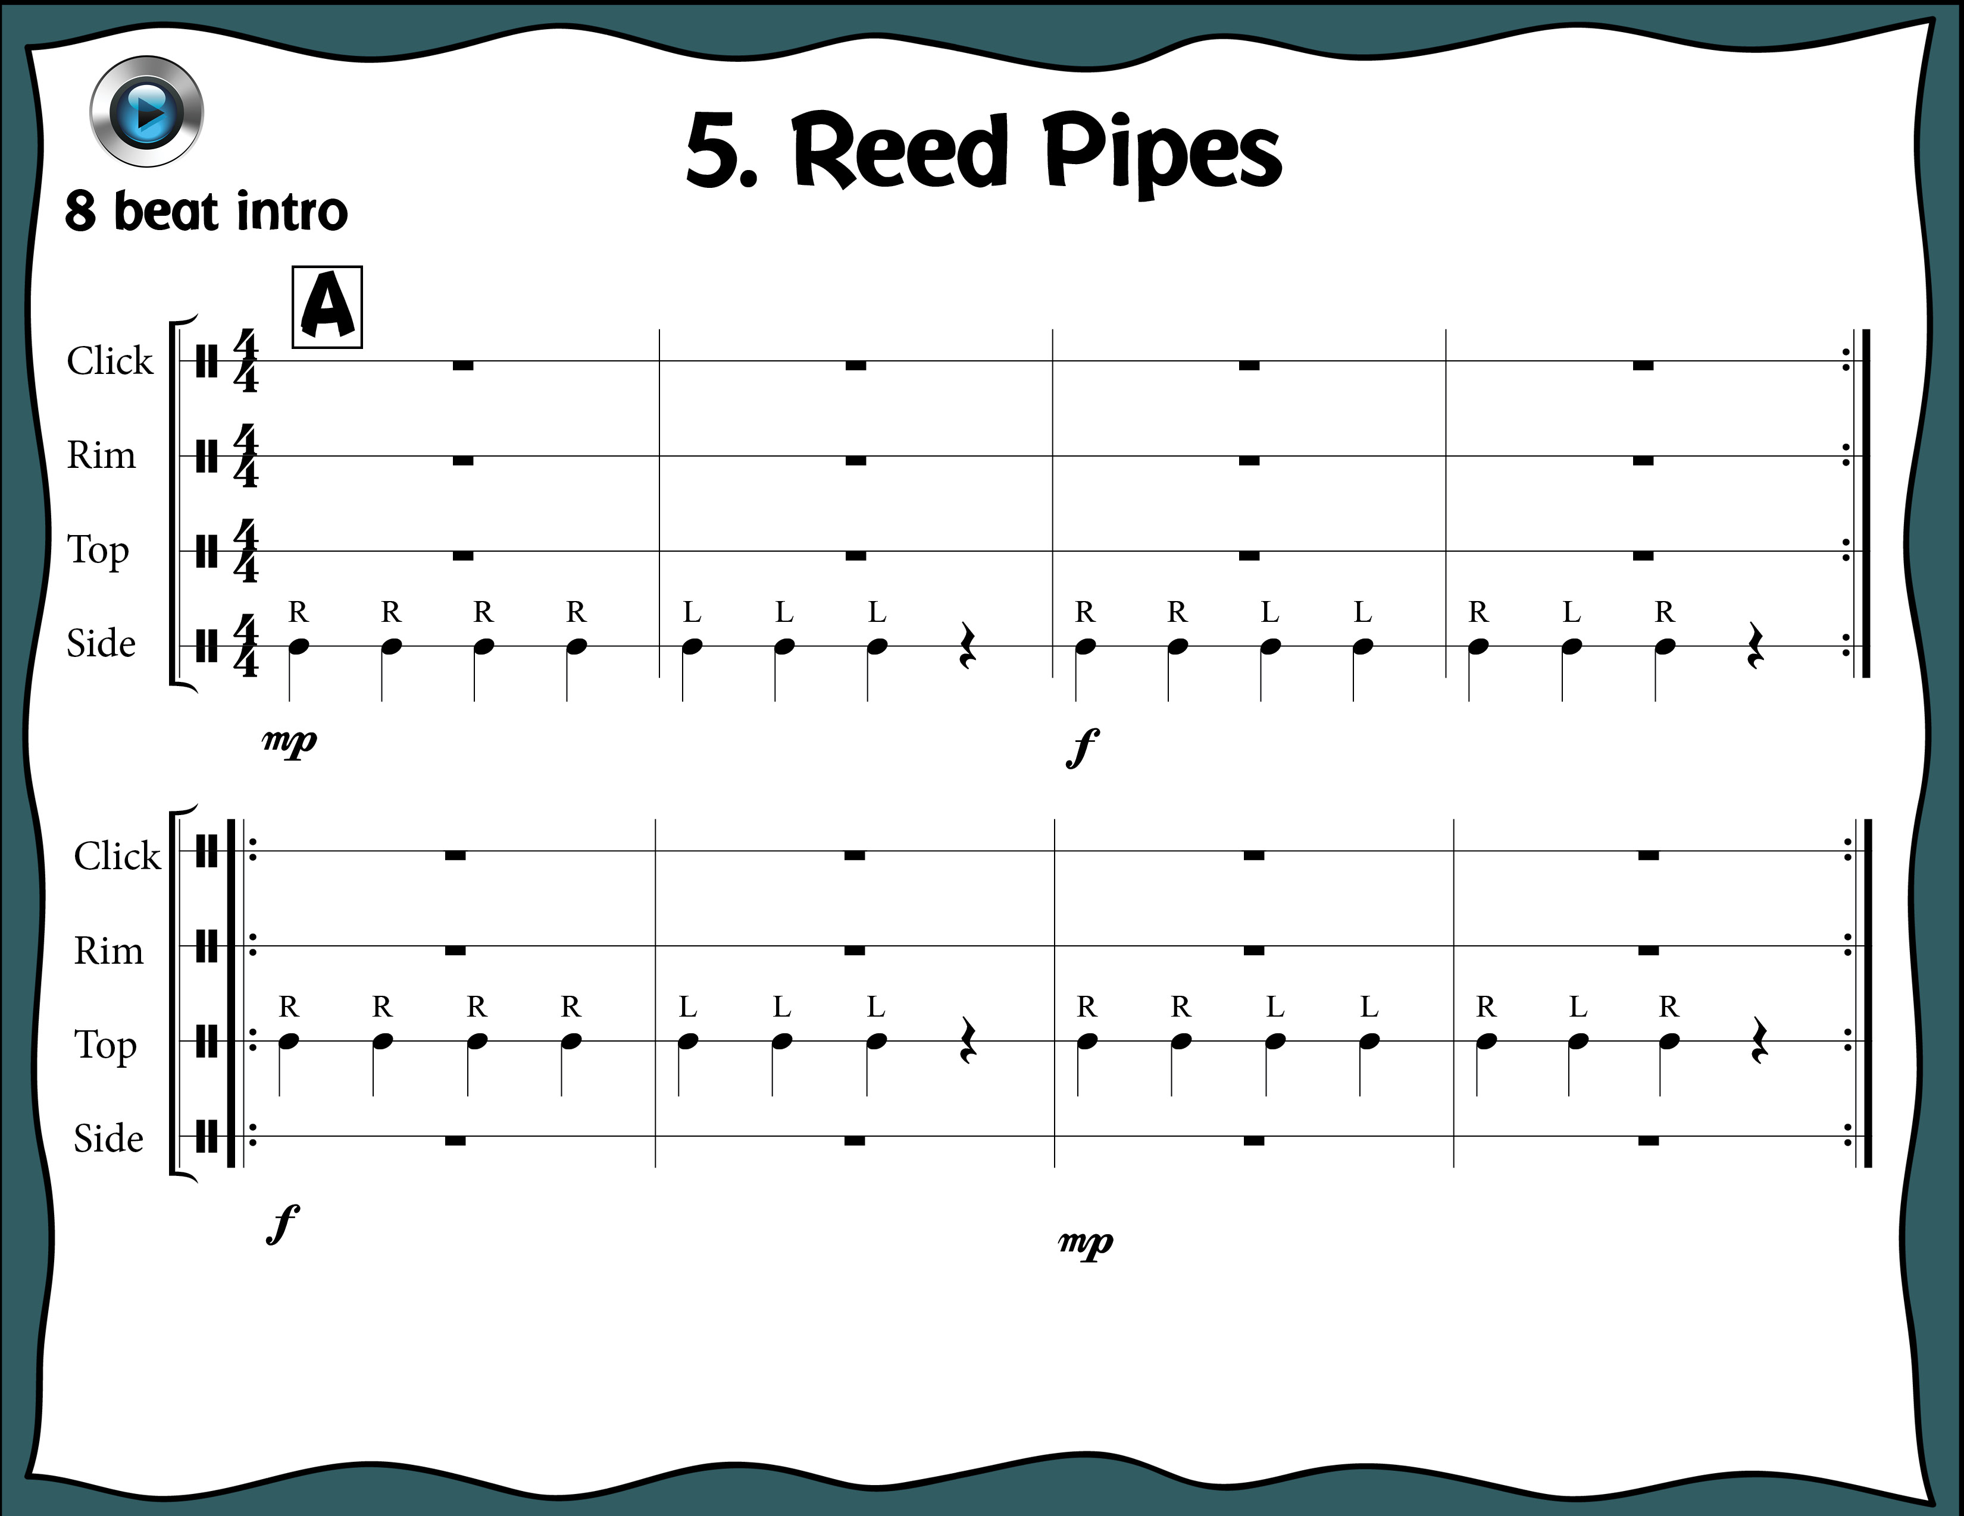
Index

Slide 17
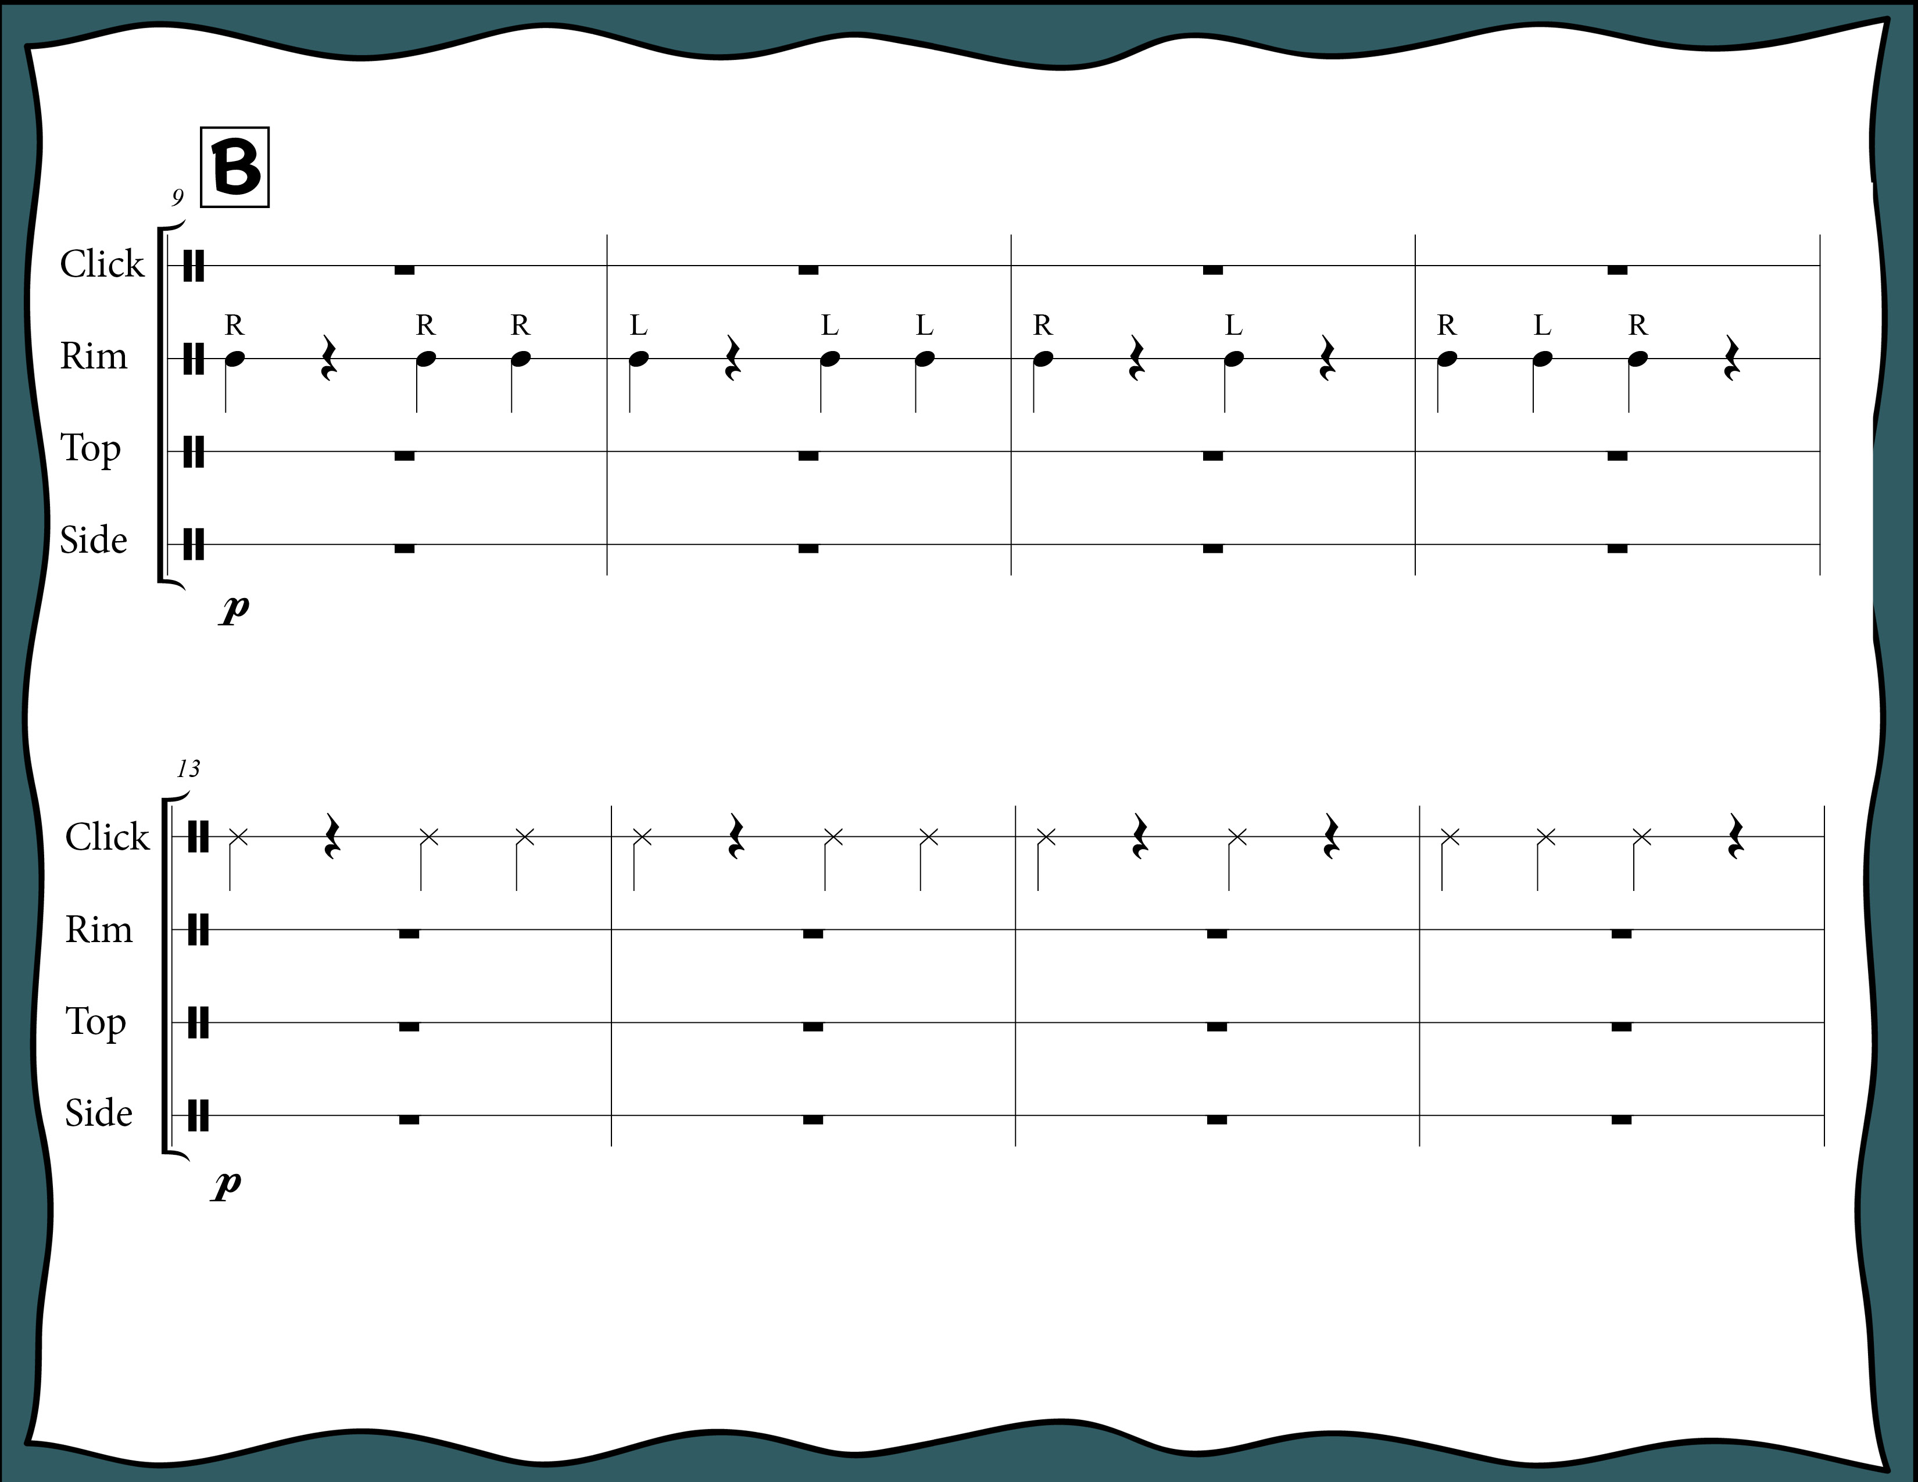
Index

Slide 18
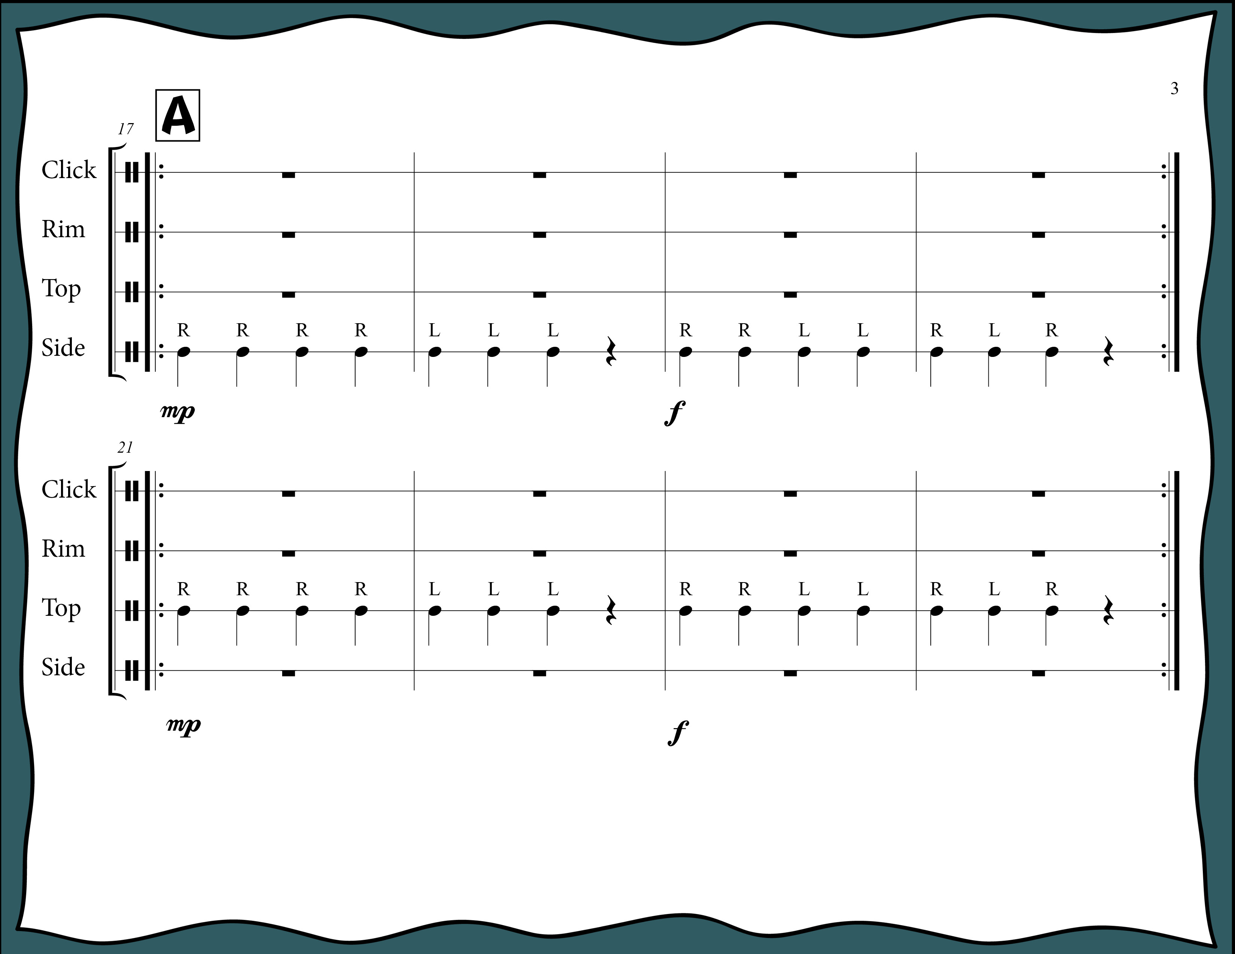
Index

Slide 19
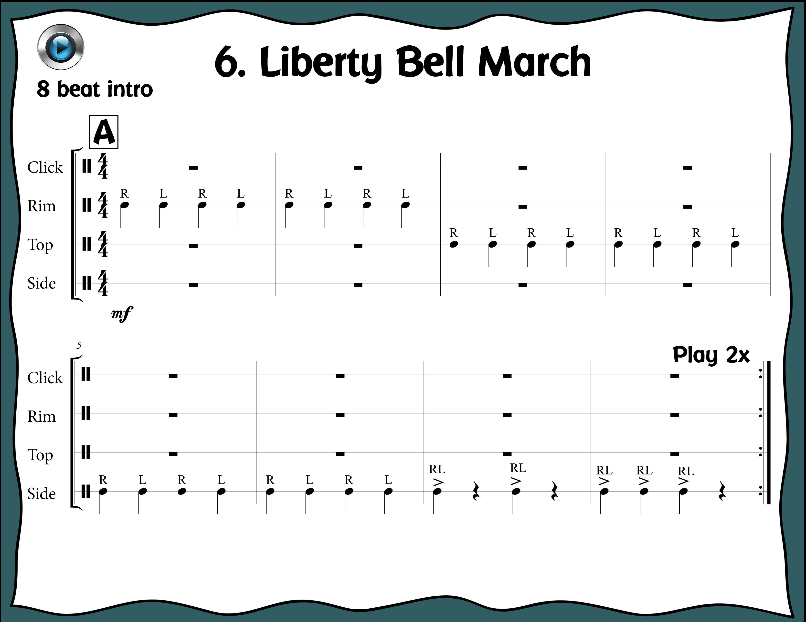
Index

Slide 20
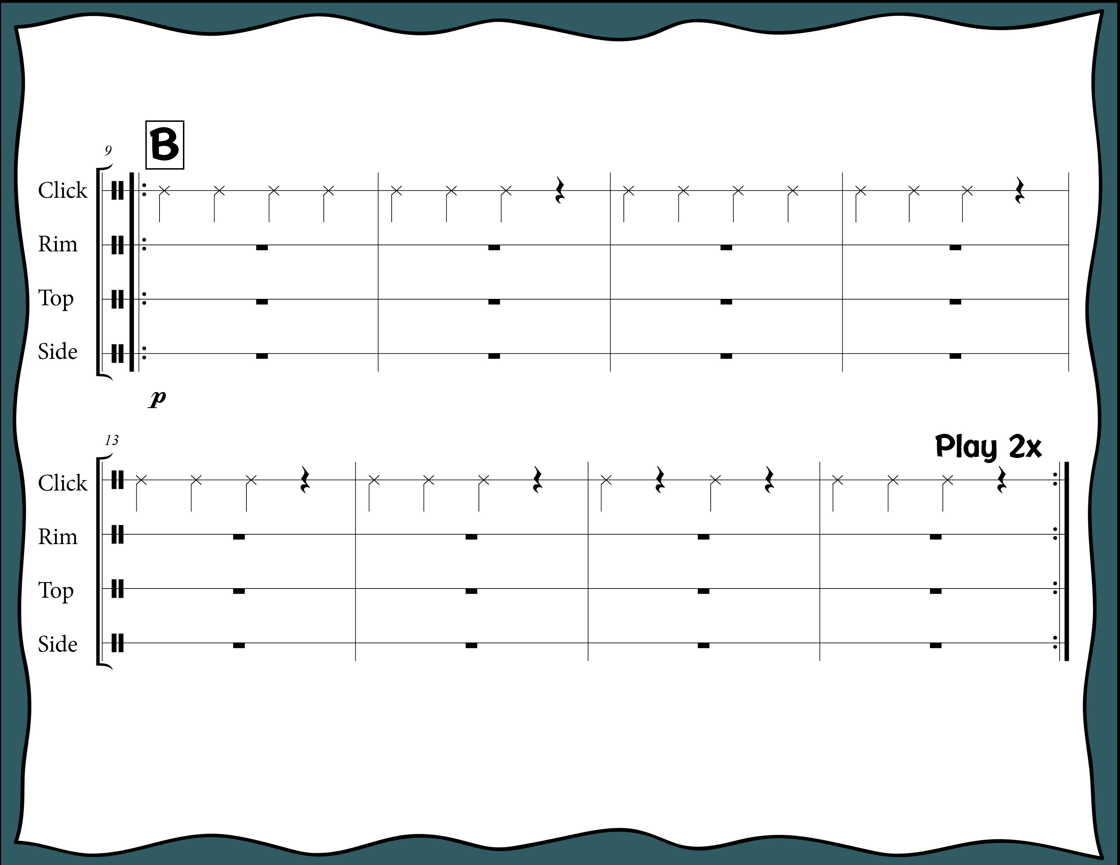
Index

Slide 21
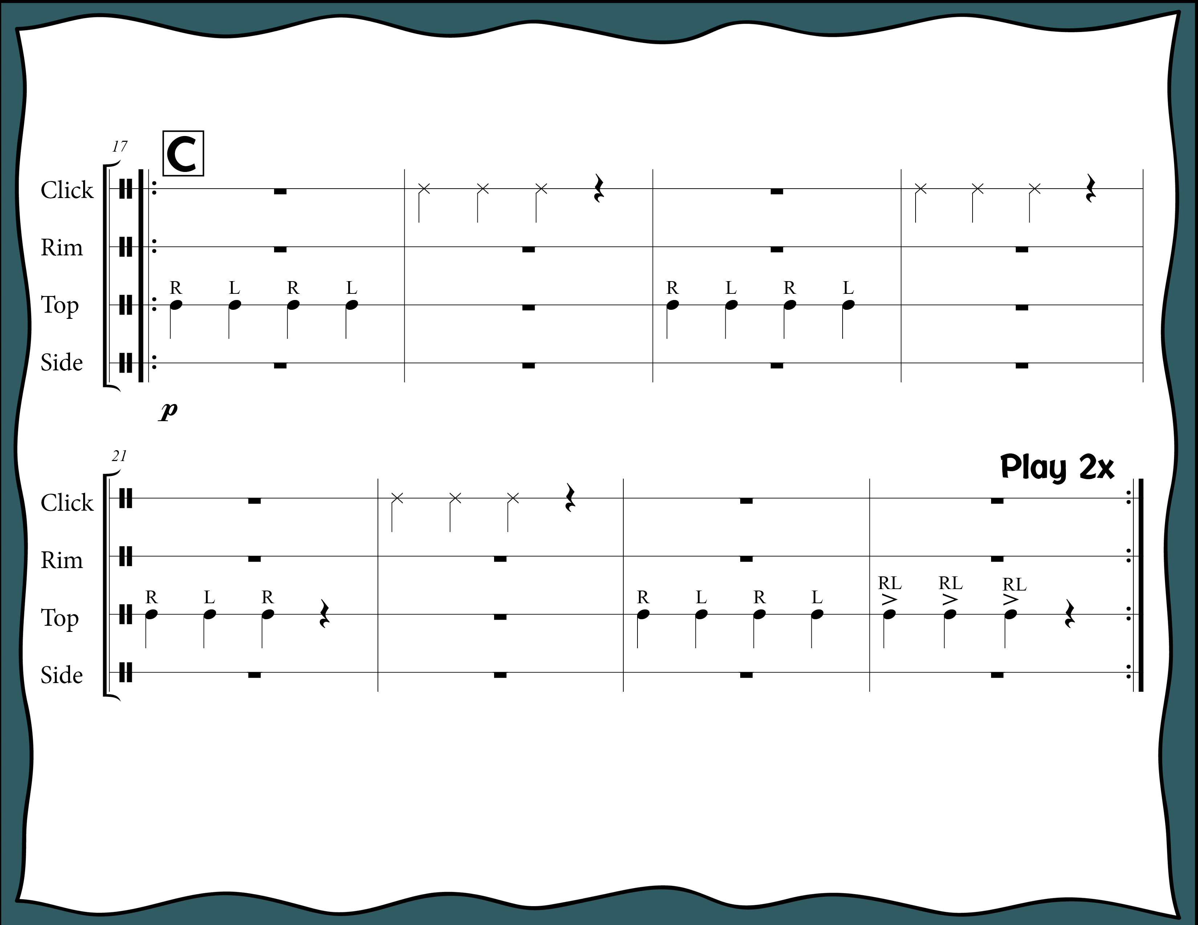
Index

Slide 22
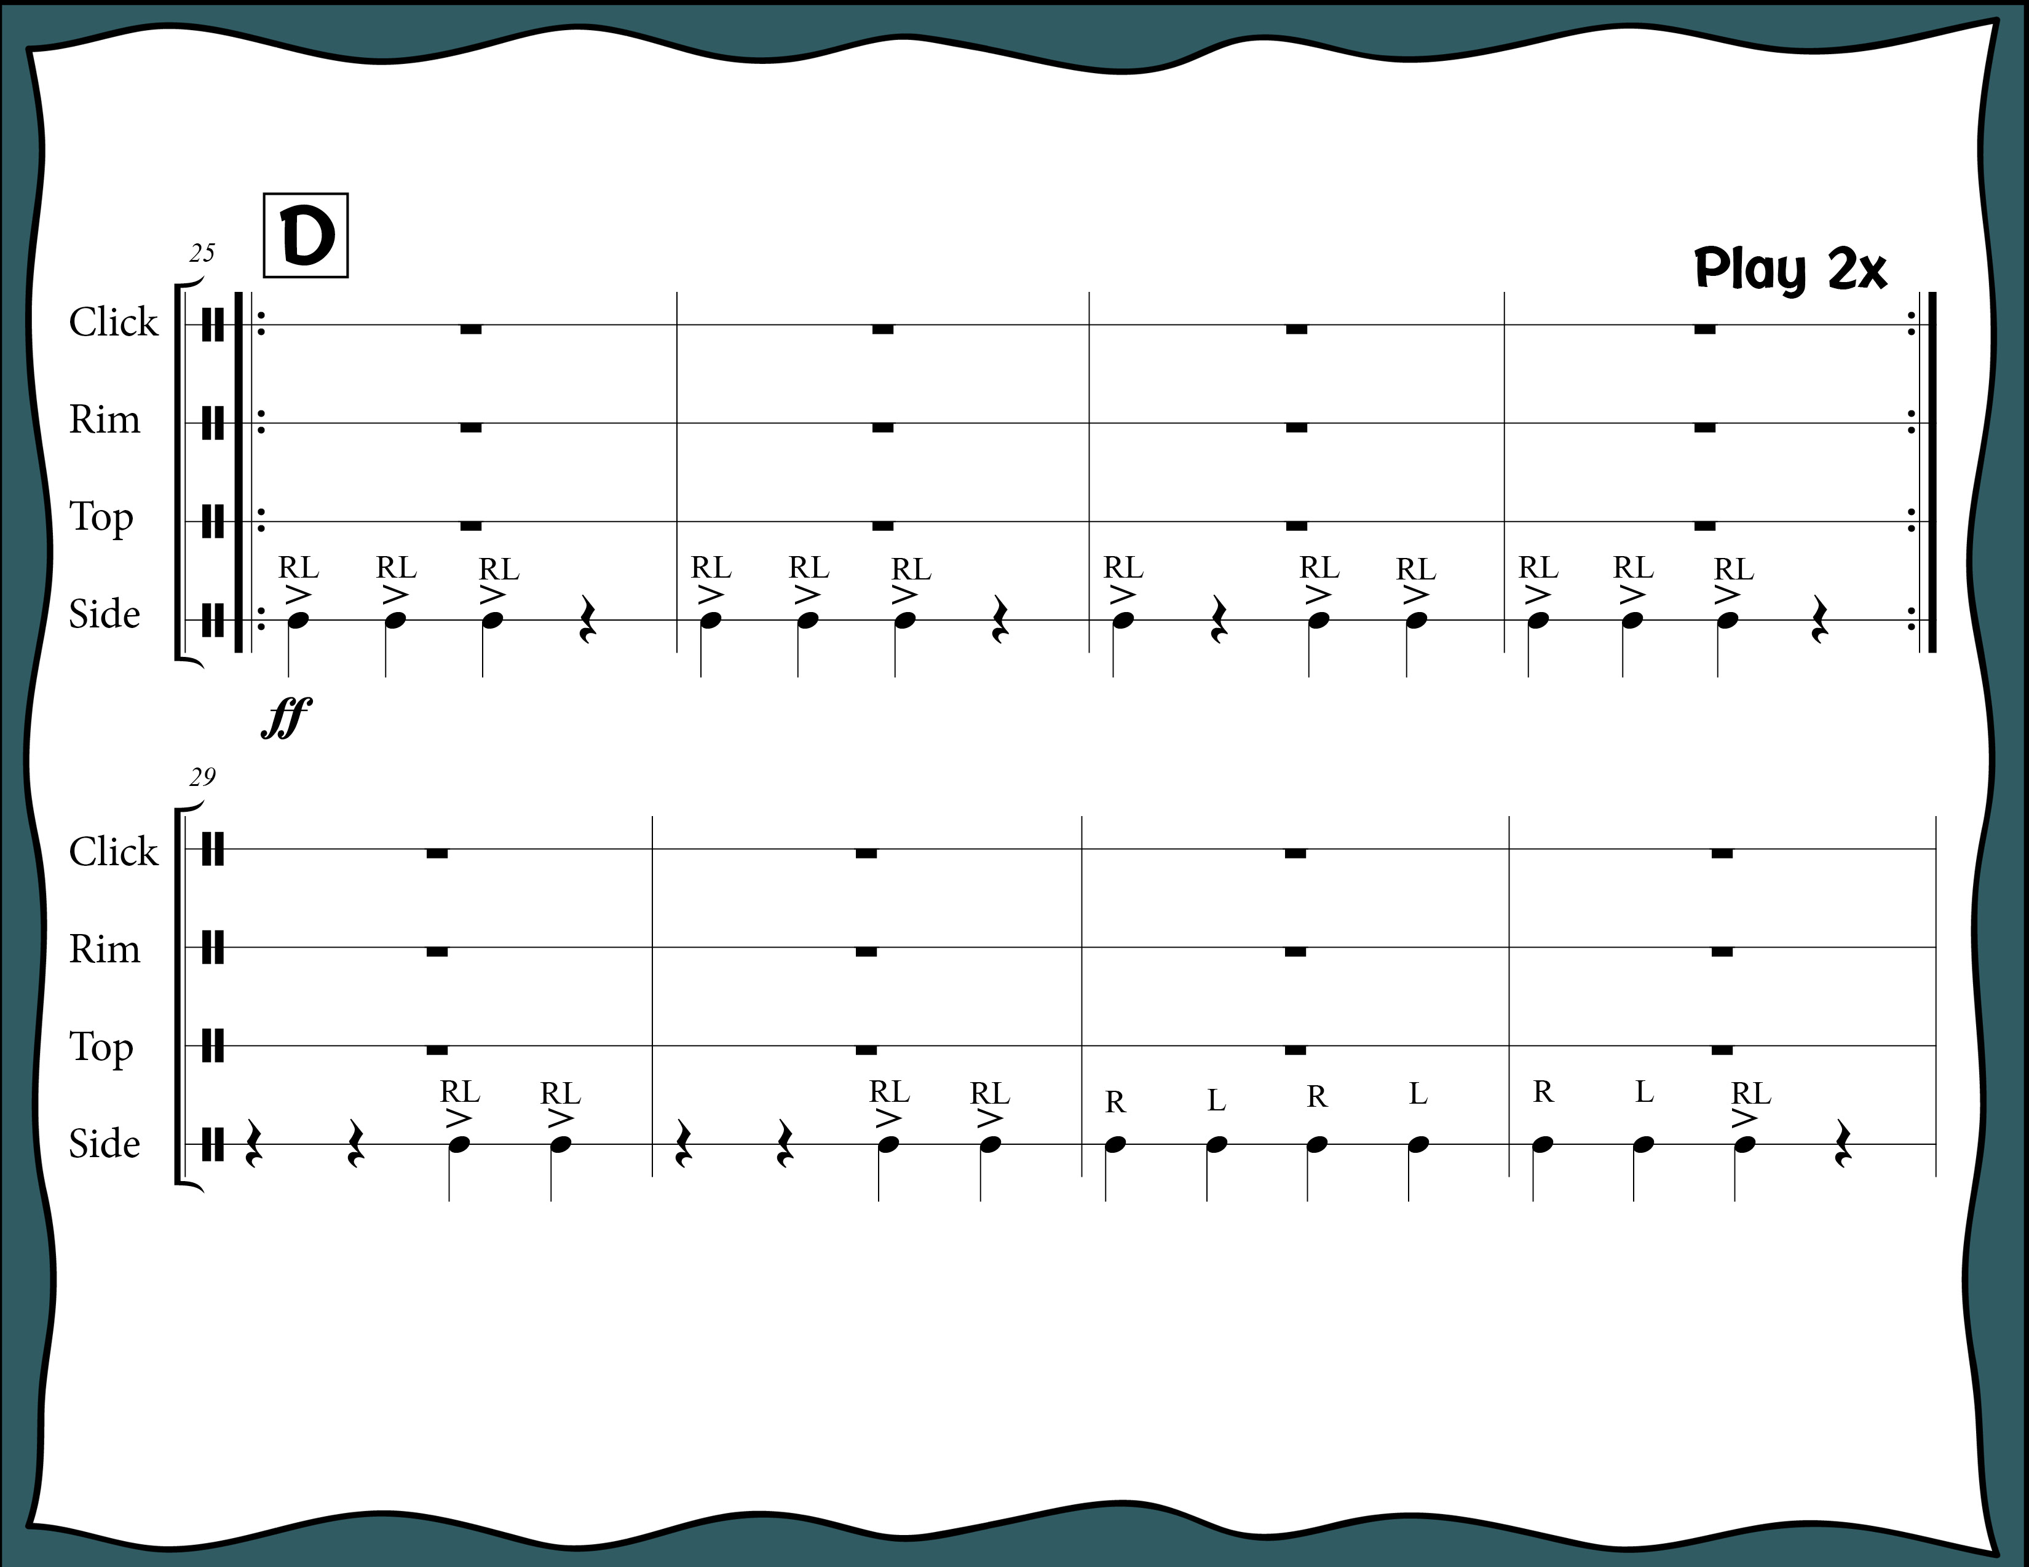
Index

Slide 23
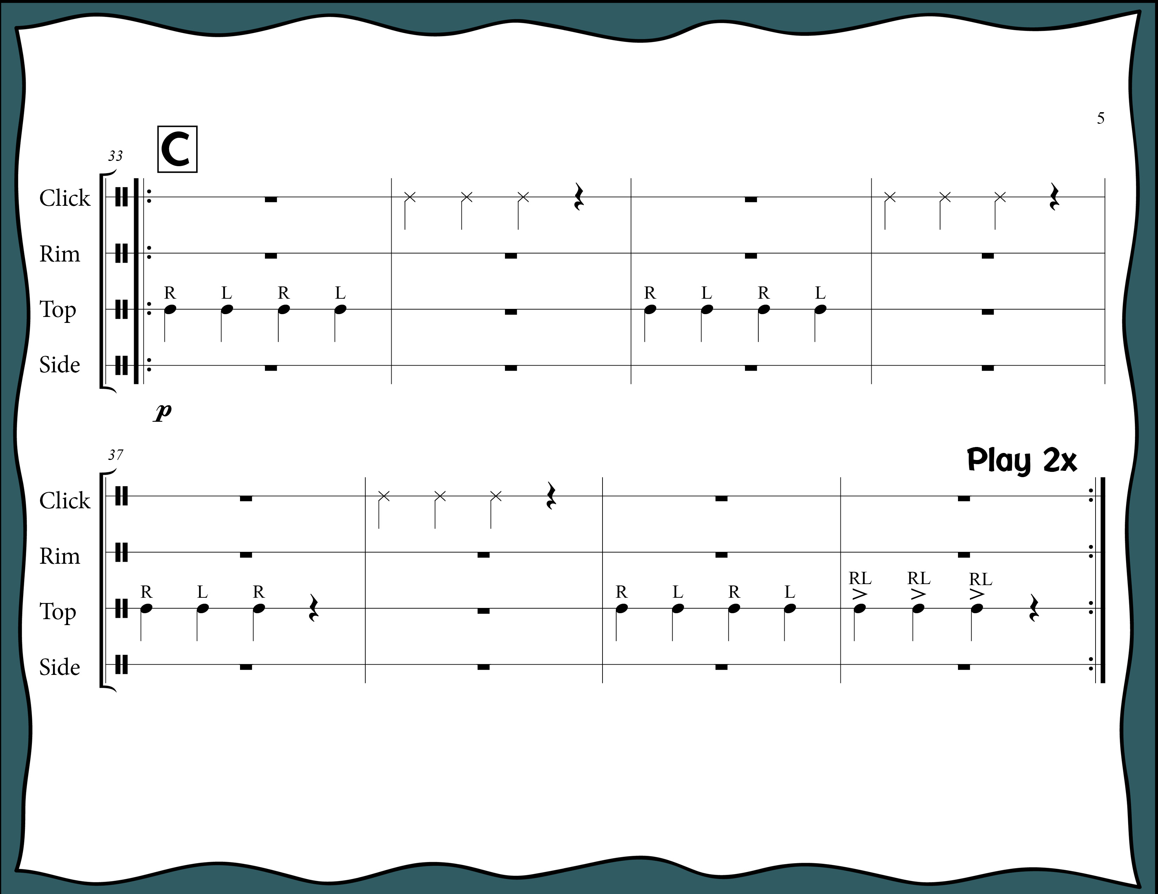
Index

Slide 24
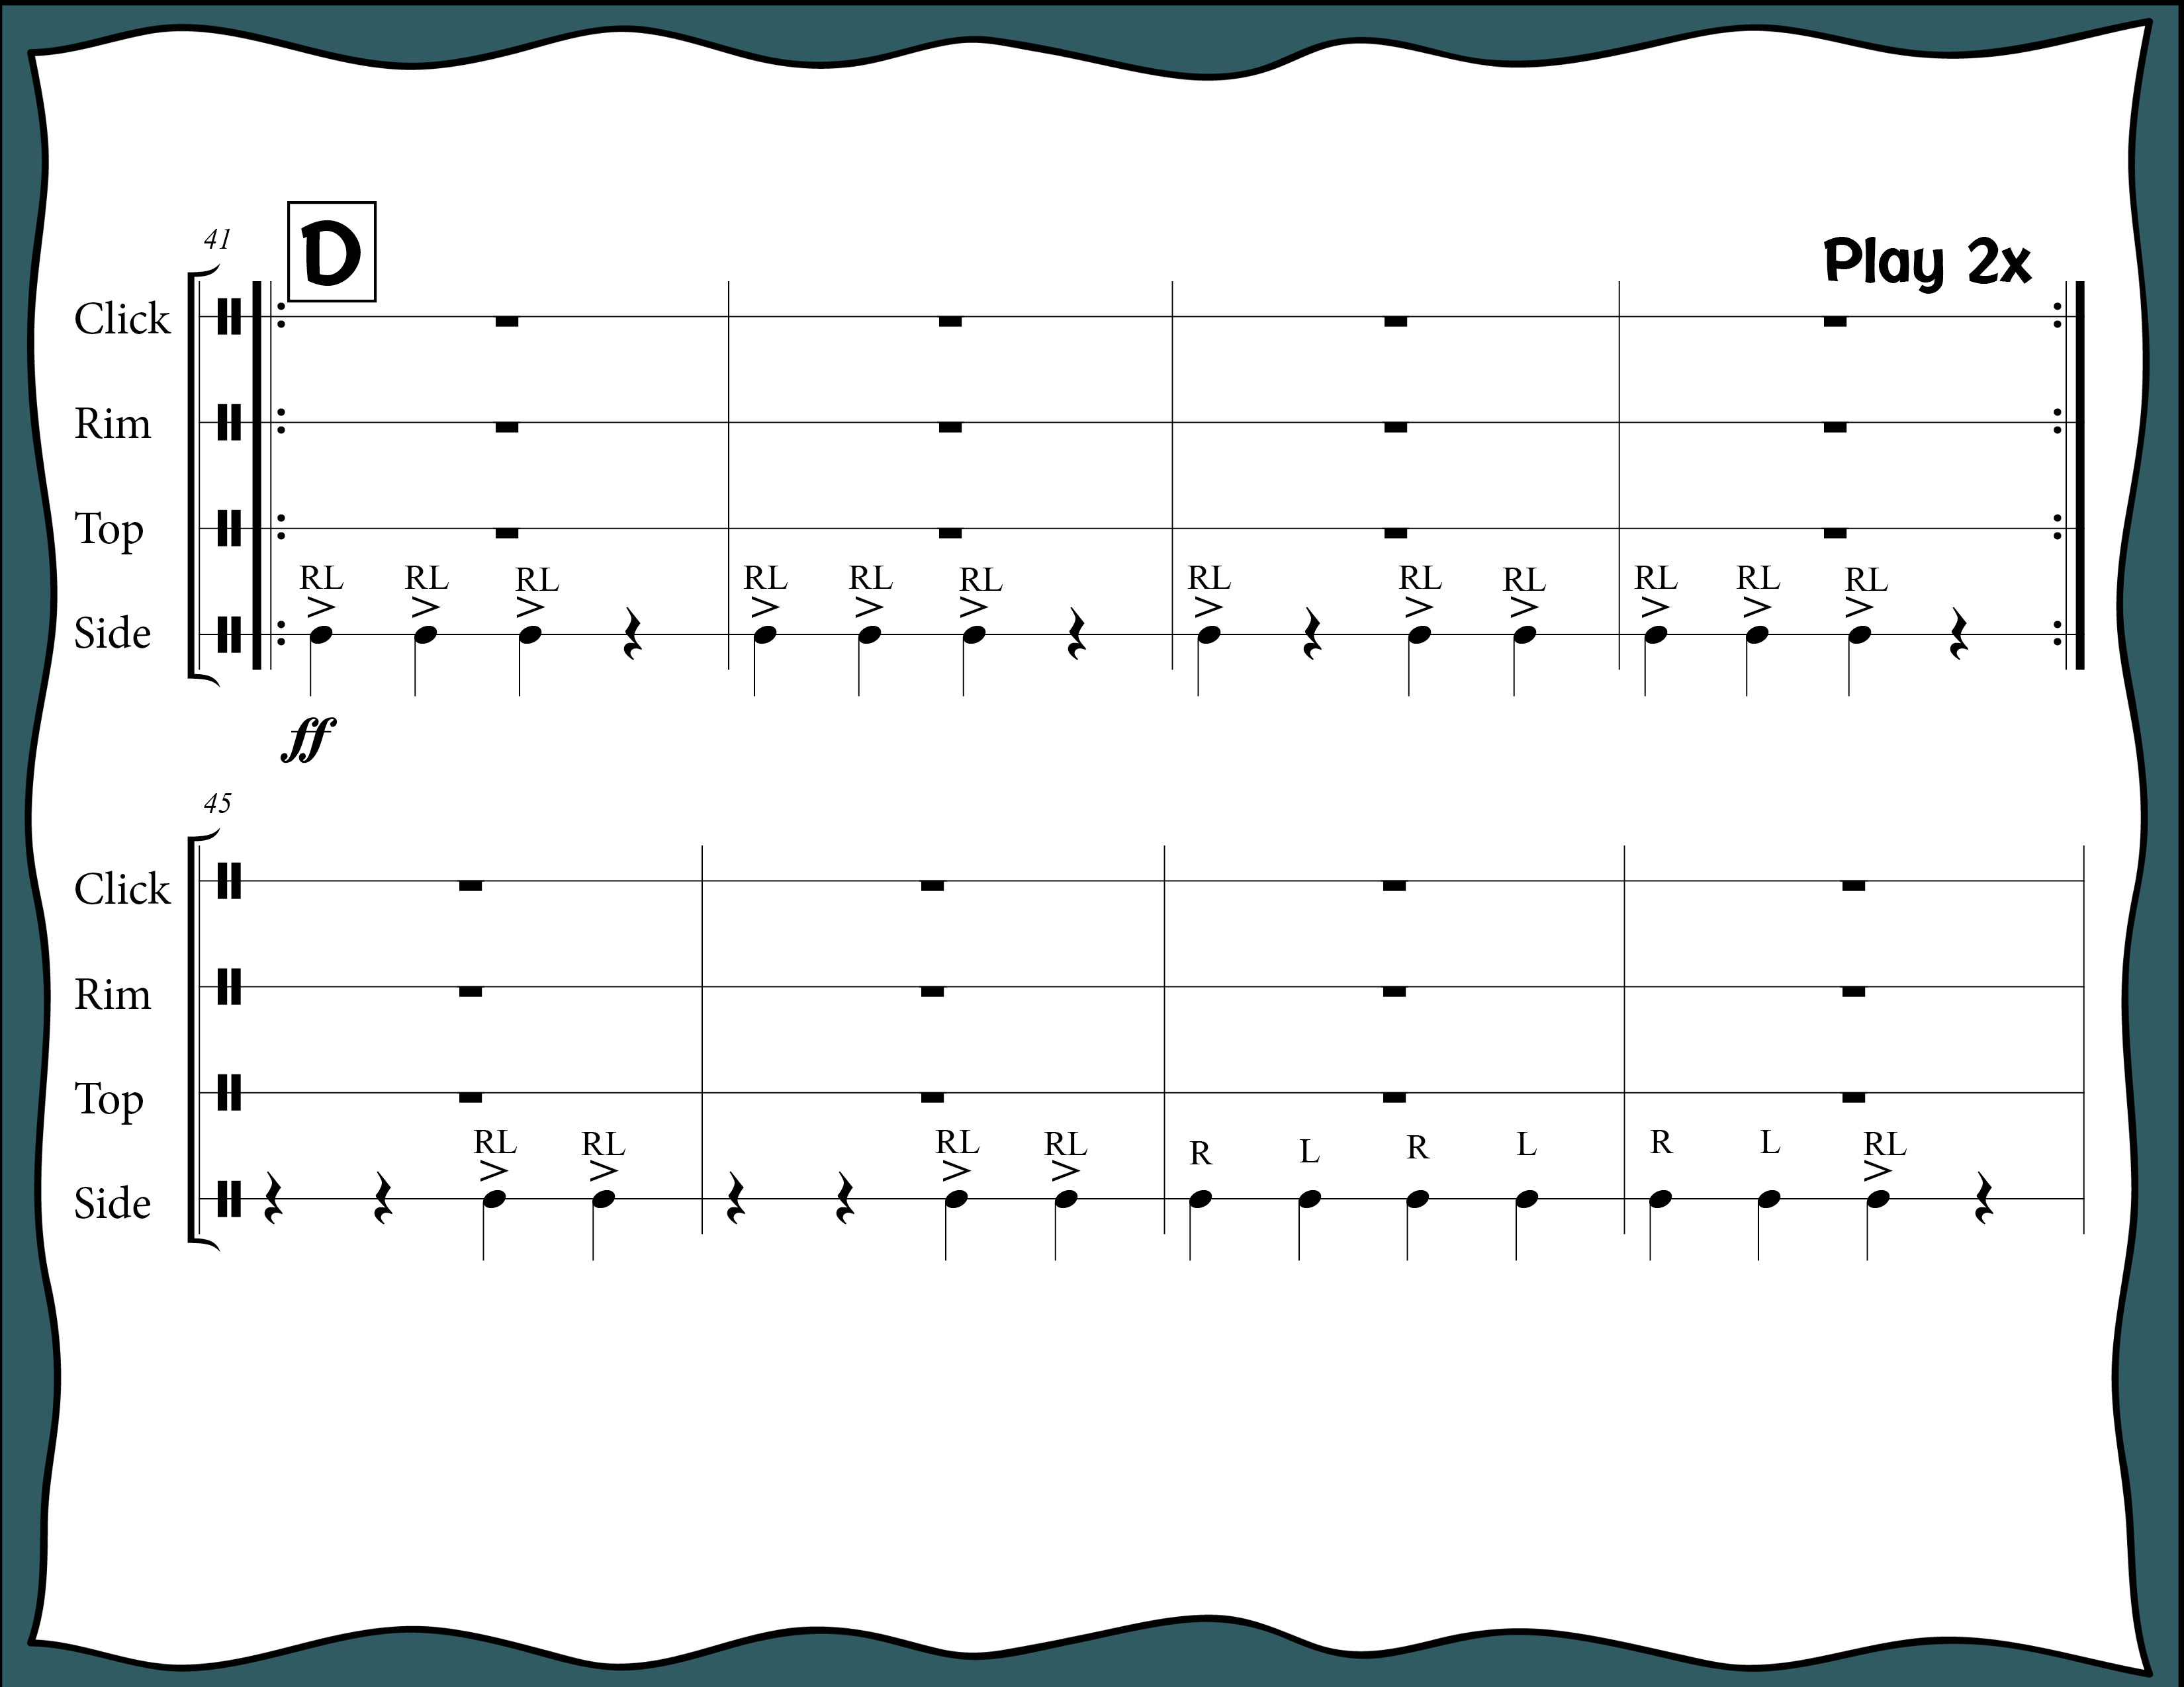
Index

Slide 25

Index

Slide 26
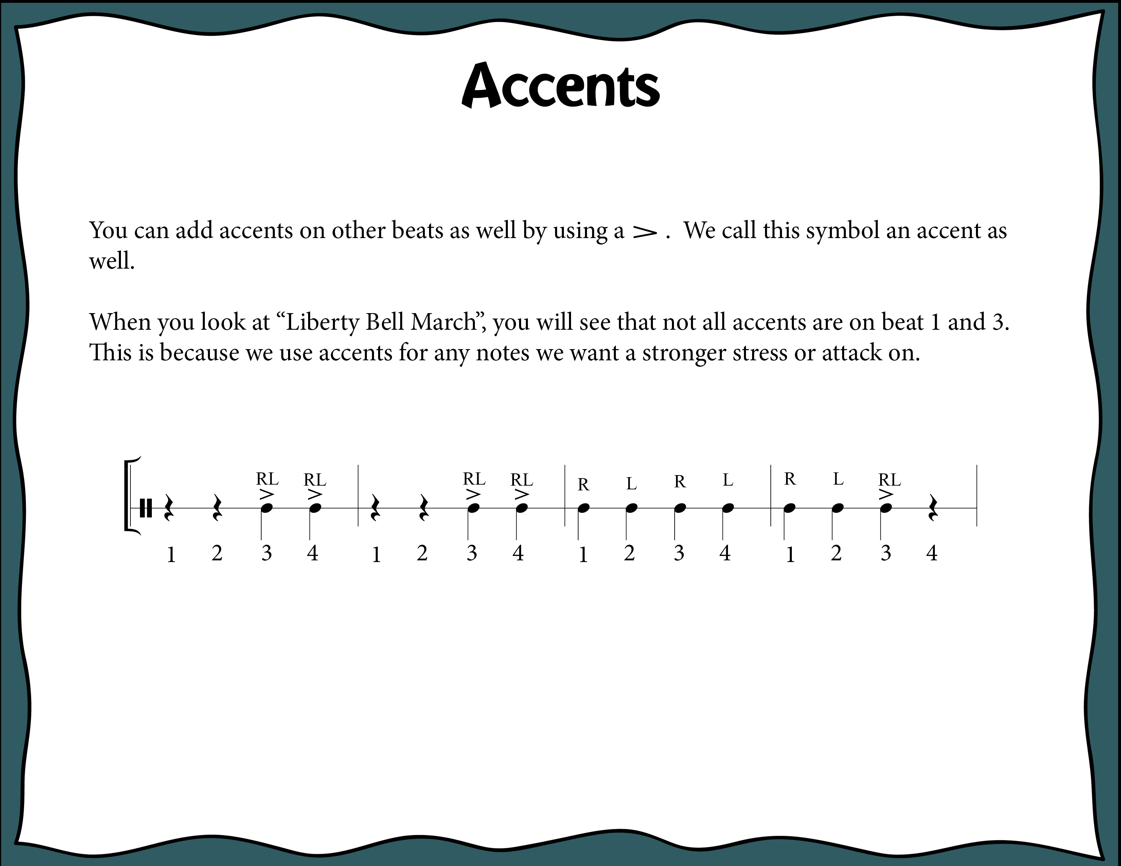
Index

Slide 27
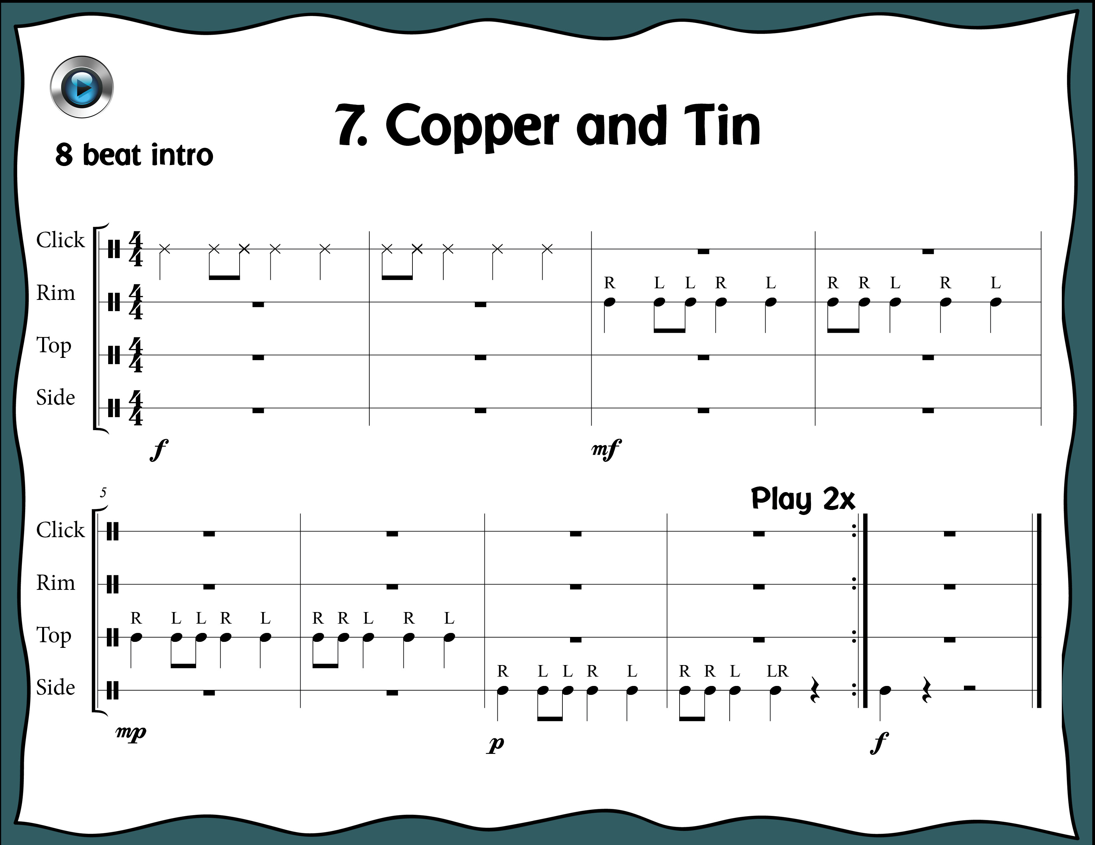
Index

Slide 28
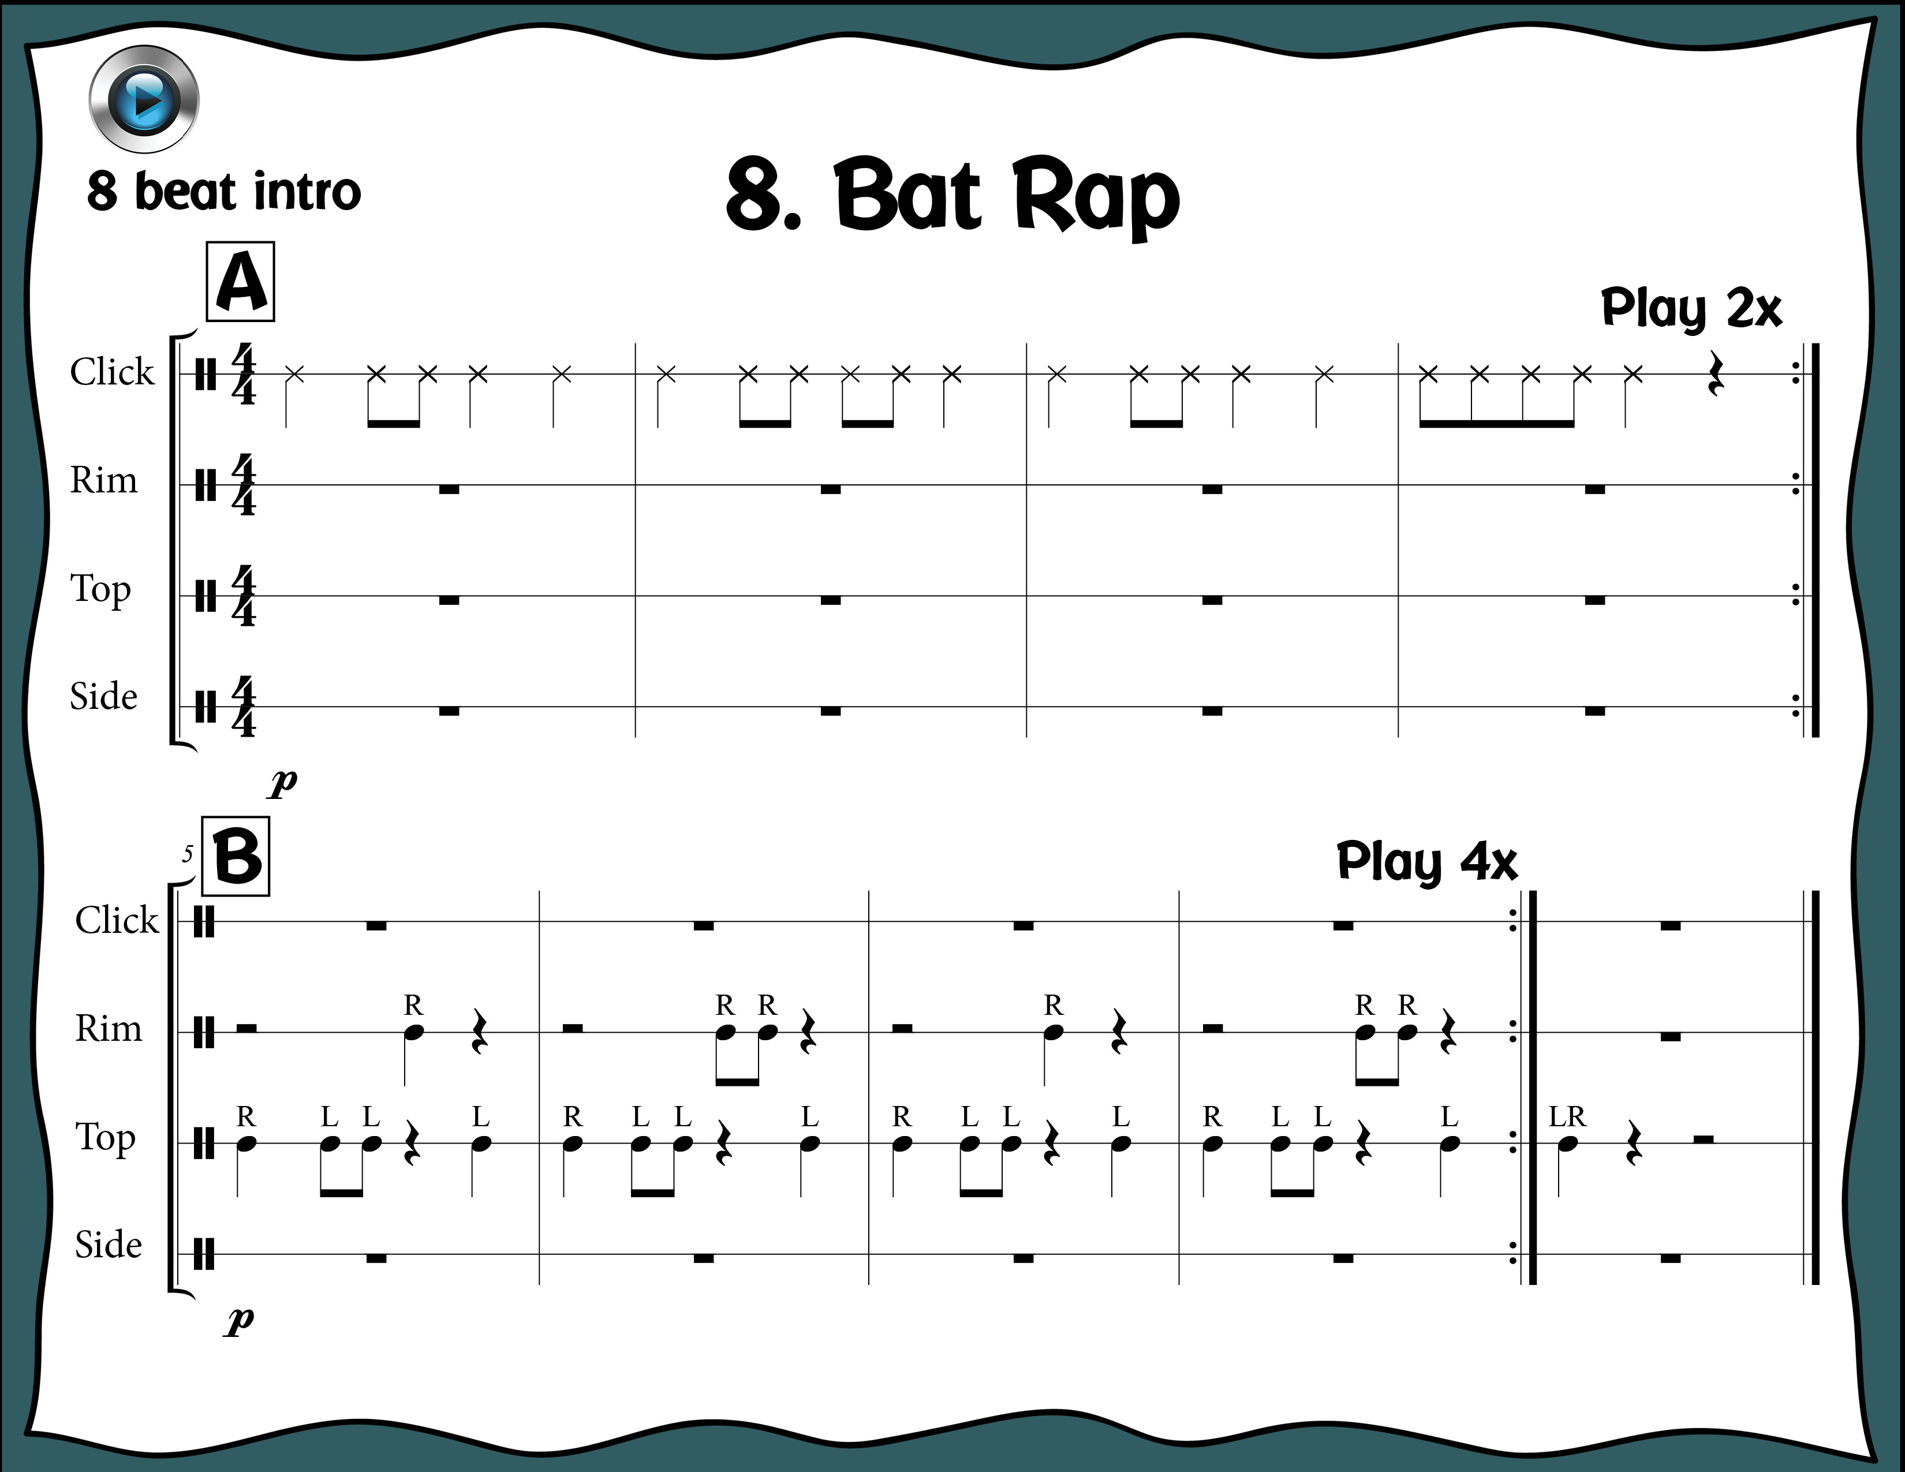
Index

Slide 29
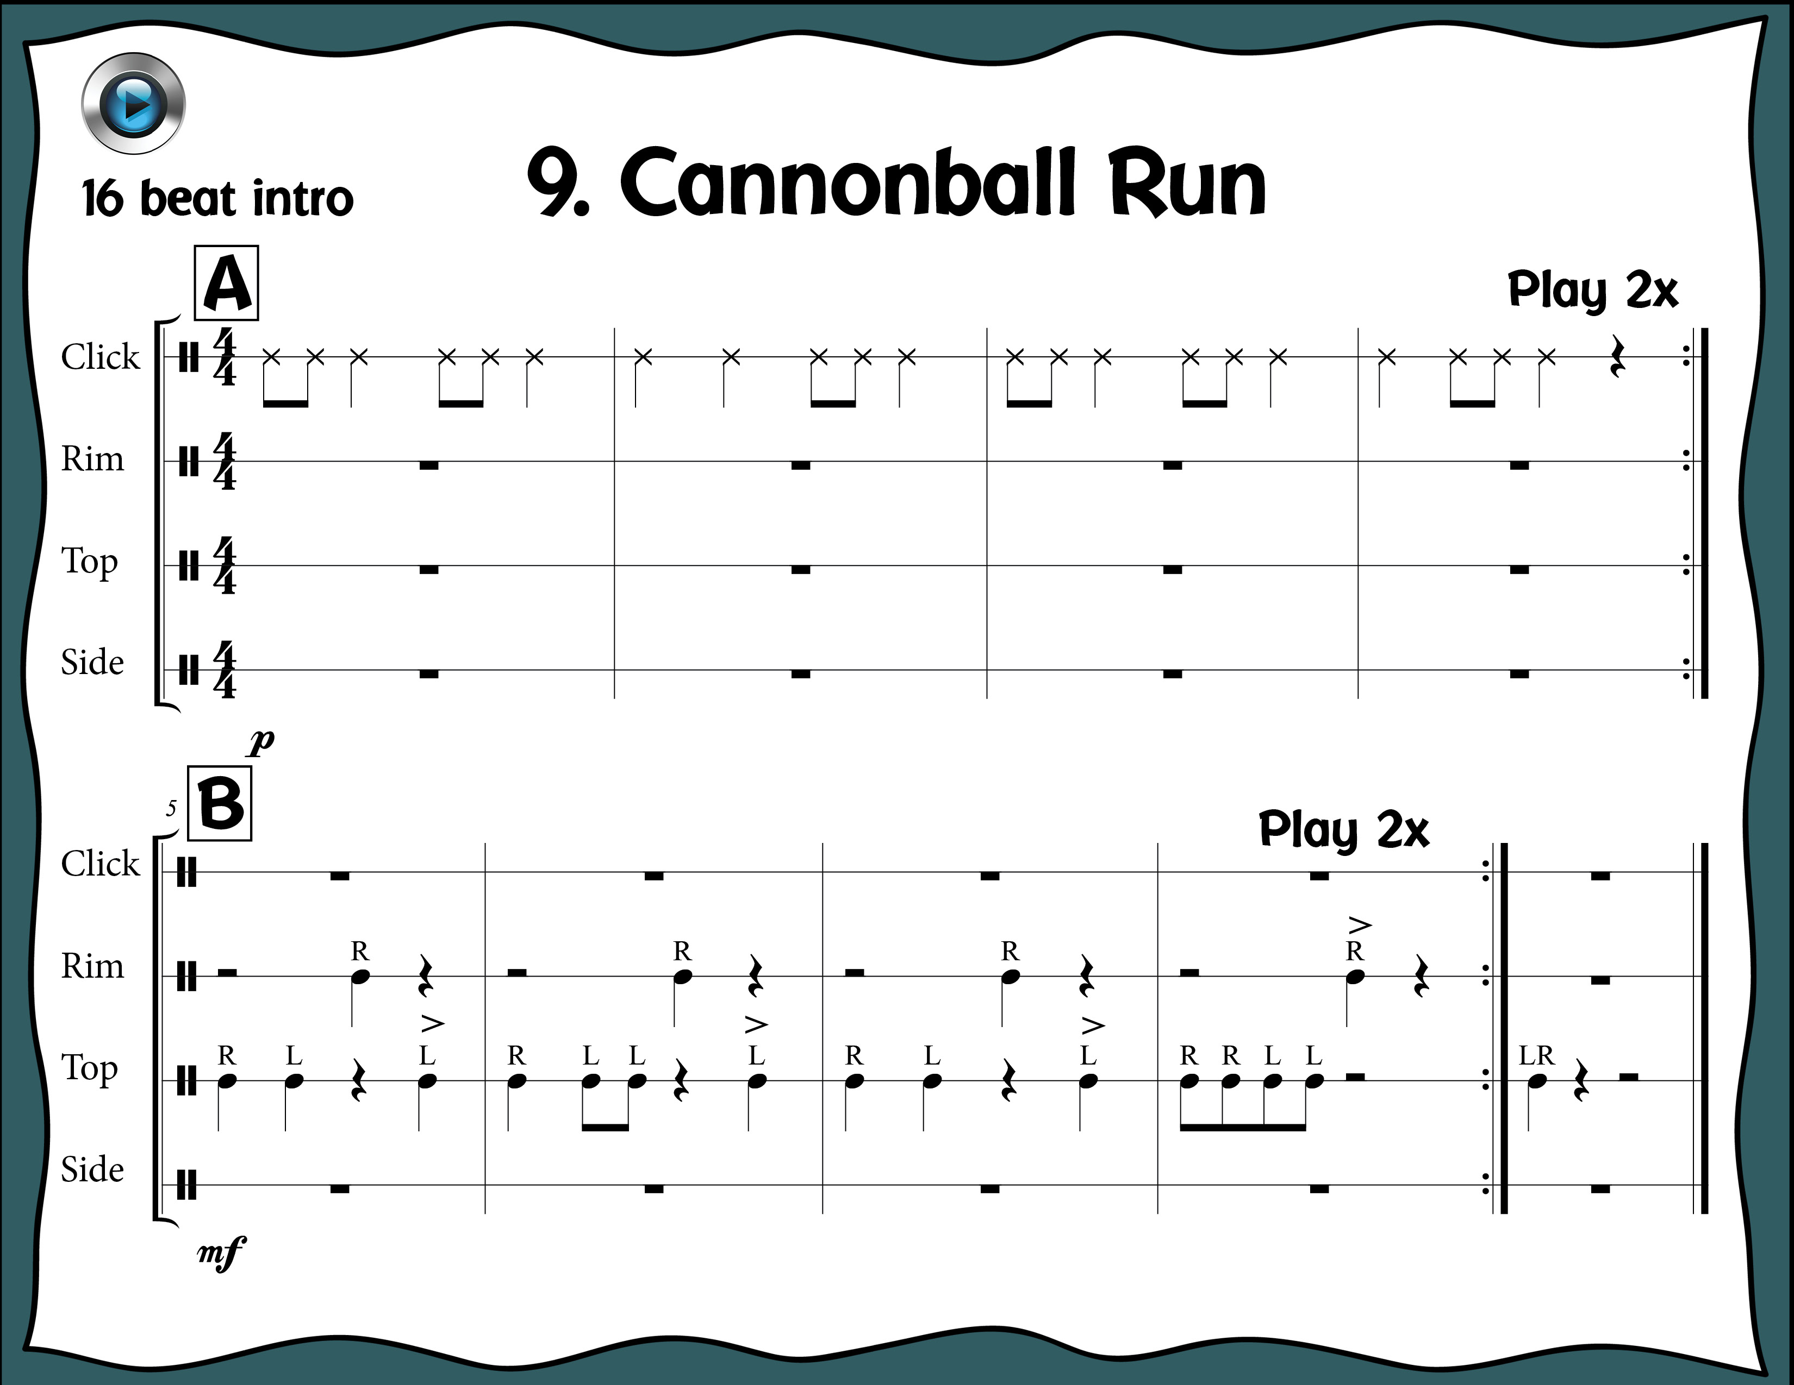
Index

Slide 30
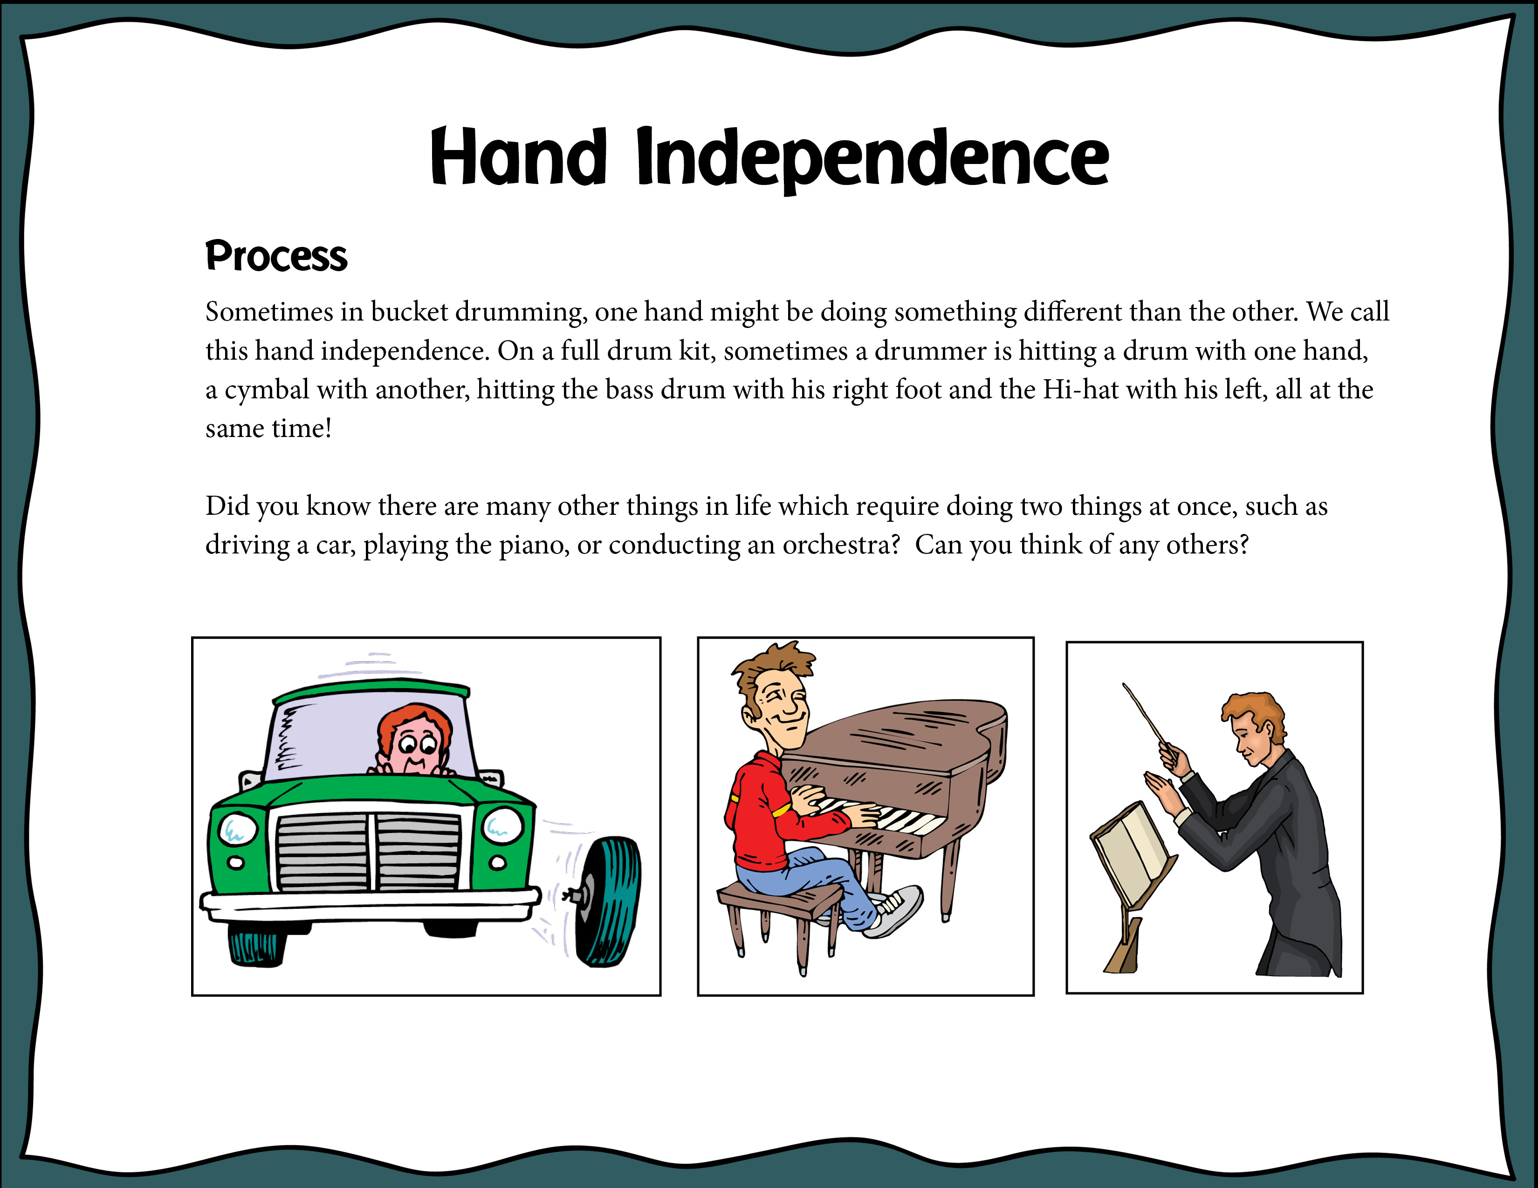
Index

Slide 31
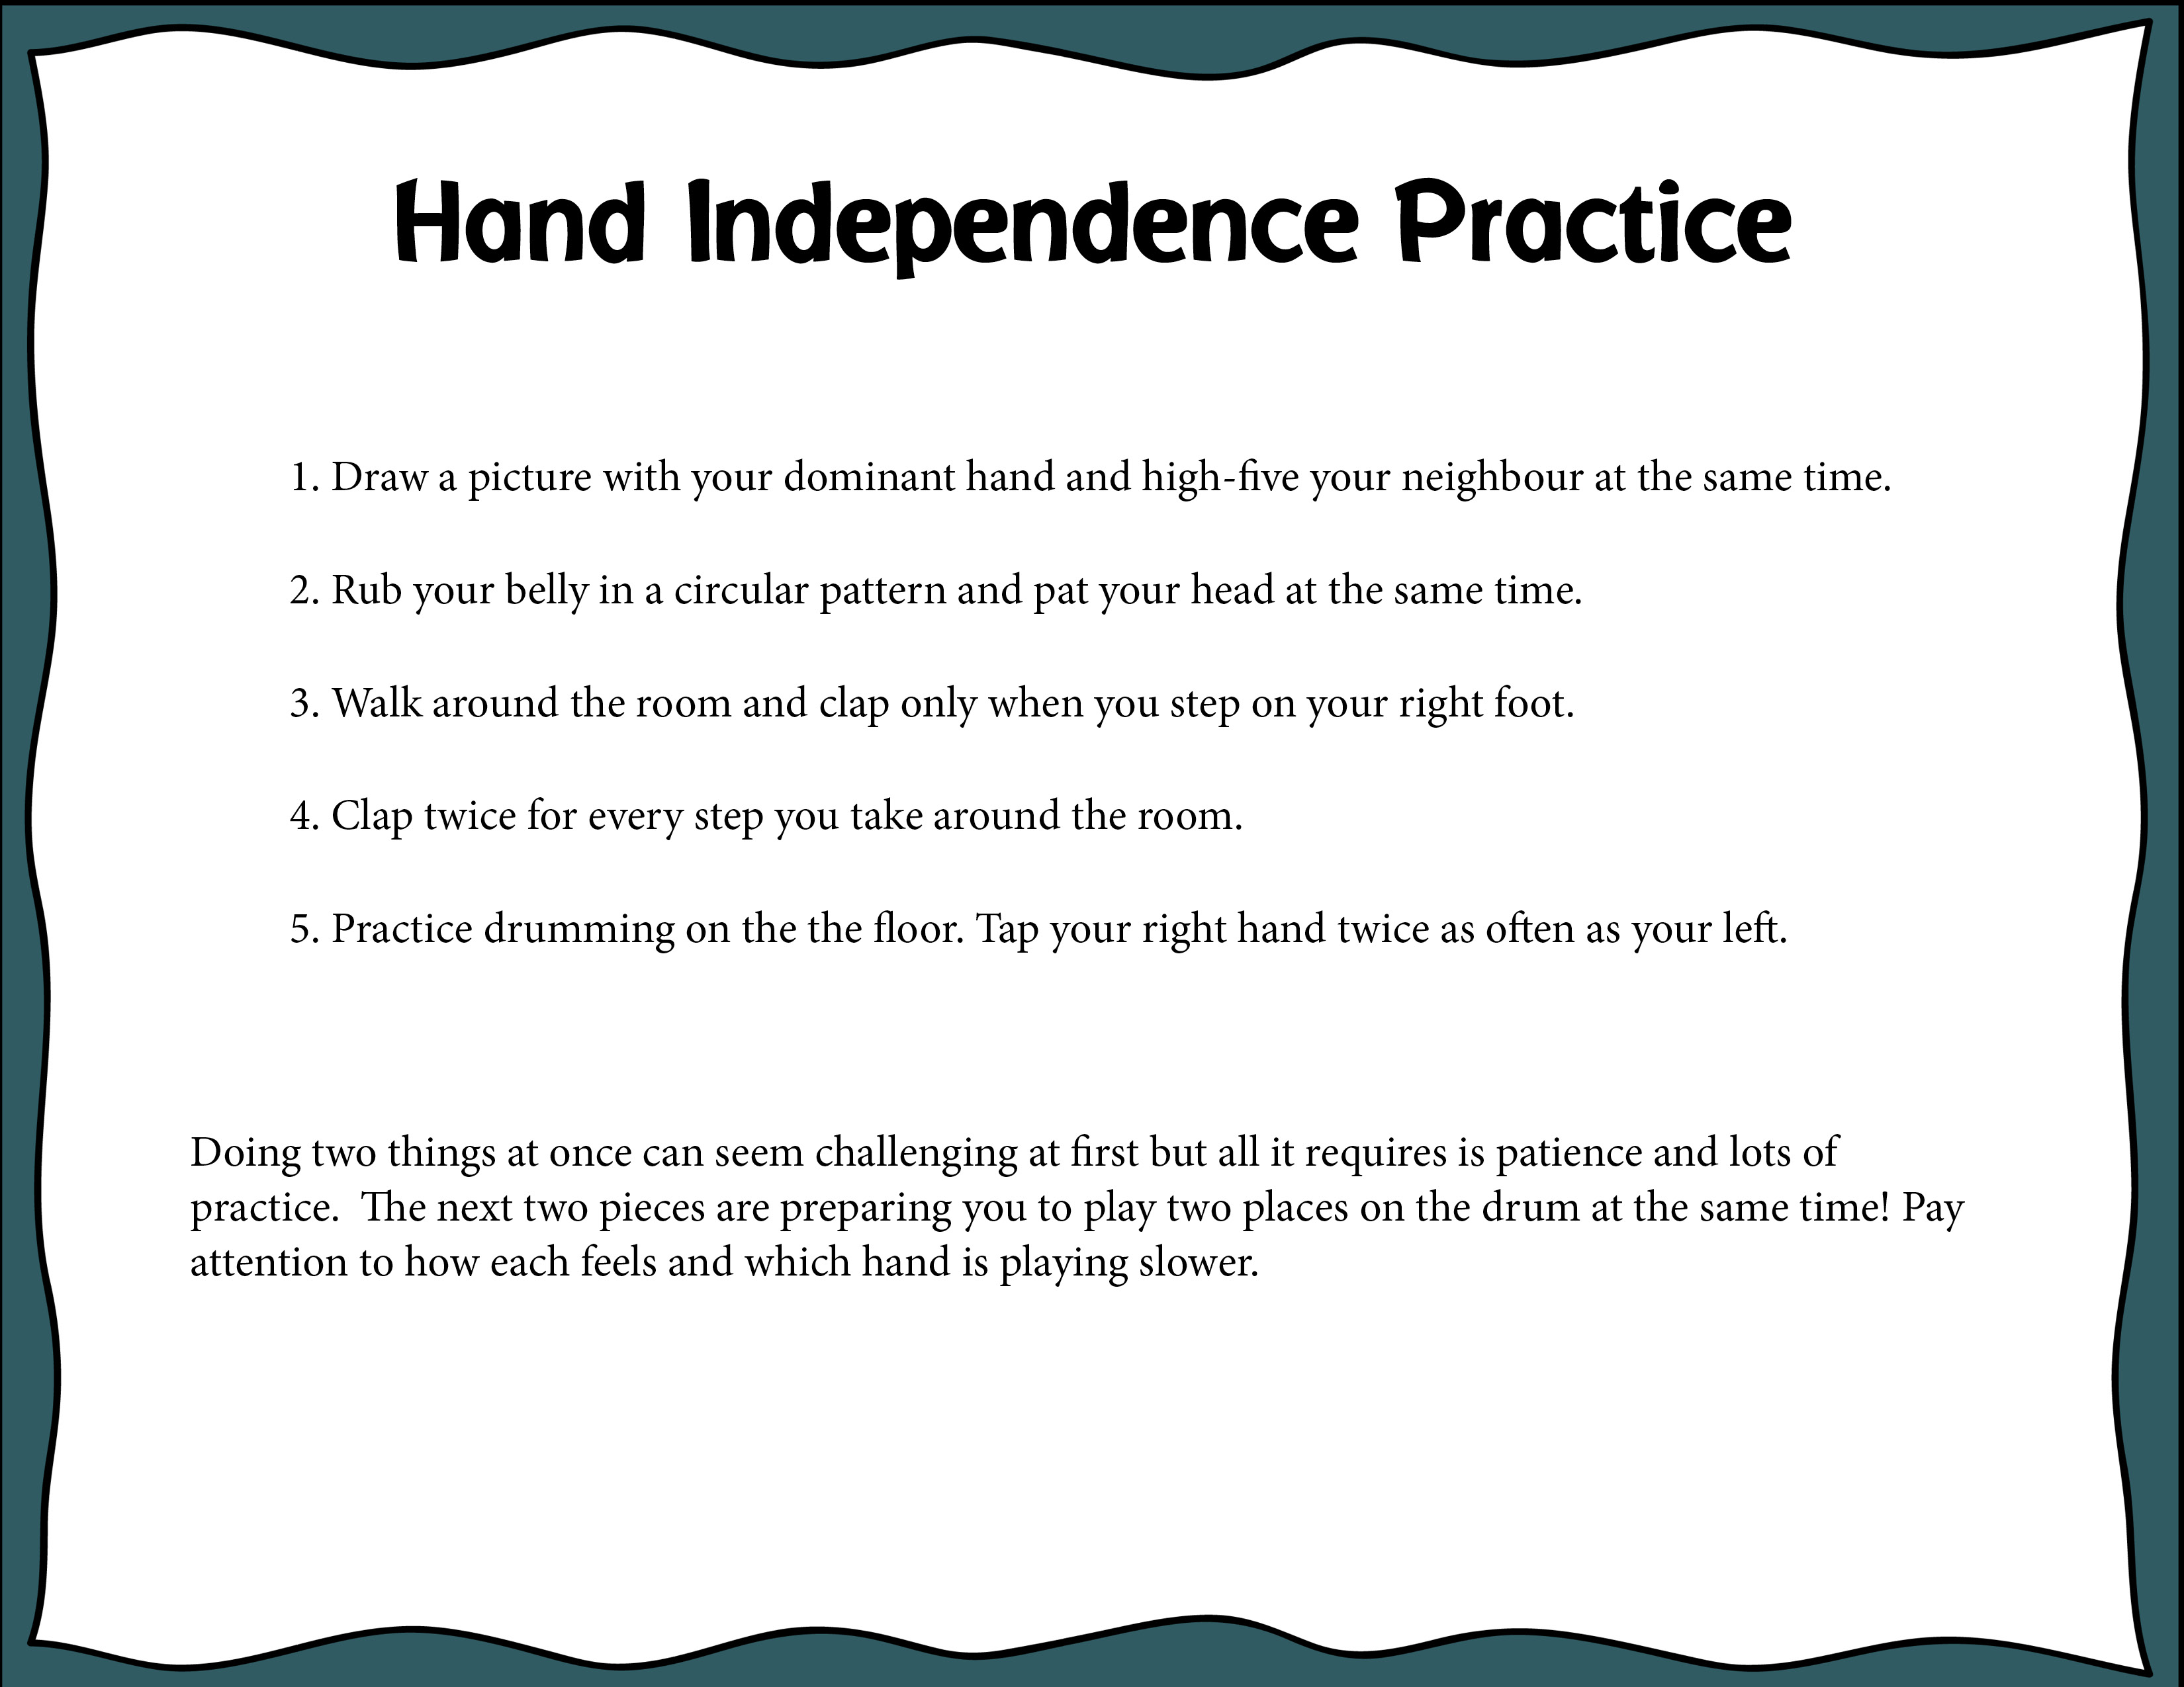
Index

Slide 32
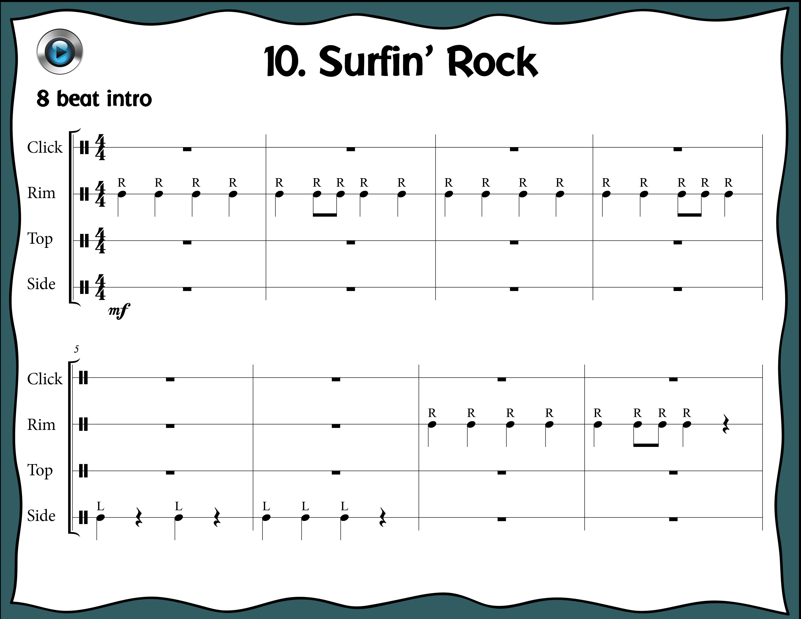
Index

Slide 33
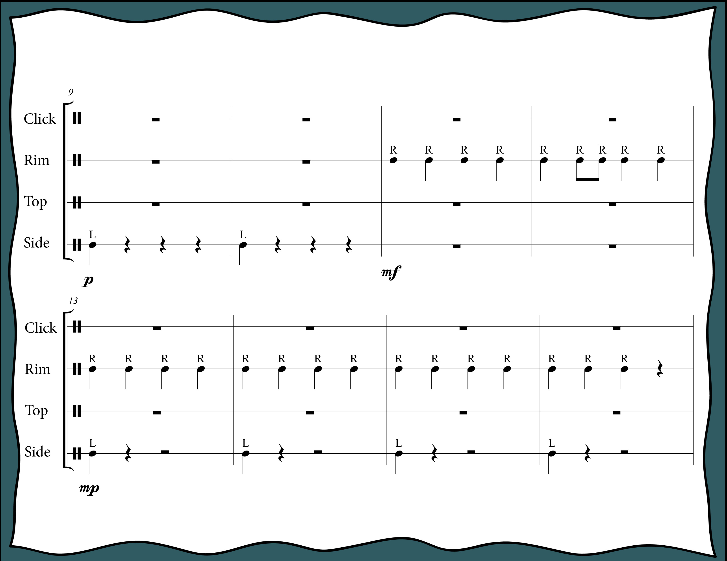
Index

Slide 34
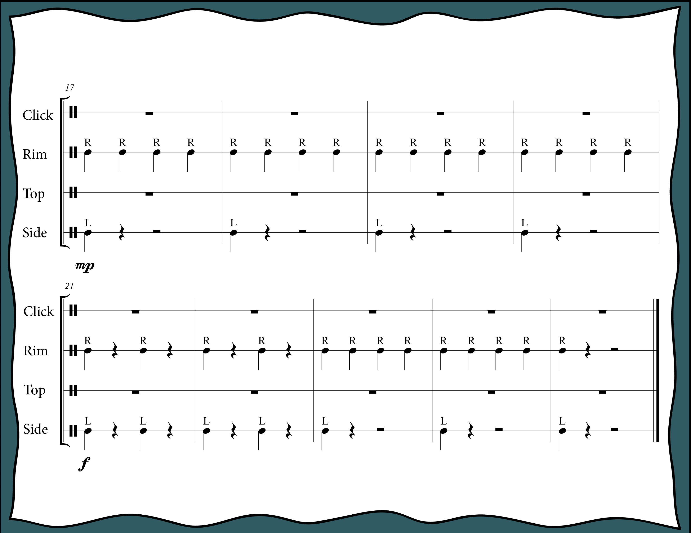
Index

Slide 35
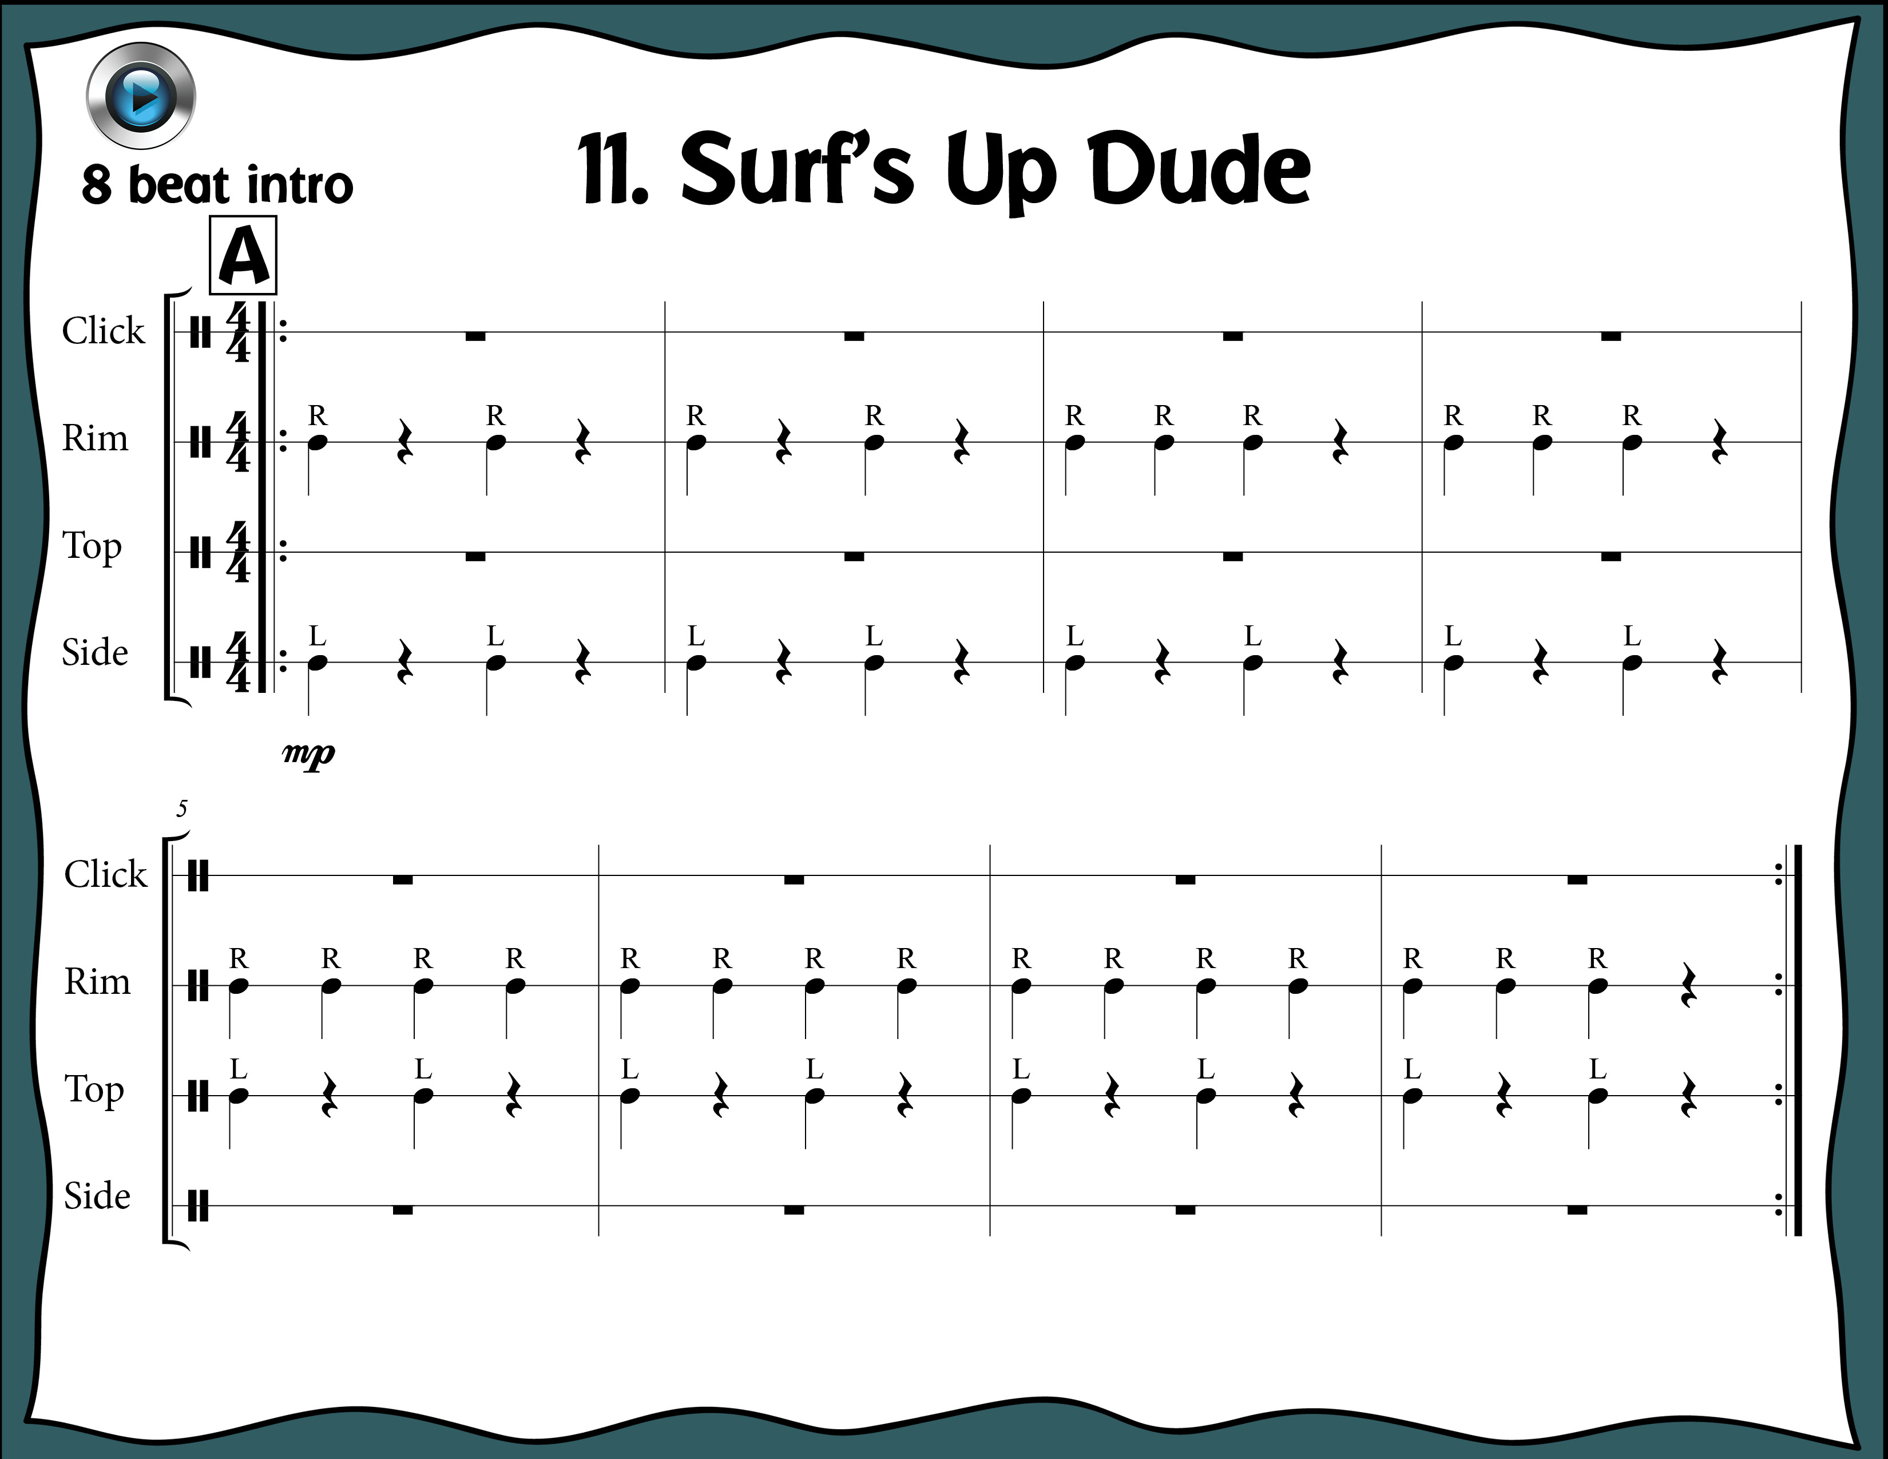
Index

Slide 36
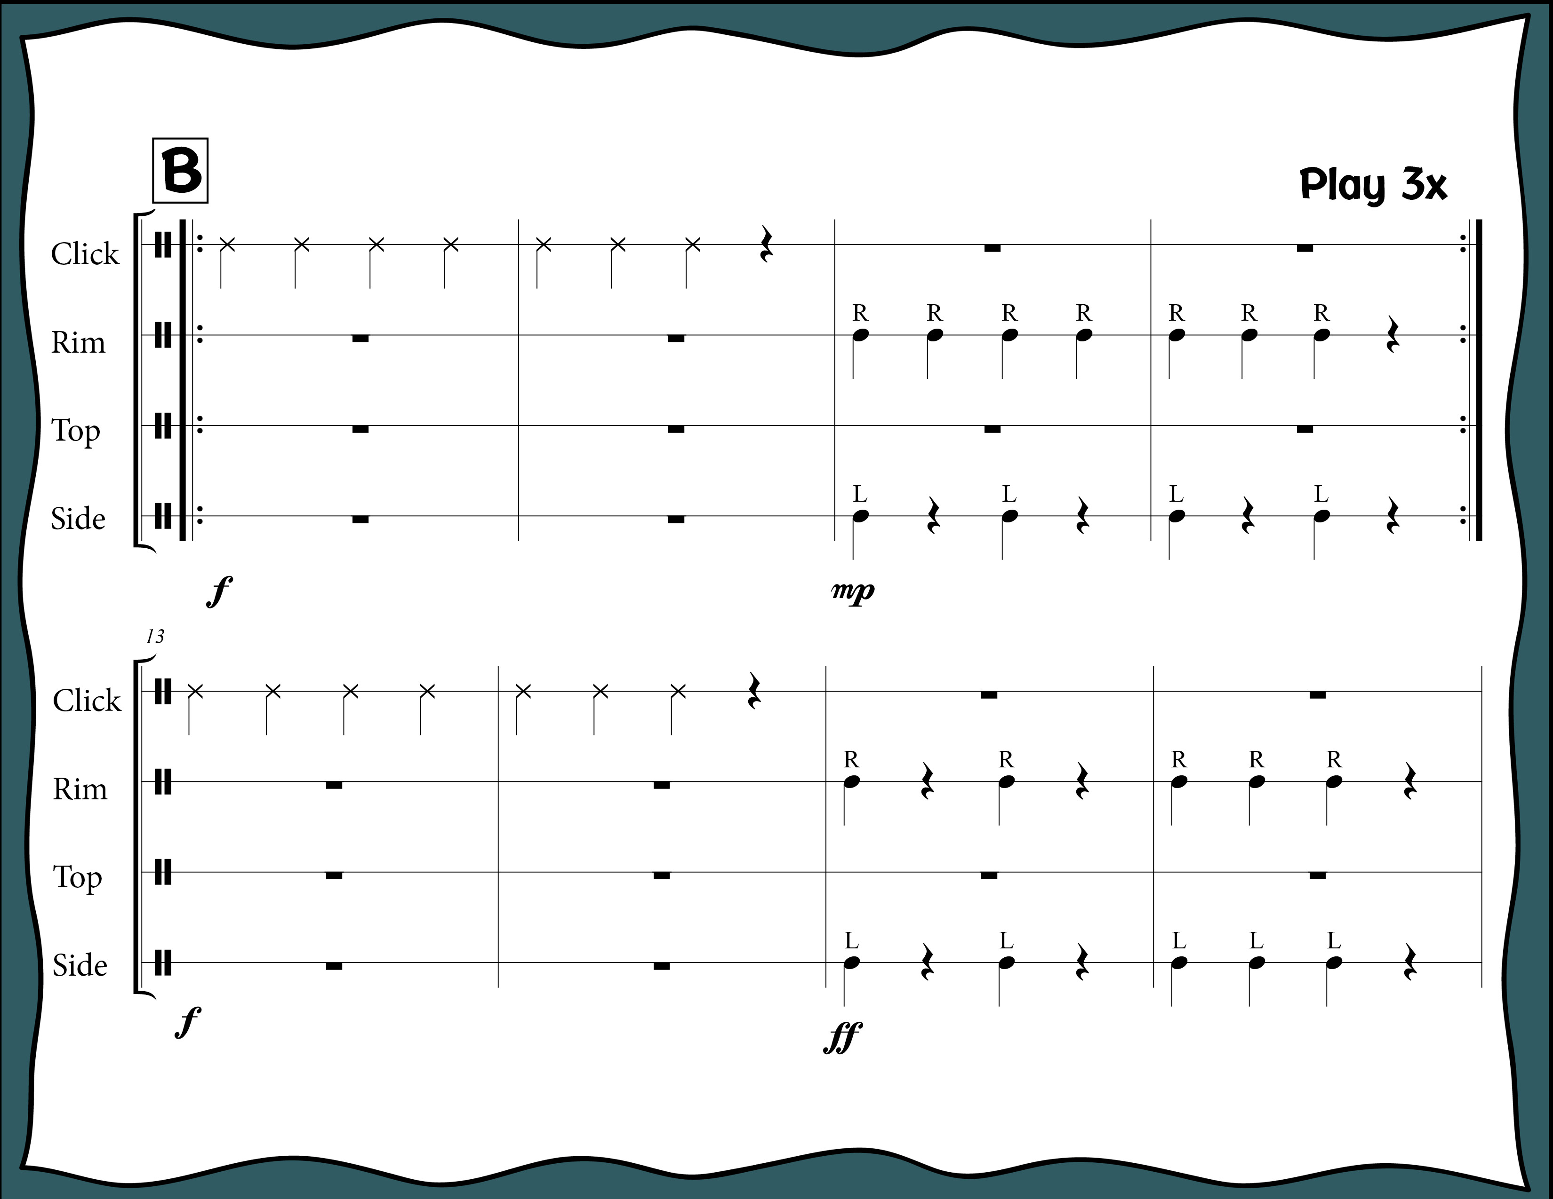
Index

Slide 37
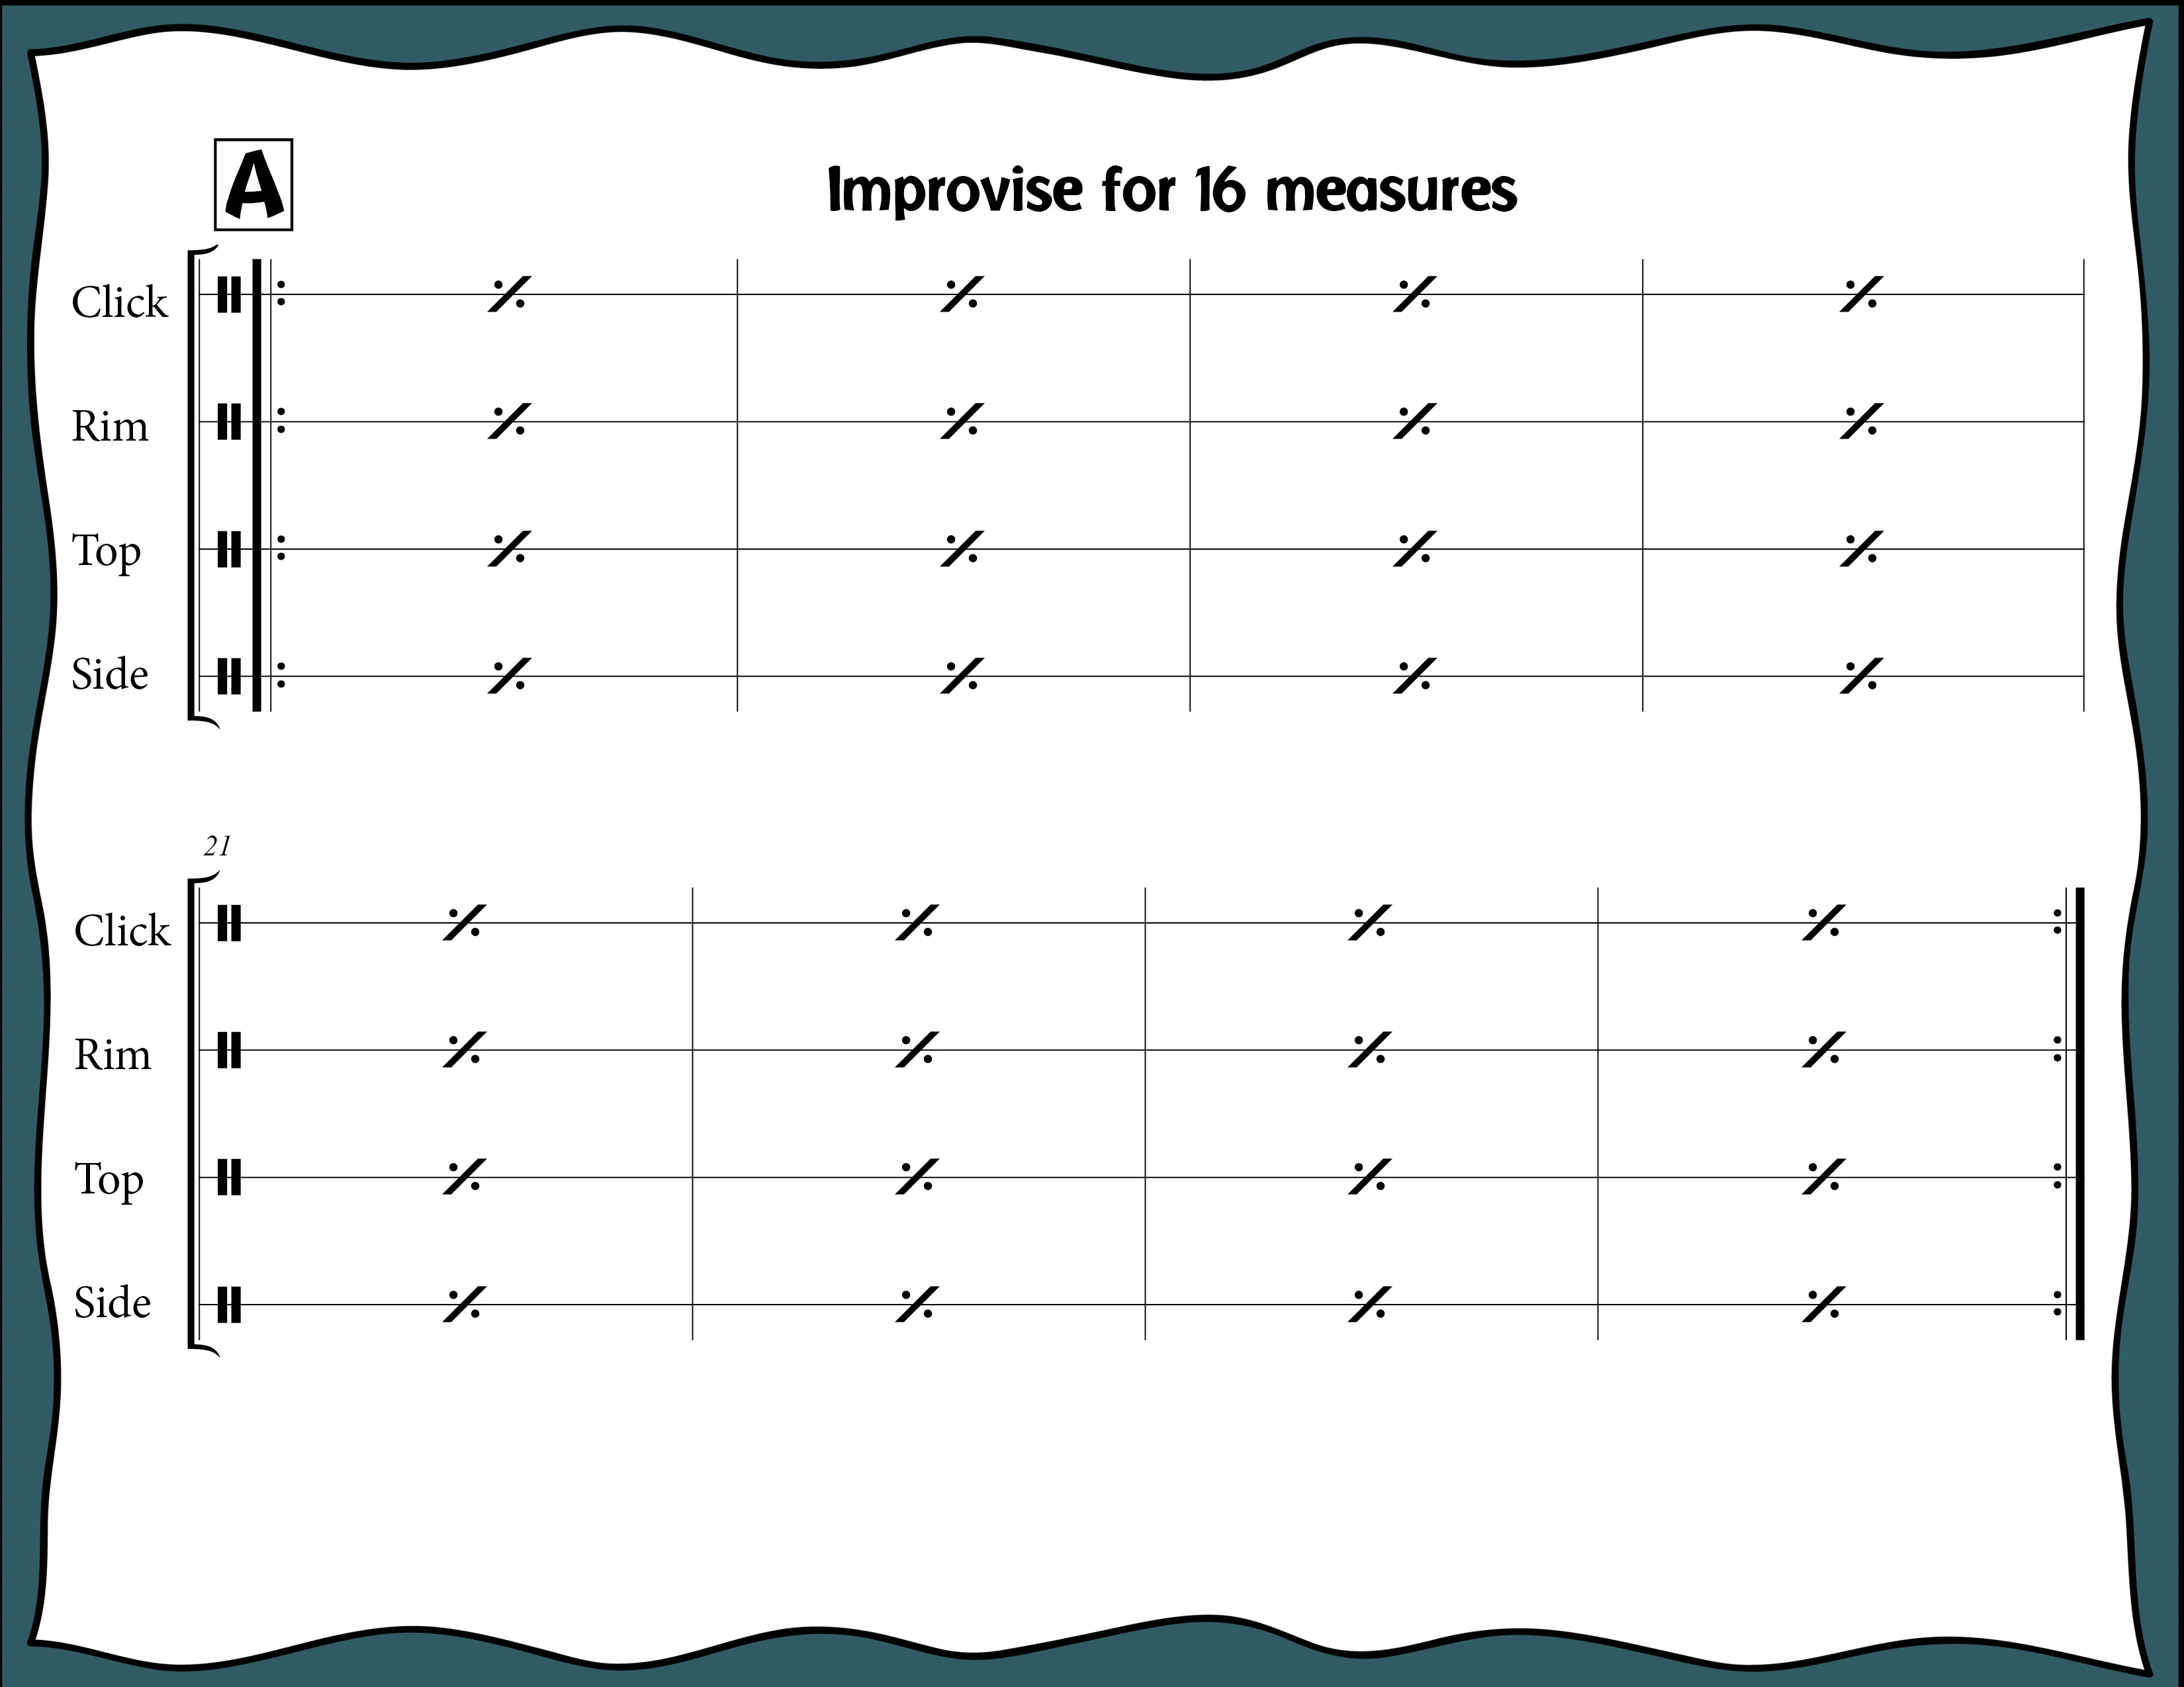
Index

Slide 38
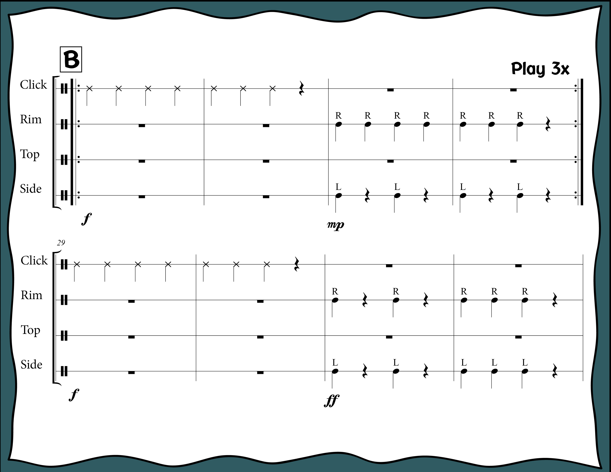
Index

Slide 39
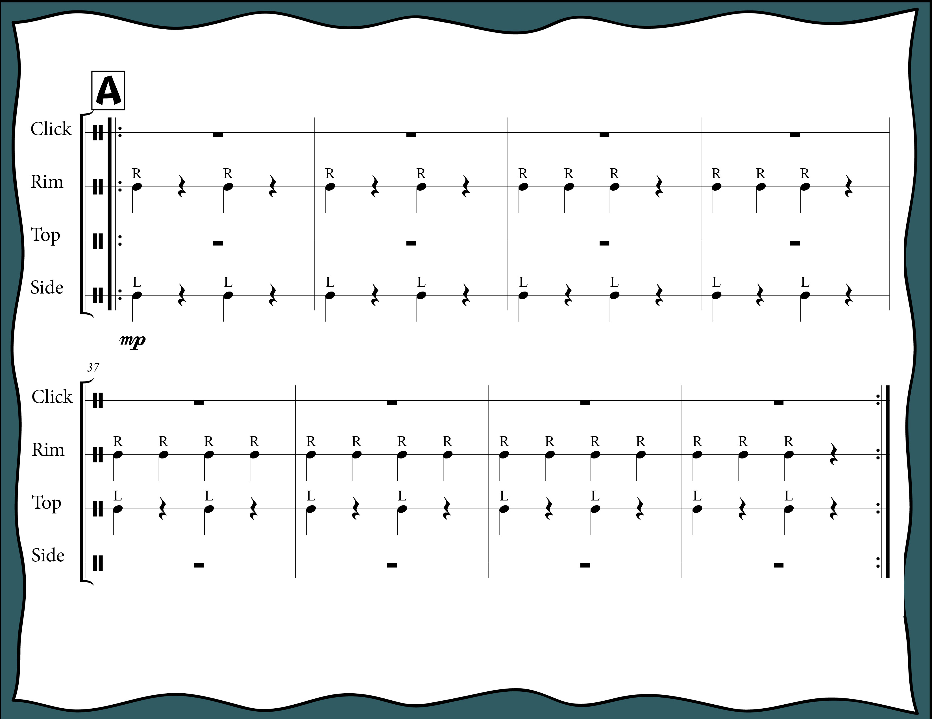
Index

Slide 40
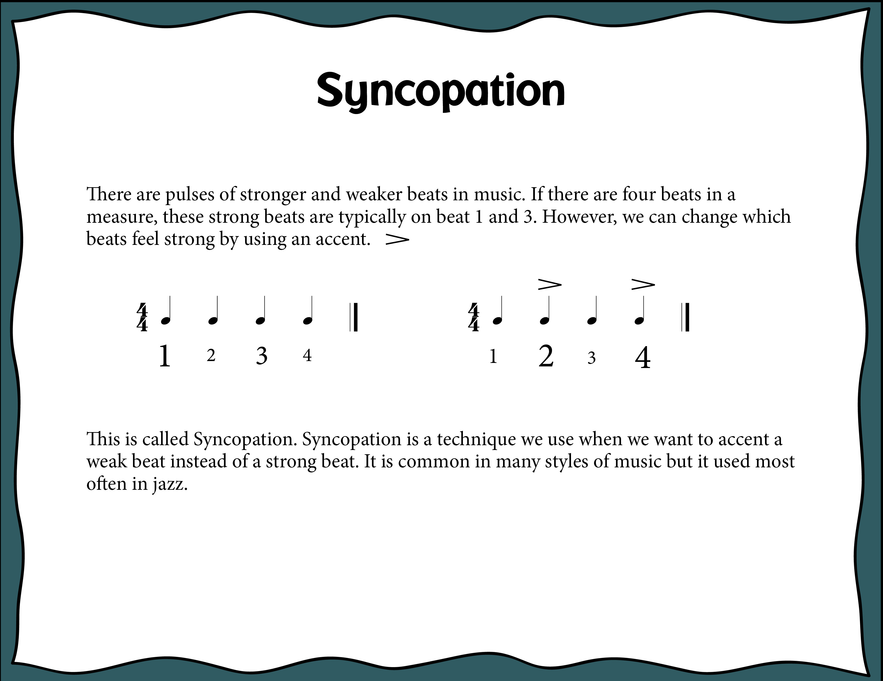
Index

Slide 41
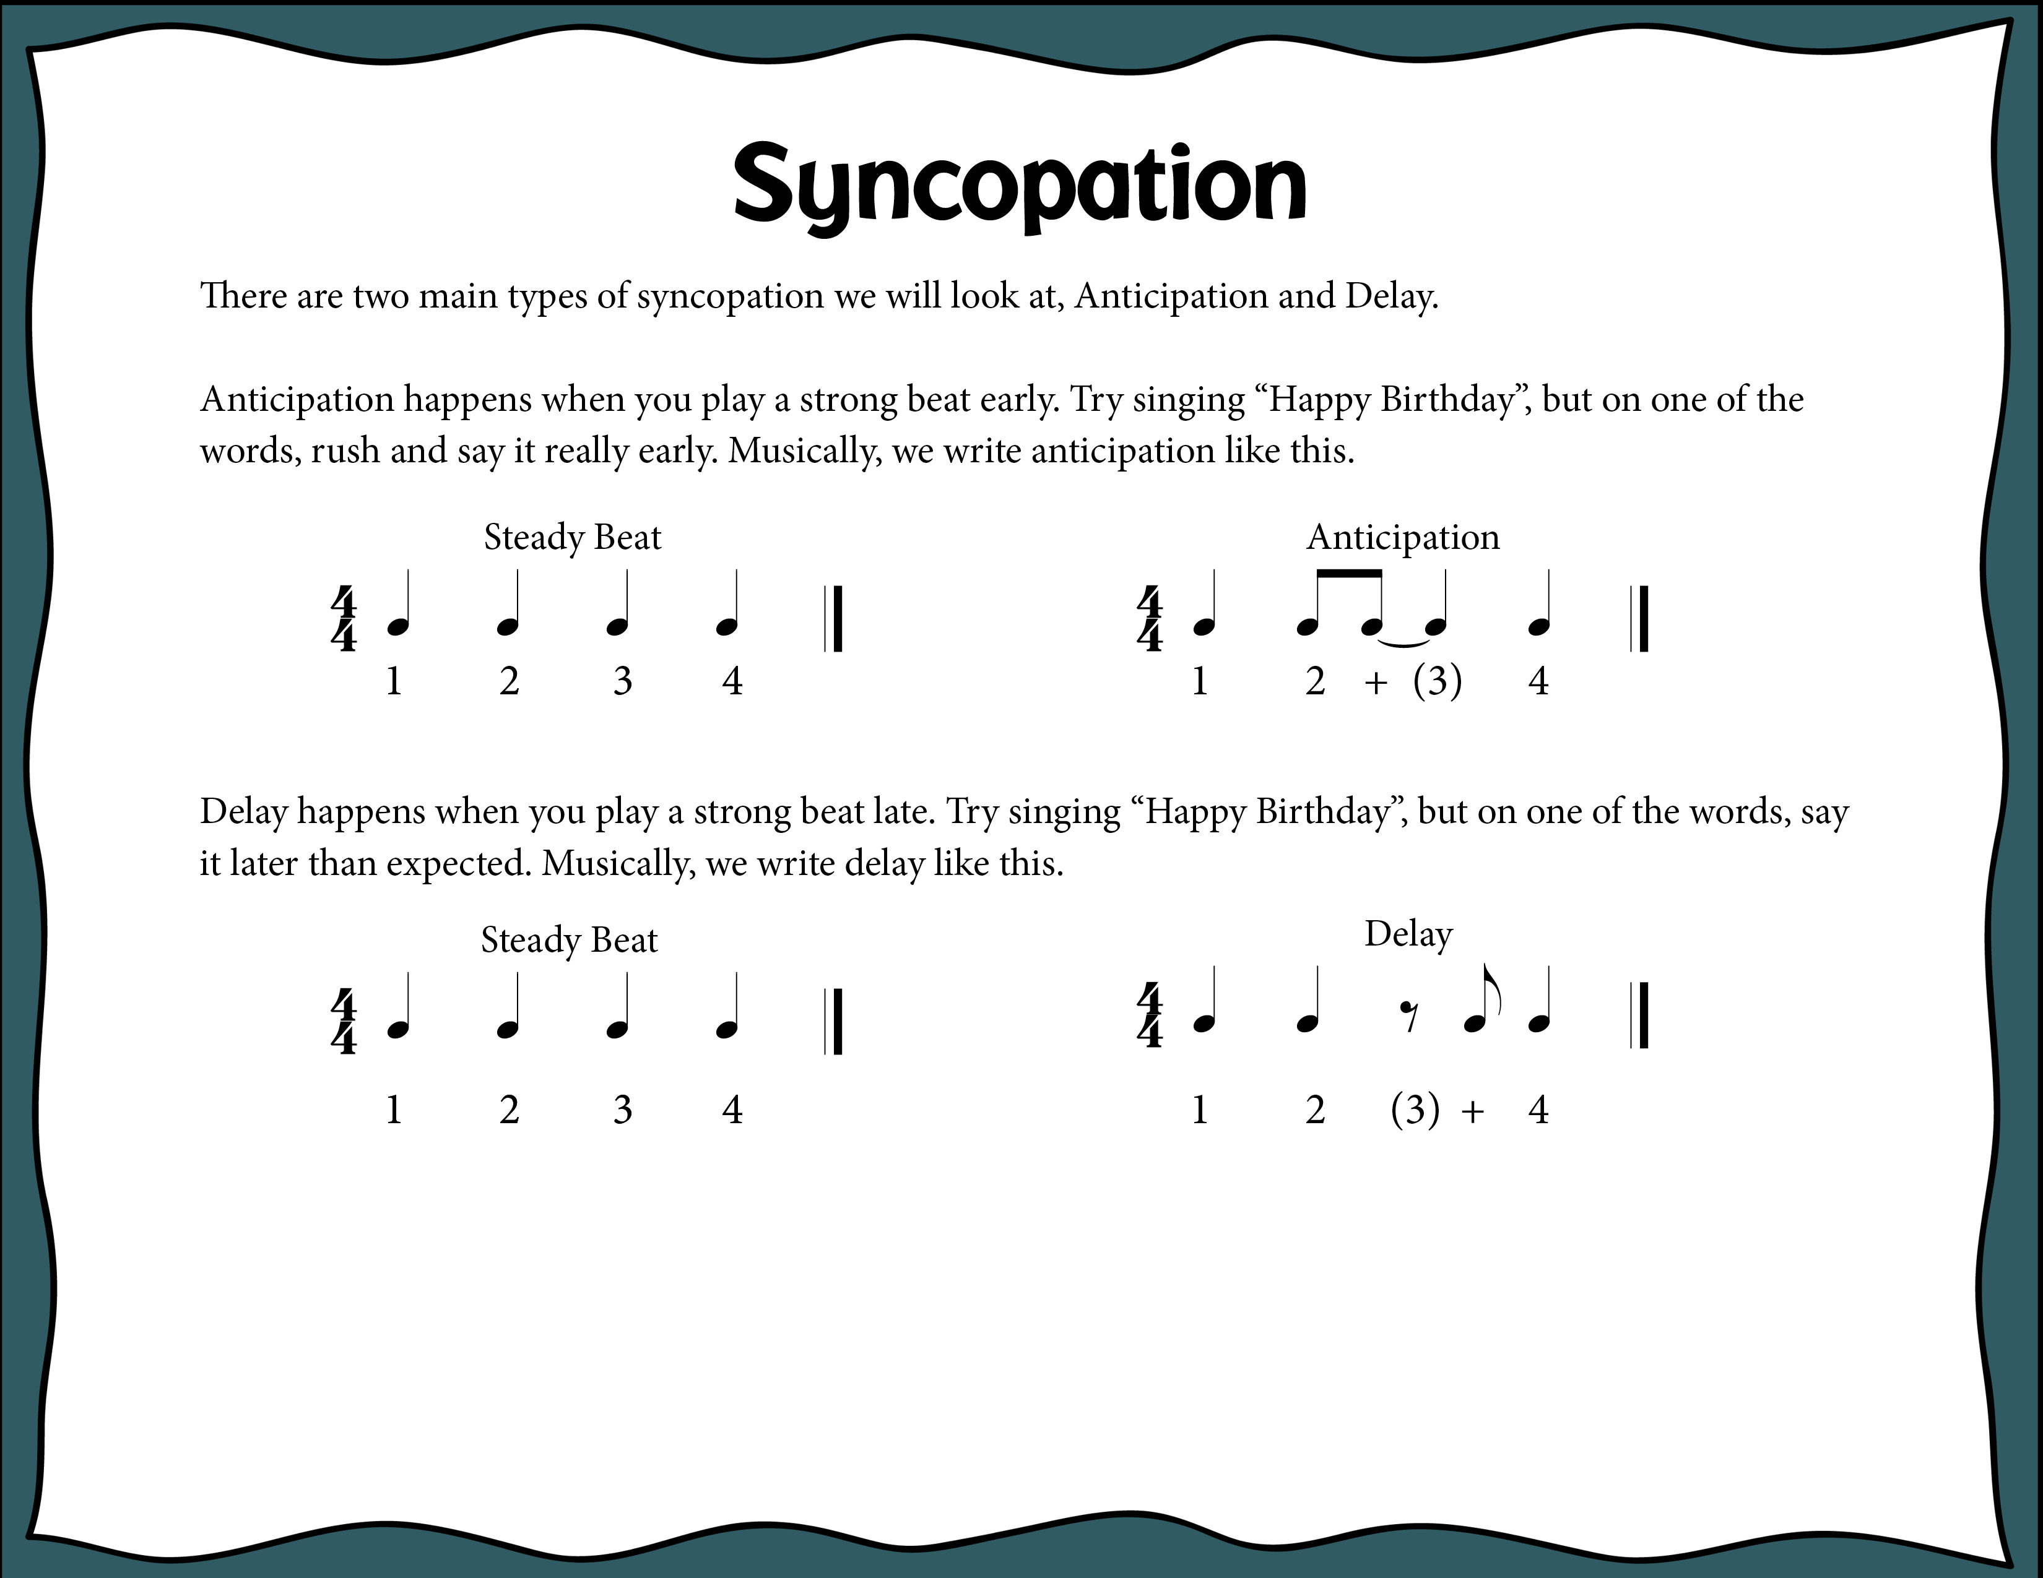
Index

Slide 42
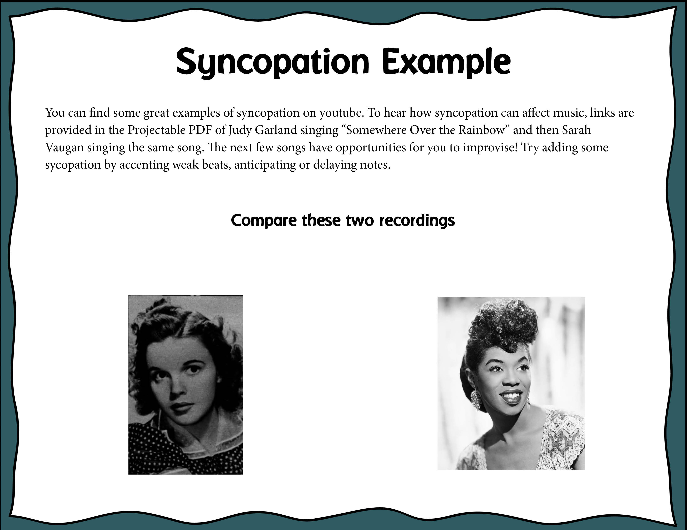
Judy Garland “Somewhere Over the Rainbow”
Click Here: https://youtu.be/PSZxmZmBfnU
Sarah Vaughan “Somewhere Over the Rainbow”
Click Here: https://youtu.be/QYxbP1dhnxE
Index

Slide 43
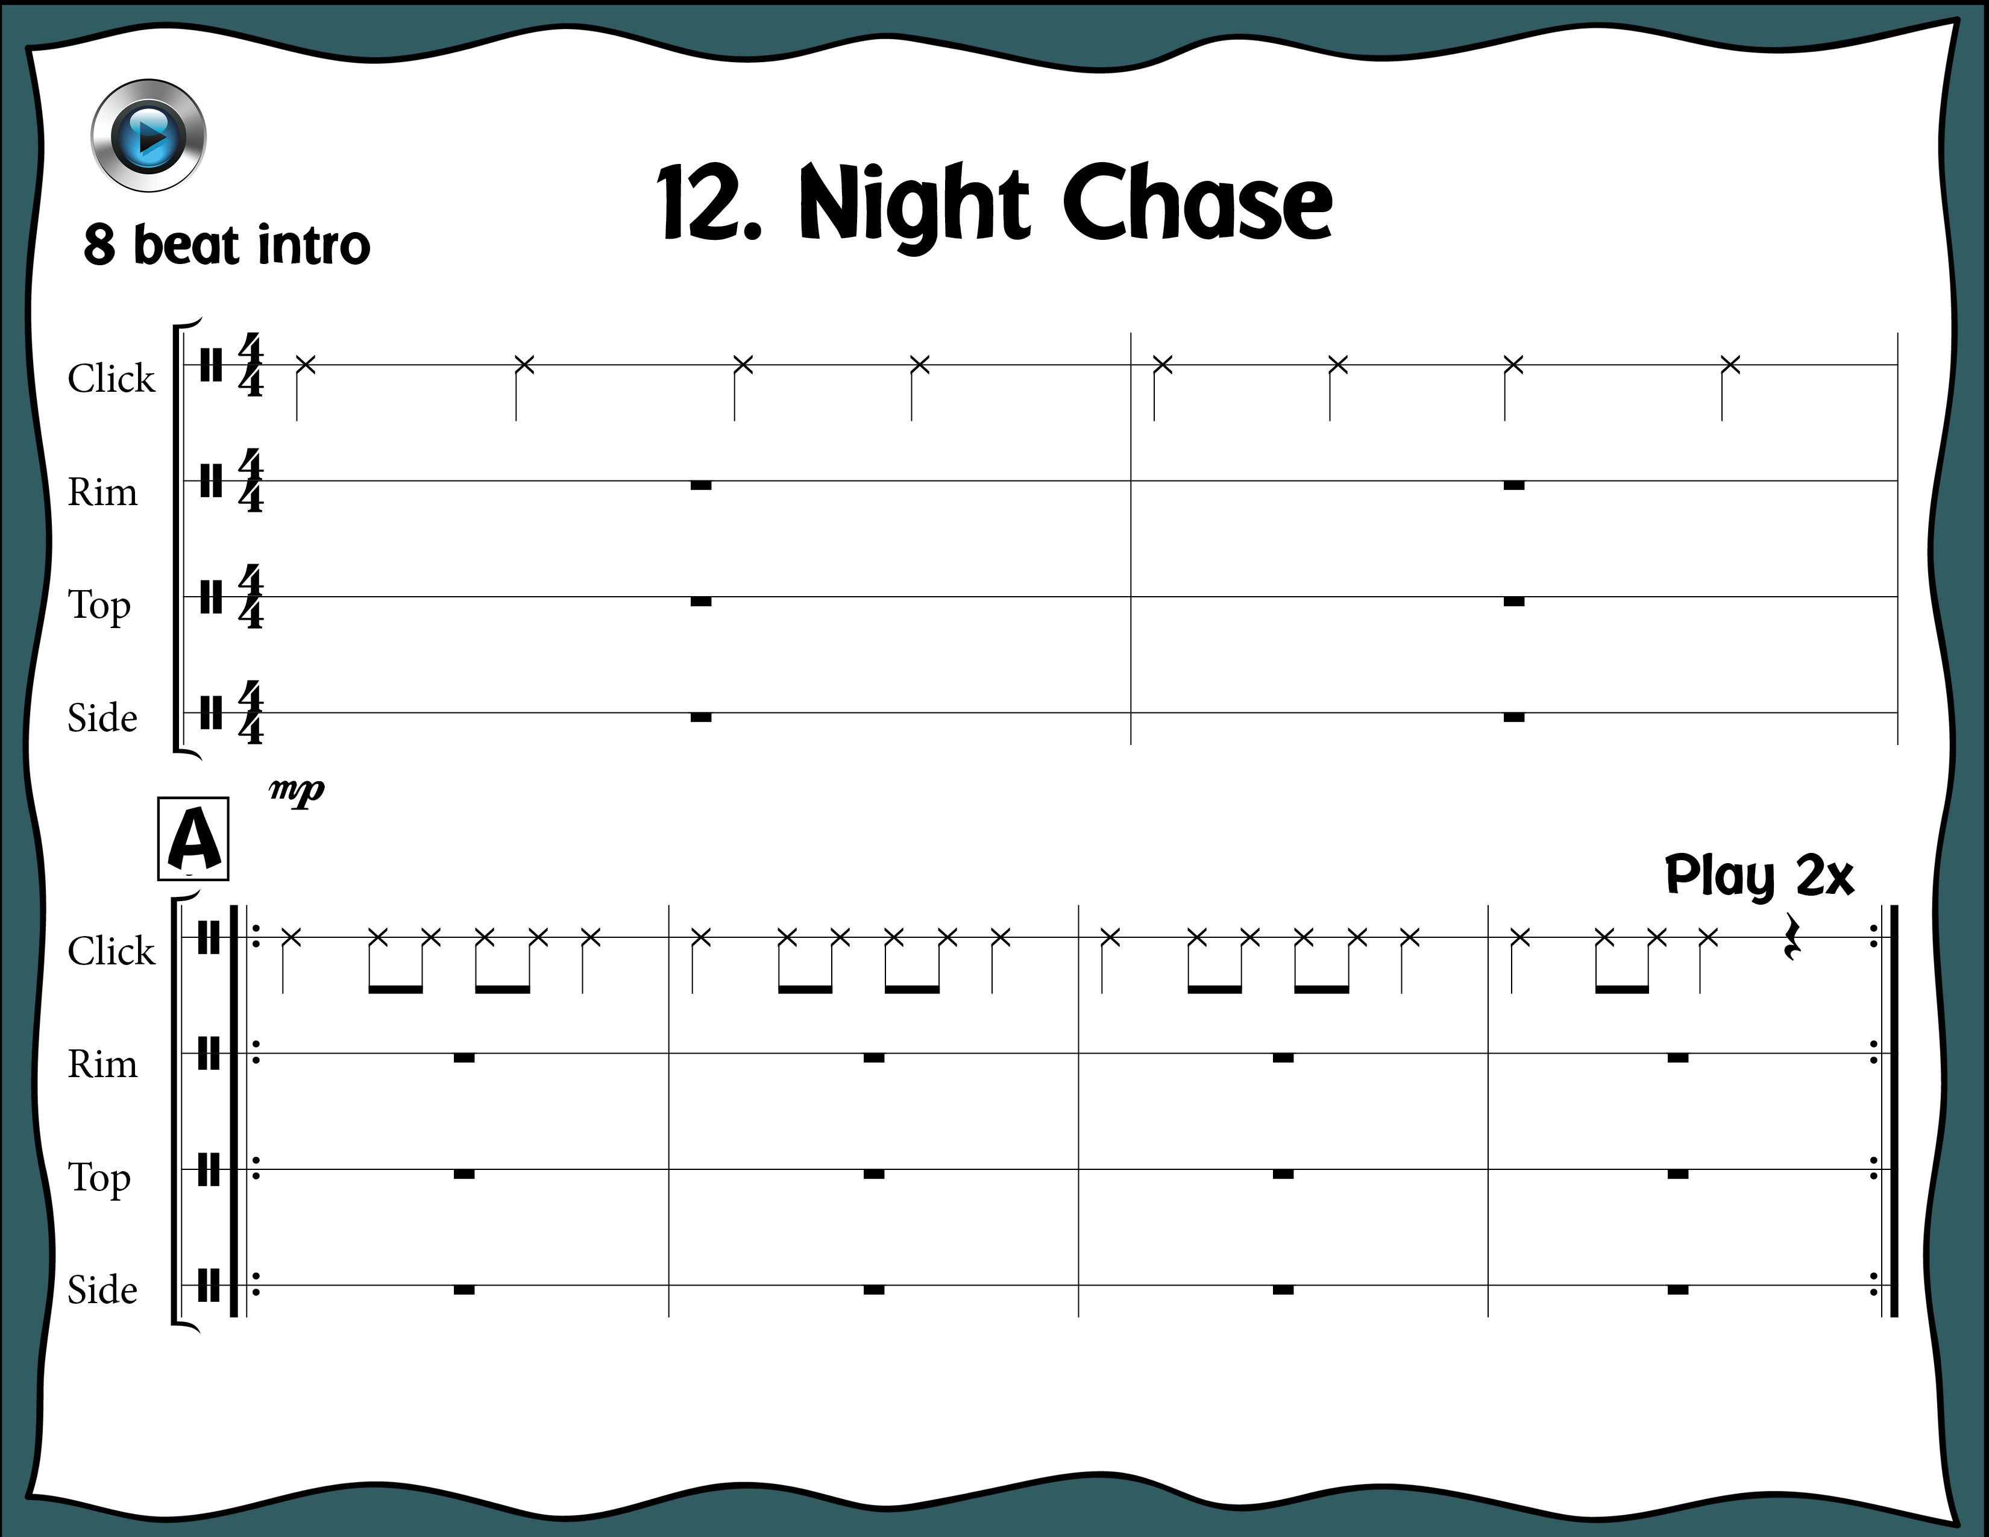
Index

Slide 44
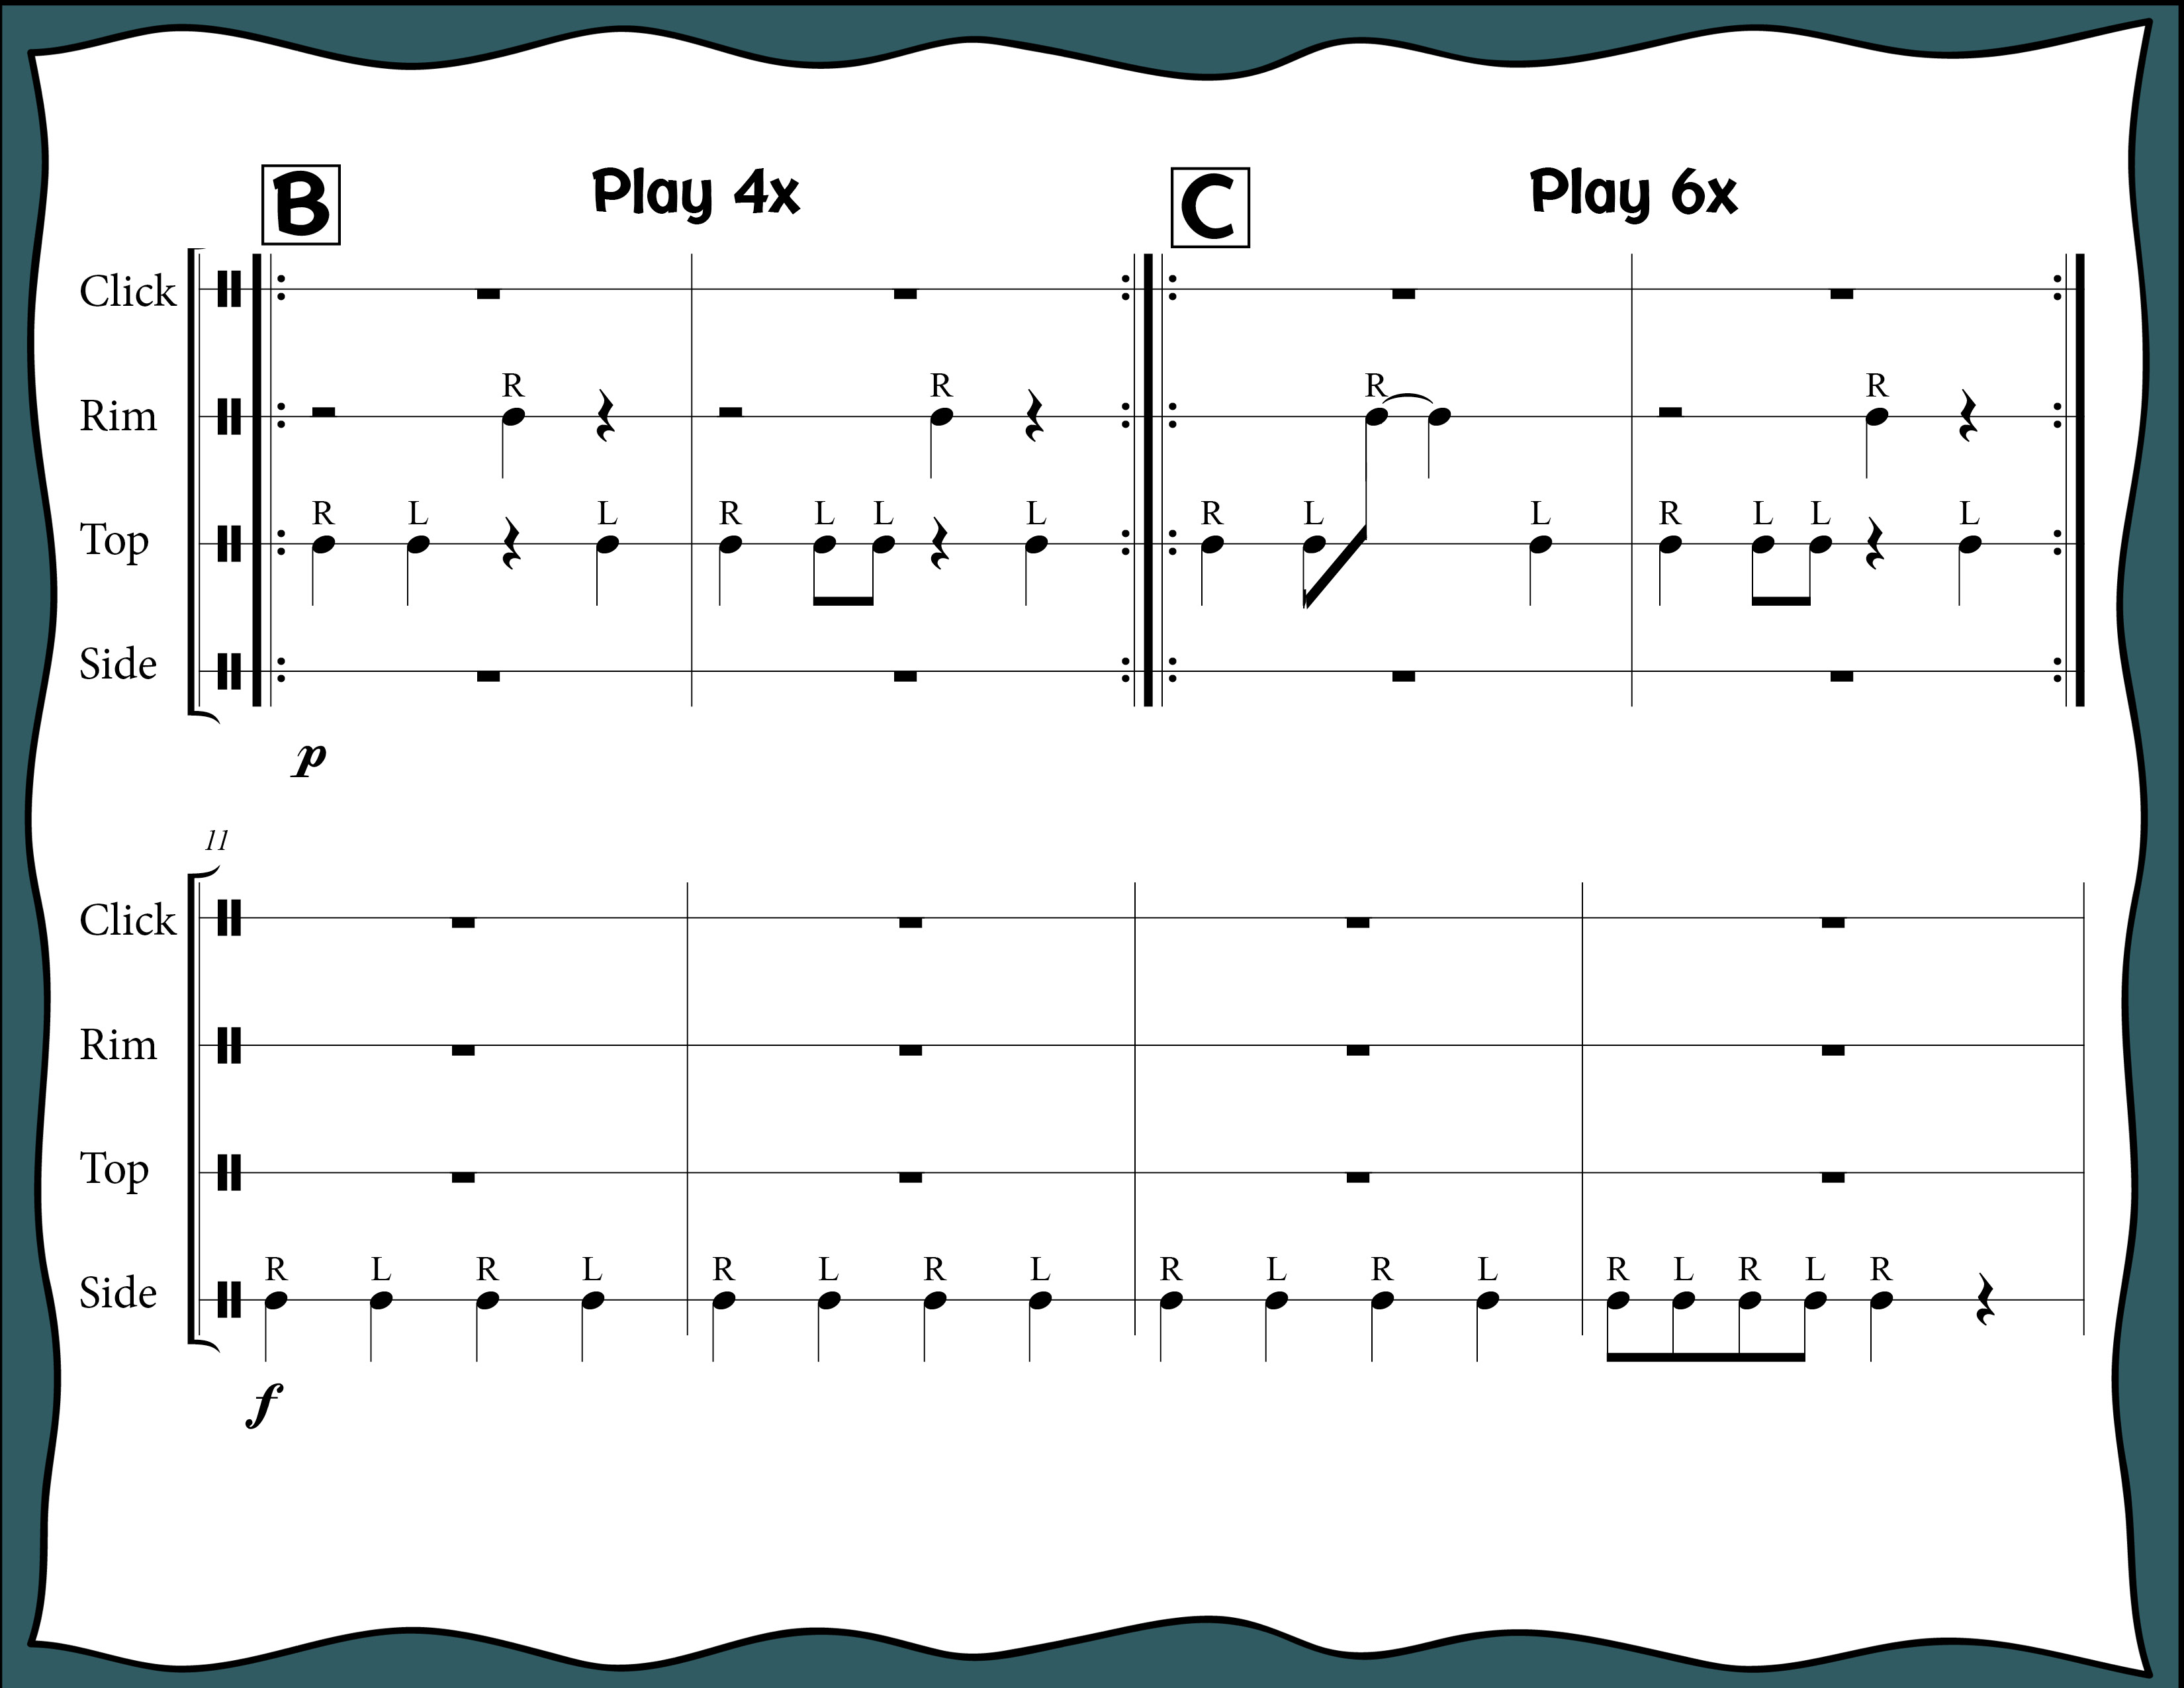
Index

Slide 45
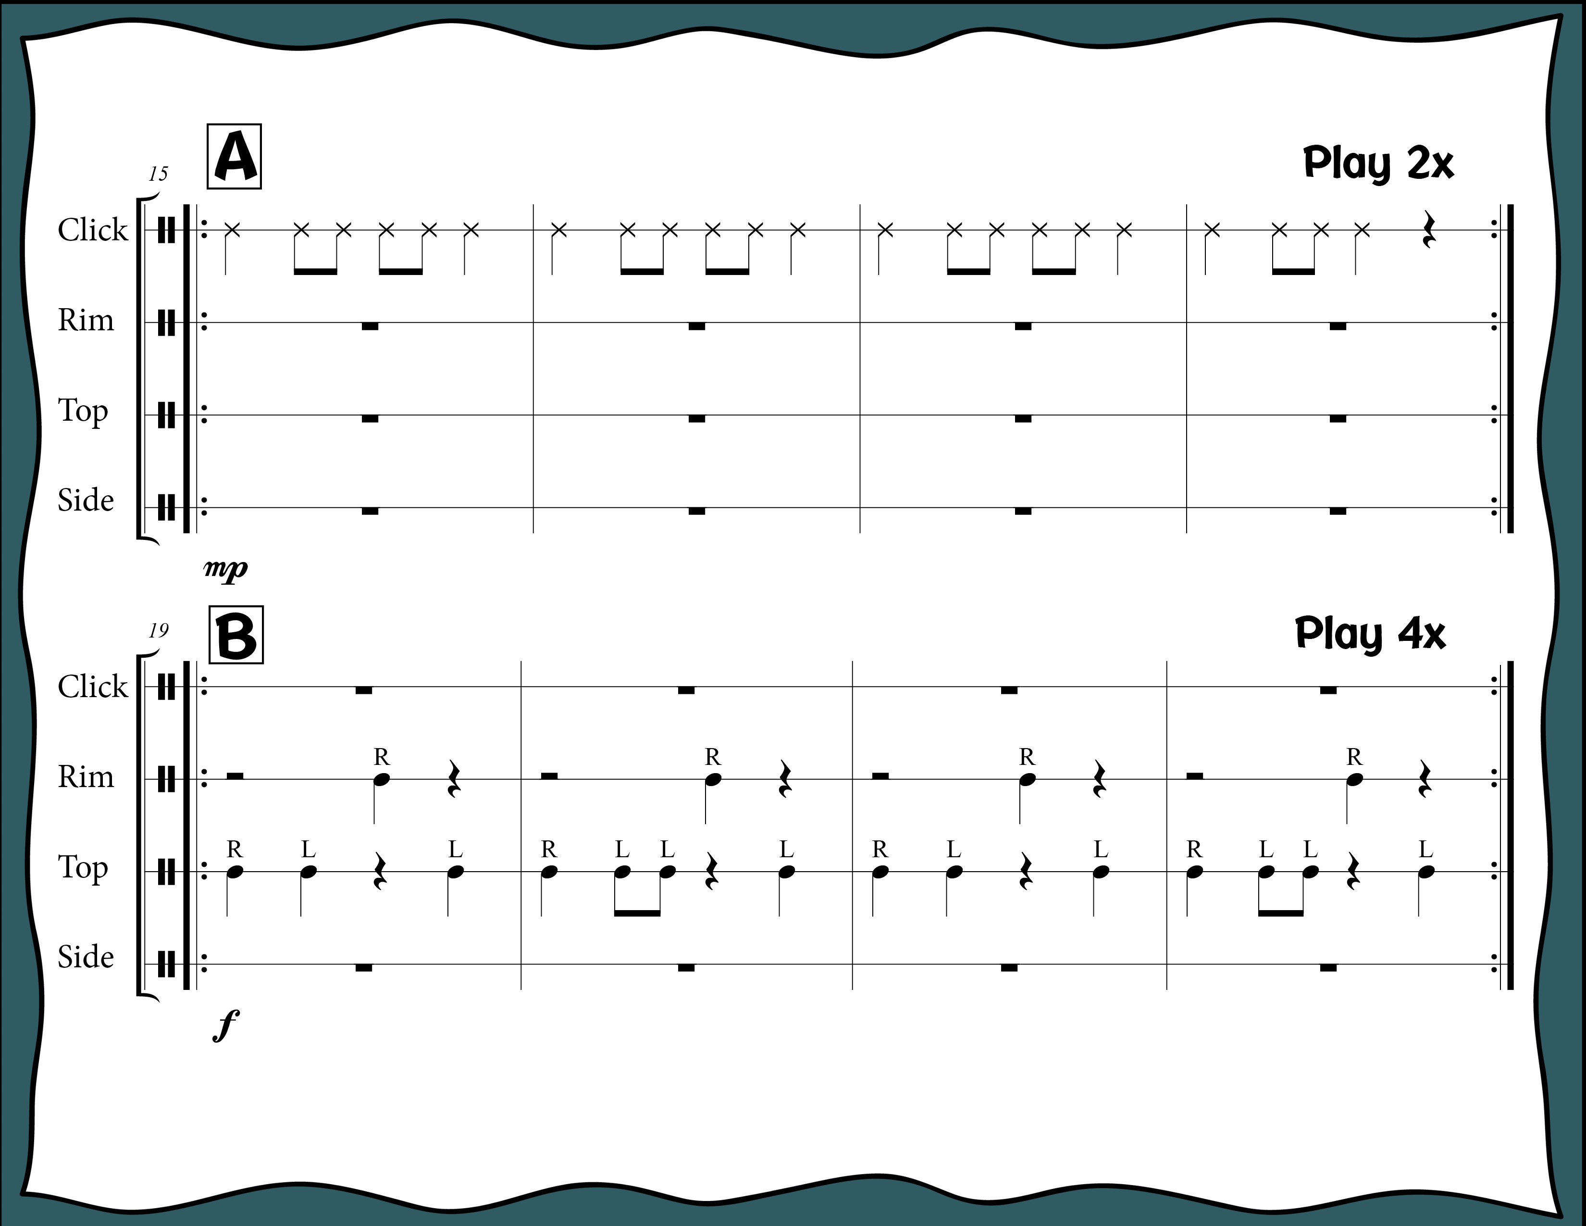
Index

Slide 46
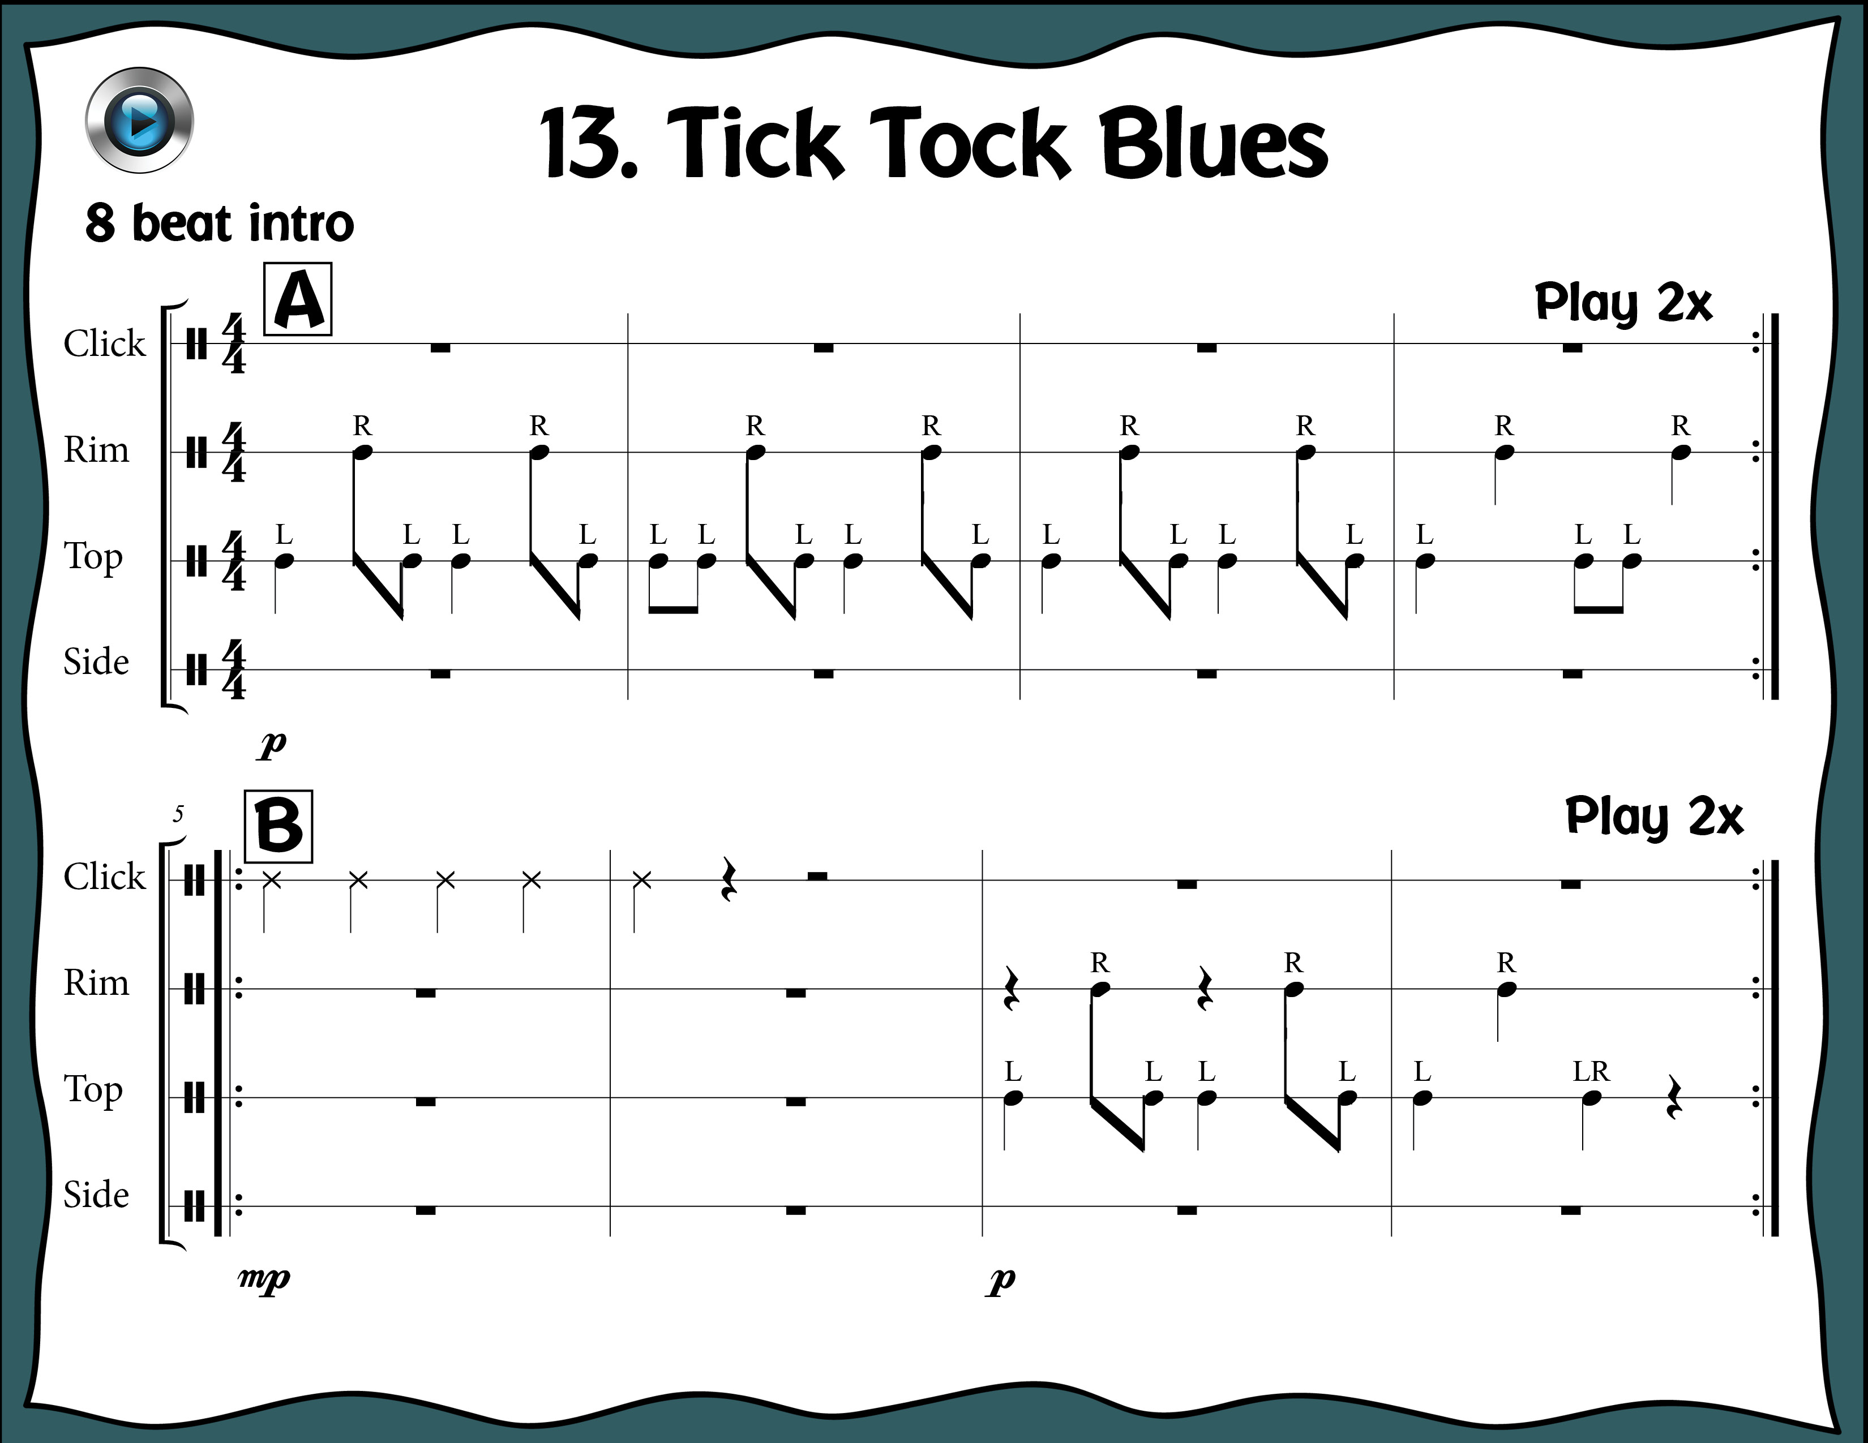
Index

Slide 47
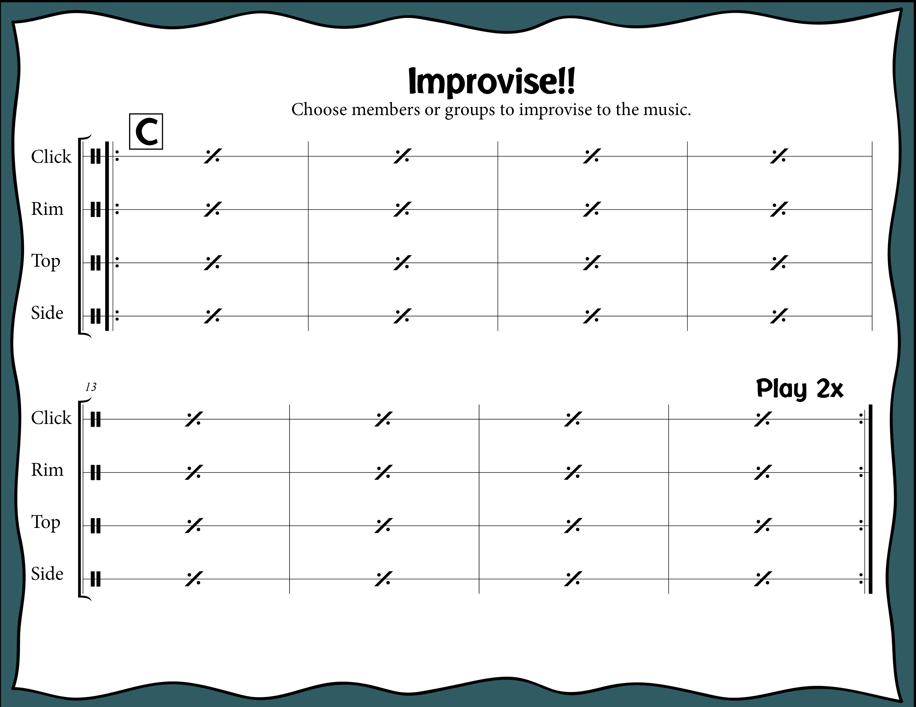
Index

Slide 48
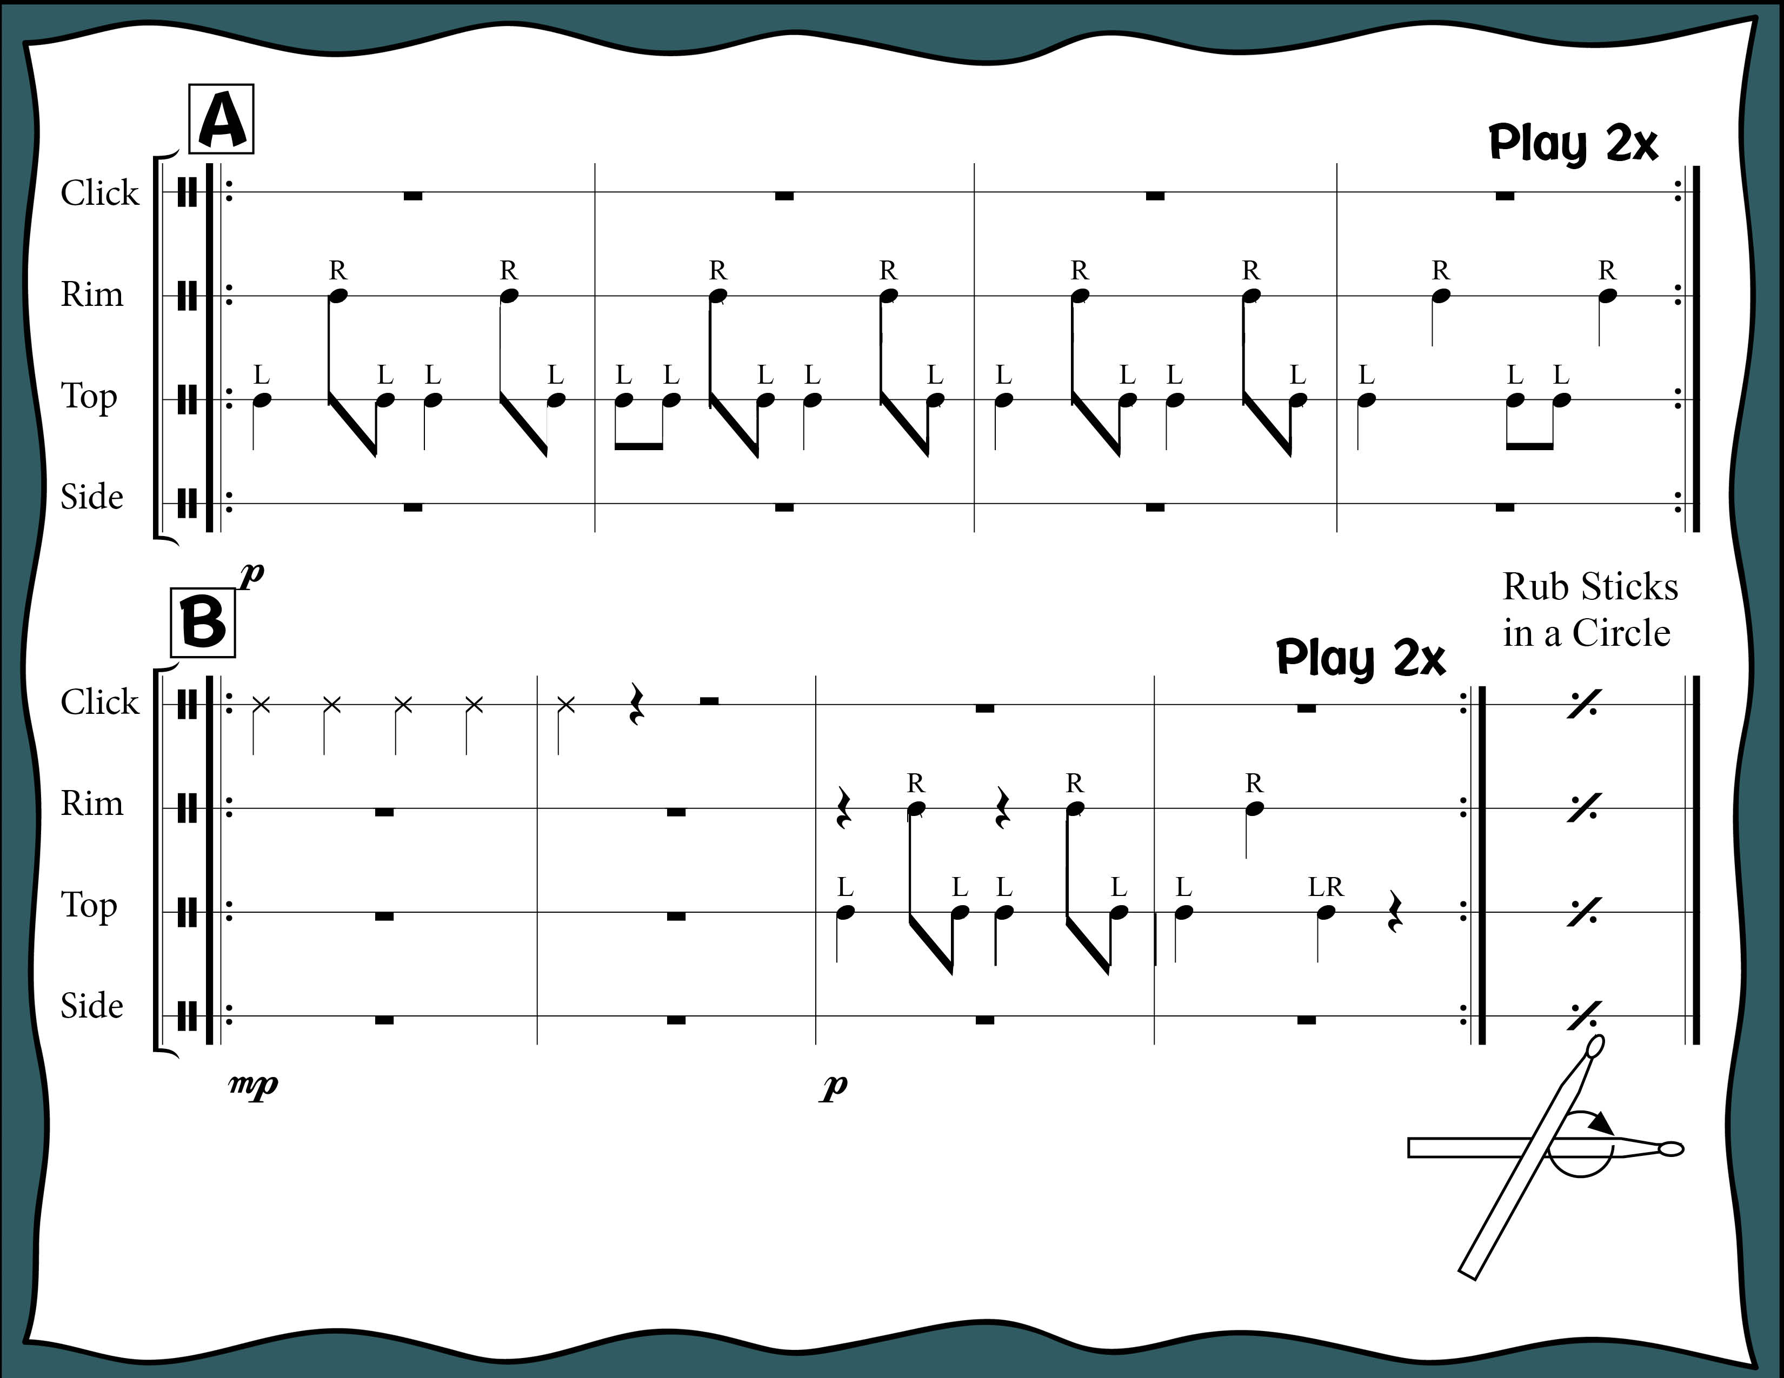
To see a drummer use
the circle brush technique.
Click Here: https://youtu.be/Ux3fLryNZXM
Index

Slide 49
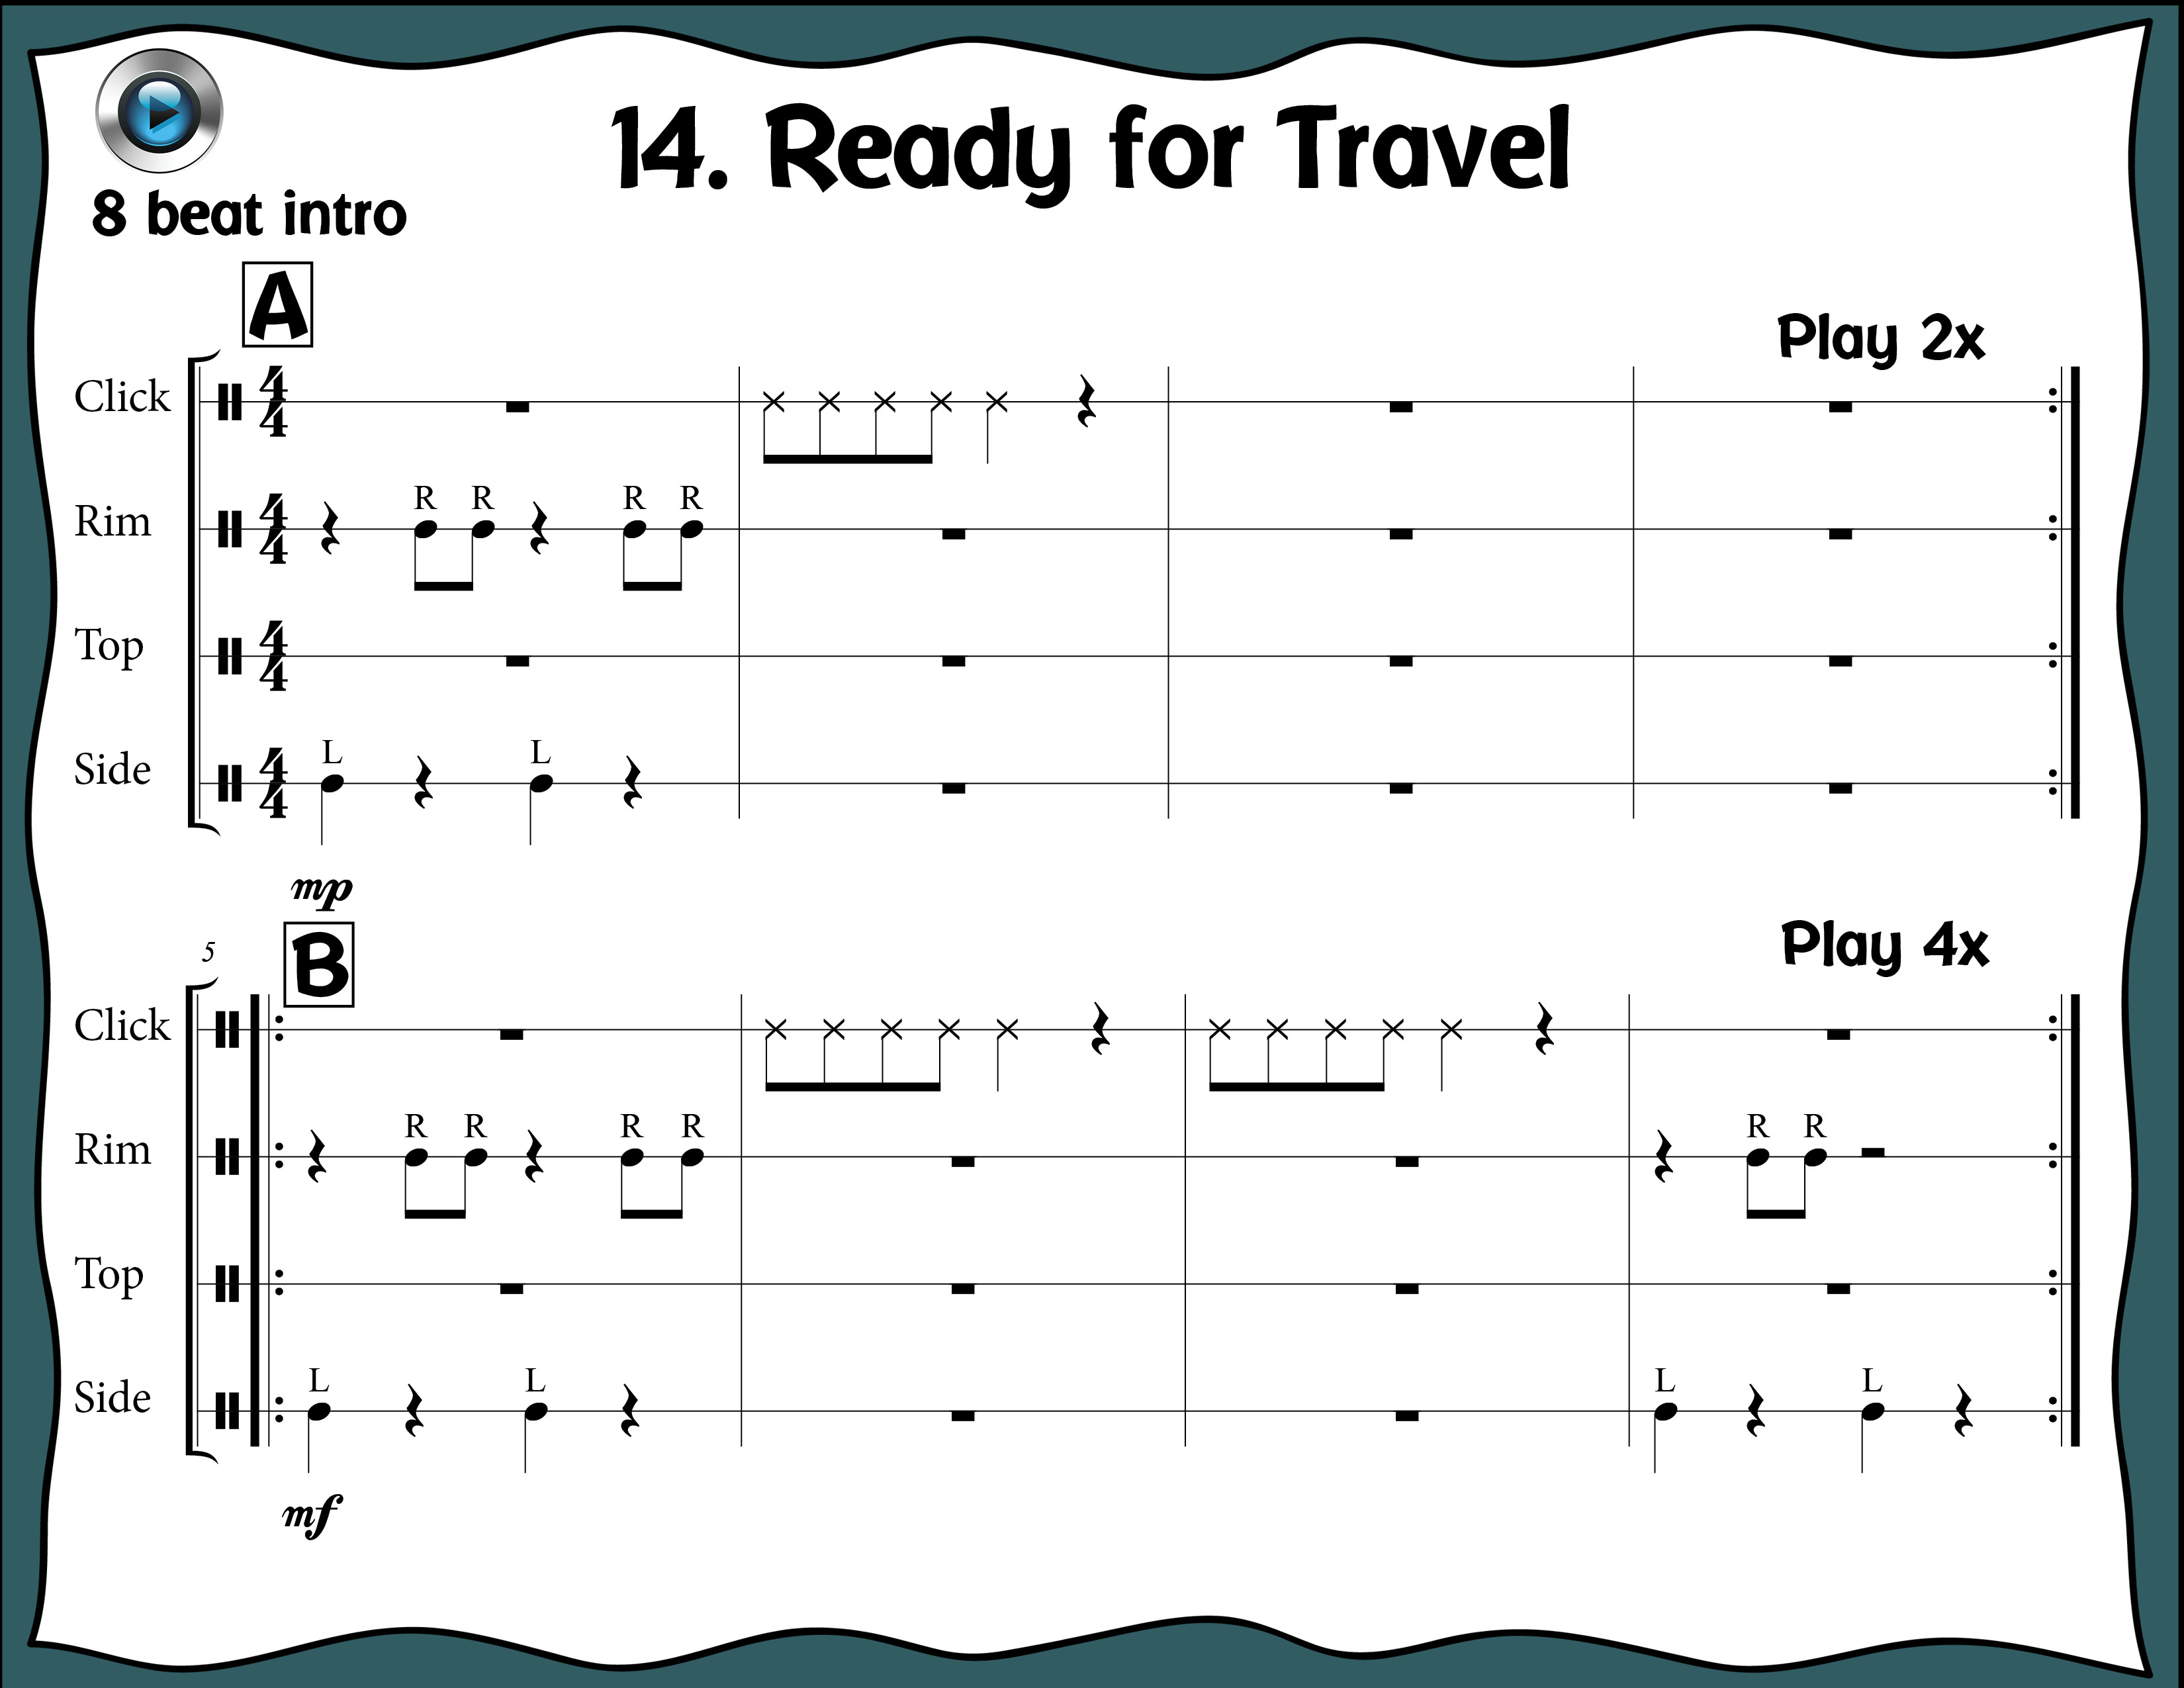
Index

Slide 50
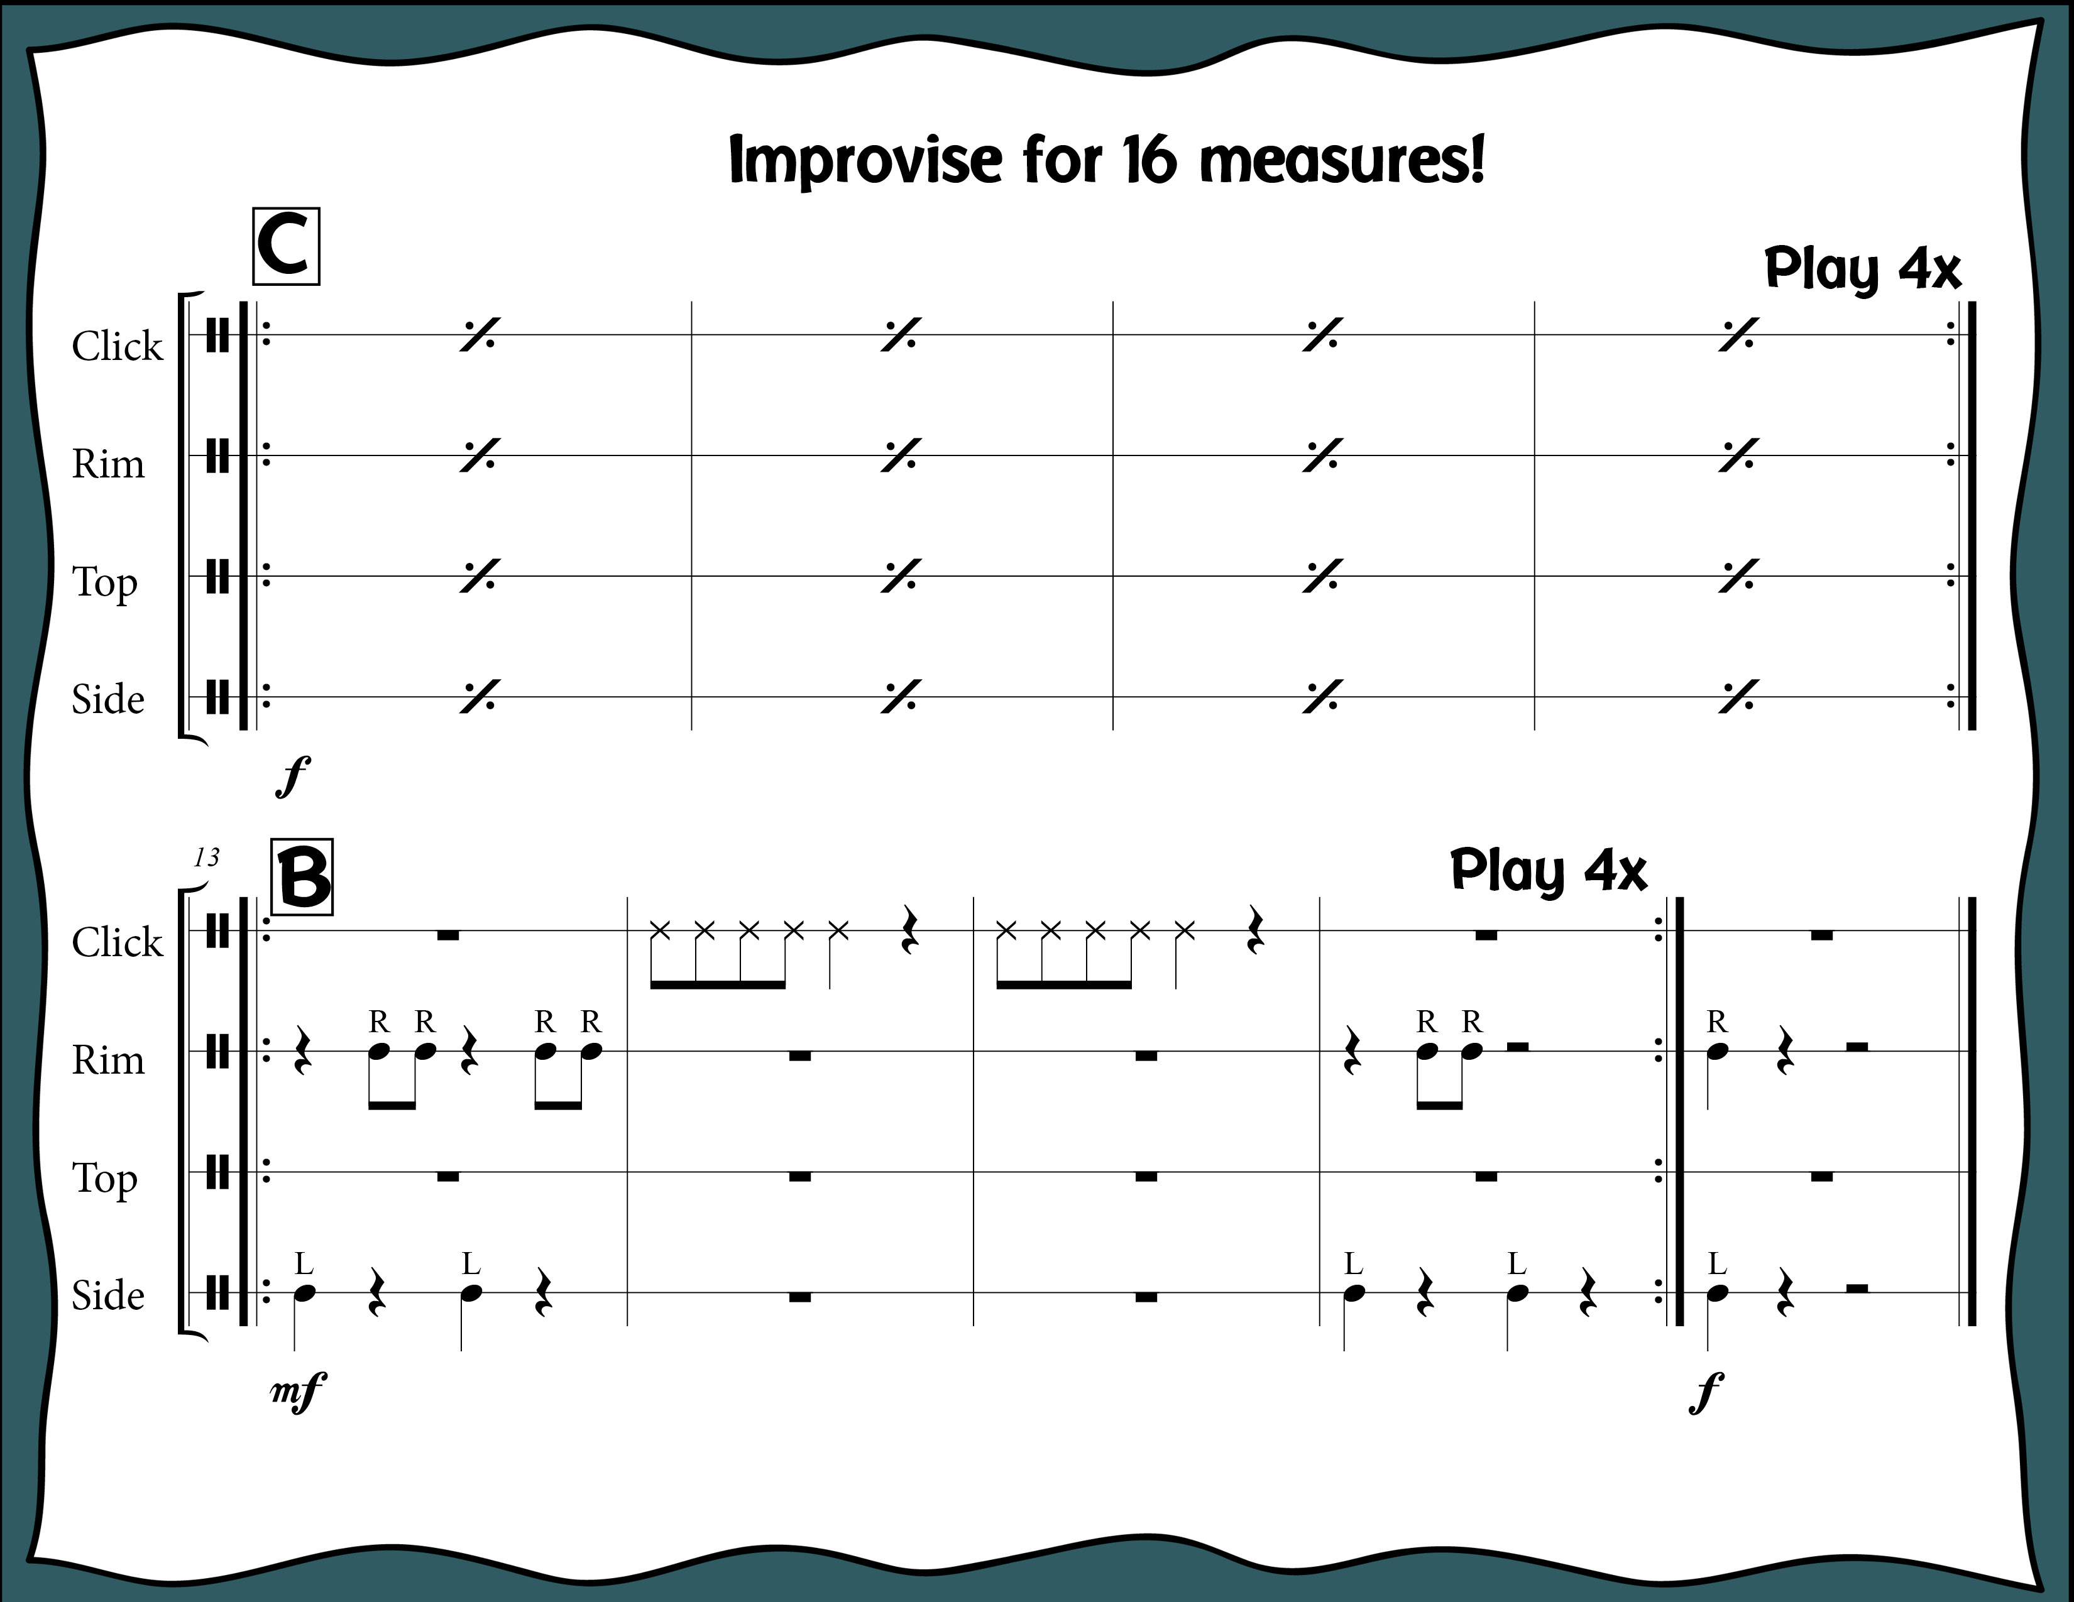
Index

Slide 51
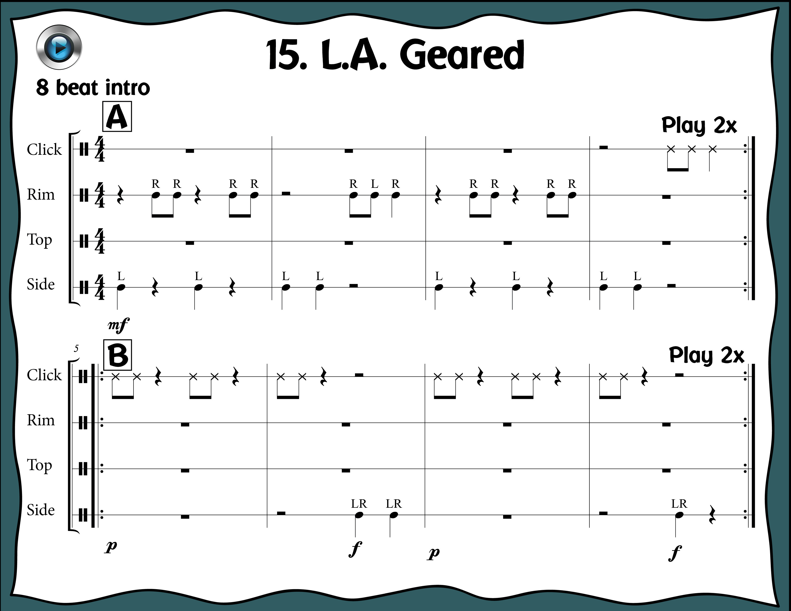
Index

Slide 52
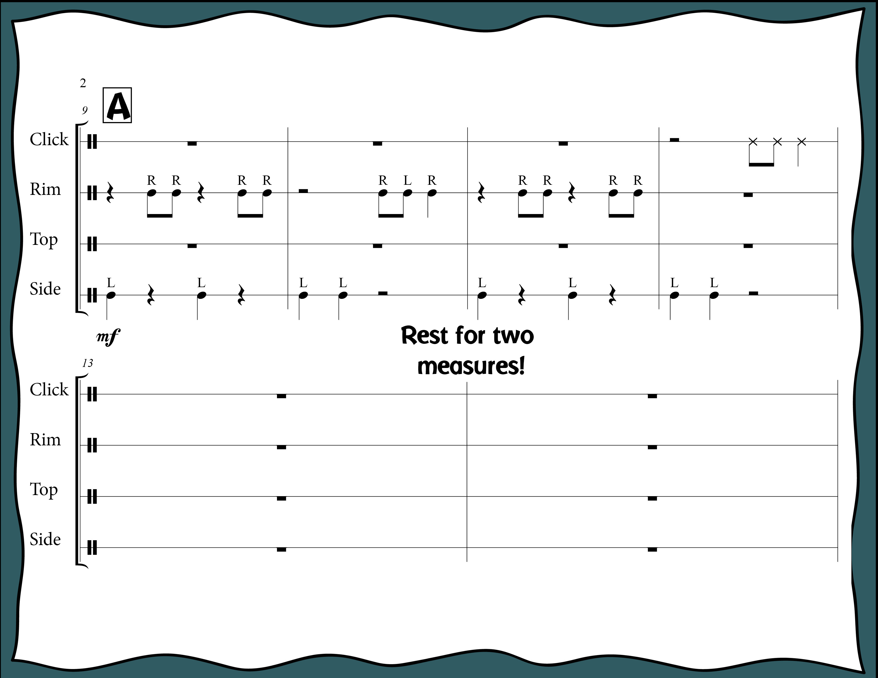
Index

Slide 53

Index

Slide 54

Index

Slide 55

Index

Slide 56

Index

Slide 57

Did you know? You can play this exact arrangement with
K’NAAN’s “Wavin’ Flag (Coca Cola Celebration Mix)”
Click Here: https://youtu.be/WTJSt4wP2ME
Index

Slide 58

To go to the pop song
Click Here:
https://youtu.be/WTJSt4wP2ME
Index

Slide 59

To go to the pop song
Click Here:
https://youtu.be/WTJSt4wP2ME
Index

Slide 60

Index

Slide 61

Index

Slide 62

Index

Slide 63

Index

Slide 64

Index

Slide 65

Did you know? You can play this exact arrangement
With Meghan Trainor’s “Better When I’m Dancin”
Click Here: https://youtu.be/pkCyfBibIbI
Index

Slide 66

To go to the pop song
Click Here:
https://youtu.be/pkCyfBibIbI
Index

Slide 67

To go to the pop song
Click Here:
https://youtu.be/pkCyfBibIbI
Index

Slide 68

Index

Slide 69

Index

Slide 70

Index

Slide 71

Index

Slide 72

Index

Slide 73

Did you know? You can play this exact arrangement with
Justin Timberlake’s “Can’t Stop the Feeling”!
Click Here: https://youtu.be/ru0K8uYEZWw
Index

Slide 74

To go to the pop song
Click Here:
https://youtu.be/ru0K8uYEZWw
Index

Slide 75

To go to the pop song
Click Here:
https://youtu.be/ru0K8uYEZWw
Index

Slide 76

Index

Slide 77

Index

Slide 78

Index

Slide 79

Index

Slide 80

Index

