Slide 1
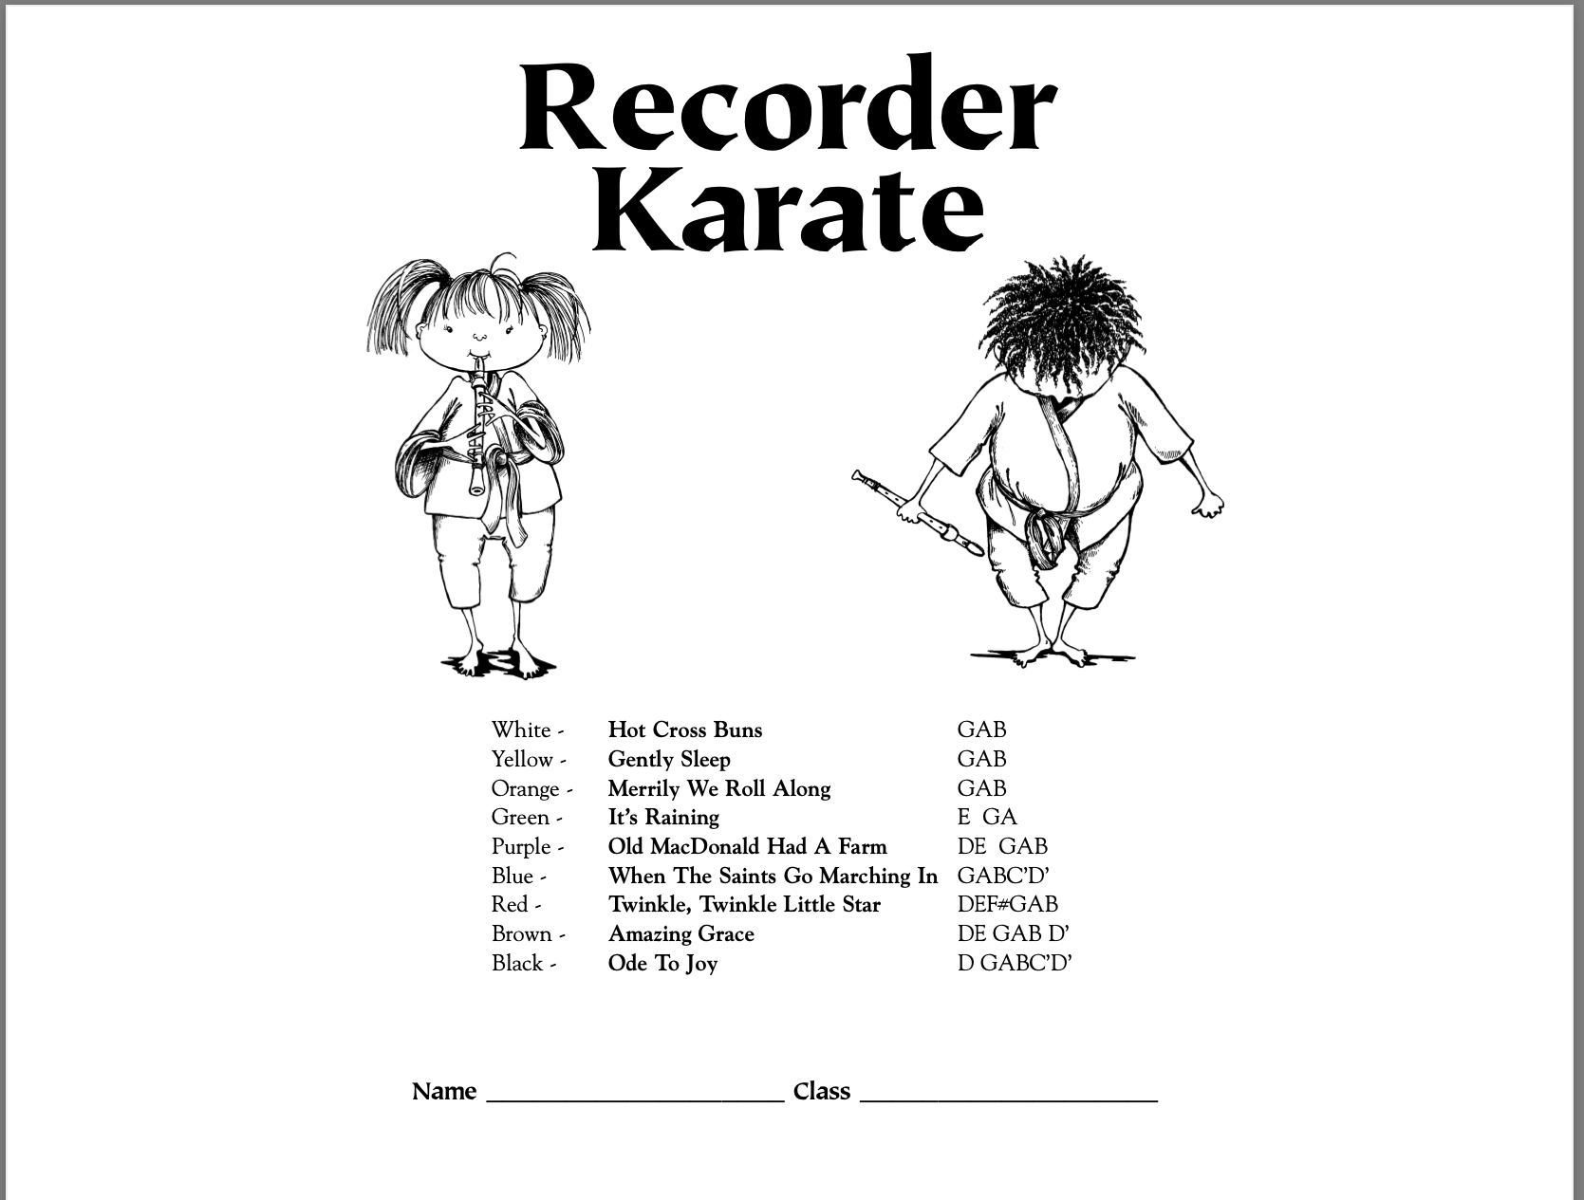
f5
Notes:
Hot Cross Buns - https://www.youtube.com/watch?v=uRhcWu-0RrQ

Slide 2
Notes:
https://www.youtube.com/watch?v=uRhcWu-0RrQ

