Slide 1
From Gene to Protein
Lesson 2: Details of transcription & Translation Sec 17.2-17.4

Slide 2
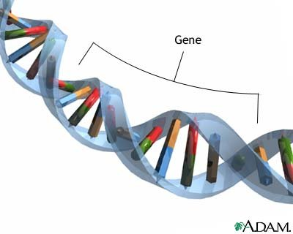
Rapid Review… The Genetic Code
Gene:
a short section of DNA that codes for a protein
Proteins are made of amino acids
Genes code for the order of amino acids!

Slide 3
One-Gene-One Enzyme Hypothesis
“ The function of a gene is to dictate the production of a specific enzyme”
Nobel Prize 1958 shared by Beadle & Tatum
“genes act by regulating definite chemical events”
(-Nobel Committee)

Slide 5
Today we call it: “One gene-One Polypeptide hypothesis”
Because not all proteins are enzymes!
Ex: keratin, hormone insulin = non enzyme proteins
Some proteins are made of multiple polypeptide chains & each chain is coded for by its own gene
Ex: hemoglobin → 2 polypeptides→ two genes code for this 1 protein
Many genes code for RNA molecules that cells need too!

Slide 6
Why is gene expression referred to as a “Triplet Code” ?
Last class we you were “cracking the code” of transcription and translation…

Slide 7
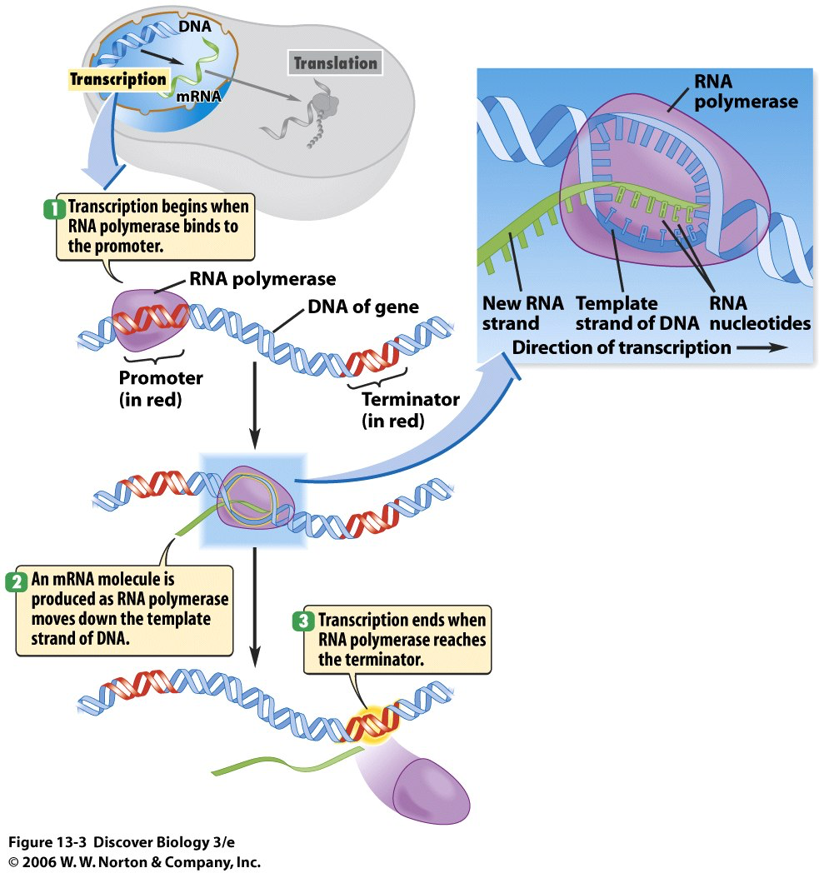

Slide 8
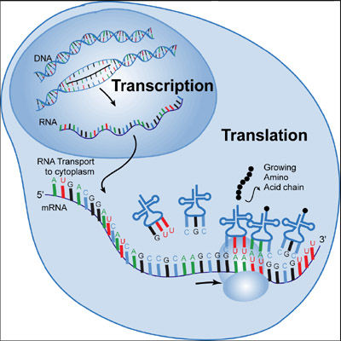
Overview of Gene expression
DNA → RNA → PROTIEN
Transcription:
using the DNA to make an RNA copy that can leave the nucleus
Creates “messenger RNA” aka mRNA
Occurs in nucleus
Translation:
Using the mRNA to obtain the correct order of amino acids and to join them into a polypeptide
Creates a protein
Occurs at ribosomes in cytoplasm

Slide 9
Transcription & Translation A closer look…
Chap 17.2 -17.4 p 331

Slide 11
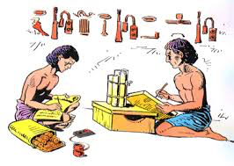
Transcribing the DNA message into an RNA message!

Slide 12
II. Translation from mRNA→ amino acids→ protein

Slide 13
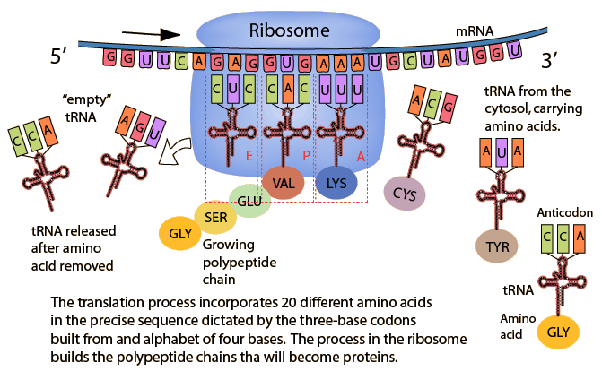
II. Translation
mRNA message is translated into a protein!

Slide 14
Learning Goals:
Know key terms: gene expression, transcription, translation
Describe major events of transcription
Explain how eukaryotes modify mRNA after transcription
Describe the steps in translation
Explain how mutations can change the amino acid sequence of a protein

Slide 15
Transcription: “to make a close copy”
The synthesis of mRNA, directed by DNA
DNA is the template
The RNA strand made is complementary
Requires RNA polymerase enzyme

Slide 16
Transcription begins at a promoter:
The DNA sequence where the RNA polymerase first attaches
A TATA box- ( TATA nucleotide sequence)is usually ~25 nucleotides before the promoter
RNA polymerase can only work in a 5’ to 3’ direction

Slide 17
PROCESSING of mRNA in Eukaryotes
There are some “non-coding” regions on the DNA/mRNA copies
Introns: sections that don’t code for genes
Introns are removed before mRNA leaves the nucleus
mRNA contains only EXONS:
codons for proteins that will be “expressed”

Slide 18
snRNPs (“snurps”)
Small nuclear ribonucleoproteins (snRNPS) recognize splice sites for pre-mRNA splicing
Found in the nucleus and made of protein and RNA

Slide 19
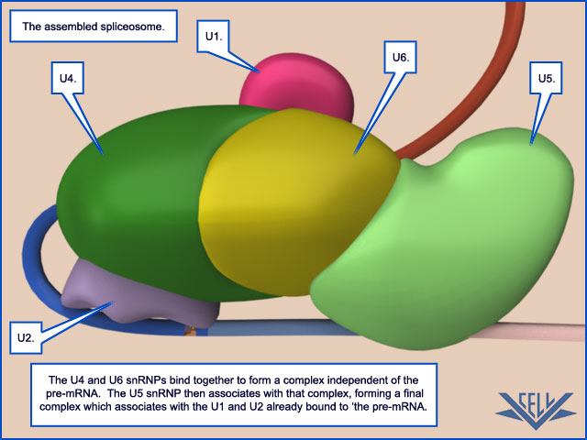
Several snRNPs join with other proteins to form a Spliceosome:
cuts the pre-mRNA& releases the intron
See Fig 17.12

Slide 20
Ribozymes:
RNA molecules that work as enzymes

Slide 21
Why do introns exist?
Some sequences may provide adaptive benefits depending on how they are spliced
Provides variation for evolution to act upon!

Slide 22
II. Translation from mRNA→ amino acids→ protein

Slide 23
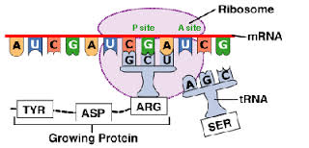
II. Translation:“to put info into a different language”

Slide 24
II. Translation
mRNA message is translated into a protein!

Slide 25
II. Translation: “to put info into a different language”
Occurs in the cytoplasm, at the ribosome
Types of RNA Needed:
tRna
mRNA
Other REQUIREMENTS:
mRNA
Ribosome
Amino acids

Slide 26
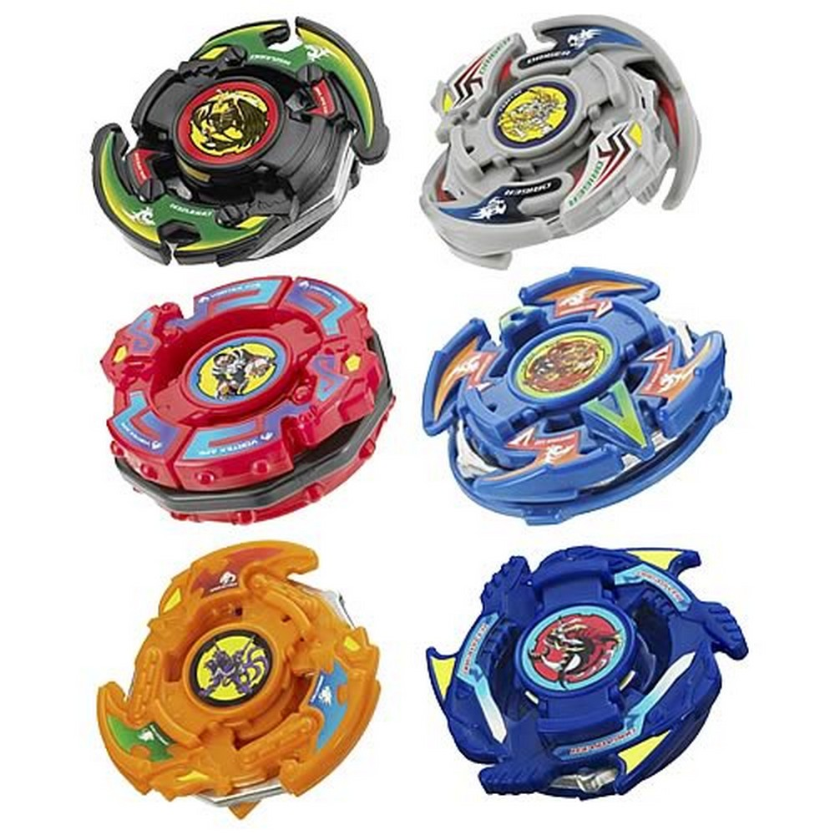

Slide 27
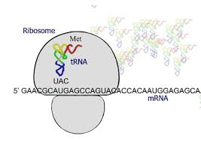
Detailed Steps of Translation
Initiation:
The codon “AUG” ( methionine) occurs on the mRNA strand and signals START
tRNA- brings the correct amino acid to the mRNA strand

Slide 28
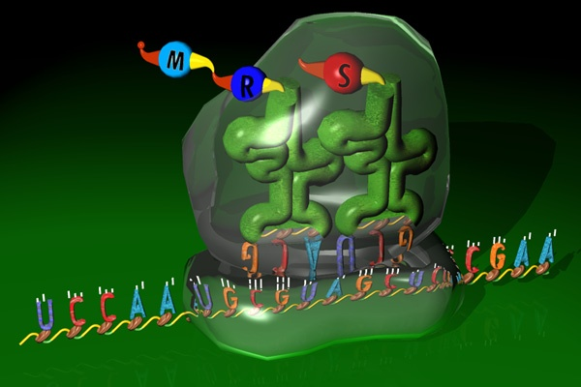
What do you see in this picture?

Slide 29
tRNA attaches to mRNA at it’s anticodon
ANTICODON:
Area at bottom of tRNA
3 bases that are complementary to mRNA
Binding site to mRNA

Slide 30
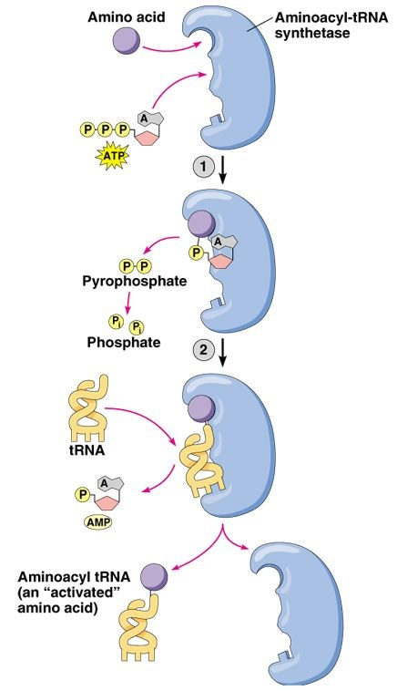
Enzyme: tRNA- synthase
Helps join correct amino acid to tRNA
Requires ATP

Slide 31
Amino Acid
tRNA synthetase helps bind the amino acid to the tRNA molecule
tRNA
Anticodon
mRNA strand codon

Slide 32
Understanding Codes…
DNA: A G C T T G C A A
mRNA:
U C G A A C G U U
ANTI-CODONS:
A G C U U G C AA
Amino Acids? p511
serine, asparagine, valine

Slide 33
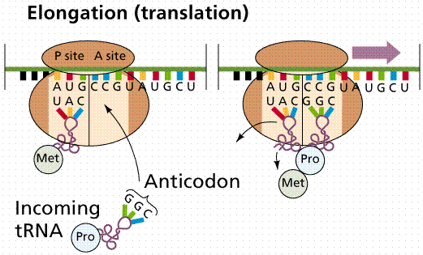

Slide 34
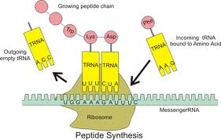
Elongation
one amino acid at a time is added
Polypeptide gets longer
Each ribosome has space for 2 tRNAs at once

Slide 35
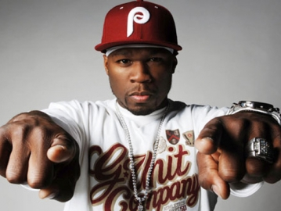
III. Termination
“STOP” codon (UAA, UGA or UAG) is read
“Cut n Release”
Enzyme cuts polypeptide off
Ribosome separates & falls off mRNA

Slide 36
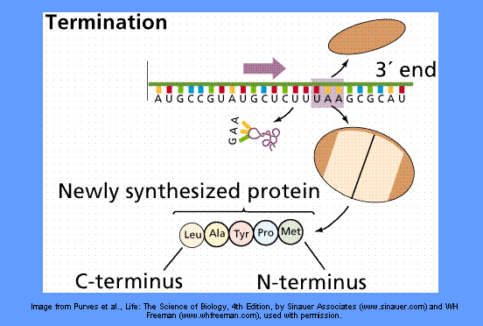

Slide 37
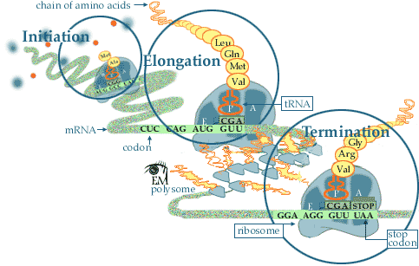

Slide 38
