Slide 3
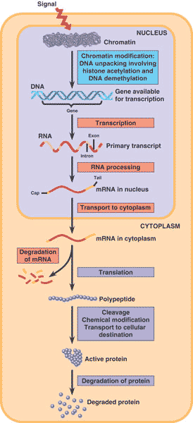
Sec 18.2 Eukaryotic Gene Expression is regulated at many stages
Pg 356-

Slide 5
What factors can affect how are genes are regulated?
https://www.ted.com/talks/nadine_burke_harris_how_childhood_trauma_affects_health_across_a_lifetime?language=en

Slide 8
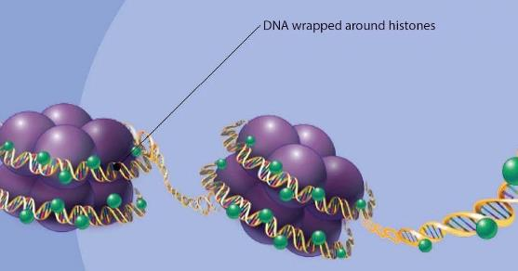
1. Regulation of Chromatin Structure
The packaging of DNA:
Histones
a small protein with an overall positive charge that bind _negative DNA in the chromatin structure

Slide 9
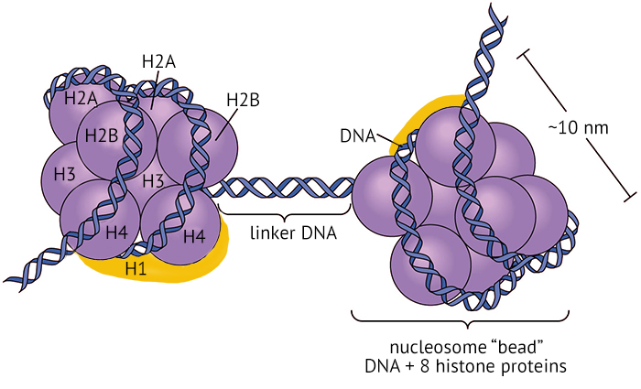
Nucleosomes
a bead like unit of DNA, consists of DNA wrapped around _histones__.

Slide 10
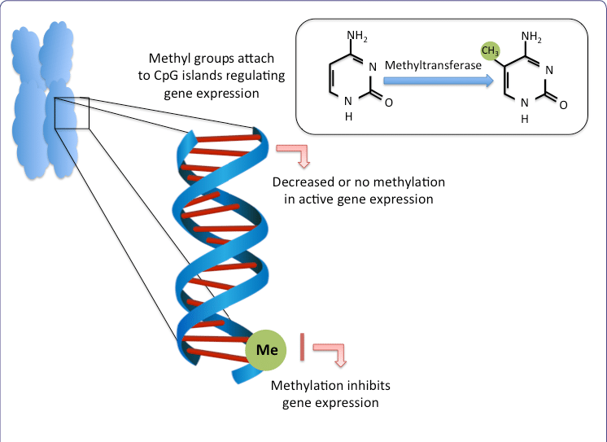
DNA methylation
The addition of _methyl_groups to DNA which causes DNA to be more __tightly packaged__ and reduces gene expression

Slide 11
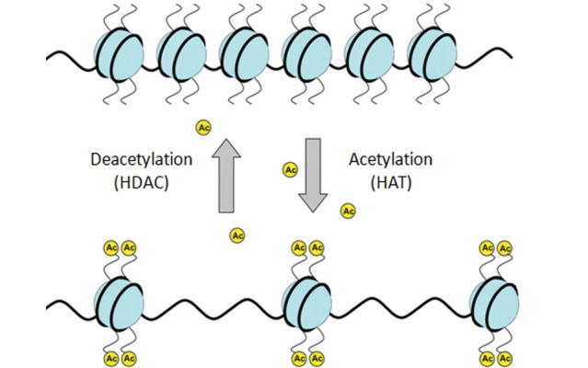
Histone Acetylation
Acetyl groups are added to amino acids of __histone proteins__and makes the chromatin less tightly packed and __encourages____transcription.

Slide 13
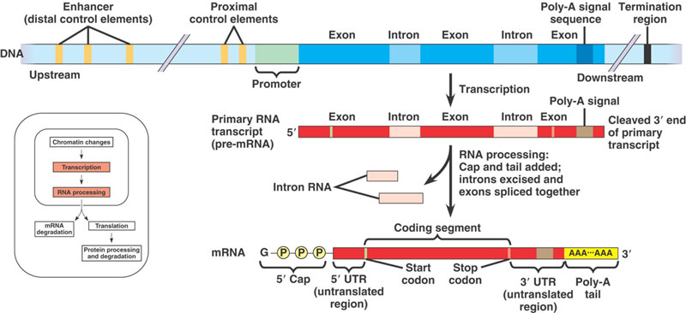
2. Regulation of Transcription Initiation

Slide 14
Transcription Factors:
a regulatory protein that binds to__DNA____ and affects transcription
Transcription Initiation Complex:
the completed assembly of __transcription factor____and __RNA Polymerase______bound to a promoter

Slide 15
Enhancer Regions:
DNA sequence___far__ from the gene, contains control elements
Activators:
bind to certain __mediator proteins____and ____transcription factors_______to form initiation complex

Slide 16
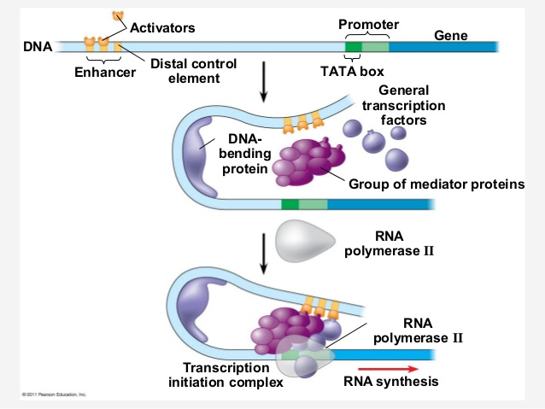

Slide 17
3. Post Transcriptional Regulation
Occurs after transcription and just after translation, when proteins are processed.
example: micro RNA (miRNA) and small interfering RNA (siRNA) can bind to __mRNA_and degrade the mRNA or bind to mRNA and block its _translation___

Slide 18
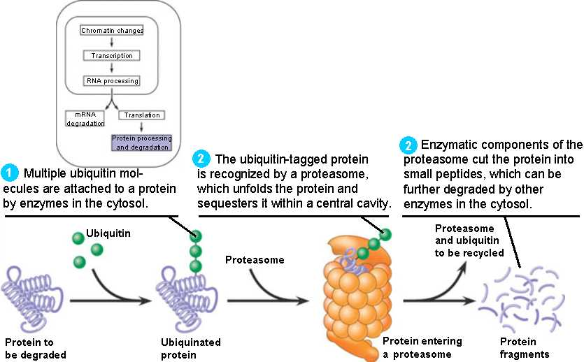
Protein Degradation → proteasomes

Slide 19
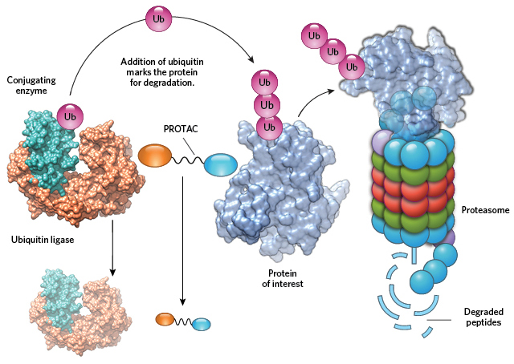
A__proteasome__, an enormous protein complex shaped like a trash can, chops up unneeded proteins.

Slide 20
Watch this!
RNAi- slicing and dicing your cells:
https://youtu.be/tzlGU5EI9rU

Slide 21
Epigenetic inheritance
These chromatin modifications do not entail a change in the DNA __sequence__ however, they may be ___passed on___in future generations of cells.
This is called epigenetic inheritance. The DNA sequence is not changed, just its ____expression______.

Slide 22
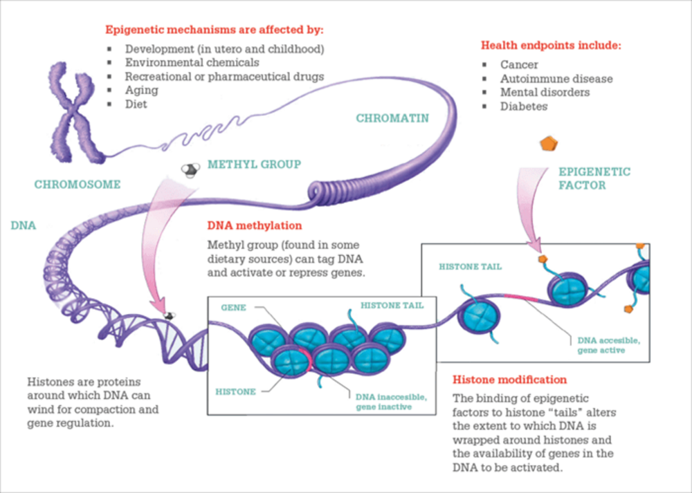

Slide 23
Epigenetic Inheritance
Ted Ed- https://www.youtube.com/watch?v=_aAhcNjmvhc
Bozeman Science- https://www.youtube.com/watch?v=i9a-ru2ES6Y

Slide 24
Practice: Do Concept Check 18.2 Qs 1-5 pg 364
…next class we will review for the Term 2 Test
Sec 18.2 and all materials in this powerpoint are the last pieces you will be tested on

