Slide 1
What is our next unit about?

Slide 2
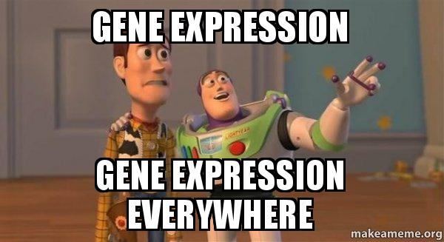

Slide 3
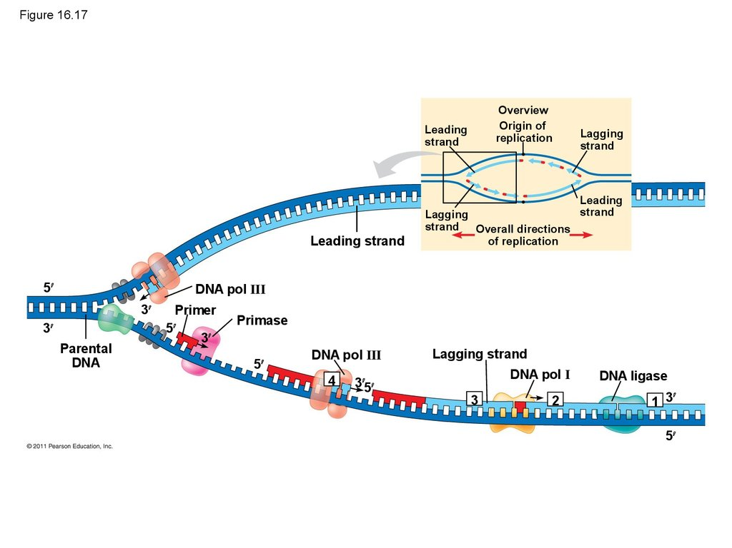
AA Summary of DNA Replication

Slide 4
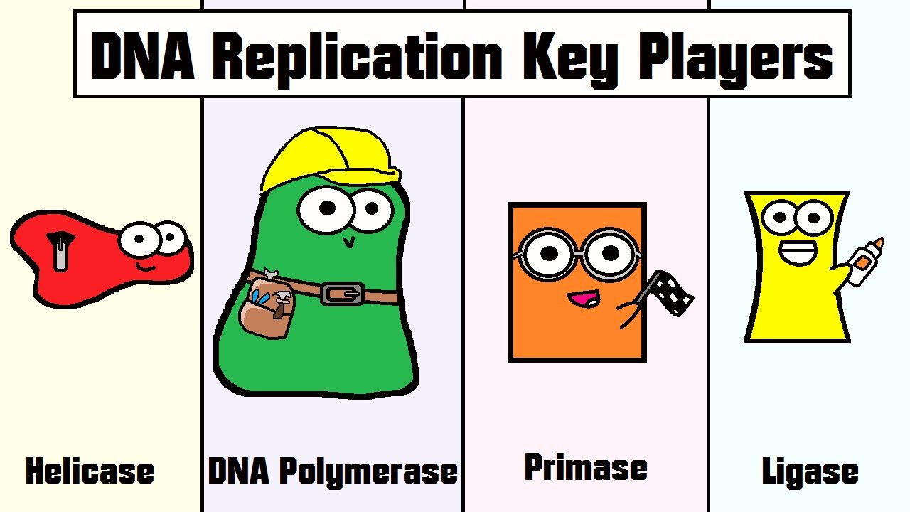
Can DNA do it all on its own?
Many enzymes & other proteins are also needed to carry out replication!

Slide 5
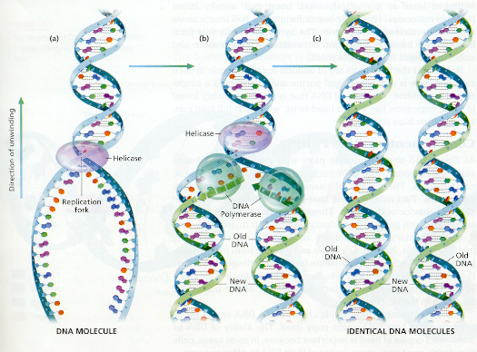
Semi-conservative
New strand= one“old parental” strand and one “new copied strand”

Slide 6
From Genes to Proteins!
Chap 17 p325

Slide 7
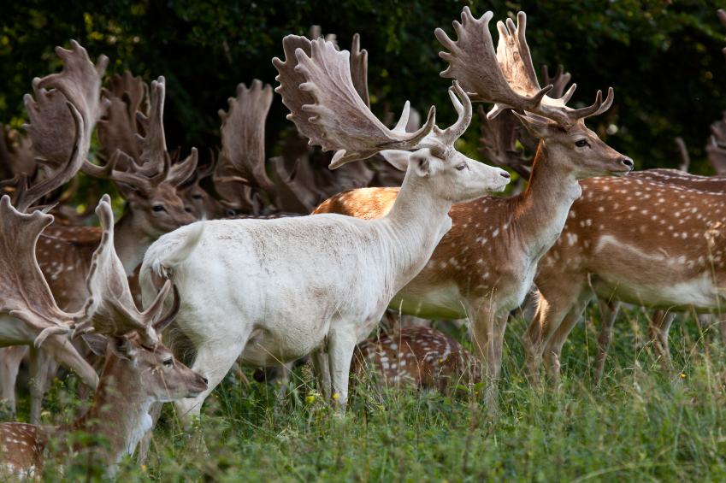
What is the connection between phenotype genotype and proteins!?
Discuss…

Slide 8
Phenotype:
the appearance of an organism’s physical traits
Genotype:
the genetic makeup that codes for a specific trait
Genes are sequences of DNA that code for protein.
The proteins that are made determine phenotype!

Slide 9
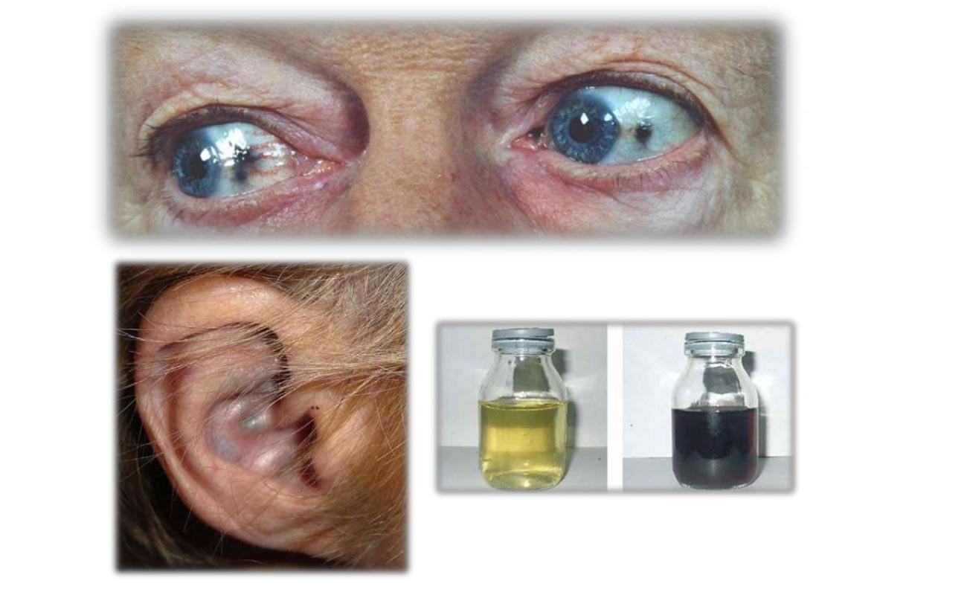
How do we know genes dictate phenotypes?
“In born errors of metabolism” first hypothesized by Archibald Garrod 1902
Suggested symptoms of inherited diseases reflect inability to make a particular enzyme
Ex: Alkaptonuria → Urine is black!
Can’t break down alkapton

Slide 10
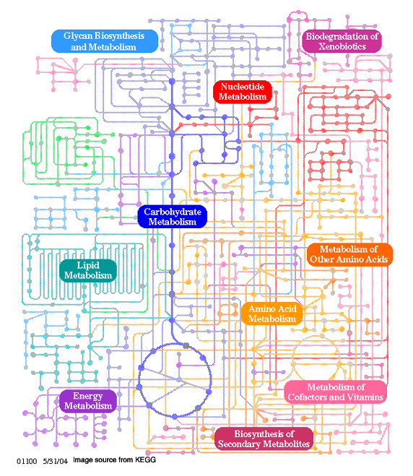
Cells make & break down most organic molecules via metabolic pathways
→ a series of chemical reactions catalyzed by enzymes
Each step in a metabolic pathway is catalyzed by a specific enzyme
enzymes are proteins…

Slide 11
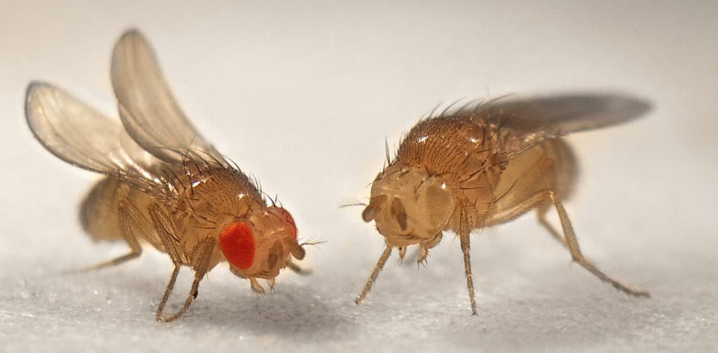
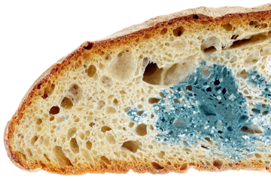
Supporting Evidence:
Research on:
Drosophila- fruit flies (1930s Beadle & Ephrussi)
Neurosporassa crassa- mold (Beadle & Tatum)
helped show mutations (unusual phenotypes) are related to missing enzymes that should be present at specific metabolic steps
relationship between genes & enzymes is crucial!

Slide 12
Gene Expression:
The process by which DNA directs the synthesis of proteins (or RNAs)
Involves 2 main steps:
transcription and translation

Slide 13
The Central Dogma of molecular BioLogy

Slide 14
Transcription
The process of making an mRNA copy of the DNA
Occurs in nucleus
RNA Bases are complementary to the DNA
RNA does not use THYMINE → Uracil instead

Slide 15
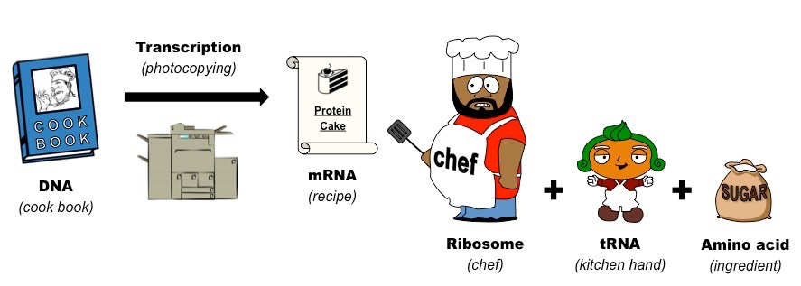

Slide 16
Translation
The process to read the mRNA, to seek out the correct amino acids using tRNA and to join the amino acids into a polypeptide chain
End result= assembly of a protein!
Occurs at the ribosome (in the cytoplasm)

Slide 17
Protein Synthesis

Slide 18
SKILLS:
I can transcribe DNA into mRNA
I can use a table of the genetic code to deduce which codons correspond to which amino acid s

Slide 19
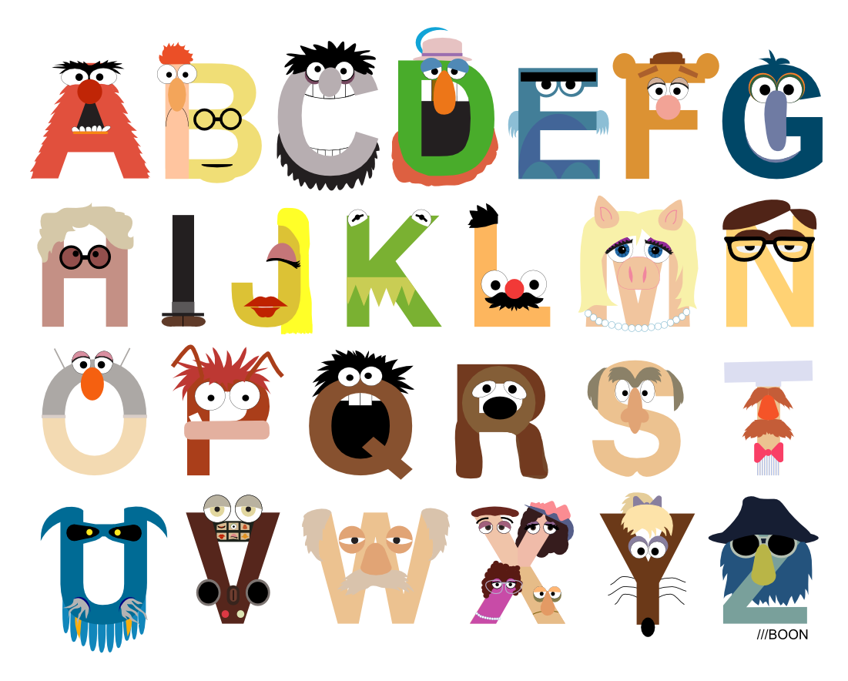
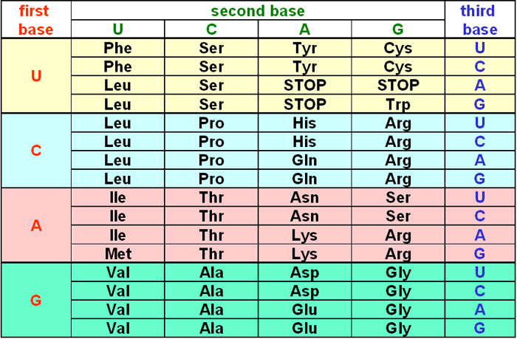
The genetic code
PROTEIN
AMINO ACIDS
CODONS
WORDS
SENTENCES

Slide 20
CODONS
A group of 3 bases that code for a single amino acid
Example: AUG
codes for methionine.
Start codons begin protein synthesis
Stop codons end it

Slide 21
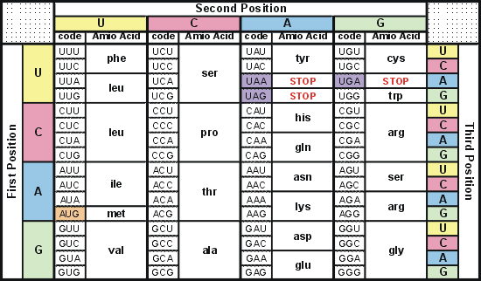
Amino Acids and Codons

Slide 22
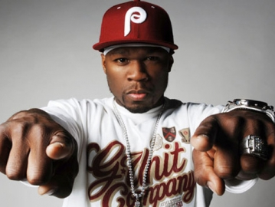
50 Cents favourite codon:
UAG

Slide 23
Protein Synthesis Scavenger Hunt!

Slide 24
One-Gene-One Enzyme Hypothesis
“ The function of a gene is to dictate the production of a specific enzyme”
Nobel Prize 1958 shared by Beadle & Tatum
“genes act by regulating definite chemical events”
(-Nobel Committee)

Slide 25
Today: “One gene-One Polypeptide hypothesis”
not all proteins are enzymes
Ex: keratin, hormone insulin = non enzyme proteins
Some proteins are made of multiple polypeptide chains & each chain is coded for by its own gene
Ex: hemoglobin → 2 polypeptides→ two genes code for this 1 protein
Many genes code for RNA molecules cells need!

Slide 26
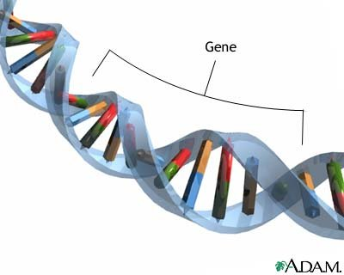
The Genetic Code
Gene:
a short section of DNA that codes for a protein
Proteins are made of amino acids
Genes code for the order of amino acids!

Slide 27
Why is gene expression referred to as a “Triplet Code” ?

Slide 28
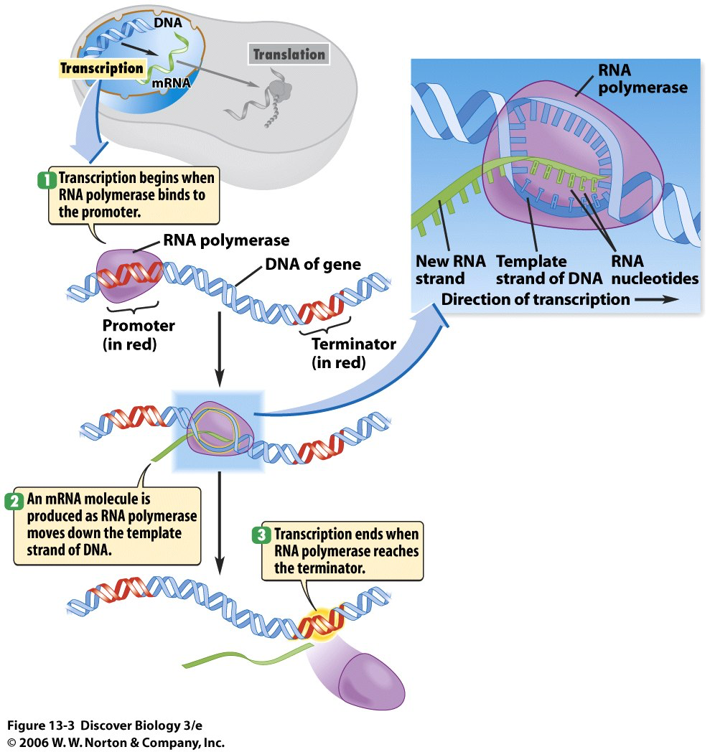

Slide 29
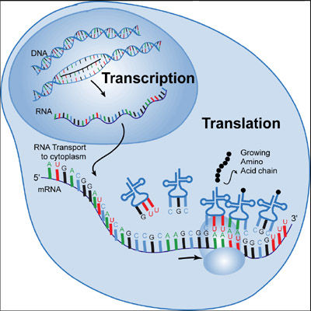
Overview of Gene expression
DNA → RNA → PROTIEN
Transcription:
using the DNA to make an RNA copy that can leave the nucleus
Creates “messenger RNA” aka mRNA
Occurs in nucleus
Translation:
Using the mRNA to obtain the correct order of amino acids and to join them into a polypeptide
Creates a protein
Occurs at ribosomes in cytoplasm

Slide 30
A closer look at transcription Sec 17.2 pg 331

