Slide 1
Body Systems & Digestion
Chap 12 p214

Slide 2
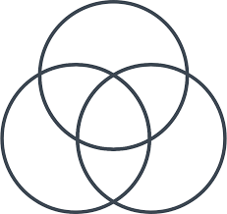
Brainstorm… How do body systems, genes AND biological molecules all connect?

Slide 3
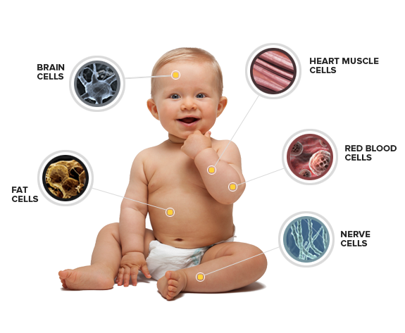
If we think of the body as a machine…
What is the most “Basic” part of this machine?
That’s right, THE CELL!

Slide 4
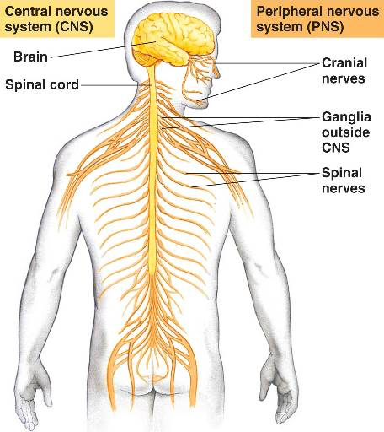
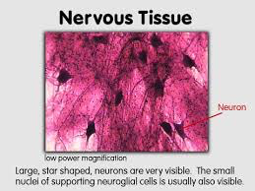
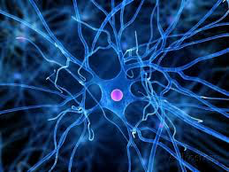
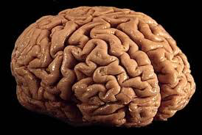
Levels of Organization in the Body
Can put these images in order from least to most complex?
E
A
D
C
B

Slide 5
How close were your predictions?
From Most Basic to most COMPLEX:
B: nerve cell
E: nervous tissue
C: the brain (an organ)
A: the nervous system (organs system)
D: the Biebs (living organism)

Slide 6
Levels of Organization in the Body
Cell- most basic unit of life
Tissue- many similar cells working together at same job
Organ- several different tissues working together at same job
Organ System- several different organs working together to accomplish a job
Living Organism- made up of many different systems performing different jobs!

Slide 7
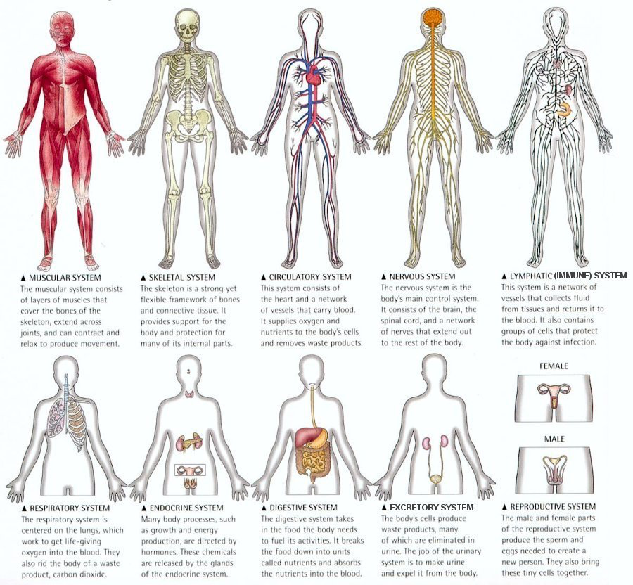

Slide 8
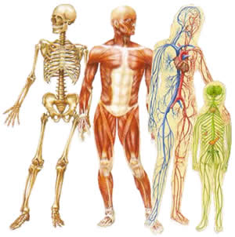
The human body is made up of many systems.
How many can you name?
Circulatory System
Digestive System
Respiratory System
Excretory System
Immune System
Endocrine system
Reproductive System
Skeletal System
Muscular System
Nervous System
Integumentary System

Slide 9
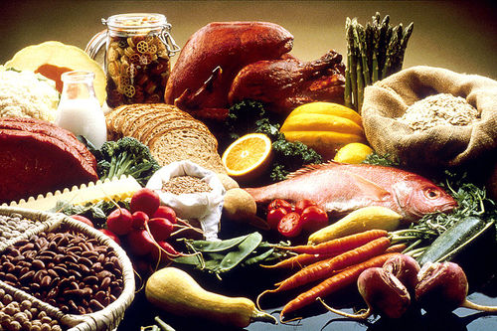
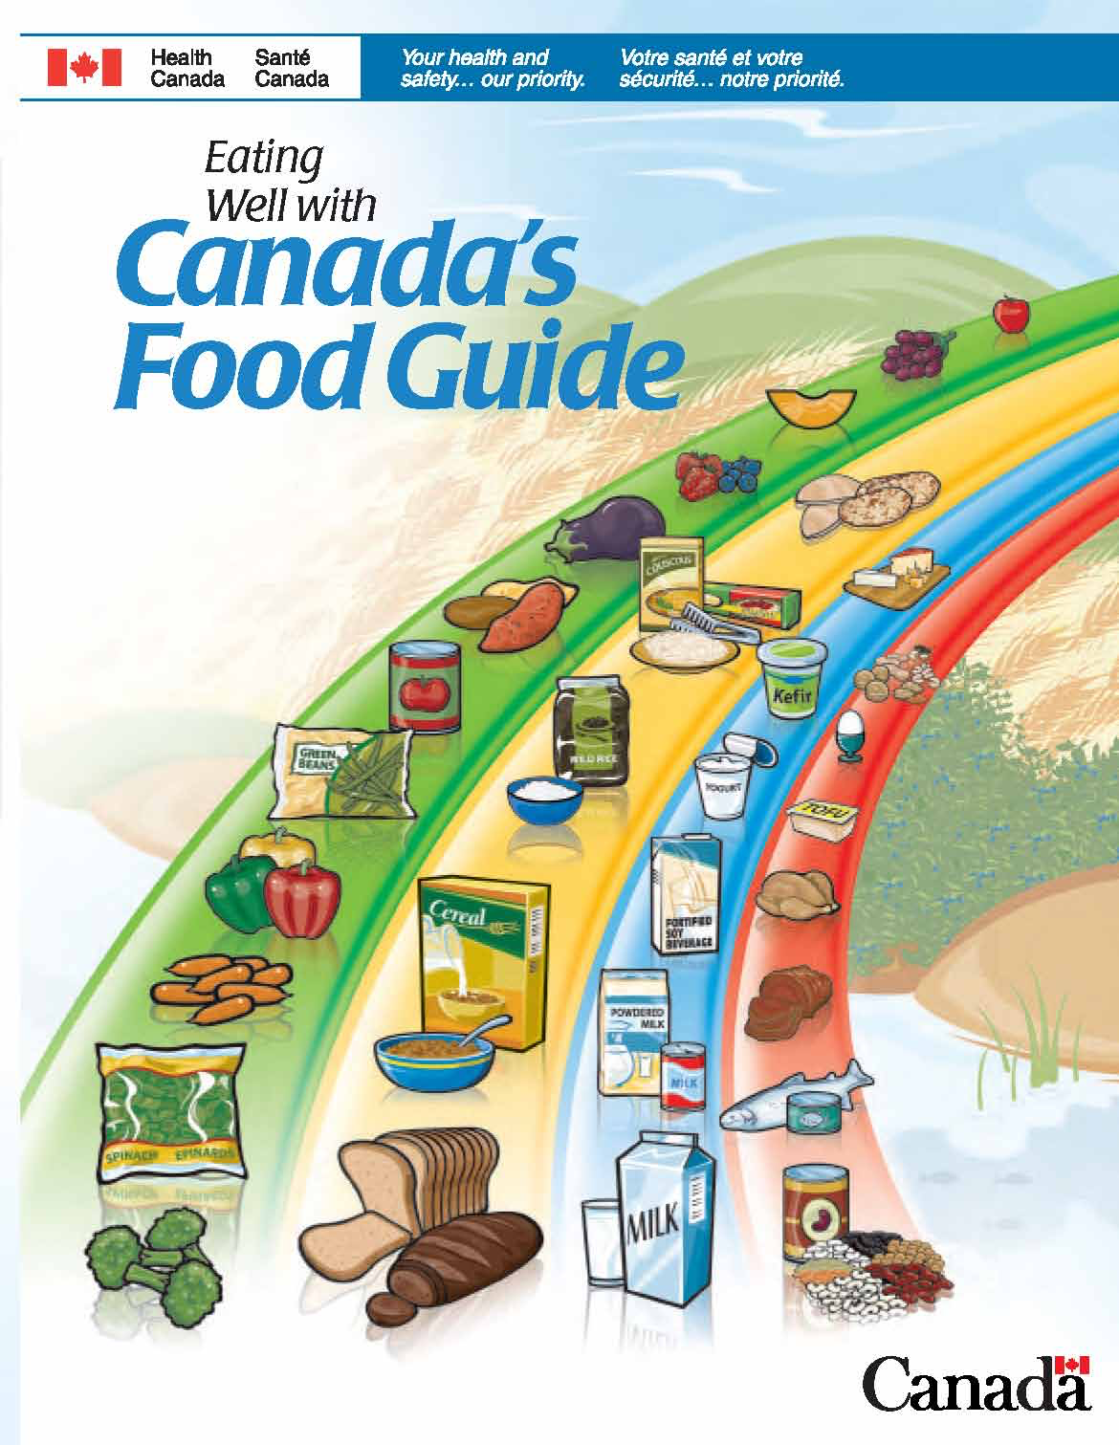
In addition to being “organized”, your body also needs “fuel”!
Where does the “fuel” for your body come from?
Obtained from food and drinks & DIGESTION!

Slide 10
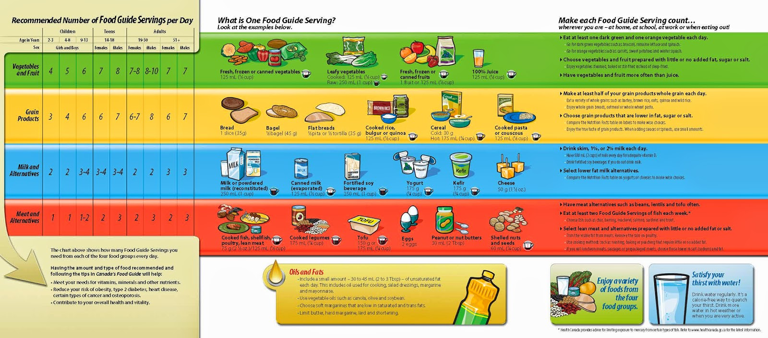
Nutrients (aka fuel)
Needed by the body for:
Energy
Growth
Development
Repair
Maintenance

Slide 11
Now… just for fun… Can you identify these digestive parts!?!?

Slide 12
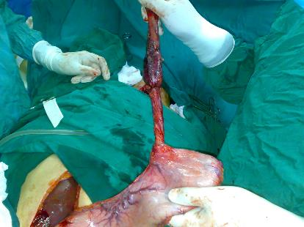
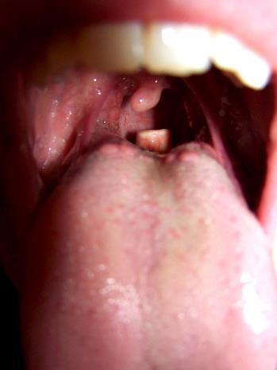
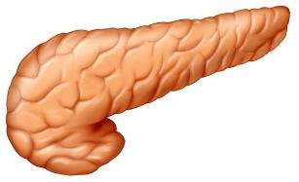
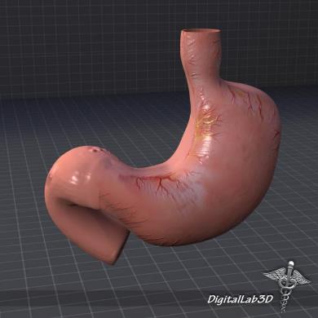
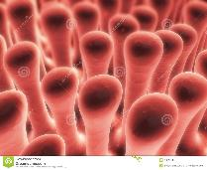
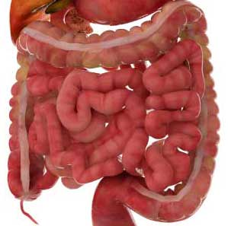
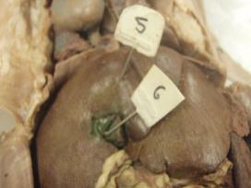
1
2
3
Can you identify the structures in each pic!?
7
4
6
5

Slide 13
Answers…
Esophagus
Epiglottis
Pancreas
Small intestine
Stomach
Villi
Gallbladder

Slide 14
Learning Goals:
I can identify and label the parts of the digestive system
I can describe the structures and functions of the organs involved in digestion

Slide 15
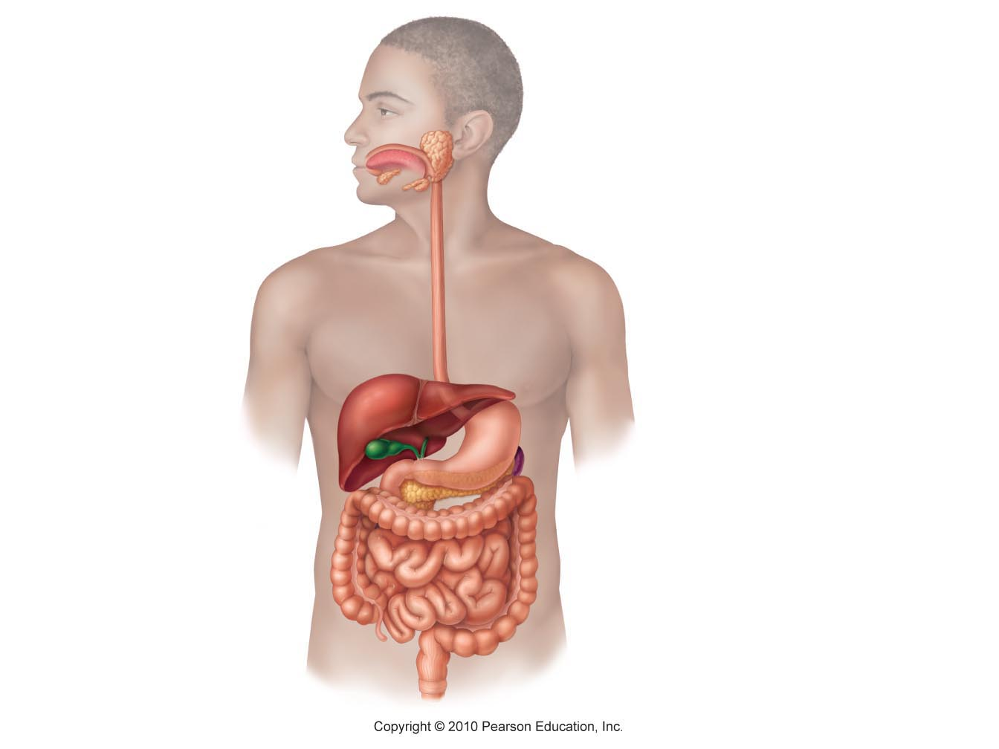
The Digestive System
What parts do you already know?
Label as many as you can on your handout! (NO PEEKING in your textbook!)
Pg 214

Slide 16
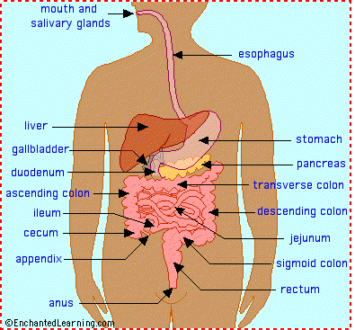
The Digestive System
Small intestine

Slide 17
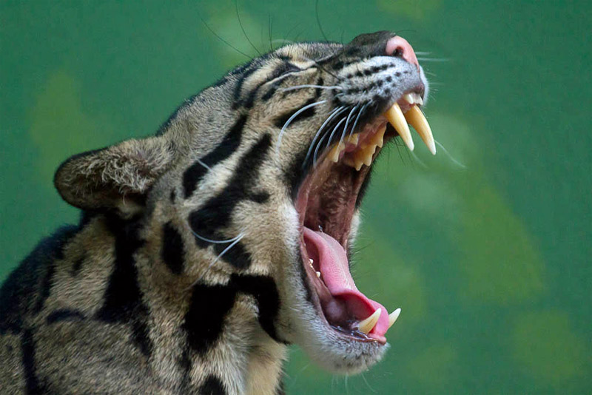
MECHANICAL DIGESTION
Physically Breaks down food
Teeth, rip, shred, tear food into sm. Pieces

Slide 18
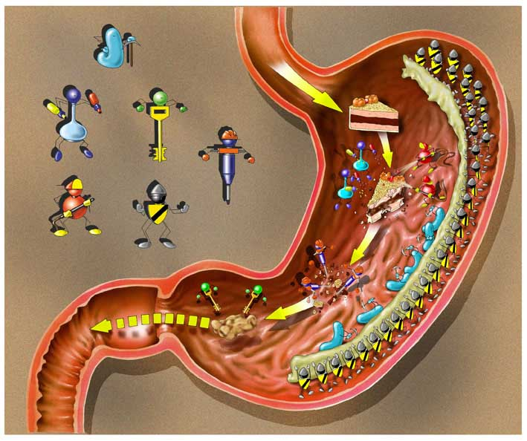
CHEMICAL DIGESTION:
Uses chemical reactions to break down food
→Enzymes & acids
Ex: Salivary Amylase breaks complex carbs to simple

Slide 19
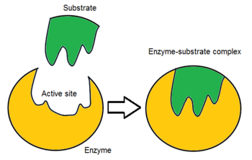
ENZYMES
Special proteins that help speed up chemical reactions
“Lock & Key`
Hydrolytic: adding water helps them break specific bonds
Ex: salivary amylase
Ex: pepsin

Slide 20
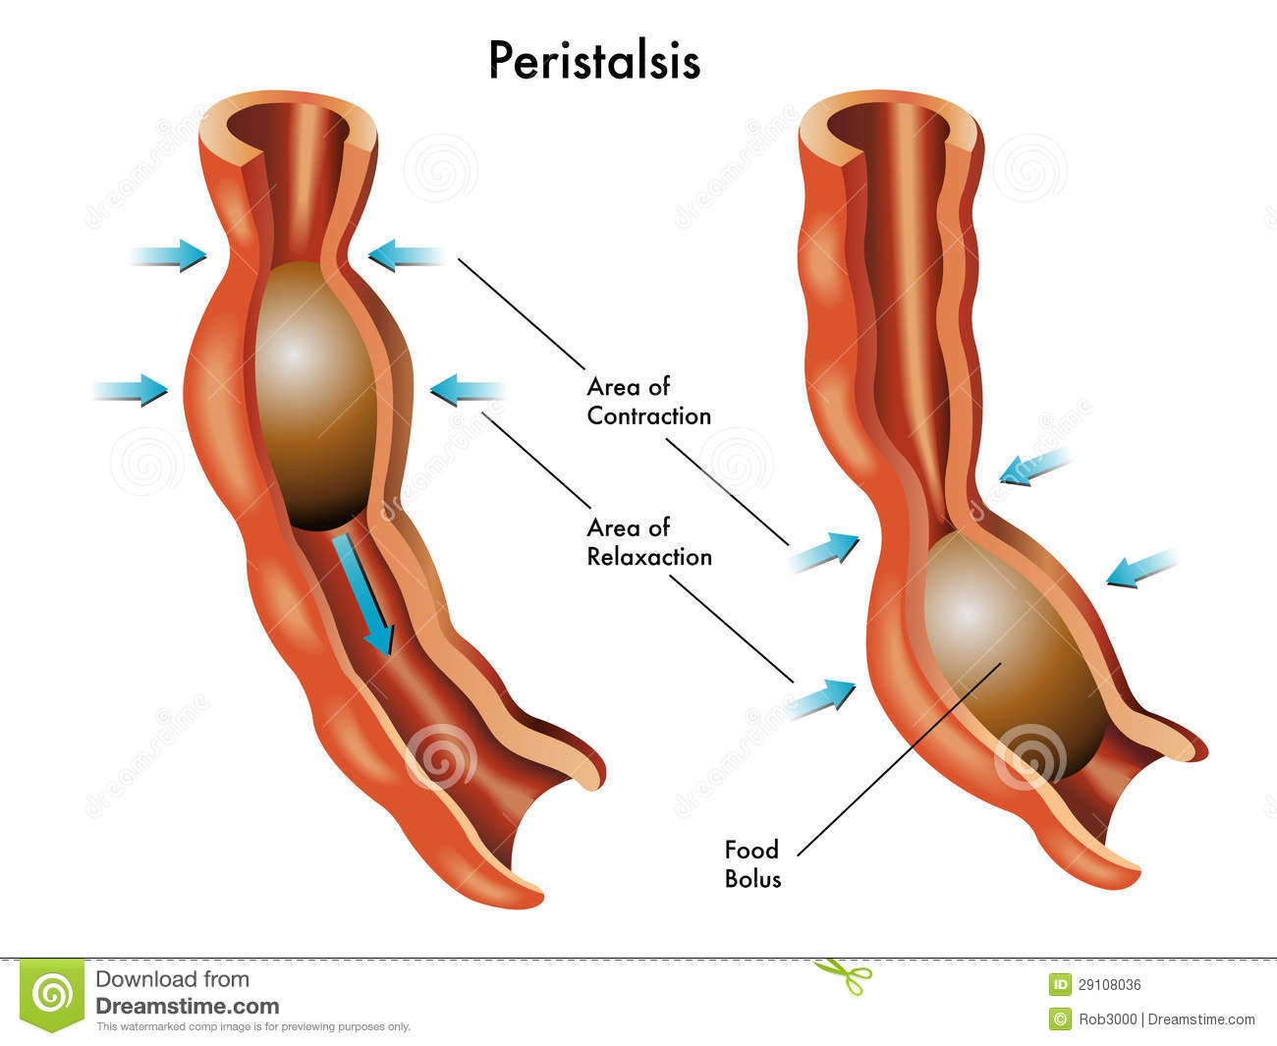
PERISTALSIS
A series of muscle contractions
Push food through the digestive tract
Ex: in Esophagus moves food
Ex: in stomach physically breaks food

Slide 21
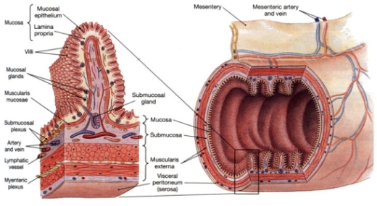
ABSORPTION
Nutrients must be absorbed into blood for distribution → VILLI
Water & Minerals also re-absorbed
→LG INTESTINE

Slide 22
EXTENSION Qs:
Compare and Contrast Mechanical vs Chemical Digestion
What is the difference between an enzyme & a hormone

Slide 23
Mechanical Digestion | BOTH | Chemical Digestion
Physically Breaks down food Teeth, rip, shred, tear to break food into pieces Peristalsis: muscle contractions break food down in stomack | Help break food down so nutrients that can be absorbed Occur in Mouth Needed to make Bolus Occur in Stomach | Uses enzymes to break down food Salivary Amylase breaks complex carbs to simple Pepsin breaks proteins down Pancreatic enzymes break down fat, carbs & proteins Most occurs in Duodenum

Slide 24
HORMONES
Made by specific cells to cause a reaction in “target cells”
“Chemical messenger” carried in blood
Ex: Gastrin

