Slide 4
Crossing Over In a Nutshell…

Slide 5
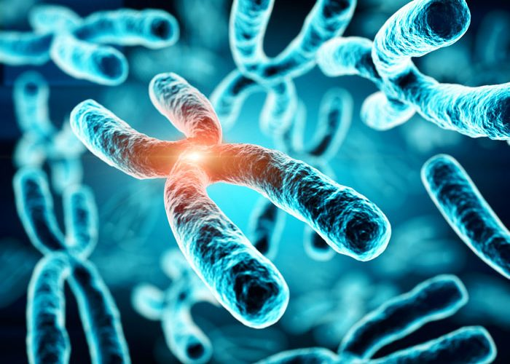
Alterations of Chromosome Number & Structure
Sec 15.4 Page 297

Slide 6
Nondisjunction
How do alterations in chromosome number occur?

Slide 7
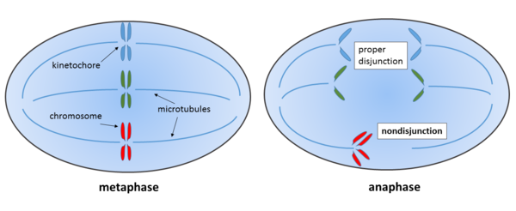
Alterations of chromosome number
Caused by: Non Disjunction
Occurs when homologous chromosomes do not separate properly during meiosis II.
Result: Aneuploidy
-Incorrect number of a chromosome
Trisomic: three copies of the chromosome
Monosomic: one copy of the chromosome
-Polyploidy
More than two complete sets of chromosomes

Slide 8
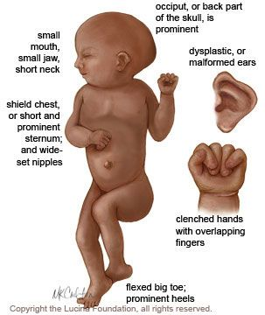
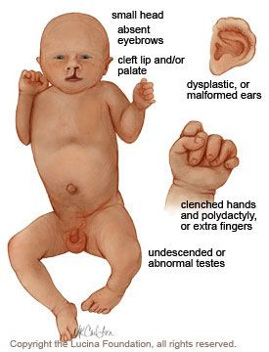
Most common nondisjunction in humans:
Trisomy 21:
Down Syndrome
Trisomy 18:
Edwards Syndrome
Trisomy 13:
Patau Syndrome

Slide 9
Other ways chromosome abnormalities happen…
Mitosis: problems with cell division
Maternal Age: Women are born with all the eggs they will ever have. Errors may crop up in the eggs' genetic material with age.
Environment: No conclusive evidence however may still play a role in the occurrence of genetic errors.

Slide 10
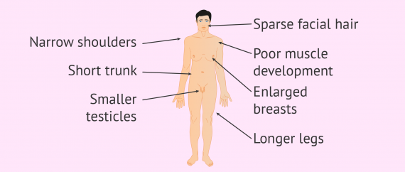
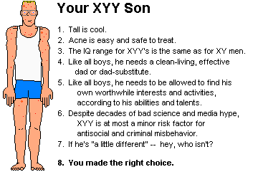
Sex Chromosome Aneuploidy:
XXY – Klinefleter Syndrome
Anatomically male, but unable to have kids
XYY- Male
-no well defined symptoms
XXX- Trisomy X
-healthy, no adverse side effects
X- Monosomy X “Turner Syndrome”
Female sex organs do not mature

Slide 11
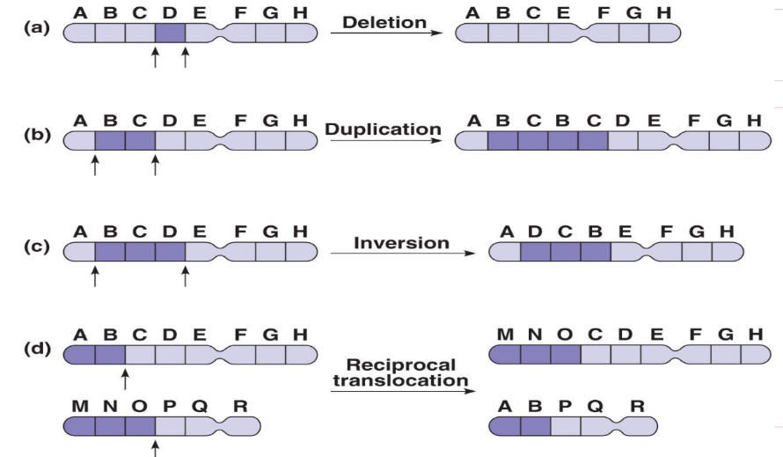
Alterations to Chromosome Structure
Portions of a chromosome may be lost or rearranged during crossing over

Slide 12
Structural Alterations to Chromosomes
a) Deletion- fragment lacking a centromere is lost during cell division
b) Duplication- extra fragment, extra genes.
c) Inversion- a chromosomal fragment reattaches in reverse orientation
d) Translocation- when a fragment of a chromosome becomes attached to a non-homologous chromosome

Slide 13
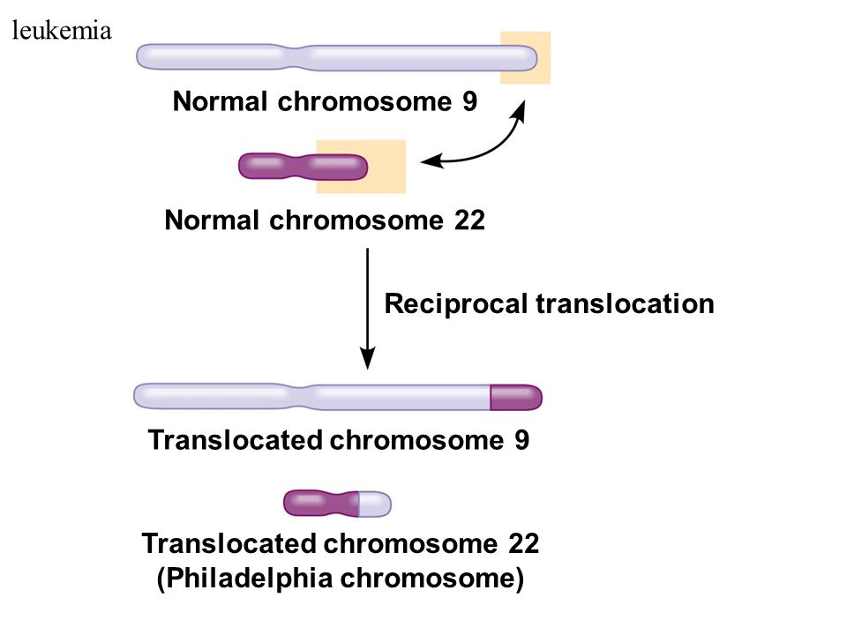

Slide 14
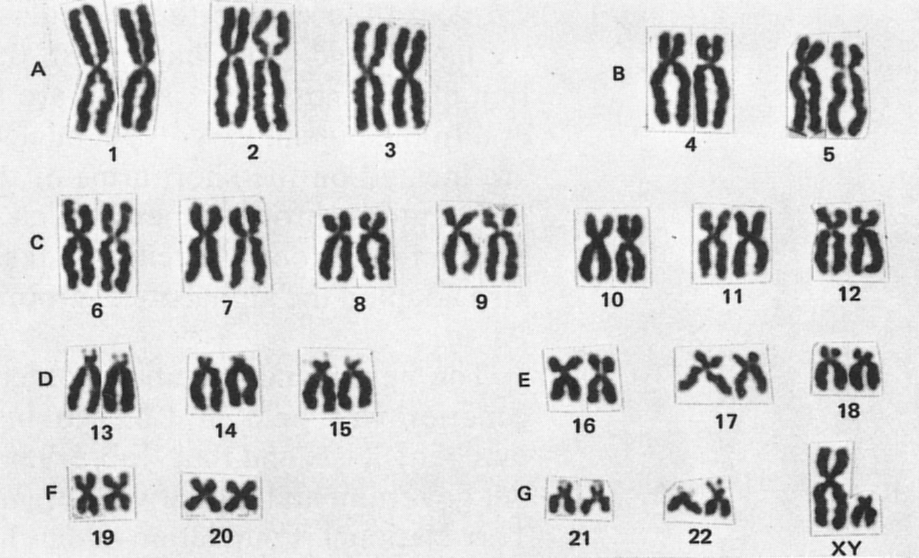
Karyotype:
Shows the size, number, and shape of chromosomes
Can reveal any unusual chromosomal features in developing fetuses

Slide 15
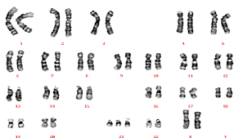
Atypical Karyotype…
Can you spot the difference? Male or Female?

