Slide 3
Sec 15.3: Linked genes are inherited together
Pg 292

Slide 4
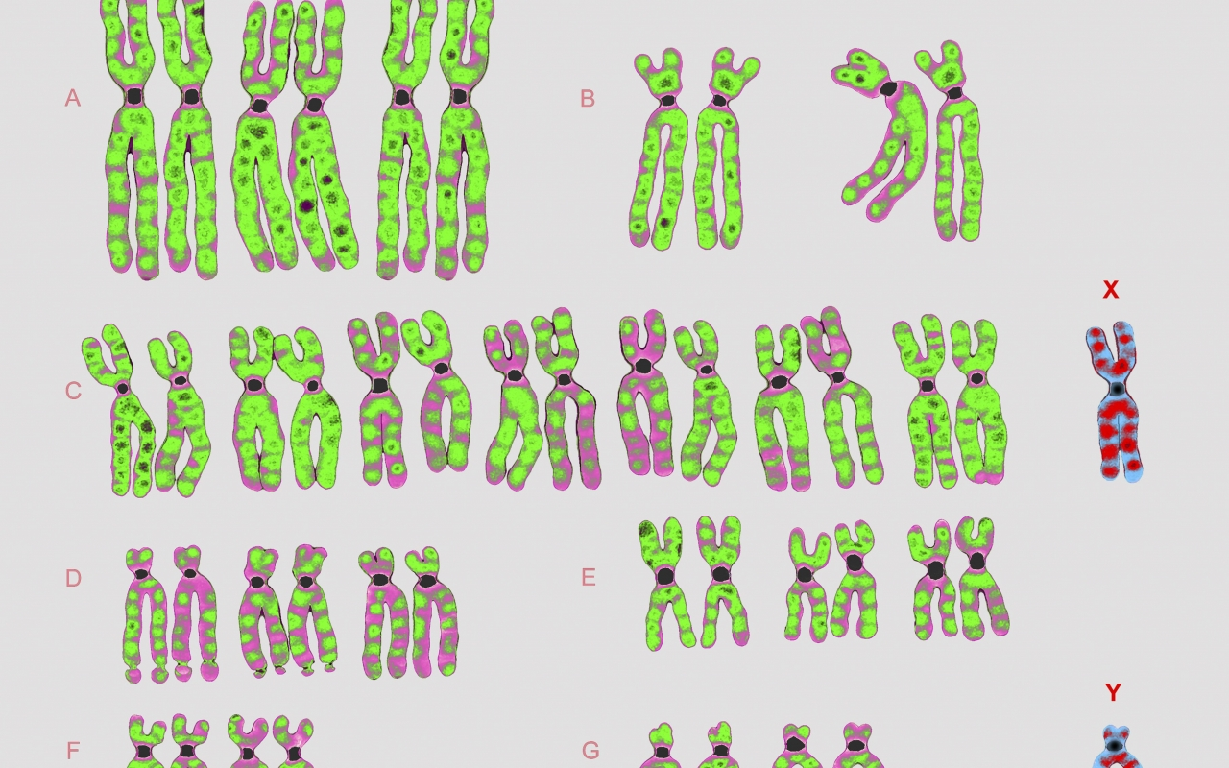
What’s the difference between sex linked genes and linked genes?

Slide 5
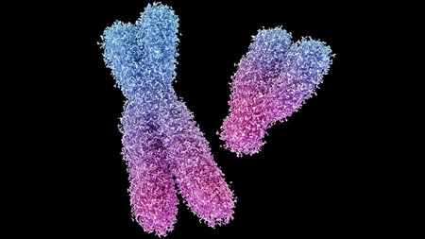
What’s the difference between sex linked genes and linked genes?
Sex linked – a single gene on a sex chromosome (X or Y)
Linked – two or more genes on the same chromosome!

Slide 6
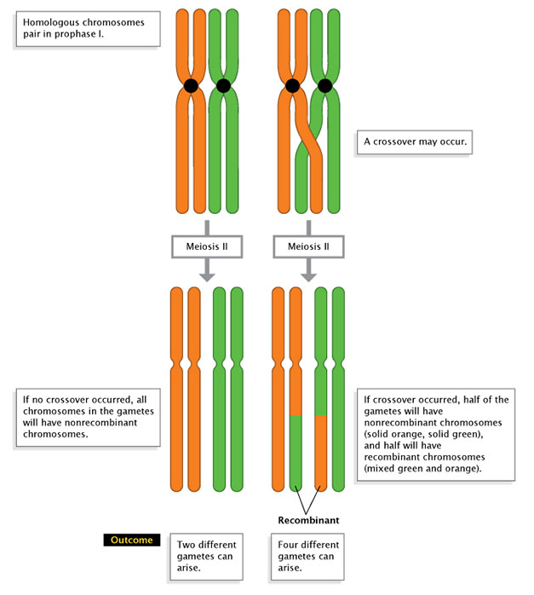
Crossing Over: Recombination of DNA

Slide 7
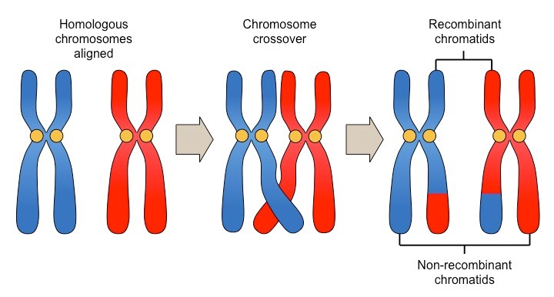

Slide 8
Linkage Map
Are the chances higher for a fly to have vermillion eyes and miniature wings or white eyes and rudimentary wings? Explain.

Slide 9
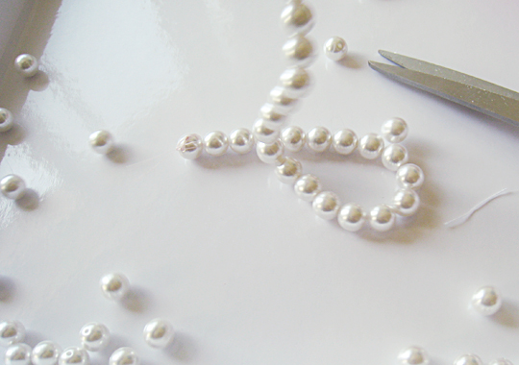
It is similar to breaking a pearl necklace
Genes or pearls that are closer together are more likely to stay together, than the ones farther away.

Slide 10
After Morgan came Alfred Sturtevant…
a 19-year-old Columbia University undergraduate who was working with Morgan, realized that if the frequency of crossing over was related to distance, one could use this information to map out the genes on a chromosome.
After all, the farther apart two genes were on a chromosome, the more likely it was that these genes would separate during recombination.

Slide 11
Linkage Map :
a genetic map that is based on the percentage of crossover events
Map unit: a genetic map that is based on the percentage of crossover events

Slide 12
Lab Set up
For example, to find the distance between P (vermilion eyes) and M (long wings), Sturtevant performed crosses between flies that had long wings and vermilion eyes and flies that had small wings and red eyes.
These crosses resulted in F₁ flies that either had long wings and red eyes or long wings and vermilion eyes.
Sturtevant then crossed these two types of F₁ flies and analyzed the offspring for evidence of recombination

Slide 13
Sturtevant then worked out the order and the linear distances between these linked genes, thus forming a linkage map.
In doing so, he computed the distance in an arbitrary unit he called the "map unit," which represented a recombination frequency of 0.01, or 1%.
Later, the map unit was renamed the centimorgan (cM), in honor of Thomas Hunt Morgan, and it is still used today as the unit of measurement of distances along chromosomes.

Slide 14
A.) Are the chances of AB crossing over greater than BC? Explain.

Slide 15
Draw a linkage map for the following:
The frequency of recombination for cn and b is 9%
The frequency of recombination for cn and vg is 15%
The frequency of recombination for b and vg is 24%
Solution: Draw the greatest distance first and then the work your way towards the shortest distances.

Slide 16
A Summary of Genetic Recombination & Gene Mapping
Watch, Learn & Practice! ~10mins with Bozeman Science
Link: https://www.youtube.com/watch?v=TU44tR0hJ8A

Slide 17
Determining Recombinant Frequencies
Small numbers of non parental phenotypes are explained by cross-over events!
This creates the occasional break in the linkage of genes & new “recombinants”

Slide 18
Calculating Recombination Frequencies:
Number of recombinants x100
Total number of offspring

Slide 19
Wild Type, gray normal | Black vestigial | Gray vestigial | Black normal
G/g N/n (parental phenotype) 1 | g/g n/n (parental phenotype) 1 | G/g n/n (nonparental phenotype) 1 | g/g N/n (nonparental phenotype) 1
G/g N/n (parental phenotype) 1 | g/g n/n (parental phenotype) 1 | 0 | 0
ACTUAL Results | 965 | 944 | 206 | 185

Slide 20
Number of recombinants x100
Total number of offspring
Number of recombinants:
Total number of offspring:
The recombination frequency for these linked genes , G/g and N/n ____

Slide 21
Number of recombinants x100
Total number of offspring
Number of recombinants: 206 + 185 = 391
Total number of offspring: 965 + 944 +206 + 185 =2300
The recombination frequency for these linked genes , G/g and N/n __17 %__

