Slide 1
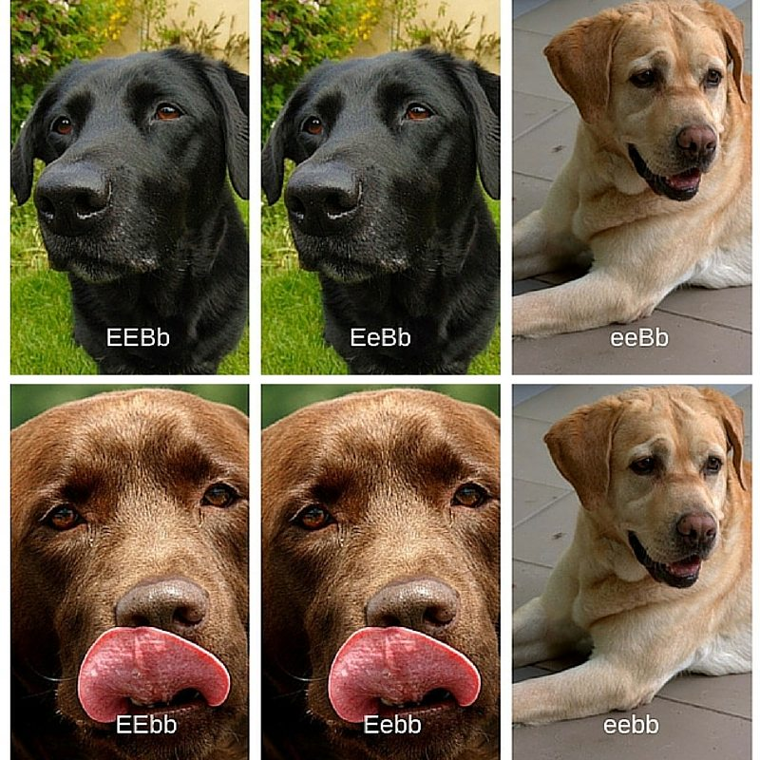
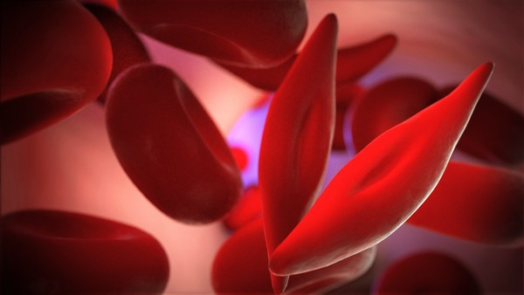
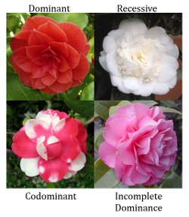
Extending Mendelian Genetics Sec 14.3 pg 271-275

Slide 2
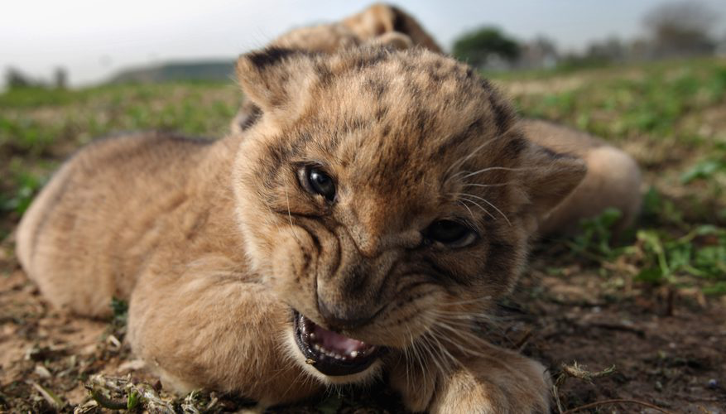
First Rapid Review…Try This!
What is the probability that when two lions mate they will have 4 offspring in which, 1 will be male and 3 will be female?

Slide 4
1.

Slide 5
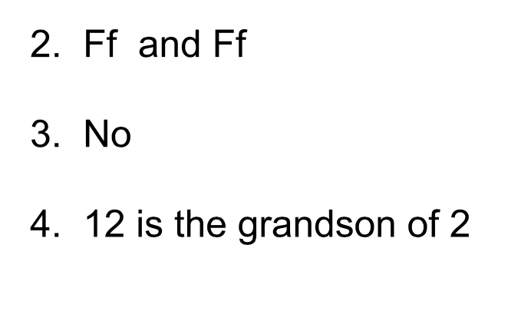

Slide 6
Extra Background / Review
https://www.youtube.com/watch?time_continue=9&v=Mehz7tCxjSE

Slide 7
Extending Mendelian Genetics Sec 14.3 pg 271

Slide 8
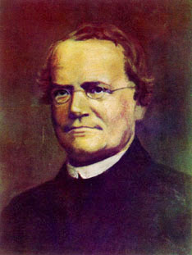
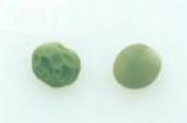
Degrees of dominance
Complete dominance-
the offspring always look like either parent A or parent B (NOT a combination)
Hh and HH phenotypes look the same ( NOT a mix)
The basis of Mendel’s work!

Slide 9
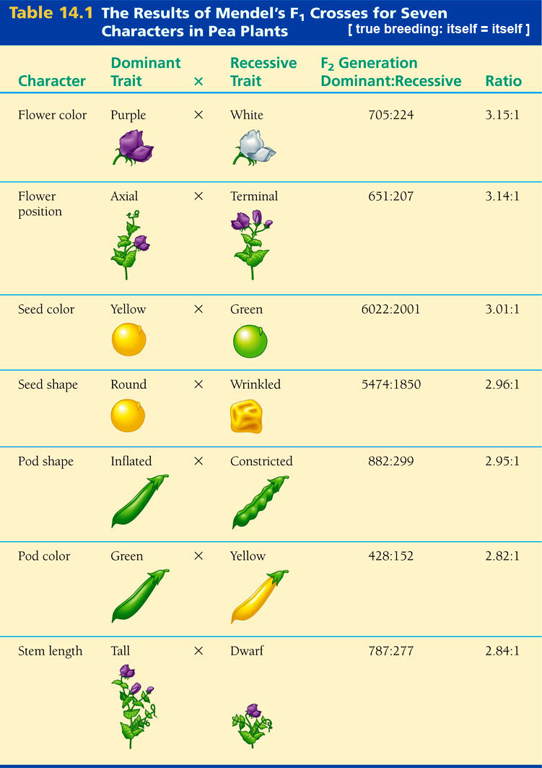
Mendel’s peas showed complete dominance!
EXCEPT… he couldn’t explain the ratios for pod shape!

Slide 10
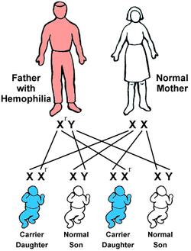
Not all traits follow simple Mendelian patterns

Slide 11
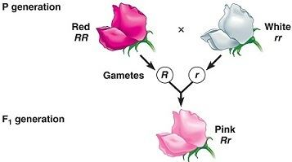
ii) Incomplete Dominance
-Neither allele is dominant so Heterozygote (Hh) shows a blended phenotype
-Ex: Snap dragon flowers

Slide 12
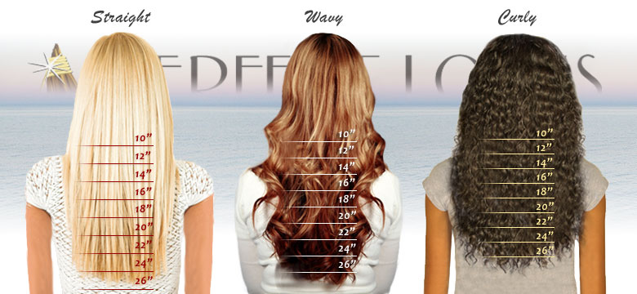
Example: Straight and curly hair=wavy
TT Tt tt

Slide 13
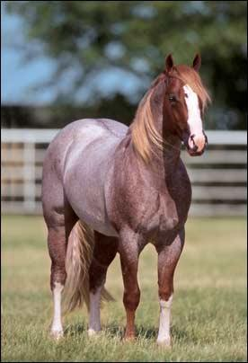
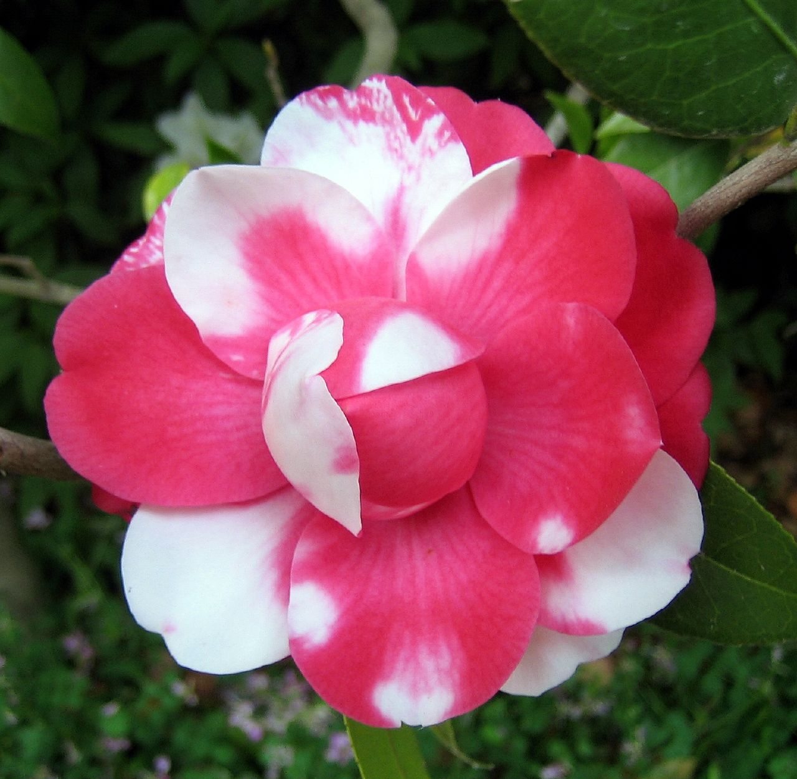
iii) Codominance
2 alleles each affect the phenotype is separate, visible ways
Heterozygote shows both traits at same time

Slide 14
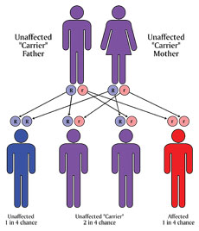
Assessing Degrees of Dominance Ex: Tay Sach’s disease
Autosomal recessive condition, results in destruction of brain and nerve cells
Caused by mutation of HEXA gene
→ codes for an enzyme need to break down lipids

Slide 15
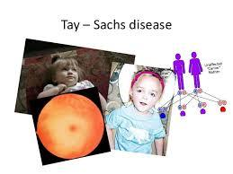
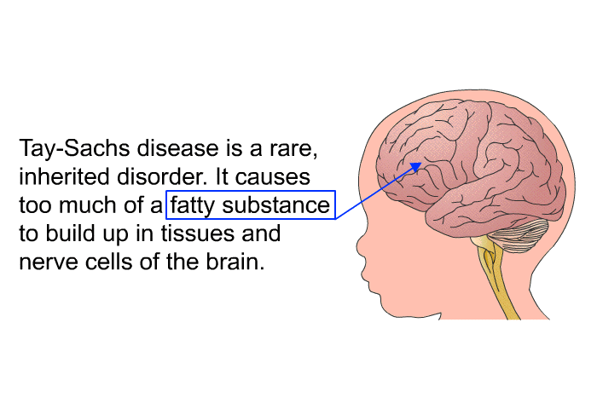
Diagnosed at 3-6mths
Loss of ability to turn over, sit, crawl, or move

Slide 16
At level of the organism→ recessive disorder
At biochemical level …
half the normal amount of enzyme is made (enough so that no symptoms)
→ incomplete dominance
At molecular level…
→ half normal enzyme is made AND half dysfunctional enzyme is made
→ codominance

Slide 17
Degrees of Dominance…
Not cut and dry…
depends on the level at which we examine the phenotype!
https://www.youtube.com/watch?time_continue=6&v=bdp8UjV7C74
Ex: Tay Sachs Disease

Slide 18
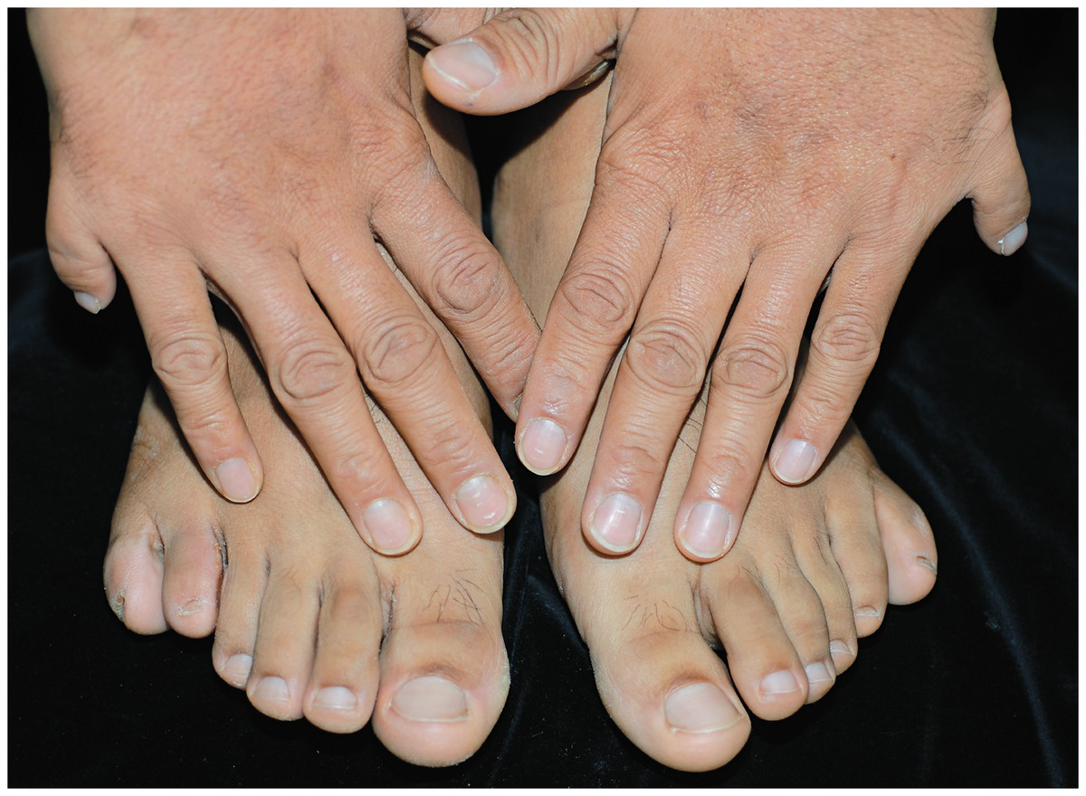
Polydactyly

Slide 19
Polydactyly
1/400 people in US is born with an extra toe or finger
Caused by a dominant allele
Recessive alleles = 5 fingers & MORE Common

Slide 20
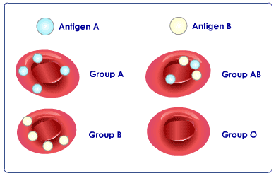
Multiple Alleles
Several alleles may exist for one gene
Ex: Blood Types…
different combinations of the gene for enzyme type lead to 4 different blood types

Slide 21
Each allele codes for an enzyme that adds a specific type of carbohydrate
Gene for blood type:
I has enzyme
i- no enzyme
Possible variations of enzyme:
A, B, AB, O (none)

Slide 22
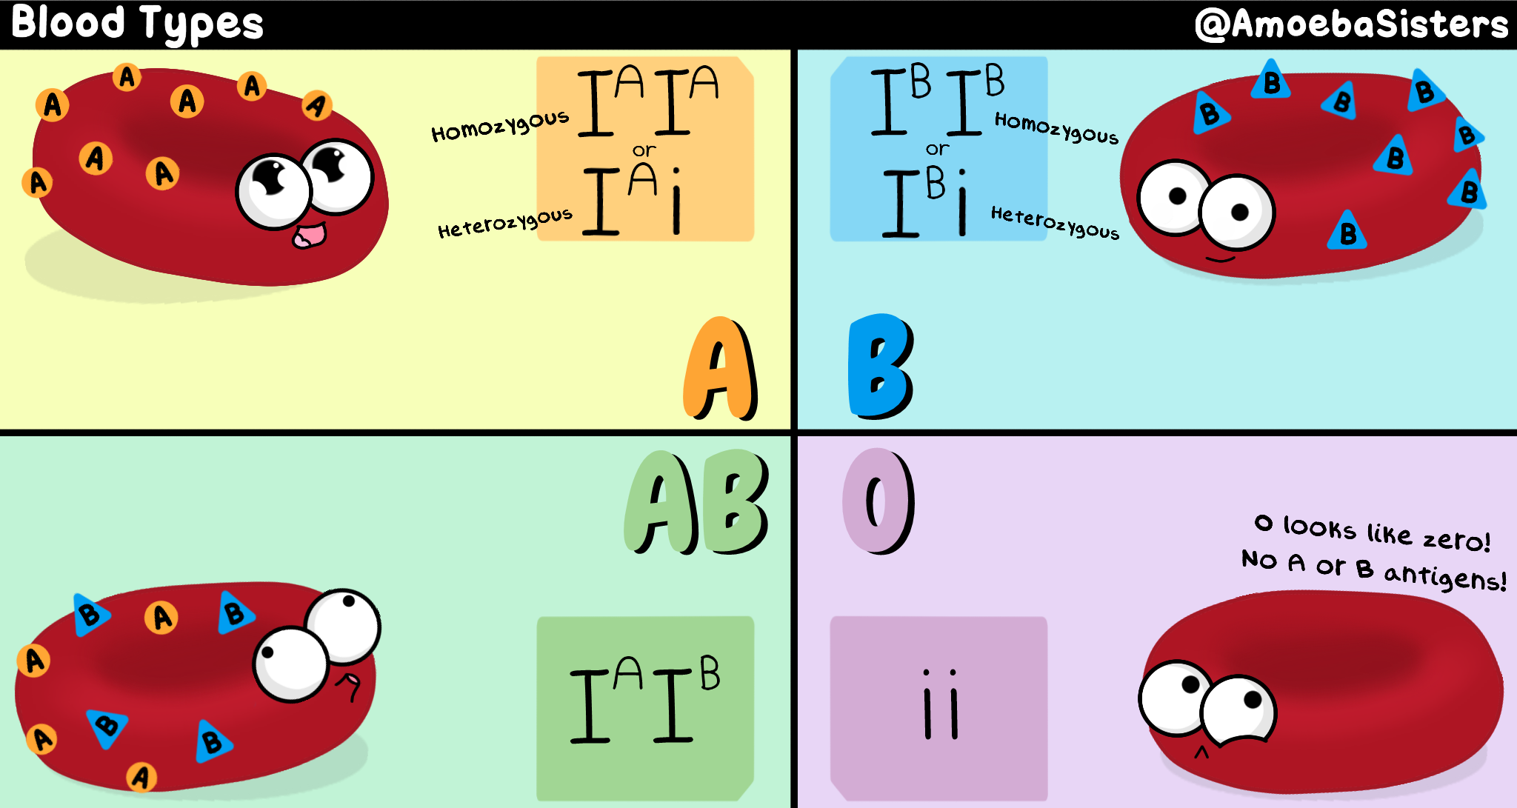

Slide 23
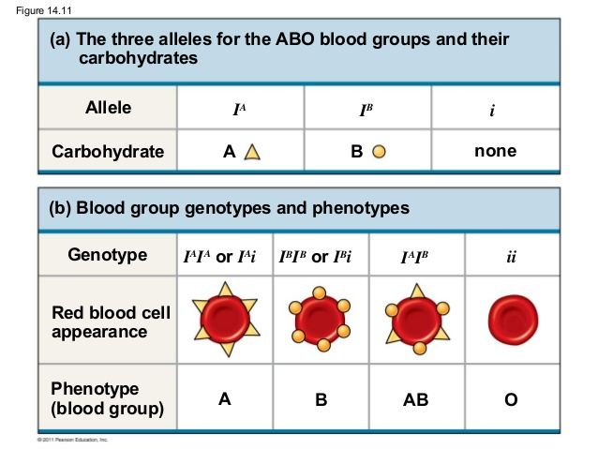

Slide 24
Take a peek at this
https://www.youtube.com/watch?v=9O5JQqlngFY

Slide 25
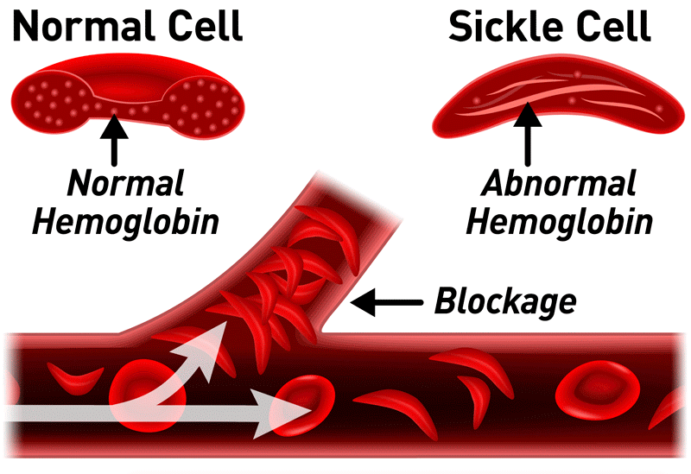
Pleiotropy
One gene that has multiple effects on phenotypic characters
Ex: Sickle cell Anemia

Slide 26
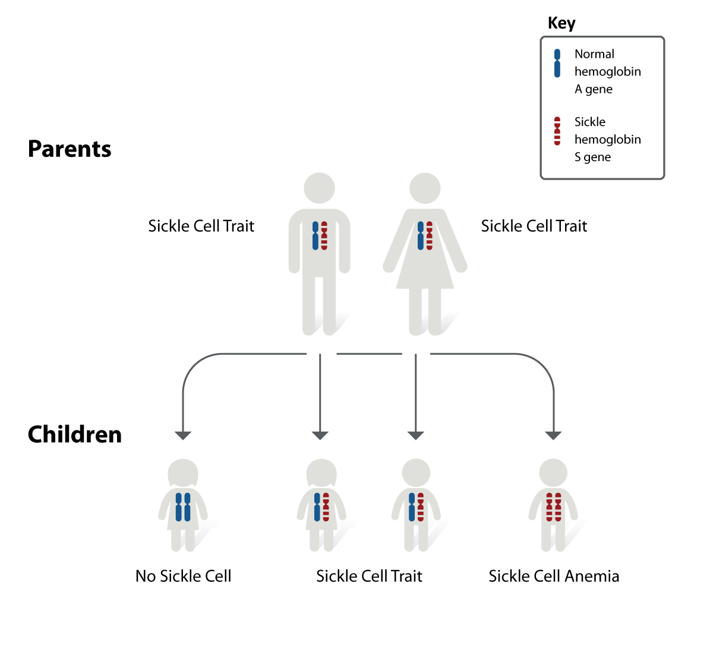

Slide 28
Pleiotropy
Sickle Cell Anemia
https://www.youtube.com/watch?time_continue=10&v=Qd0HrY2NlwY
Cystic Fibrosis
https://www.youtube.com/watch?time_continue=11&v=FMAOEOmLoUE

