Slide 1
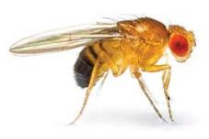
Genetics & Stats Reunited at Last!
AP Science Practice 2:
The Student can use, justify and apply mathematics appropriately

Slide 2
Chi-Squared with Bozeman Science & Crash Course
Bozeman- https://www.youtube.com/watch?v=WXPBoFDqNVk
Crash course- https://www.youtube.com/watch?v=7_cs1YlZoug
In Class: Intro + M & M Chi Square Analysis
We need to know Chi Square for the fruit fly lab!

Slide 3
Have you ever wondered why that package of m & m’s you bought never seems to have enough of your favorite colour?

Slide 4
In this activity we will use stats to find out!
Does the number of different coloured M & M s in each really match the expected number given by the company’s website?!?
What “Sweet STAT” will we use to find out!?
The Chi Square Analysis!

Slide 5
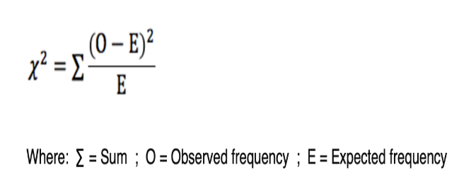
Chi-squared (χ²) tests
This equation will be given to you in the AP data booklet:
Useful because:
It determines is the variation in the data due to chance OR is it actually due to one of the variables being tested?
Helps us accept OR reject our null hypothesis!

Slide 6
Chi-squared (χ²) tests are used to determine
Very useful in genetics & we will use for the fruit fly lab!
We can apply (χ²) tests to results from dihybrid crosses
→ ie is the predicted 9:3:3:1 ratio being upheld?
Is there statistical difference between the actual ratios observed (data collected) and what would be expected from our Punnet’s Square?

Slide 7
Simple steps to using a Chi Squared Test
Identify null and an alternate hypothesis
Ho: there is no significant difference between expected & observed
Construct a table of frequencies to compare the observed and expected frequencies
Apply the chi squared formula to calculate a Chi squared value
Calculate the Degrees of Freedom (df) by subtracting 1 from the number of classes
Identify the critical Chi squared value at p<0.05 & compare to calculated Chi squared

Slide 8
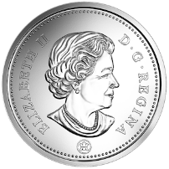
Simple Example:
Flipping 50 coins…
We’d expect the number of Heads and Tails to occur with equal chance so
Expected= 25 Heads 25 Tails
Null Hypothesis: There is no difference between the expected and observed frequencies
Flip the coins…. Get the ratios & record the actual number of Heads and Tails observed
Observed : H- 28 T- 22
Calculate

Slide 9
Build a Table of Frequencies & Calculate
 | Heads | Tails
Expected | 25 | 25
Observed | 28 | 22
(28-25)²/25
=9/25
(22-25)²/25
=9/25
Sum = 18/25 = 0.72

Slide 10
Calculate the Degrees of Freedom (df) by subtracting 1 from the number of classes
Number of class: Heads or Tails so 2 classs
df= 2 -1
=1

Slide 11
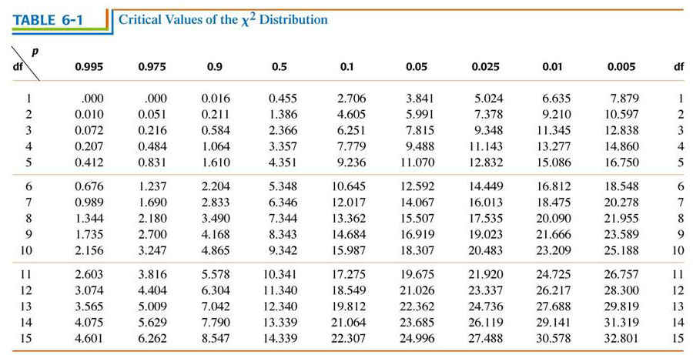
Identify the critical Chi squared value at p<0.05 & compare to calculated Chi squared

Slide 12
Compare to critical value & Conclude:
Calculated x² = 0. 72
At p0.05 critical value = 3.841
Since our x² is less than 3.841 we accept our null hypothesis!
There is no statistical difference between the number of heads and tails flipped!

Slide 13
Step 1: Identify hypotheses
Null hypothesis (H₀): There is no significant difference between observed and expected frequencies (i.e. genes are unlinked)
Alternate Hypothesis (H_{A}): There is a significant difference between observed and expected frequencies (ie. genes are linked)

Slide 14
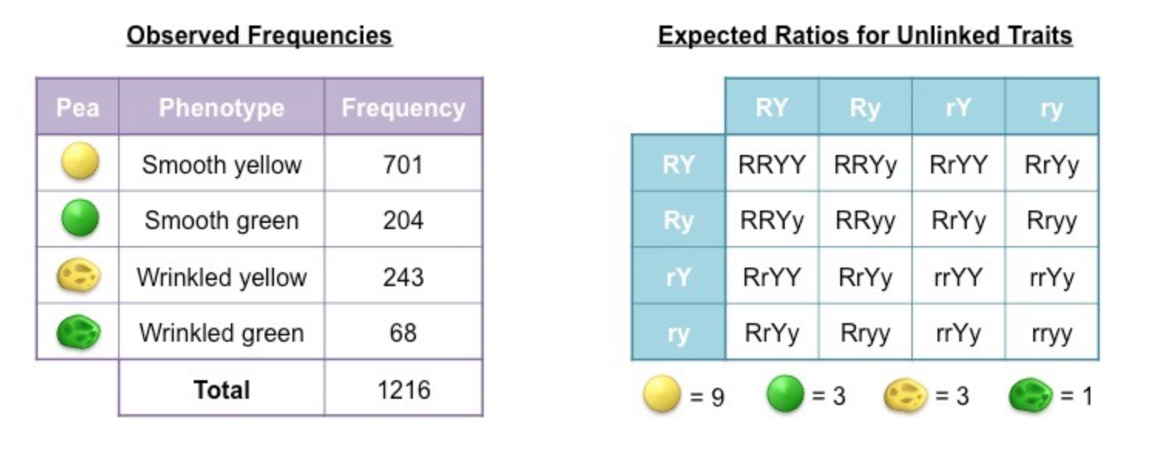
Step 2: Construct a Table of Frequencies
Compare observed and expected frequencies for each possible phenotype in a table
Expected frequencies are calculated by: determining the expected ratios and then multiplying against the observed total
Ex: Smooth Yellow
Observed: 701 (from data)
Expected: 1216 x 9/16 = 684

Slide 15
Step 2: Construct a Table of Frequencies

Slide 16
Step 3: Apply the Chi-Squared Formula

Slide 17
Step 3: Apply the Chi-Squared Formula
X² = the sum of the bottom row
=( 0.42 + 2.53 +0.99 + 0.84)
=4.76

Slide 18
Step 4: Determine the Degrees of Freedom
*For our purposes use number of classes– 1

Slide 19
Step 5: Identify the p value & use a Chi- Squared distribution table

Slide 20
Conclusion…Which hypothesis do the stats support?
Since the calculated x2 is less than the critical value at p 0.005…
→Accept the null hypothesis (H_{O})
REJECT the alternative hypothesis
There is no significant difference between observed and expected frequencies (genes are unlinked)

Slide 21
M & M Activity
Follow instructions.. You can eat the candies when the lab tells you!

Slide 22
Class Data
 | Brown | Blue | Orange | Green | Red | Yellow | TOTAL
O | 5+6+4+9+3+5+4+7+9 | 6+16+8+13+6+11+14+16+11 | 7+12+12+10+10+12+7+3+6 | 17+9+12+11+21+11+13+14+13 | 11+3+10+3+7+9+10+7+9 | 10+7+10+11+7+9+8+10+8 | 56+53+56+57+54+57+56+57+56
E
O-E
(O-E)² /E
X²

Slide 23
Assignment
For next class you must hand in your m and m lab AND the practice Question on the extra handout (see next slide)
Today we will start the fruit fly lab and continue next day, it will be due next week
Fruit Fly Lab Link: https://www.biologycorner.com/fruitflygenetics/index.html
Go to sexing fruit flies first then follow instructions

Slide 24
See Practice Q on Handout:
In sweet pea plants, the trait for purple flowers (P) is dominant to red flowers (p). Similarly, the trait for long pollen (L) is dominant to round pollen (l).
Two heterozygotes are crossed, yielding the following frequencies for the F1 generation:
296 purple long pollen plants, 19 purple round pollen plants, 27 red long pollen plants, 85 red round pollen plants.
Use the chi-squared test to determine if these results are due to independent assortment.
Include a null and alternate hypothesis and a table to show all calculations

Slide 26
X² =
Ho: There is not statistical difference between the expected and observed frequencies of each phenotype
Ha: There is a statistical difference between expected and observed
Plant Phenotype | Observed # (O) | Expected Ratio | Expected # (E) | O-E | (O-E)2 E
Purple /Long |  | 9
Purple / Round |  | 3
Red /Long |  | 3
Red/ Round |  | 1
TOTAL:

