Slide 1
Hela Cells can live forever…
But would you want to?

Slide 2
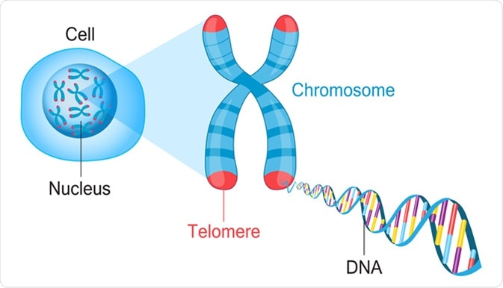
“Telomeres have been compared with a bomb fuse AND measuring telemorase may be away to detect cancer’…

Slide 3
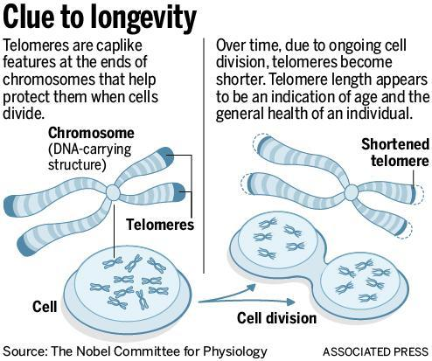

Slide 4
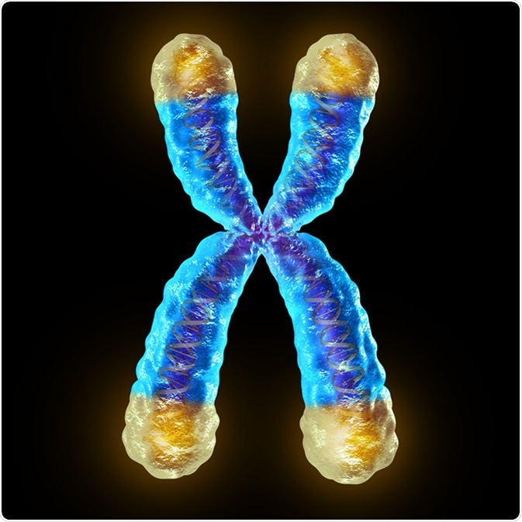
List Group Label

Slide 5
Step 1
Work in a group of 4
Write down each vocab word on a sticky note

Slide 6
Life expectancy
Shoelaces
Oxidative stress
Sperm & Eggs
Heart Muscle
RNA
TTAGGG
Genetic Blueprint
Cancer
Glycation
3000 base pairs
Chromosomes
Immortalize human cells
Impair Fertility
Chemical Code
Telomeres
Cell Divides
Dyskeratosis Congenita
Bomb Fuse
DNA polymerase
Senescent
Shortening
Telemorase
Loses 30-200 Base pairs

Slide 7
Step 2
Arrange words into 4 categories on a LARGE white board
Give each category a TITLE
Be ready to share your categories and reasoning

Slide 8
Step 3
Read article
ANNOTATE!
Highlight, write words, use arrows connect ideas etc

Slide 9
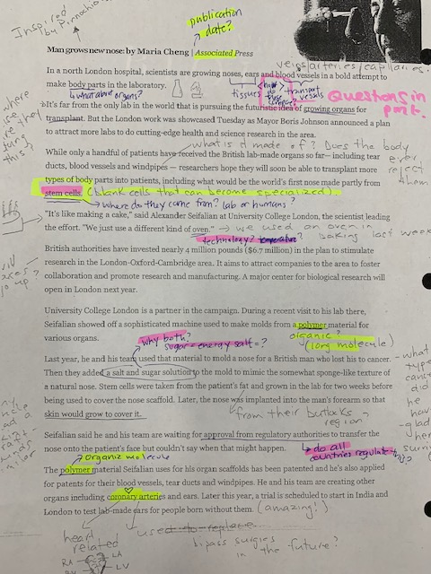

Slide 10
Annotations
The active process of writing, underlining, illustrating, questioning & understanding text, photos or video

Slide 12
Why Annotate?
Makes text, pictures, videos more manageable
Helps identify structures and patterns to analyze ideas
Helps me visualise as I read & keeps me engaged with the text
Helps me focus on important aspects and prevents “skimming” or “fake reading”
Helps me create a study tool→ key ideas & connections stand out after

Slide 13
How can I annotate?
Use a highlighter
Use different colour pens to code
Write/ draw directly on the page
Add QS & connections (arrows)
Add definitions
Use post-It notes

Slide 14
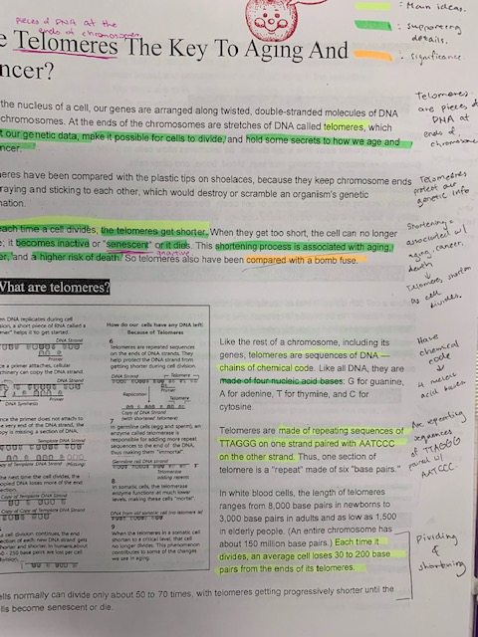

Slide 15
Annotation Skills to Practice
Annotation Skills | Explanation
Vocabulary | I Write down synonyms I Write down & look up difficult words meanings
Questions | I Write down my questions as I read
Connections | I write my connections (similarities) between what I read with my own life, the world around me, other texts, videos or images I have seen
Pictures/Visualization | I draw pictures or images to help me interpret and make sense of vocab and text
Imagery | I write down what I see, hear, smell, taste or touch as I read, listen or watch
Opinion forming | I write down what I am thinking about what I am reading
Inferences | I write down my assumptions or educated guesses based on clues from what I am reading, watching etc

Slide 16
Step 4
RE-CLASSIFY your vocab words
Discuss meanings of words with your team!
Goal: Eliminate any “IDK” categories
Re-arrange or create New groups & titles!
Decide on 2 Questions, Connections or Concerns about the article to share out on BIG STICKY & POST! ☺
Step 5

Slide 17
Step 5
Share your new understanding of the vocab words
What did you already know?
What surprised you?
Real life applications?
Examples?
Questions?
Cross- subject area connections or new topics?

