Slide 1
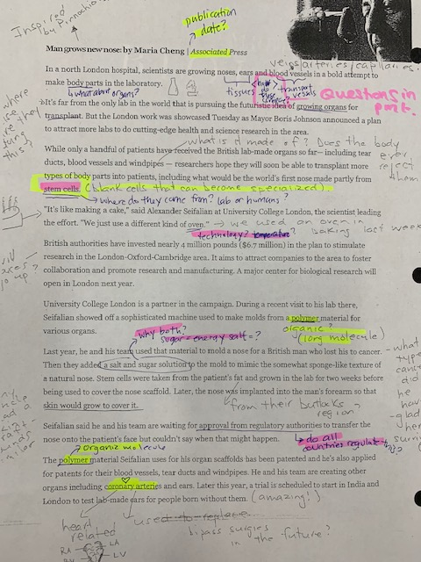
Annotating Text

Slide 2
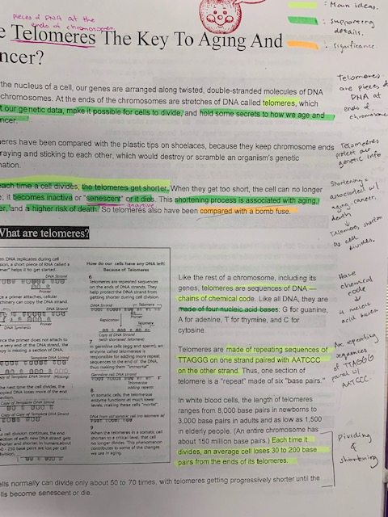
Annotation:
The active process of writing, underlining, illustrating, questioning & understanding text, photos or video

Slide 3
WHY ANNOTATE?
Helps you gather info & ideas
Helps you interpret & make meaning
Useful to investigate new questions

Slide 4
Team Task #1: Annotate the Article
Group read aloud OR 5 min individual skim & share
Annotate as you go→ highlight, underline, question etc
Create TWO Group QUESTIONS
1 Simple Q: Who, what, where, when, why? (easy to google!)
1 Complex Qs: investigates relationships, layers, society, ethics etc

Slide 5
Team Task 2: Sketch notes
Finish reading the article…
Identify the 3 big Ideas
Decide how could you visually summarize the article
Divide large sheet into 4 categories – 1 for each team member to summarize,

Slide 6
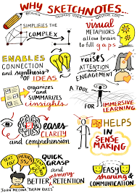
Group Annotation Activity: Sketch Notes

Slide 8
Picking up where we left off…
Why care about telomeres?
https://www.youtube.com/watch?v=HqqtFwCg3YM
Why sketch note?
https://creativeeducator.tech4learning.com/2016/articles/get-started-with-sketchnoting

Slide 9
Why Annotate?
Makes text, pictures, videos more manageable
Helps identify structures and patterns to analyze ideas
Helps me visualise as I read & keeps me engaged with the text
Helps me focus on important aspects and prevents “skimming” or “fake reading”
Helps me create a study tool→ key ideas & connections stand out after

Slide 10
How can I annotate?
Use a highlighter
Use different colour pens to code
Write/ draw directly on the page
Use post-It notes

Slide 11
Annotation Skills to Practice
Annotation Skills | Explanation
Vocabulary | I Write down synonyms I Write down & look up difficult words meanings
Questions | I Write down my questions as I read
Connections | I write my connections (similarities) between what I read with my own life, the world around me, other texts, videos or images I have seen
Pictures/Visualization | I draw pictures or images to help me interpret and make sense of vocab and text
Imagery | I write down what I see, hear, smell, taste or touch as I read, listen or watch
Opinion forming | I write down what I am thinking about what I am reading
Inferences | I write down my assumptions or educated guesses based on clues from what I am reading, watching etc

