Slide 1
Protein Synthesis
Translation

Slide 2
Transcription Over view

Slide 3
Transcription : The reading of the DNA strand creation and processing of the mRNA strand in the nucleus.
Translation: The process that reads the mRNA strand to create a strand of amino acids that becomes a protein.
Gene Expression: The process by which the genetic code of a gene is used to direct protein synthesis. The expressing of a segment of DNA found on a chromosome that specifies the amino sequence of a polypeptide

Slide 4
Codon
1 codon = 1 amino acid
A sequence of three nucleotides = 1 codon
64 different codon triplets→ 61 code for amino acids, 3 stop codons

Slide 5
Transfer RNA (tRNA)
Brings amino acids to the ribosomes
Single stranded poly nucleotide that doubles back on itself
On one end is an amino acid, other end is anticodon
Anticodon a triplet of three bases complementary to a specific codon of mRNA
During translation tRNA brings amino acids to the ribosomes the order dictated by sequence of mRNA

Slide 6
Translation
Translation requires 3 steps:
Initiation: brings all the translation components together.
Elongation: is the protein synthesis step in which a polypeptide increases length one amino acid at a time
Termination: The steps necessary to end the process of translation.

Slide 7
Initiation
During initiation the small ribosomal unit, mRNA, initiator The small ribosomal unit attaches to the mRNA in the vicinity of the start codon (AUG).
The anti-codon of the initiator tRNA pairs with the start codon.
Then, the large ribosomal unit joins to the small unit.
A ribosome has three binding sites for tRNA
A for amino acid site
P for polypeptide site
Only the initiator tRNA binds to the P site the rest start at the A site.
tRNA, and large ribosomal unit all come together.

Slide 8
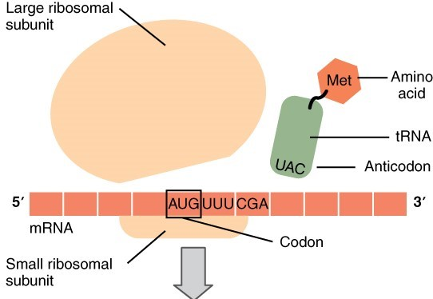

Slide 9
Elongation
1. tRNA is attached to the P site, another tRNA attaches to A site
2. the polypeptide from the tRNA on the P-site attaches to the tRNA on the A site
- to facilitate this a ribozyme which is part of the ribosomal subunit supplies energy
3. next is translocation, the mRNA moves forward one codon length. The tRNA in the P-site leaves the ribosome, the tRNA at the A-site moves to the P-site and a new tRNA attaches to the A-site.

Slide 10
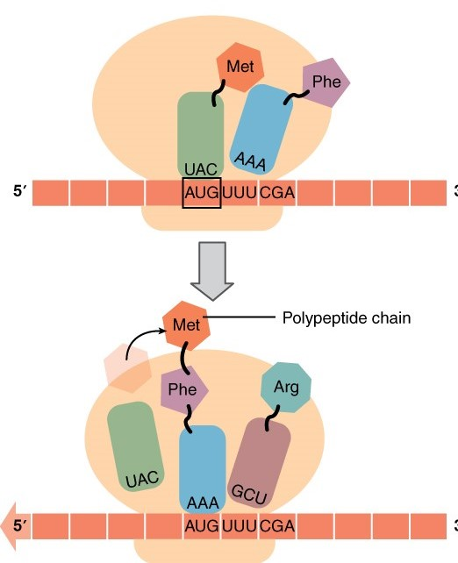

Slide 11
Termination
The steps continue until the ribosome meets a stop codon.
A stop codon is one of three codons that do not code for an amino acid.
The polypeptide is enzymatically cleaved from the last tRNA by a release factor
The tRNA and polypeptide leave the ribosome which dissociates into its two subunits

Slide 12
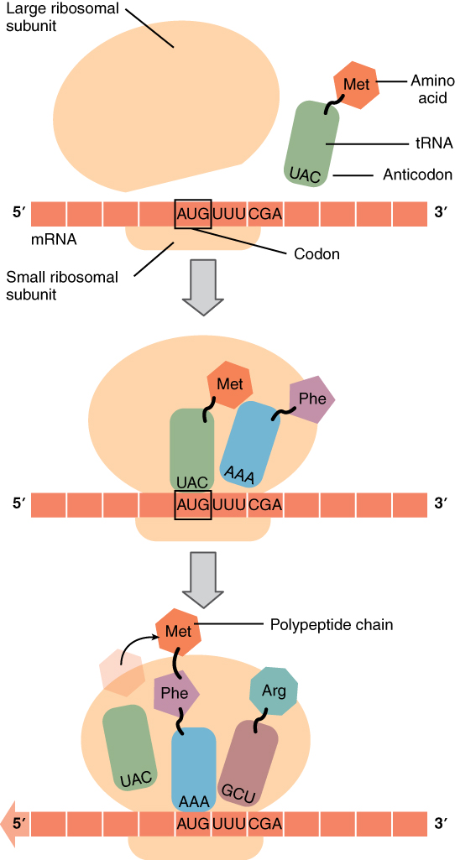
Figure 4. Translation from RNA to Protein. During translation, the mRNA transcript is “read” by a functional complex consisting of the ribosome and tRNA molecules. tRNAs bring the appropriate ami

Slide 13
