Slide 1
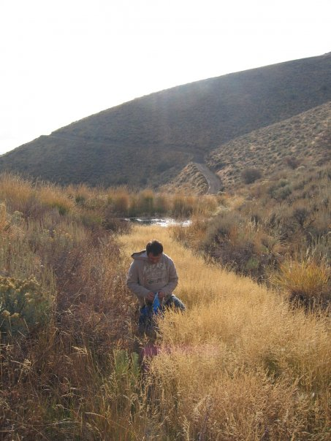
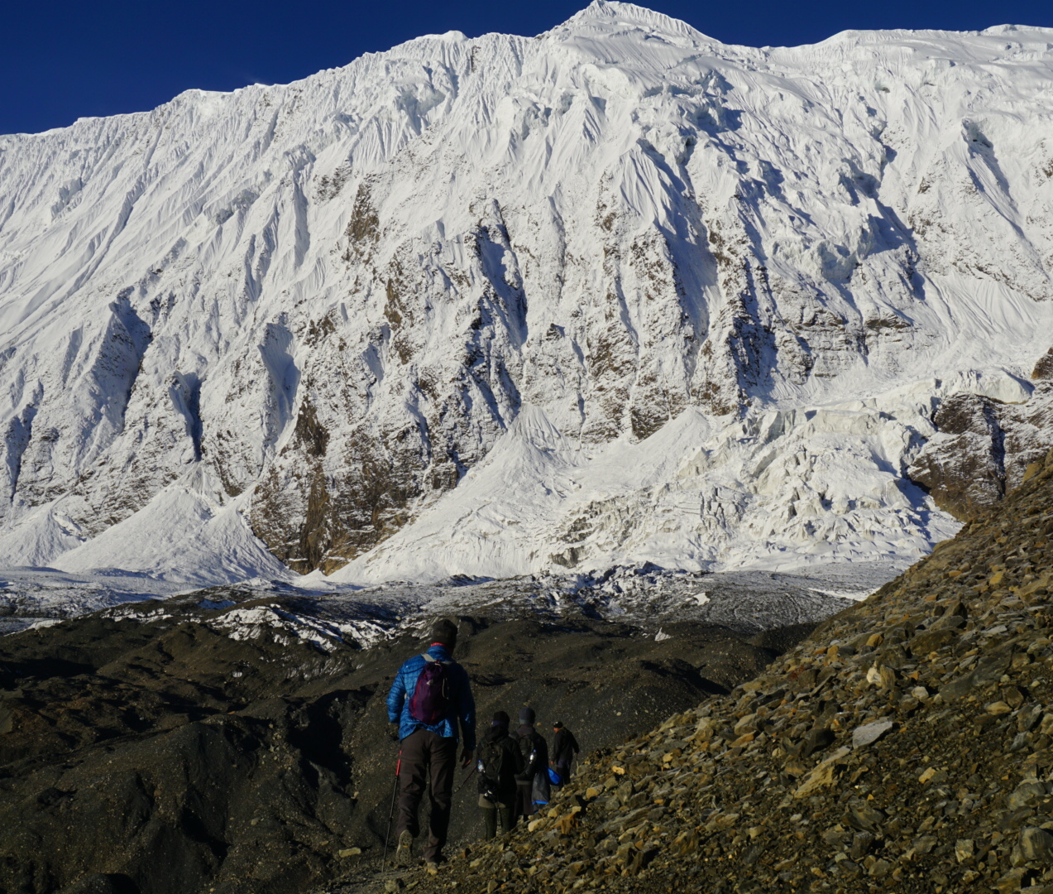

Slide 2
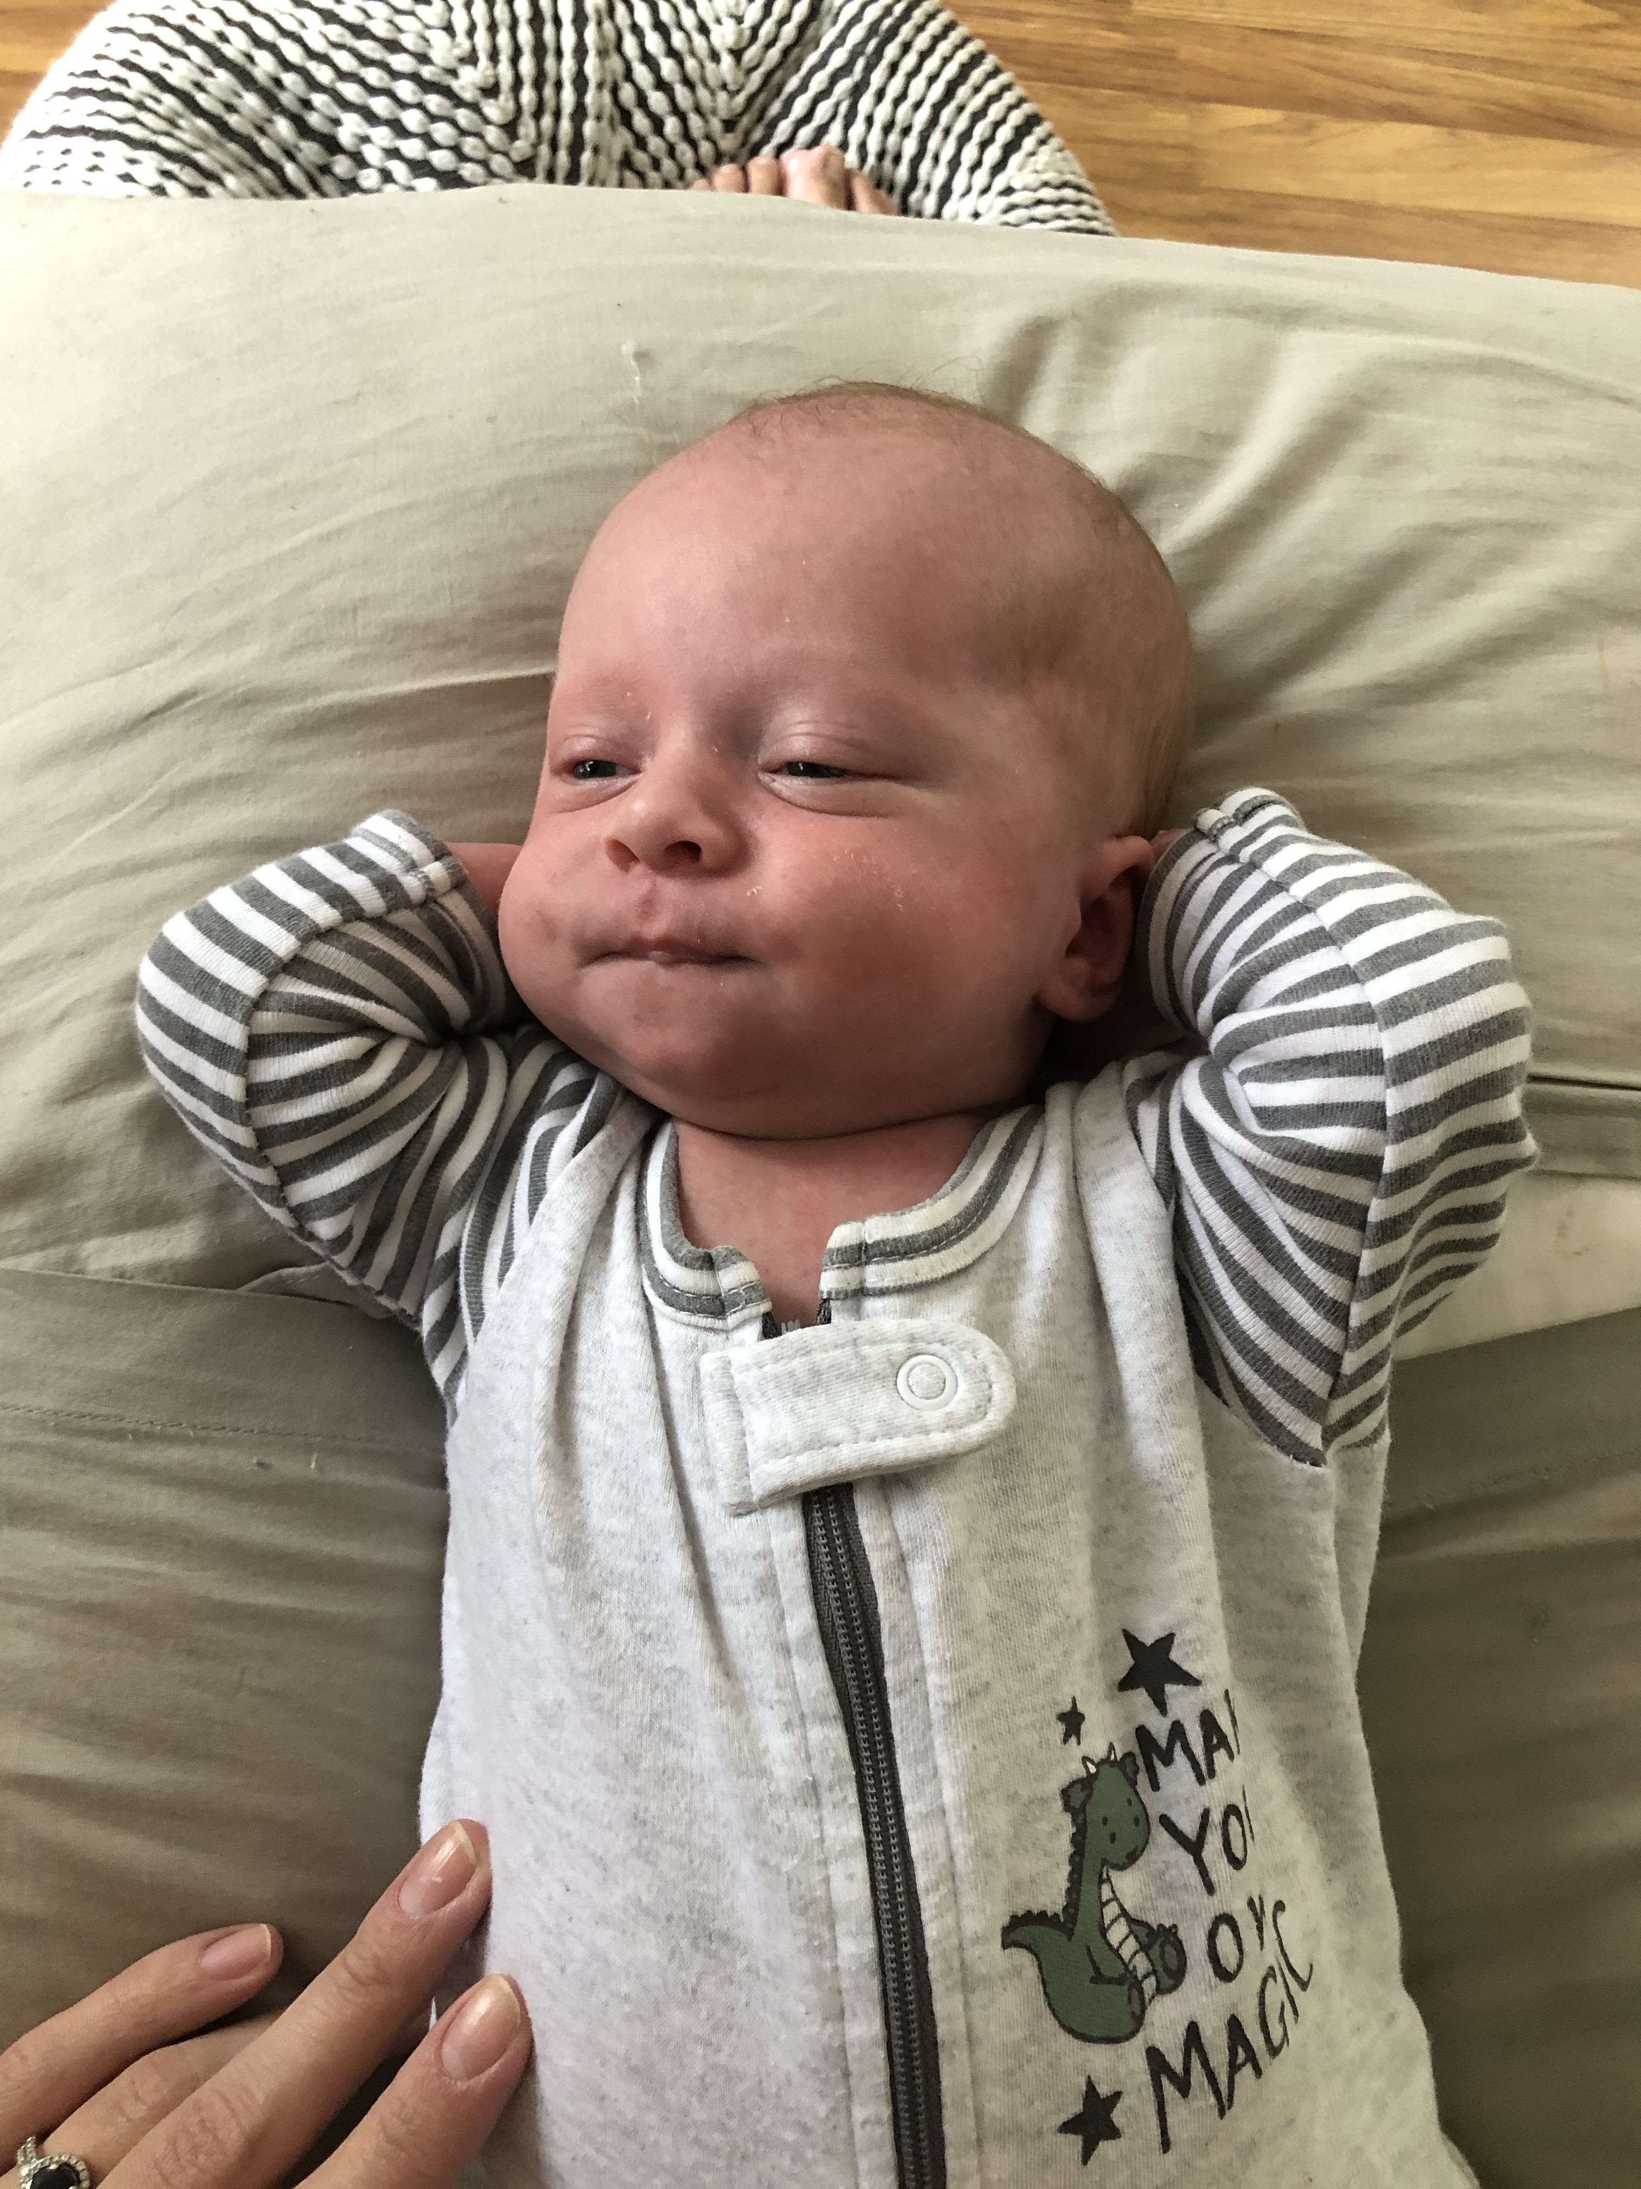

Slide 3
Protein Synthesis
Biology 12

Slide 4
What do these diseases have in common?
Type 2 diabetes
Alzheimer’s
Huntington’s disease
Duchenne muscular dystrophy

Slide 5
mRNA - It is the transcription of the gene’s protein-building instructions. It carries a genetic message from the DNA to the protein-synthesizing machinery of the cell.
Transcription - occurs in the nucleus. It is the copying of the DNA code for protein building to a mRNA strand and the preparing of that strand to leave the nucleus. 4 Steps Initiation, Elongation, Termination, preparing the mRNA strand.

Slide 6
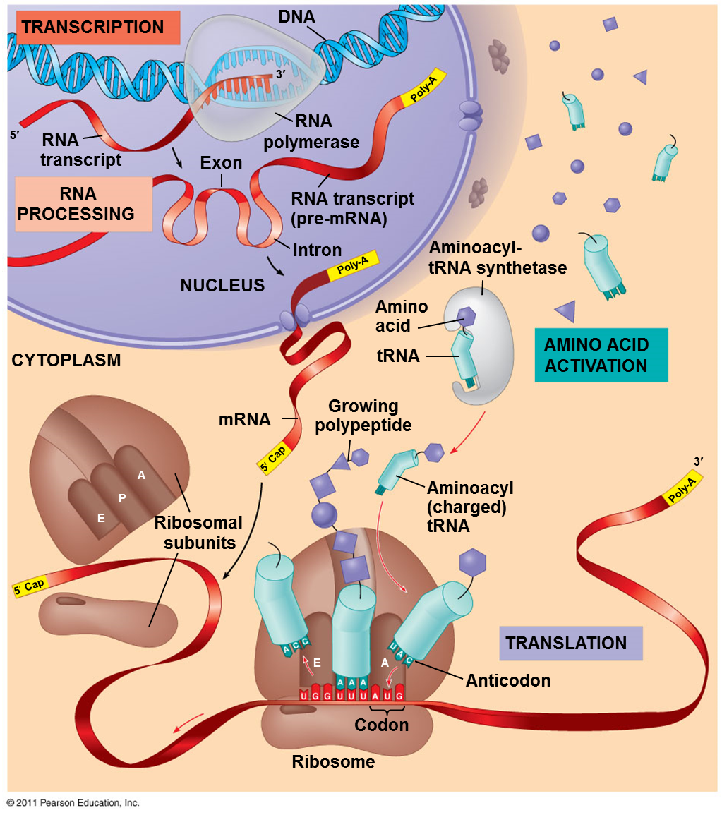
Protein Synthesis: Overview

Slide 7
Protein Synthesis: Transcription
During transcription DNA is transcribed letter by letter to an RNA called messenger RNA (mRNA)
Transcription begins when RNA polymerase binds to a promoter region of the DNA
Promoter sequence of 3 nucleotides that signals the beginning of the RNA
There is also a set of 3 nucleotides that signals the end
The RNA polymerase opens the DNA helix just in front of the sequence
RNA polymerase joins the RNA nucleotides the same as DNA replication (5’ to 3’)
mRNA has a sequence complementary bases C to G and instead of A to T, A to U.
Uracil instead of Thymine

Slide 8
Protein Synthesis: Transcription
Processing of mRNA
mRNA is processed before entering the cytoplasm
genes in humans are interrupted by segments of DNA that are not part of the gene called introns
the part of the gene that is expressed or makes protein are called exons
introns are removed and exons are joined to form a mature mRNA molecule
The Mature mRNA now leaves the nucleus

Slide 9
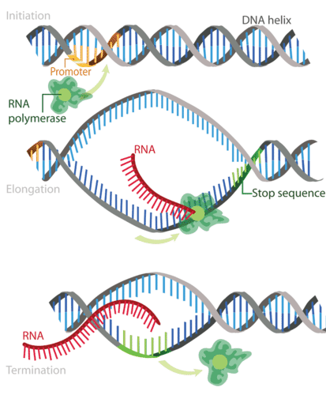
Transcription: Initiation, Elongation, Termination

