Slide 1
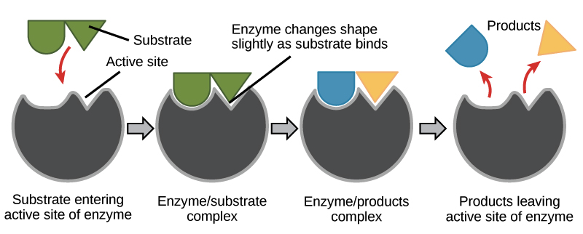
How enzymes work…

Slide 2
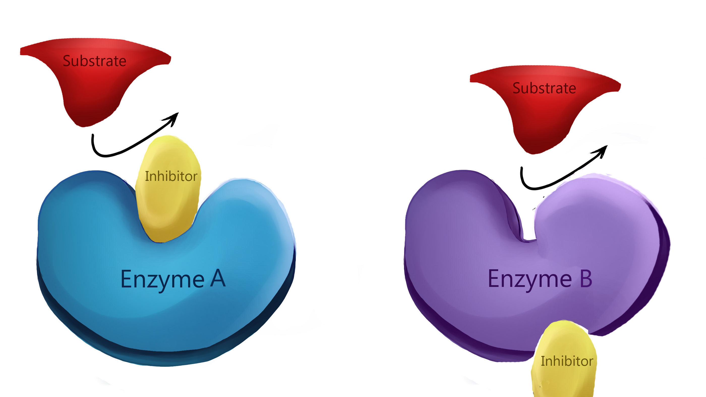
What can inhibit or enhance how enzymes work?

Slide 3
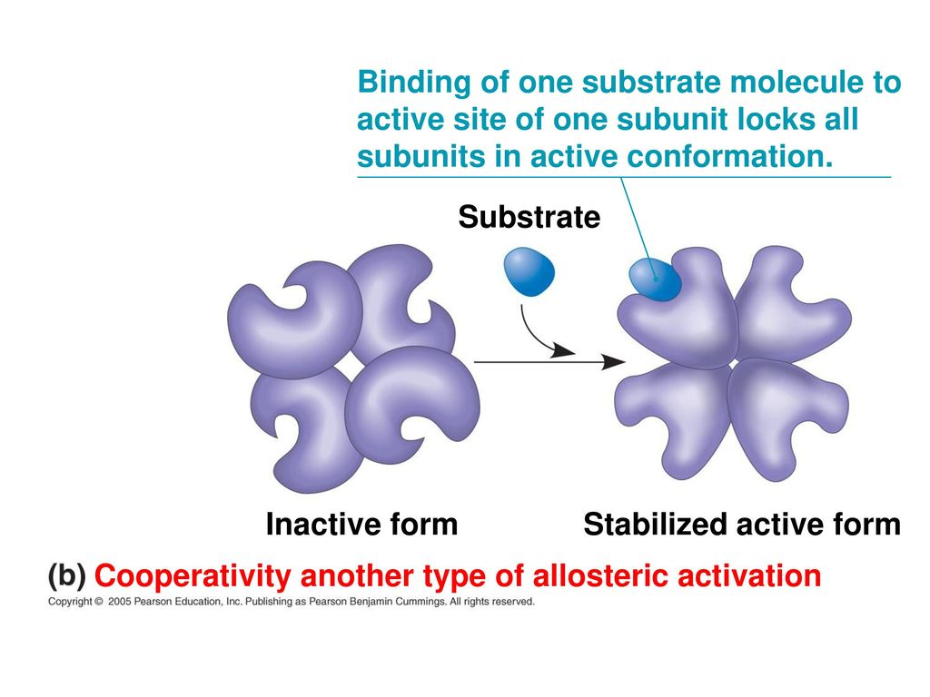
Cooperativity

Slide 4
The processes key to life depend on a cell’s ability to regulate metabolic pathways
How?
Need to control when and where enzymes are active
Need to switch the genes for specific enzymes on or off as needed
RESULT: Need for regulation of enzyme activity

Slide 5
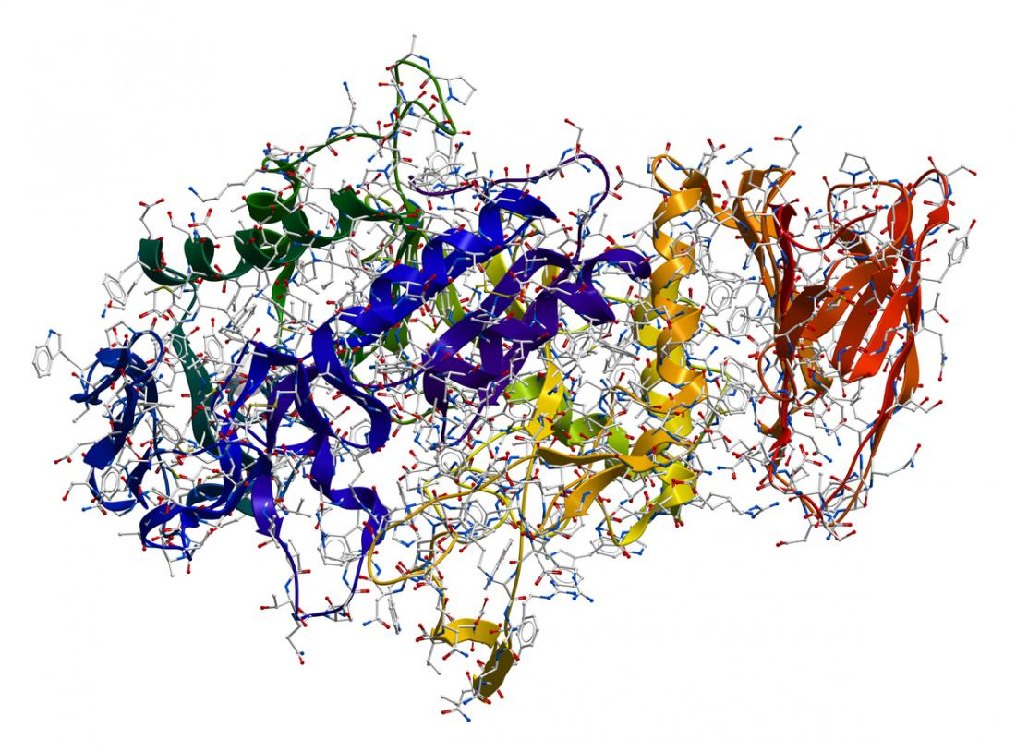
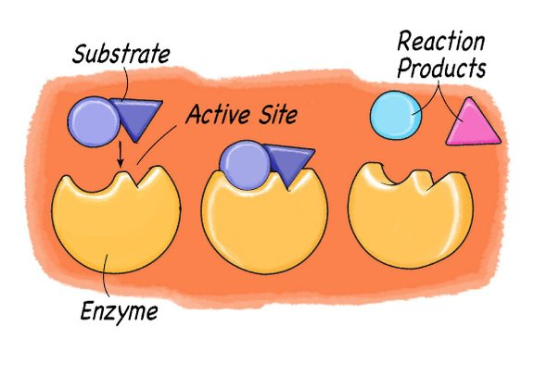
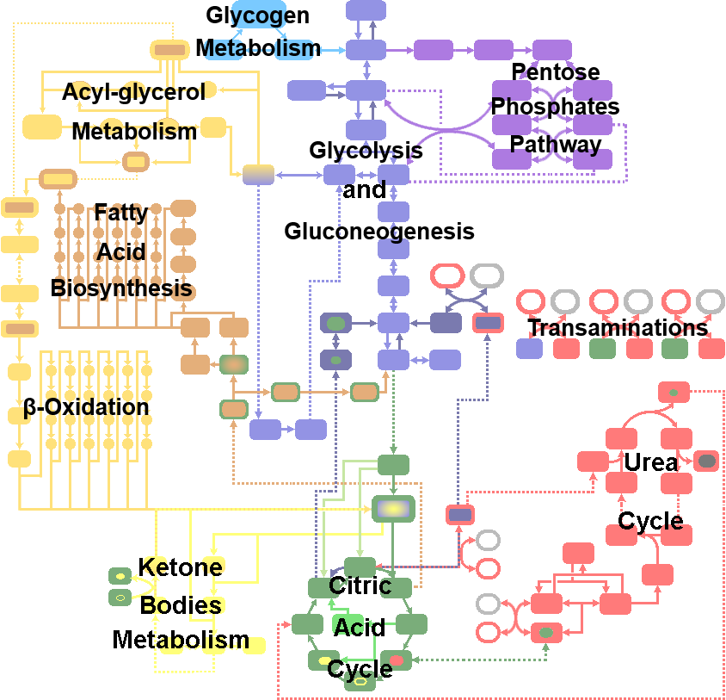
Regulating Enzyme Activity
Page 158-160

Slide 6
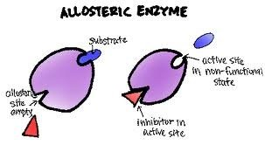
Allosteric Regulation
A molecule other than the substrate binds to the enzyme & alters shape & activity

Slide 7
Allosteric Regulation
Effects can be:
i) inhibitory→ like reversible non-competitive inhibitors
Inactive form of enzyme is stabilized
Ex: beta blockers or penicillin
ii) stimulatory
Active form of the enzyme is stabilized

Slide 8
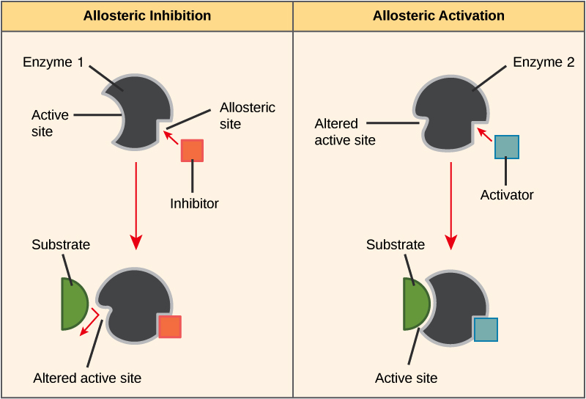

Slide 9
Feedback Inhibition

Slide 10
Negative Feedback Loop…
the end product of a reaction binds to the allosteric site = shuts down reaction=no more product.

Slide 11
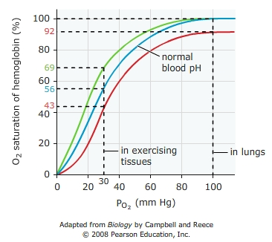
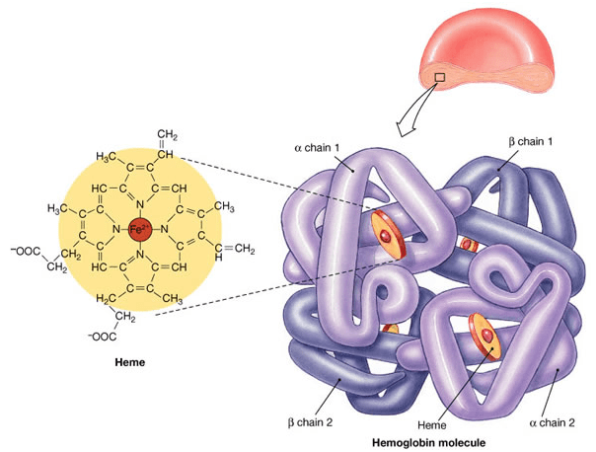
AP Practice Q:
How is cooperativity related to hemoglobin, the vertebrate oxygen transport protein?

Slide 12
Cooperativity→ define…binding of one molecule in enhances enzymatic ability
Hemoglobin Structure→ four subunits, each of which as an oxygen-binding site. When 1 oxygen molecule binds it increases the affinity for oxygen of the remaining binding sites. (seems like cooperativity to me!). Application of Graph..
Where oxygen is at high levels, such as in the lungs or gills, hemoglobin’s affinity for oxygen increases as more binding sites are filled→ PO2 saturation highest In oxygen-deprived tissues, → release of each oxygen molecule decreases the oxygen affinity of the other binding sites, resulting in the release of oxygen where it is most needed. (Not cooperativity but GOOD for vertebrates that need O2 delivered and dropped off to tissues

Slide 13
Teacher Key links
https://quizlet.com/13107663/mastering-biology-section-85-regulation-of-enzyme-activity-flash-cards/

