Slide 1
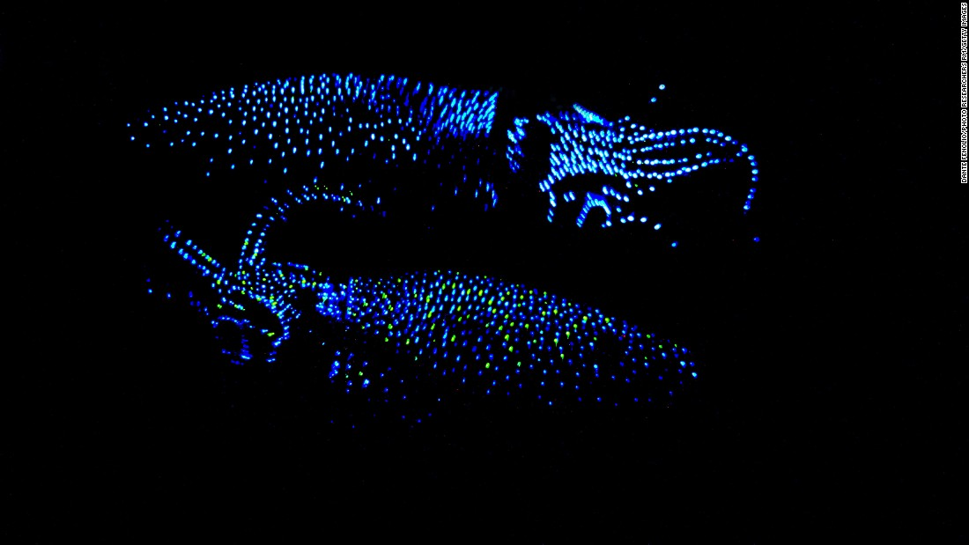
What causes these squid to glow?!?

Slide 2
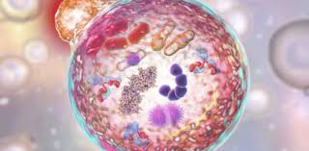
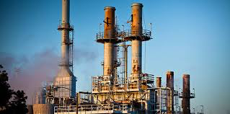
Claim:
The cell is like a miniature chemical factory
Do you agree or disagree?
Brainstorm some examples to support your opinion!

Slide 3
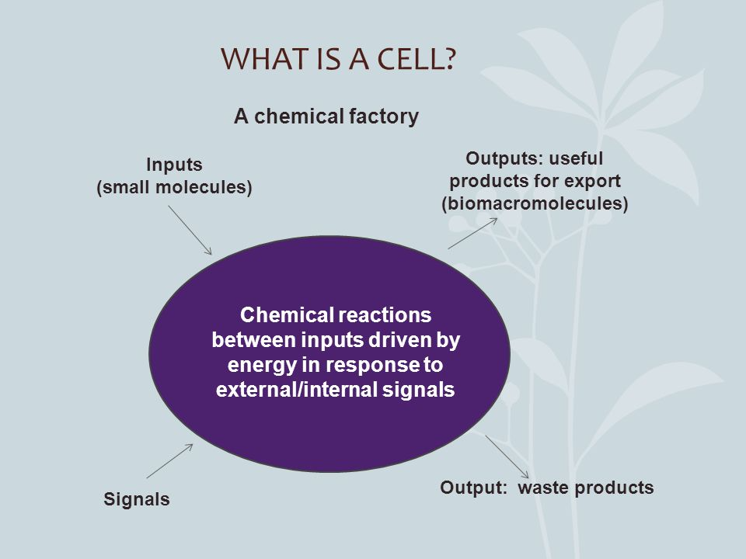
Outputs: polymers, organic macromolecues, vesicles with products for export, wastes
Inputs: sugars from foods,
small molecules (O2)
Uses energy
Creates Energy
Communication- direct contact, resource availability, reproduction
Responds to Signals: hormones, receptors on membrane, cell cycle

Slide 4
An Introduction to Metabolism
Chap 8 pg 142-159

Slide 5
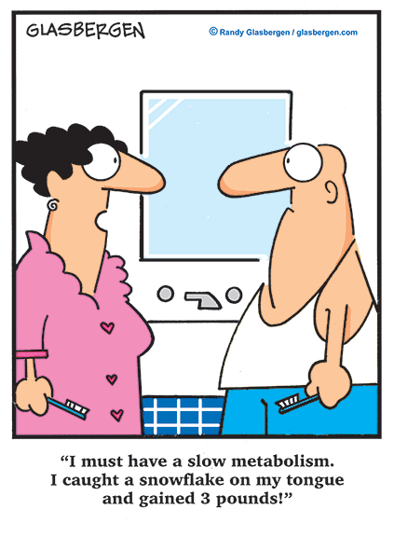
Metabolism?

Slide 6
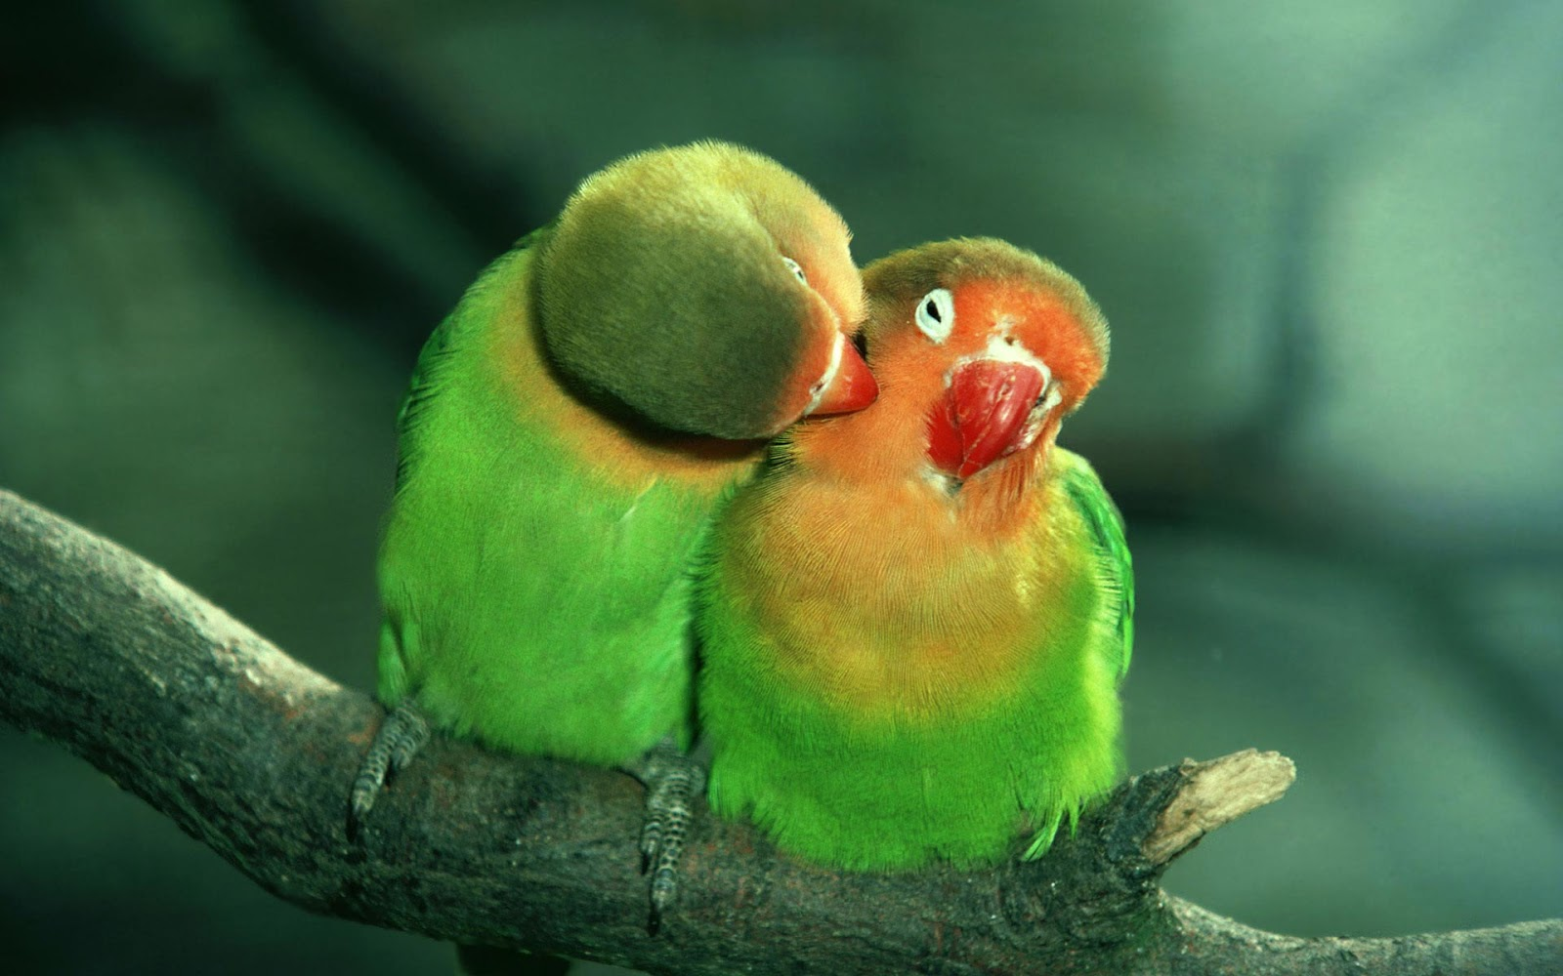
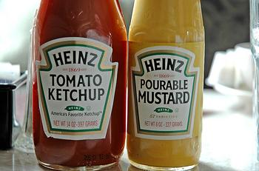
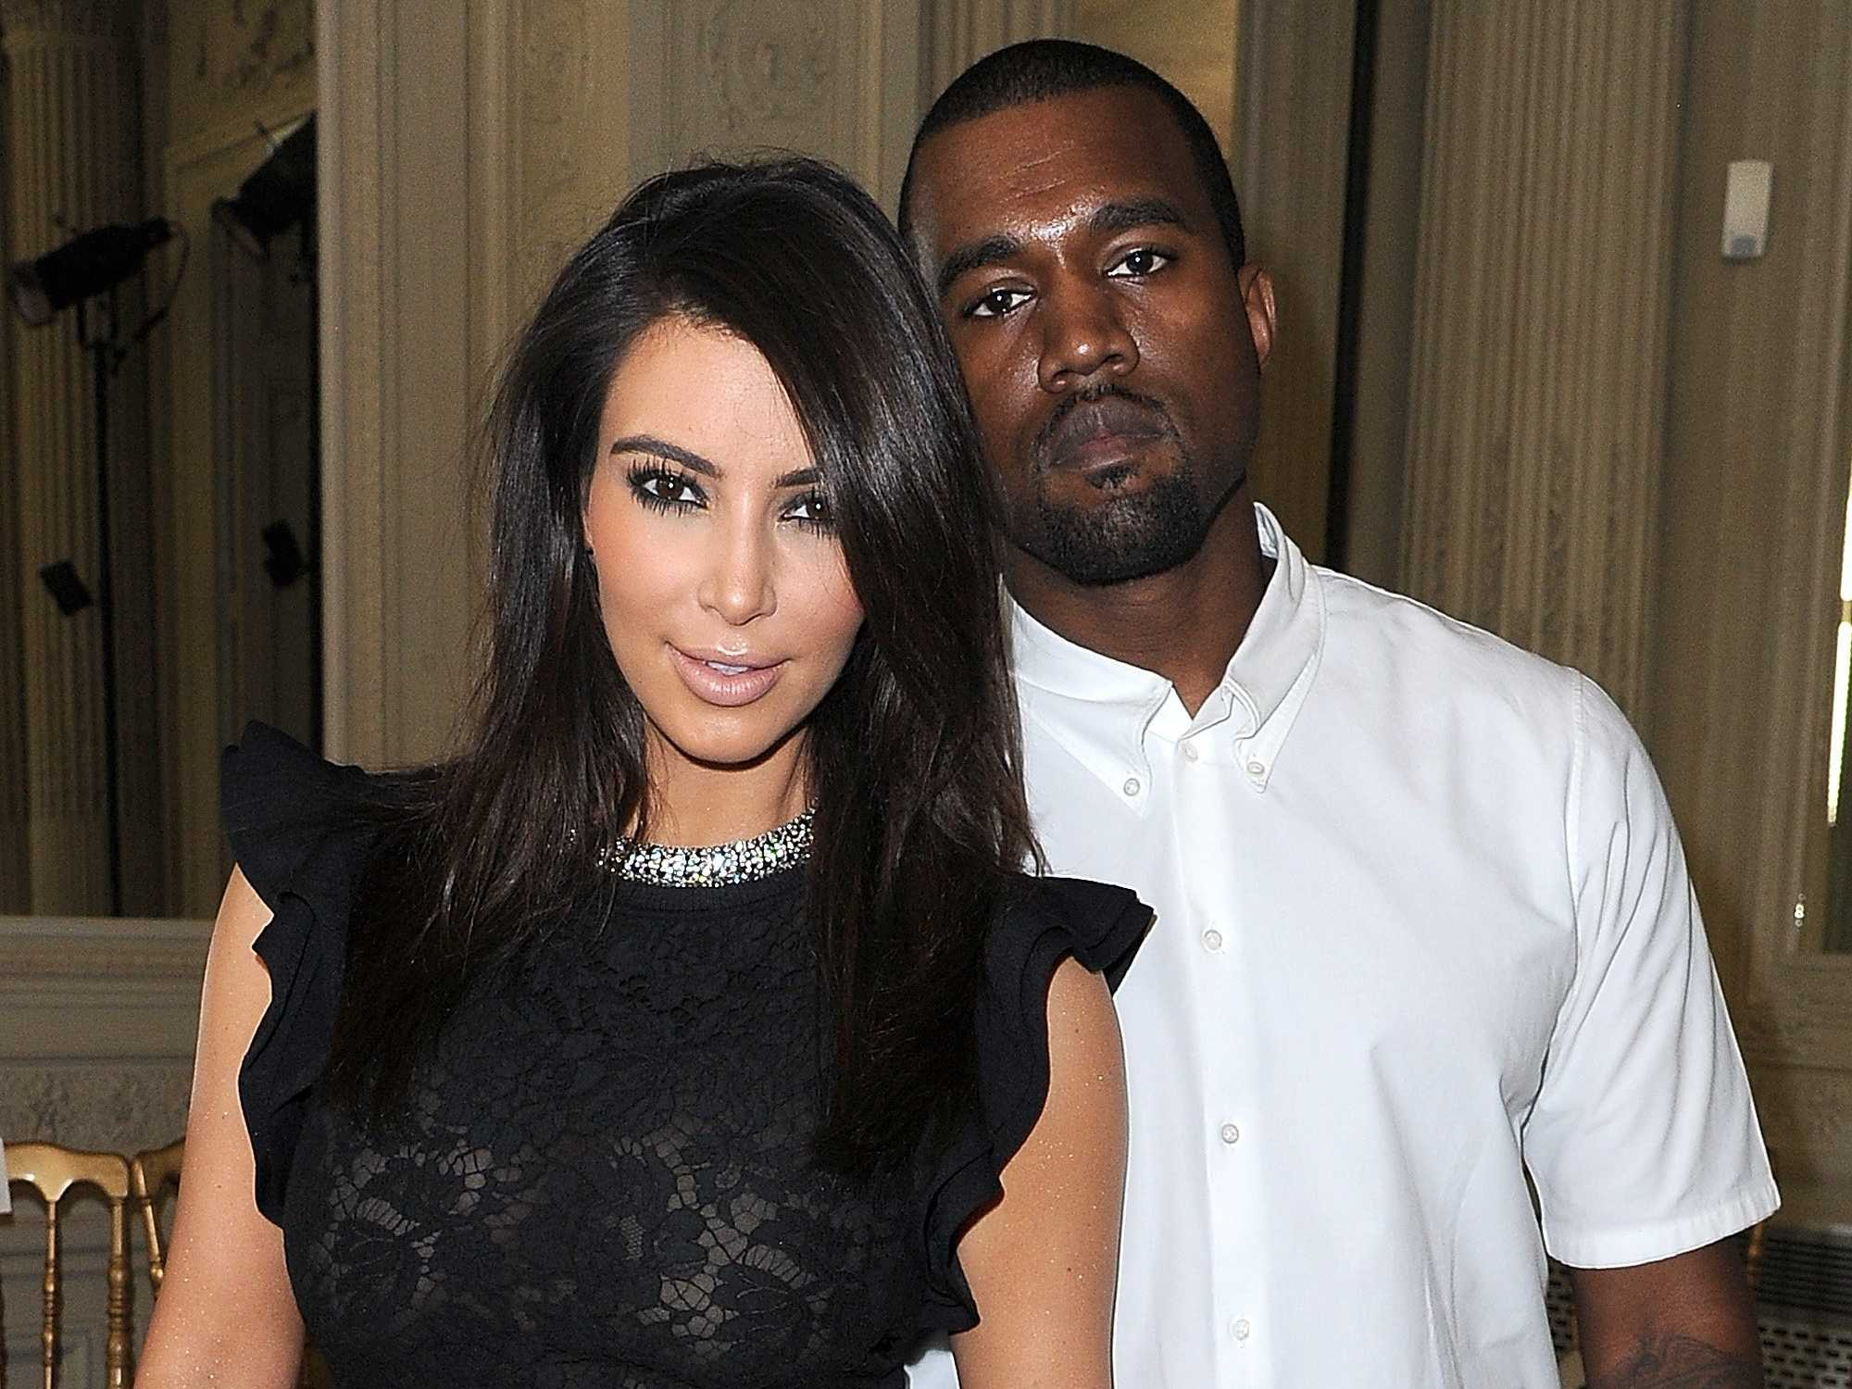
Many reactions in our bodies are “coupled” together!

Slide 7
Metabolism:
All of the chemical reactions that occur in an organism

Slide 8
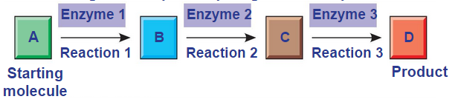
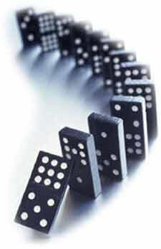
Metabolic Pathways
A series of steps, catalyzed by enzymes that create a new product
Most reactions in a cell are “coupled” ( linked) NOT random
Every rxn in a cell requires its specific enzyme!
Q1: Can you think of 3 enzymes you know? List them!
Q2: What happens if they are missing?

Slide 9
Catabolic Pathways
Release energy by breaking down complex molecules into simpler compounds
“downhill” reactions
Examples:
Hydrolysis of ATP
Cellular Respiration

Slide 10
Anabolic Pathways
Consume energy to build complex molecules from simpler molecules
“Uphill Reactions”
Ex: Dehydration Synthesis Reactions
Ex: Protein Synthesis from Amino Acids

Slide 11

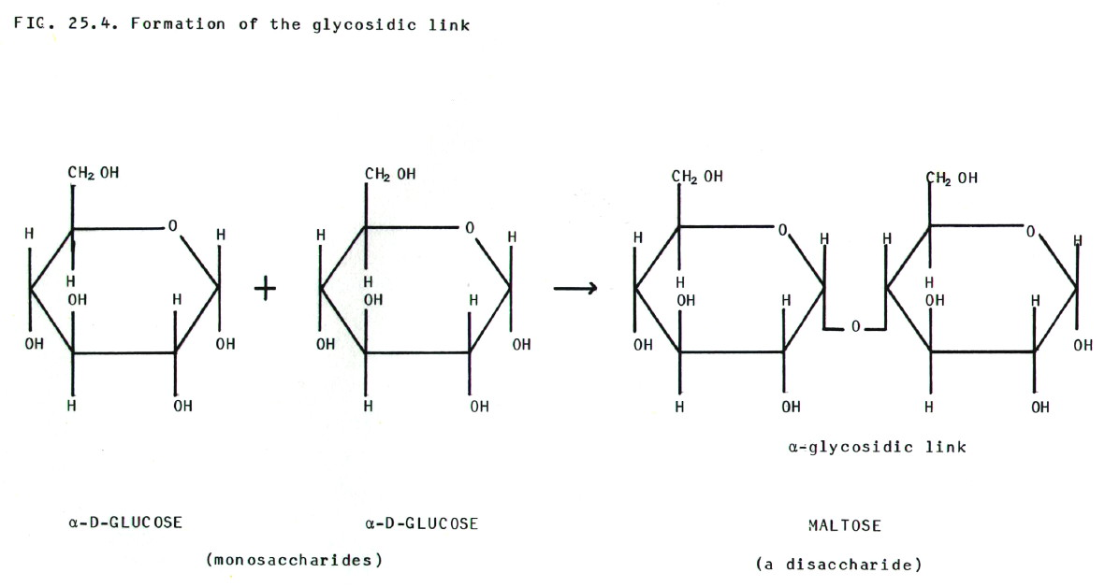

You try… Catabolic or Anabolic
`1)
2)
3)

Slide 12
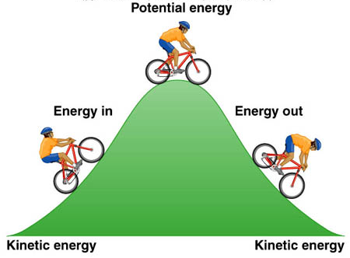
Energy
Energy: the capacity to do work
  Kinetic Energy: energy of motion
  Potential Energy: stored energy
  Bond Energy or Chemical energy: the potential energy available for release in a chemical reaction (stored/found in ATP)

Slide 13
Laws of energy Transformation
(Thermodynamics)
1) Energy cannot be created or destroyed
  Only transferred and transformed!
2) Changes in energy increases entropy
  Entropy: the measure of disorder or randomness

Slide 14
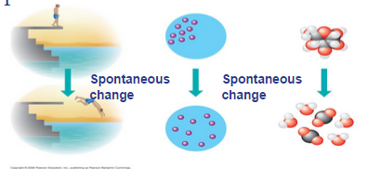
Sec. 8.2: Free Energy Change & Metabolism
A living system’s free energy is energy that can do work when temperature and pressure are constant, as in a living cell.
It can be thought of as a measure of a system’s instability
  Systems will move towards less instability!

Slide 15
  Free Energy: energy available to do work, represented by G
    therefore the change in free energy = G
      G= Final energy-Initial energy
    Exergonic Rxns- Release energy
    G is NEGATIVE the reaction occurs spontaneous
    Endergonic Rxns: Require energy
    If G is POSITIVE the reaction is non-spontaneous

Slide 16
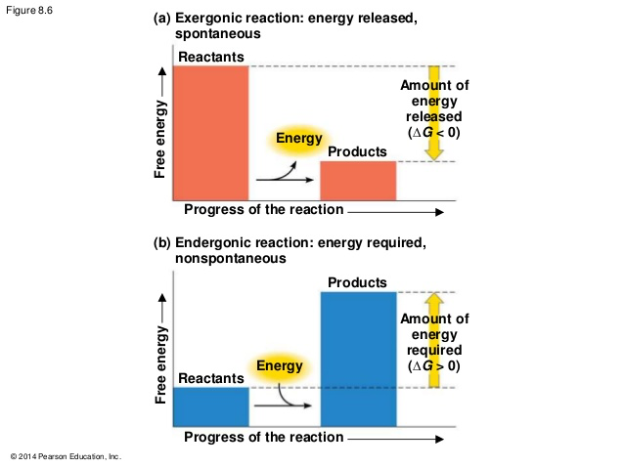

Slide 17
ATP, Cellular Work & Coupling Rxns
Sec 8.3 pg 149

Slide 18
A cell does 3 main kinds of work:
I) Chemical work
carrying out endergonic rxns (like building polymers)
II) Transport work
pumping substances across membranes (against concentration gradients)
III) Mechanical work
Beating of cilia, contraction of muscle cells etc

Slide 19
Energy Coupling:
The use of an exergonic process to drive an endergonic one!

Slide 20
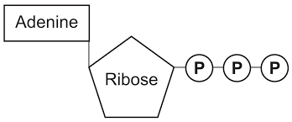
The Structure of ATP
Nitrogenous base: adenine
Sugar: ribose
3 phosphate groups

Slide 21
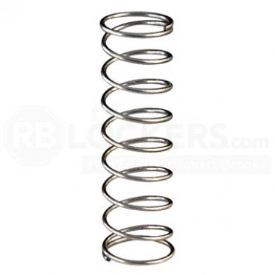
The 3 Phosphate groups are each neg. charged
Creates a mutual repulsion & instability
→ chemical equivalent of a compressed spring
Hydrolysis of the phosphate bond returns the molecule to a lower free energy state
  RESULT: ATP hydrolysis delivers more energy than most other molecules can!

Slide 22
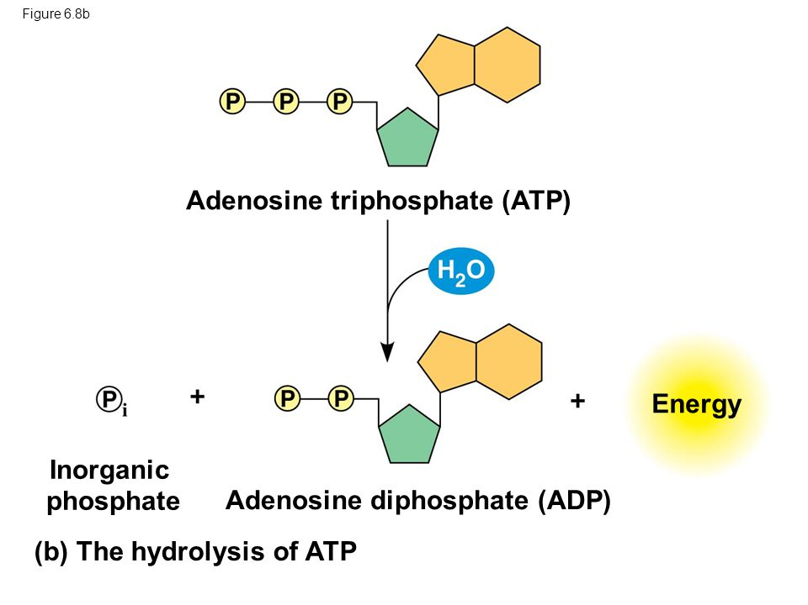
The Hydrolysis of ATP is exergonic
ATP + H20 → ADP + Pi + energy
G = -7.3 kcal/mol

Slide 23
How ATP Drives Work in Cells
The energy released from the hydrolysis of ATP can be coupled to other reactions that by themselves are endergonic
  Specific enzymes (metabolic pathways) are needed
Involves Phosphorylation- the transfer of a phosphate group from ATP to another molecule

Slide 24
ATP hydrolysis can drive chemical work:
  Example:
  Synthesis of the amino acid glutamine
  Glutamic acid + ammonia → Glutamine
  This rxn by itself is endergonic (+ G and not spontaneous)
  (see fig 8.9 pg 150)

Slide 25
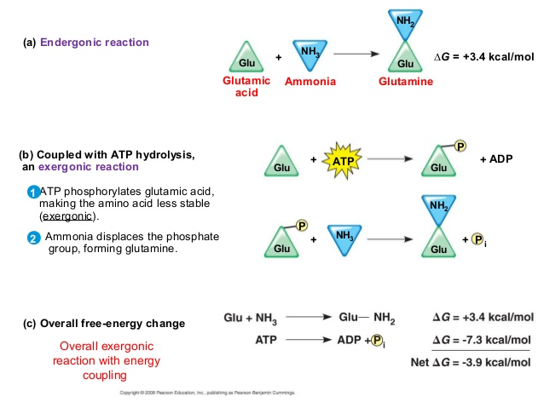

Slide 26
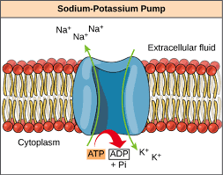
ATP hydrolysis can drive Transport:
Ex) ATP hydrolysis drives protein pumps in the cell membrane
changes the shape & binding affinity

Slide 27
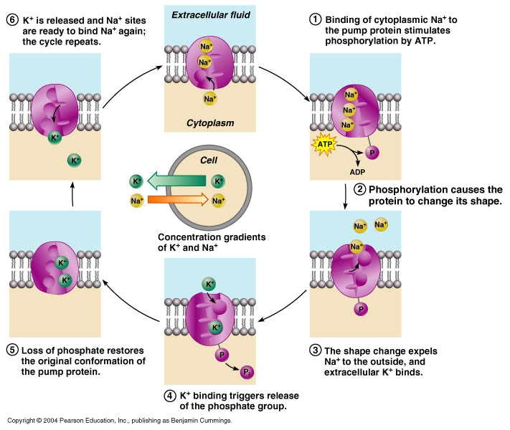

Slide 28
ATP Hydrolysis can Drive Mechanical Work
ATP bind non-covalently to motor proteins
hydrolysis of ATP helps create movement along cytoskeletal track
  can move vesicles & organelles!

Slide 29
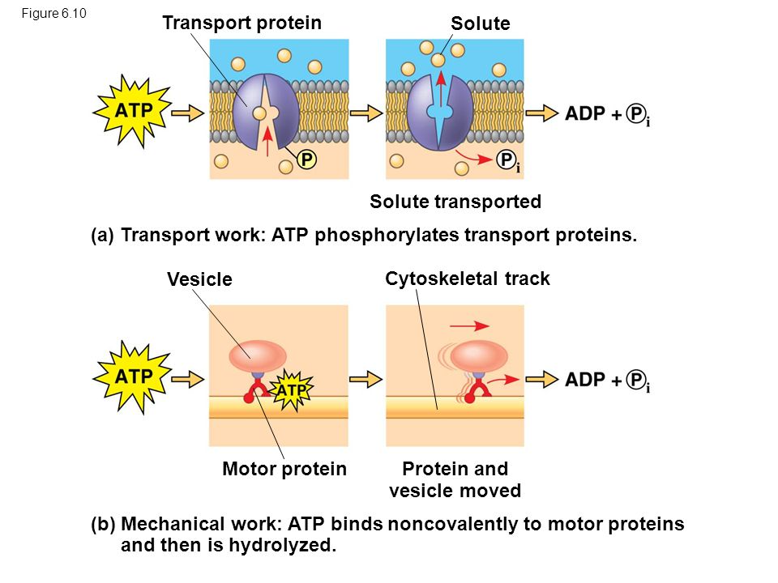

Slide 30
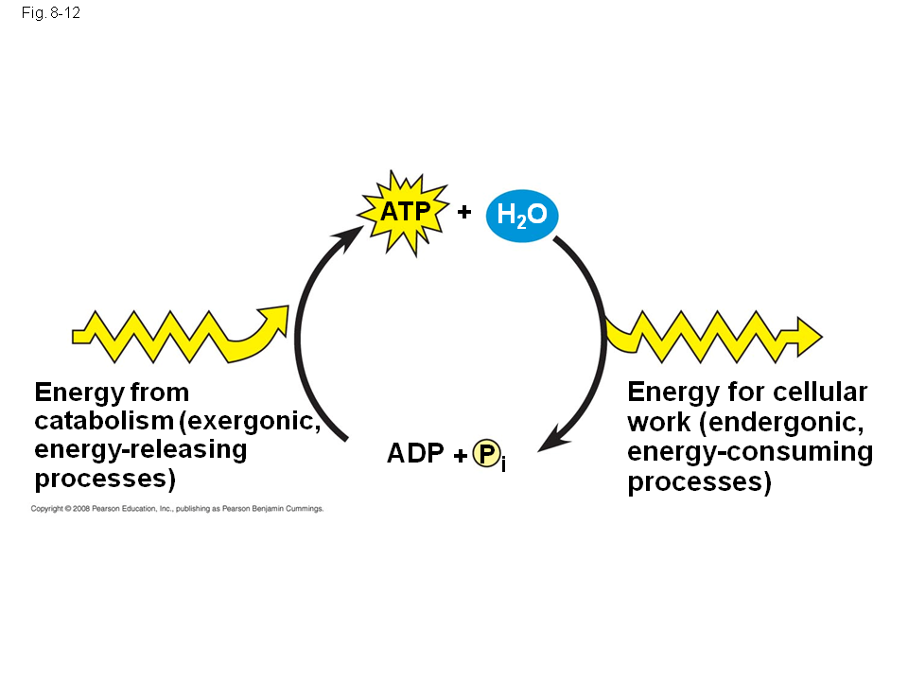
The Regeneration of ATP
ATP is a renewable resource that is regenerated by addition of a phosphate group to ADP.
The rate of renewal is VERY fast!
10 million ATP molecules are turned over every second in every one of your cells!
Making ATP is endergonic
-catabolic pathways provide the energy needed

Slide 31
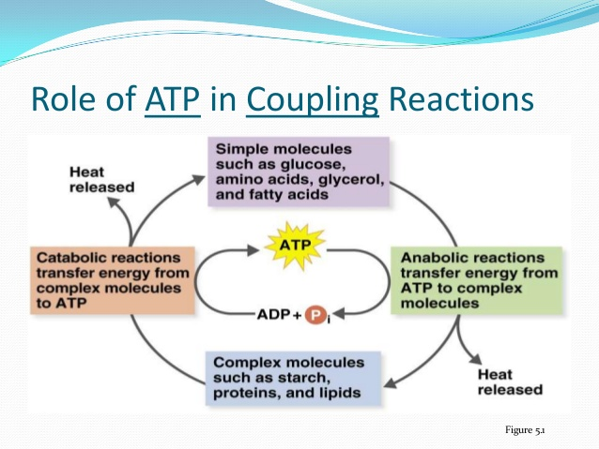

Slide 32
Assignment:
Concept Check 8.1 Qs 1-3 pg 145
Concept Check 8.22 Qs 1-3 pg 149
Concept Check 8.3 Qs 1-3 pg 151
For Next Class: Read Section 8.4… we will be doing an activity next day with these concepts

Slide 33
Relevant Links
KHAN Academy- https://www.khanacademy.org/science/biology/energy-and-enzymes/atp-reaction-coupling/v/reaction-coupling-to-create-glucose-6-phosphate
Bozeman- https://www.youtube.com/watch?v=7IqgrcBkGRU
https://www.youtube.com/watch?v=YHMxMGEjUwE

