Slide 2
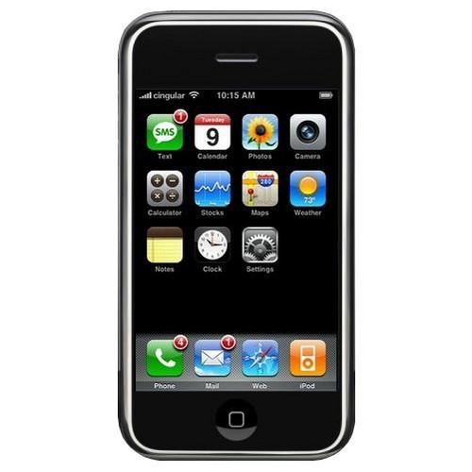

Slide 3
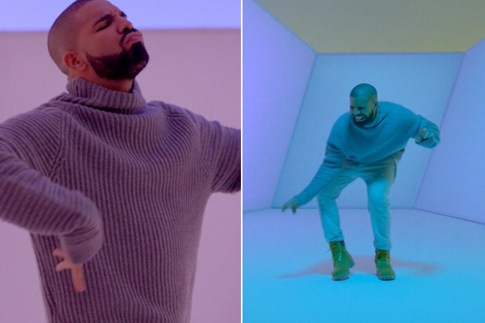
Back when cell communication was simple….you used to call me on your cell phone

Slide 4
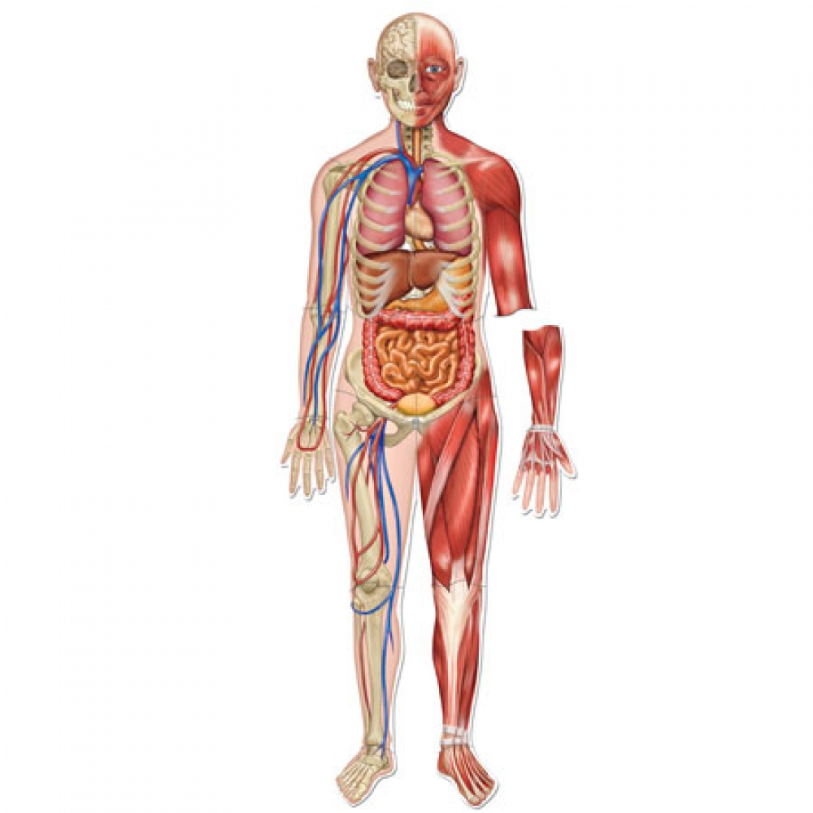
Cell Communication Chap 11. pg 206-225

Slide 5
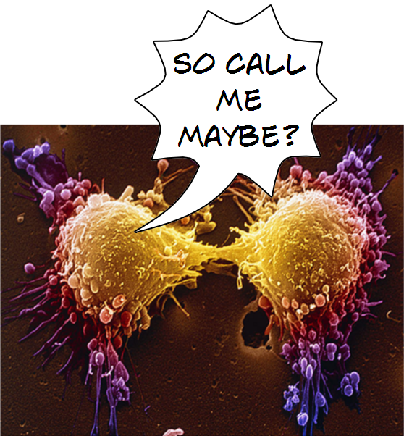

Slide 6
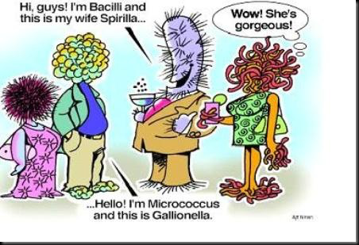
Cell Communication
If cells could talk, what would they say?
If cells were listening, what would they hear?

Slide 7
Cells must communicate with each other and with the environment in order to maintain…
homeostasis

Slide 8
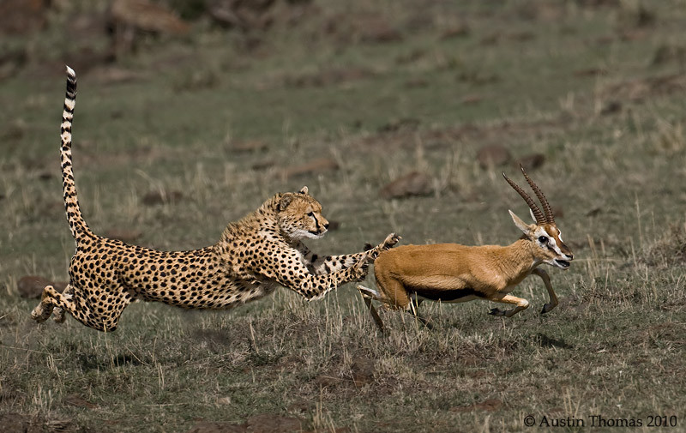

Slide 9
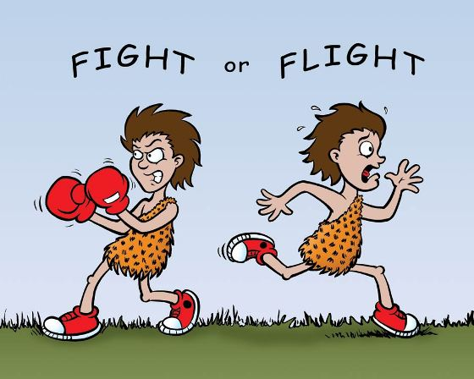

Slide 10
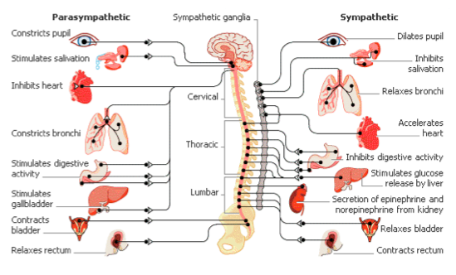

Slide 11
Cell communication can be like…

Slide 12
Examples of Cell Communication
1) Epinephrine hormone→ signals fight or flight response
long distance signaling→ relies on hormones & endocrine system!

Slide 13
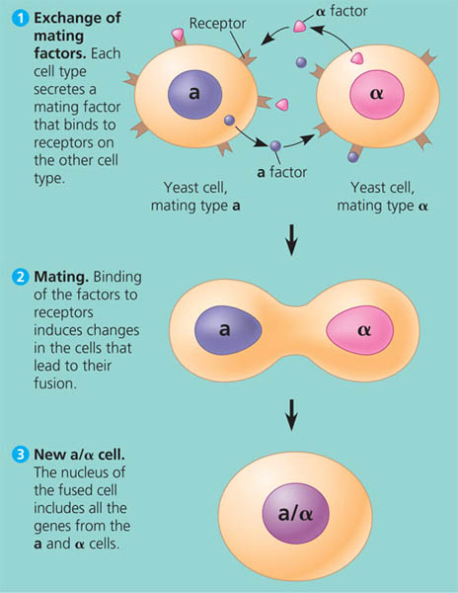

Slide 14
Examples of Cell Communication
1) Yeast Cells
→ mating factors signal cells to fuse & reproduce
-Local Signaling!

Slide 15
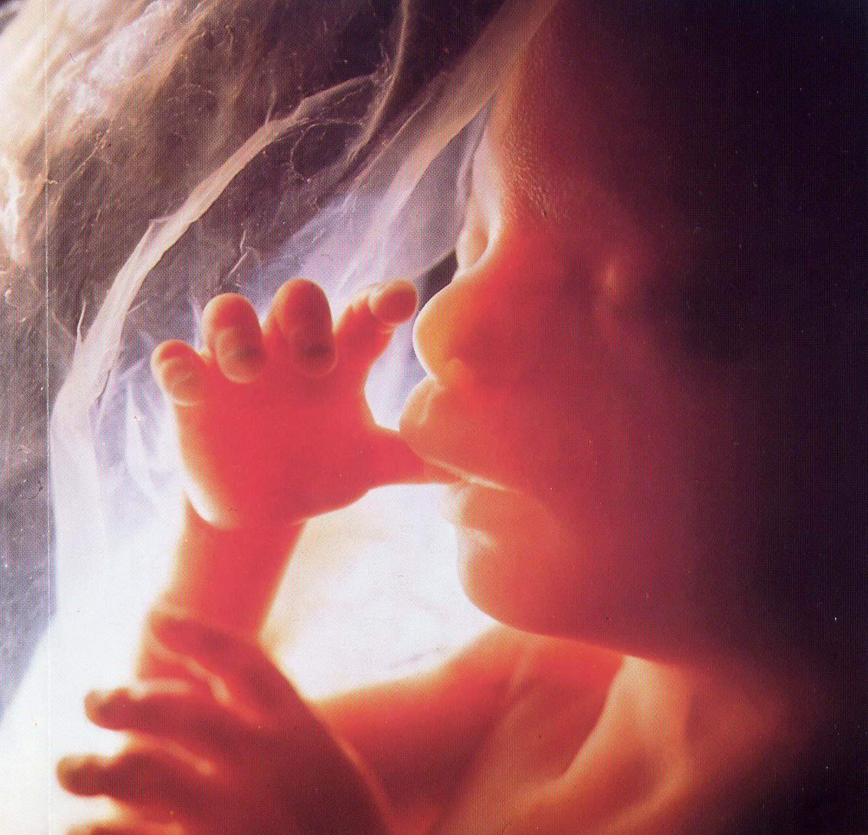

Slide 16
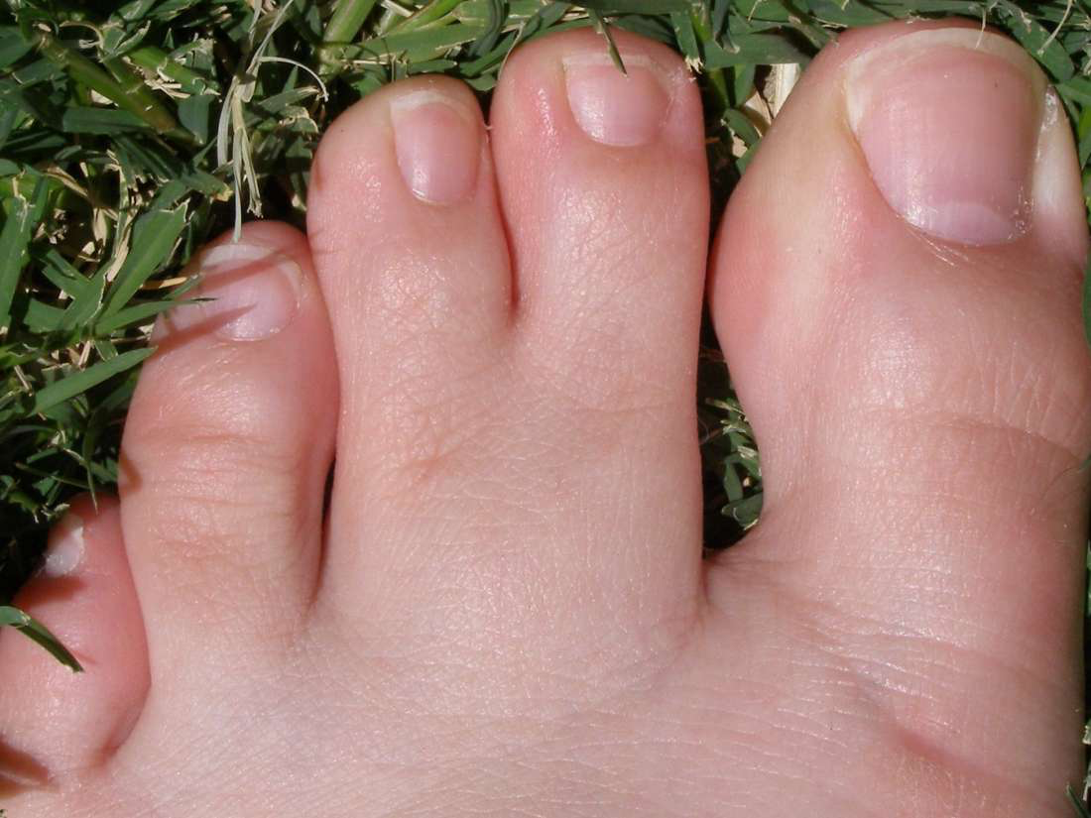
Examples of Cell Communication
3) Process of Apoptosis→
pre-programmed cell death
removes webbing during embryonic development

Slide 17
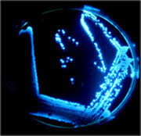
Examples of Cell Communication
4) Bacteria
-Quorum sensing→ reaching a certain population size signals bacteria to coordinate behaviours
-ex) luciferin
-ex) biofilm communities

Slide 18
How Bacteria “Talk” -Bonnie Basler on TEDEd
~18min
https://www.youtube.com/watch?time_continue=15&v=KXWurAmtf78
She also speaks about Quorum Sensing
https://www.youtube.com/watch?v=q2nWNZ-gixI
In your textbook she is Interviewed on pg 92-93 ☺

Slide 19
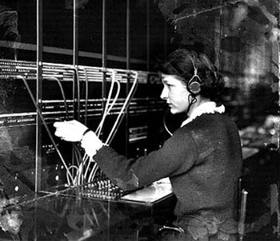
Sooo how does cellular communication happen?

Slide 20
Cell to Cell Communication:
Local Signalling - Direct contact: (like passing notes)
Cell junctions-
-small gaps connect the cytoplasm of adjacent cells
-signalling chemicals can pass directly through
-animal cells have “gap junctions”
plant cells have “plasmodesmata”

Slide 21
ii)Cell-cell recognition:
-molecules on the outside of the plasma membrane identify cell types
-ex: glycoprotein receptors

Slide 23
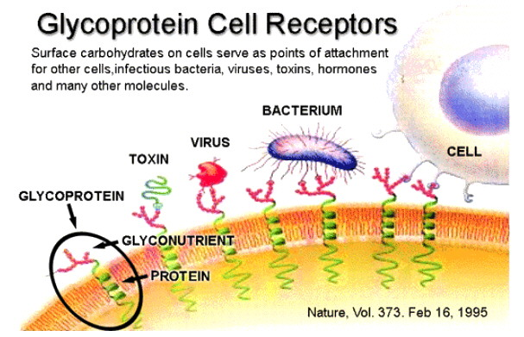

Slide 24
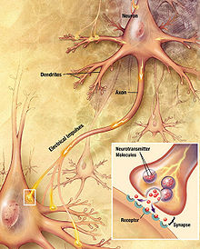
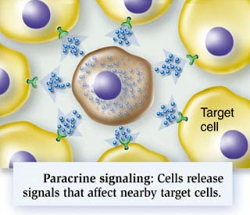
Local regulators: messenger molecules are secreted by the signalling cell influencing cells in the vicinity
Examples:
Paracrine signalling is found in animals responding to growth factors produced by a single cell (like an email)
Synaptic signalling occurs
in the animal nervous system

Slide 25
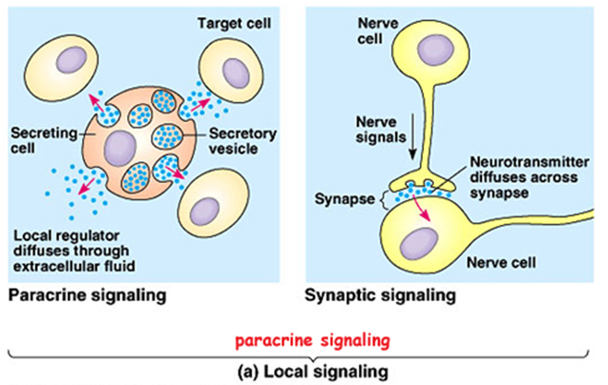

Slide 26
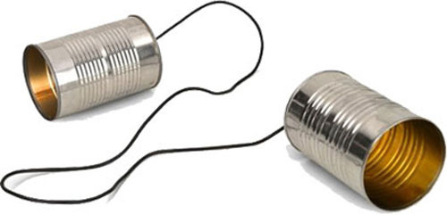
Long Distance Signalling
Hormones:
Animals send hormone signals, which travel in vessels of the circulatory system until they reach the target cell (endocrine system/can be more than one organ getting the message [like Instagram])
Example: insulin, epinephrine
Plants use hormones, but most travel through diffusion (some through xylem/phloem)
Example: ethylene (C2H6, which promotes fruit ripening)

Slide 27
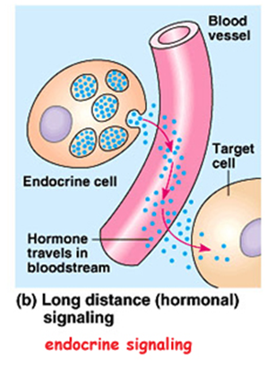

Slide 28
An animated example: Hormonal Communication using ADH
http://highered.mcgraw-hill.com/sites/0072943696/student_view0/chapter10/animation__hormonal_communication.html

Slide 29
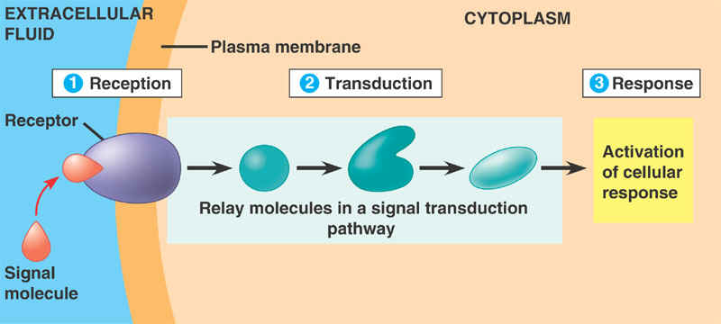
What do all these forms of communication have in common?

Slide 30
Only specific target cells recognize & respond to a given chemical signal!
3 Parts to the “cellular conversation”: The signal transduction pathway

Slide 31
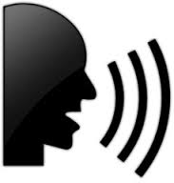
The Signal Transduction Pathway
Reception: chemical signal is detected (hear the phone ringing)
Transduction: converts and relays the signal (listens to the conversation/message)
Response : signal induces a response (person understands , response accordingly and hangs up)

Slide 32
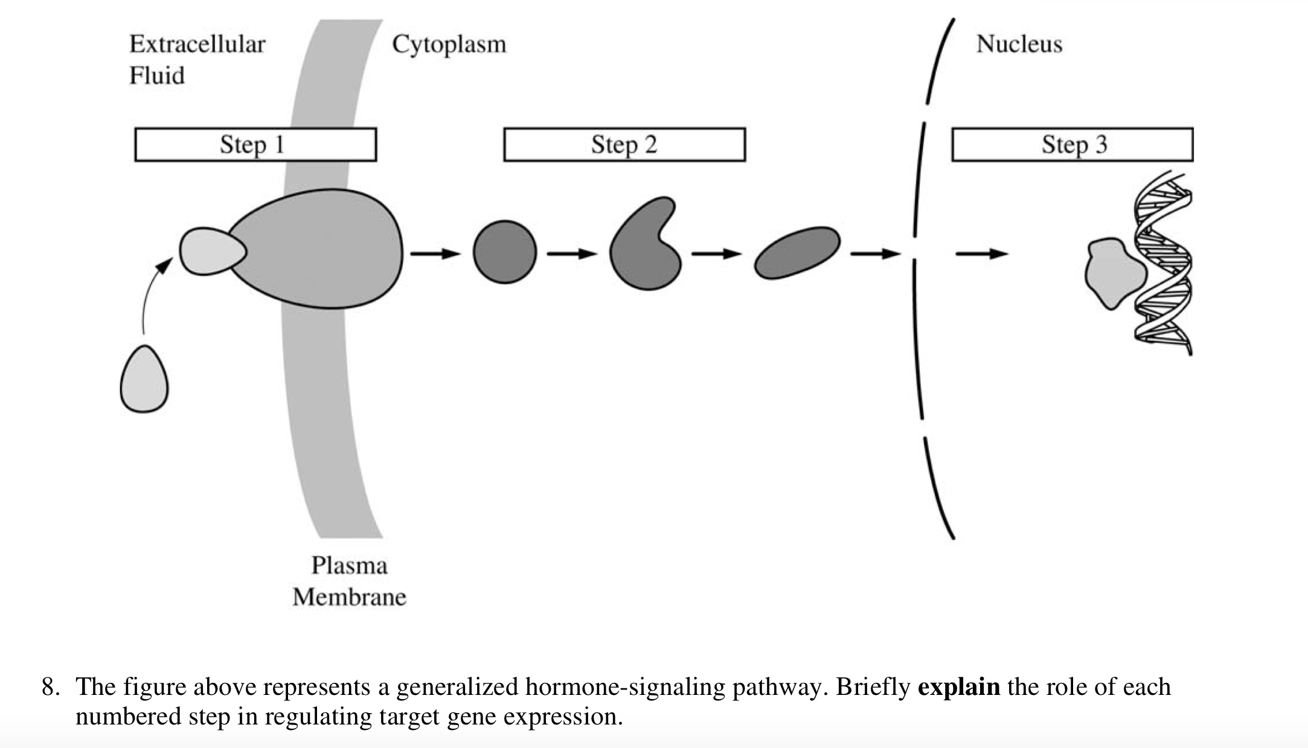
Example AP Short Response Q from 2013 AP Exam:

Slide 33
Overview of 3 steps in a Transduction pathway...
1st- We will define some key vocab together.
2nd- DO read & make your own notes on this section

Slide 34
1. Reception
A Signaling molecule (a “ligand”) binds to a receptor “lock & key”
The receptor undergoes a specific shape change that initiates transduction

Slide 35
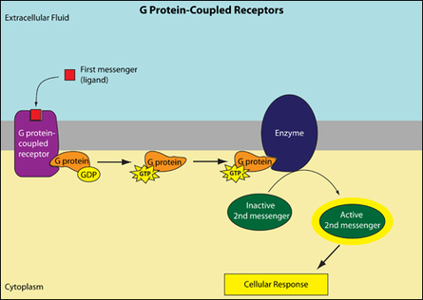
3 types of cell surface receptors:
i) G protein-coupled receptors (GPCRs)- Fig 11.7 pg 211
A “G-Protein” containing the high energy GTP molecule binds & activates receptor

Slide 36
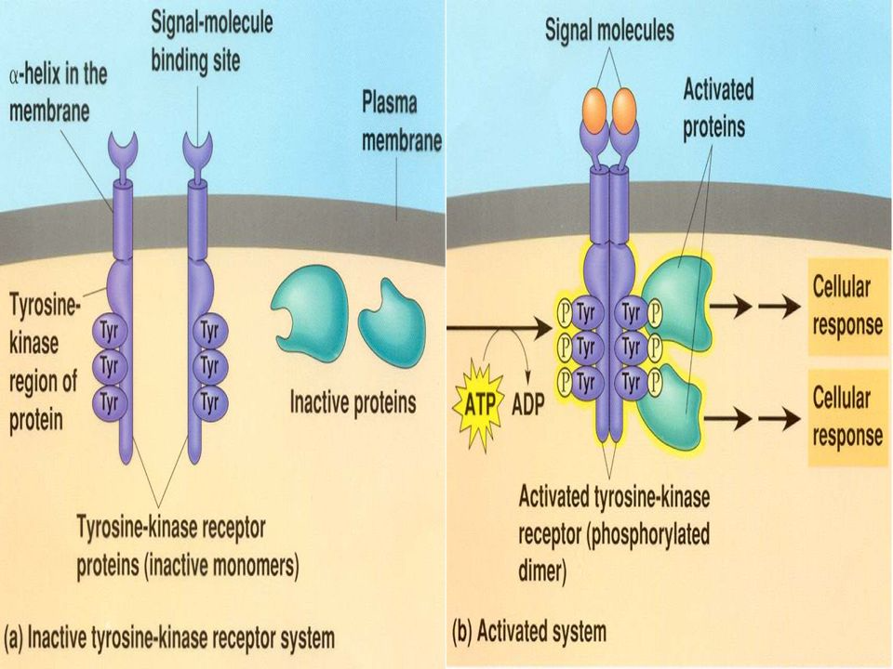
ii) Receptor Tyrosine Kinases (RTKS) pg 212

Slide 37
ii) Receptor Tyrosine Kinases (RTKs)- pg 212
enzymatic activity occurs AT receptor
Kinase enzymes→ add phosphate groups
Binding of ligand triggers receptors to team up as a dimer
Dimerization→ triggers multiple pathways!
*Abnormal RTKs→ cancer…eg) HER2

Slide 38
The HER2 Pathway and Breast Cancer
https://www.youtube.com/watch?v=Q3Tzc3jGt3U

Slide 39
iii) Ligand Gated Ion Channels (pg 213)

Slide 40
iii) Ligand Gated Ion Channels
Binding of Ligand allows OR blocks flow of specific ions (Na+, Ca+ )
Very important in Nervous System & release of neurotransmitters

Slide 41
2. Transduction
Signals from receptors are relayed to target molecules.
KEY Vocab:
Protein kinases
Phosphorylation cascade
Protein Phosphatases
Second messengers
Cyclic AMP (cAMP)

Slide 42
3. Response
Regulation of cellular activity via either:
A) Nuclear Response-
Transcription factor proteins are activated to turn specific genes on or off
B) Cytoplasmic Response-
Cytoskeleton is rearranged to change cell shape
Change in enzyme activity
Role of Scafolding proteins:

Slide 43
Apoptosis
Programmed cell death
Studied of the worm C.elegans showed importance during embryonic development !

Slide 44
Apoptosis… see page 223-225
What is Apoptosis?...remember Caspases!?! (4 mins)
https://www.youtube.com/watch?v=-vmtK-bAC5E
Apoptic Pathways (2mins)
https://www.youtube.com/watch?time_continue=89&v=SyvOPXeg4ig
Nemotuzuma- Cancer Targeting Therapy Targetting Ligand Receptor EGFR
https://www.youtube.com/watch?time_continue=2&v=GXJ__5cUugo

Slide 45
Other Examples of Cell Signals
Enzyme inhibiting drugs for medical conditions
Example:
Blood vessel dilation→ Viagra!
Chemotherapy
Bacteria (penicillin/vanomycin)
Pesticide control
Disinfectants
ATP production (inhibits glycolysis which prevents over production of ATP)

