Slide 1
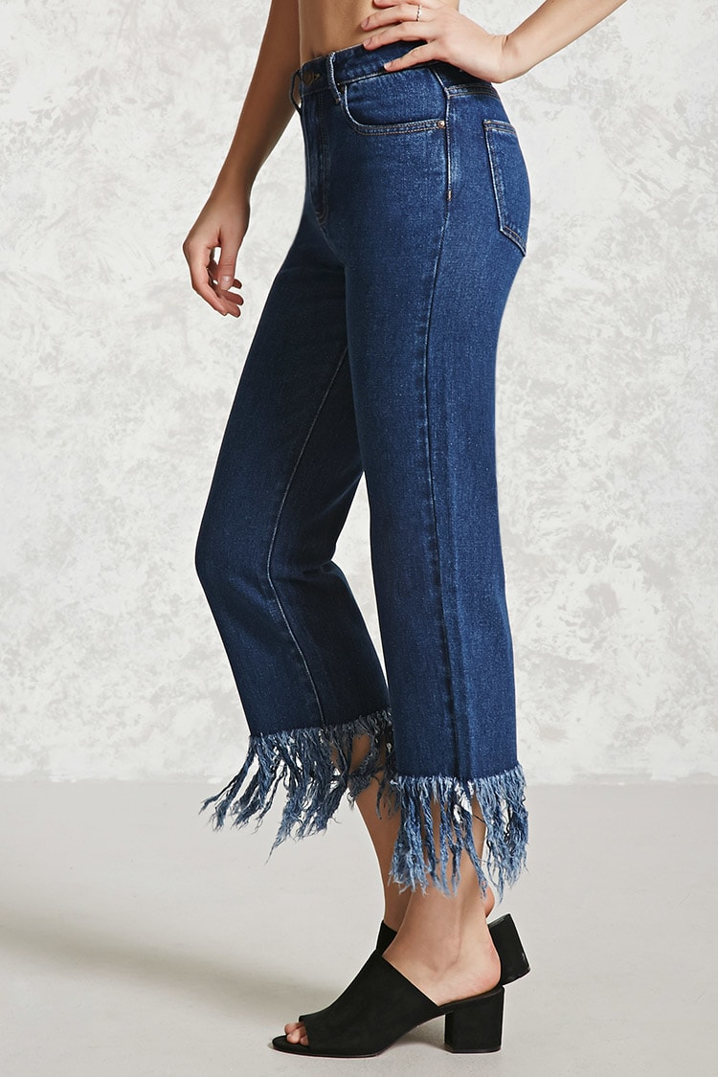
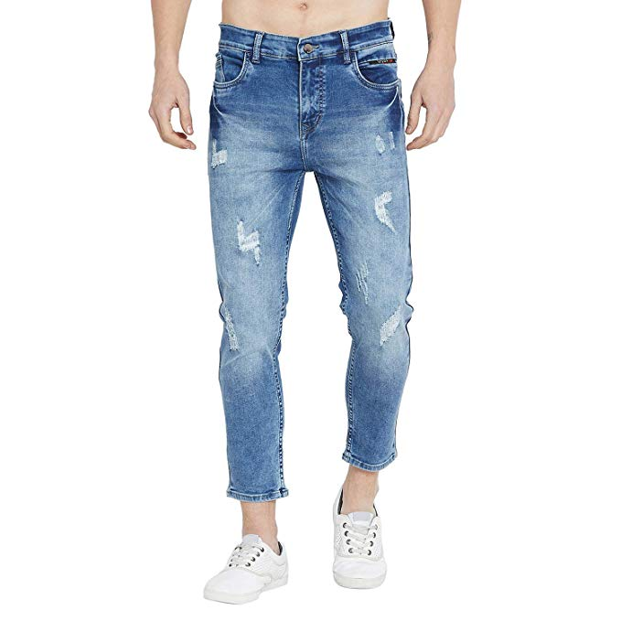
What is our next unit about?

Slide 2
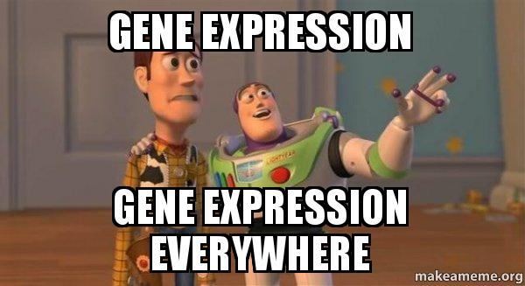

Slide 3
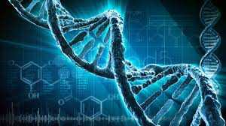
But First…. DNA

Slide 4
The structure of DNA is well suited to it’s function!

Slide 5
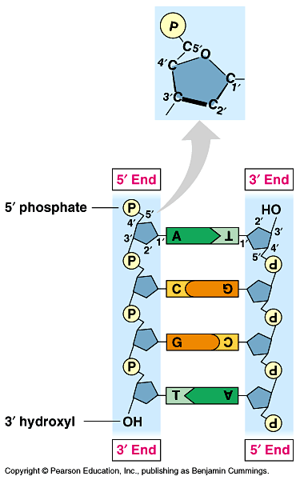
The structure of DNA suggests a copying mechanism…
Complementary Base pairing
always A- T and C-G
The 2 strands held together by weak Hydrogen bonds
Can separate
The 2 strands are antiparallel
Orientated in opposite direction

Slide 6
Rapid Review: Let’s build some DNA
Use the models to review the structure!

Slide 7
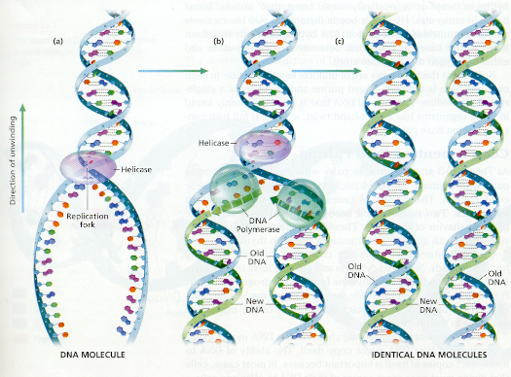
Semi-conservative
-> each new daughter strand will consist of one “old parental” strand and one “new copied strand”

Slide 8
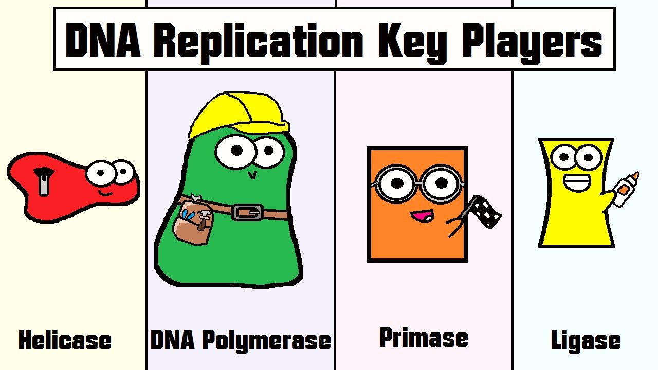
Can DNA do it all on its own?
Many enzymes & other proteins are also needed to carry out replication!

Slide 9
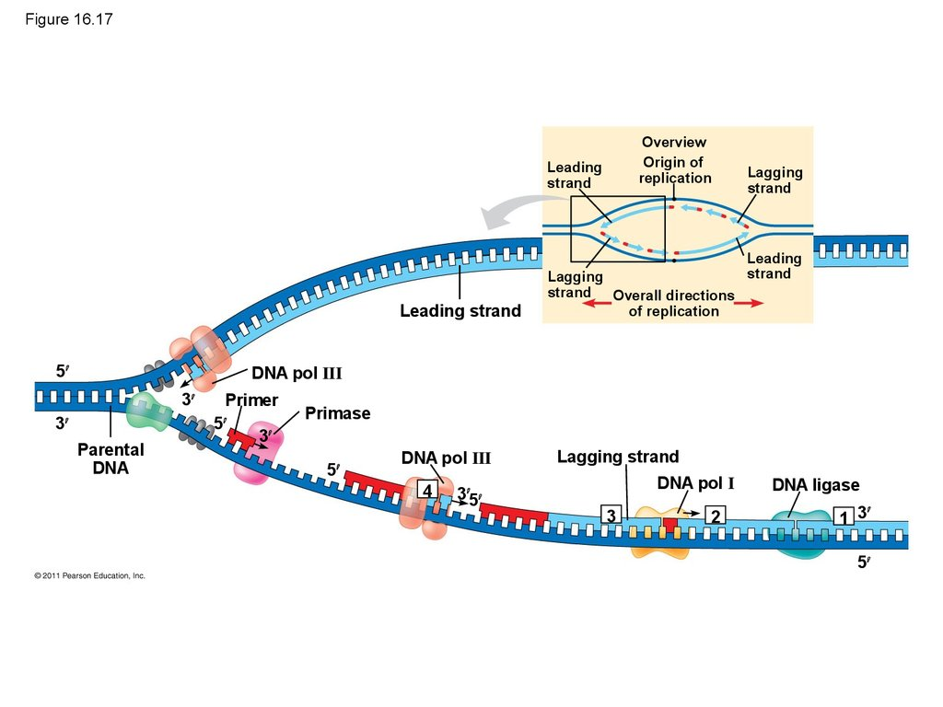
How does DNA Replicate?
Visual Thinking Strategy:
let’s preview this concept & warm up our brains!
Analyze the diagram & use the handout
We will follow up with a video & text pg 509

Slide 10
AA Summary of DNA Replication

Slide 11
Connecting the diagram…
Video with Ameoba Sisters: https://www.youtube.com/watch?v=Qqe4thU-os8
HW: Read pg 509- start summary notes on steps of replication

Slide 12
Helpful Replication Clips
3D Animation: https://www.youtube.com/watch?v=TNKWgcFPHqw
Animation: https://www.youtube.com/watch?v=VpmT7Lw_4v0
Ameoba Sisters: https://www.youtube.com/watch?v=5qSrmeiWsuc
Crash Course: https://www.youtube.com/watch?v=8kK2zwjRV0M
The immortal cells of Henriette Lacks: https://www.youtube.com/watch?v=22lGbAVWhro

