Slide 1
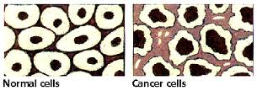
Cancer & The Cell Cycle pg 242-243

Slide 2
Qs of the Day…
What is cancer?
What does cancer have to do with the cell cycle?

Slide 3
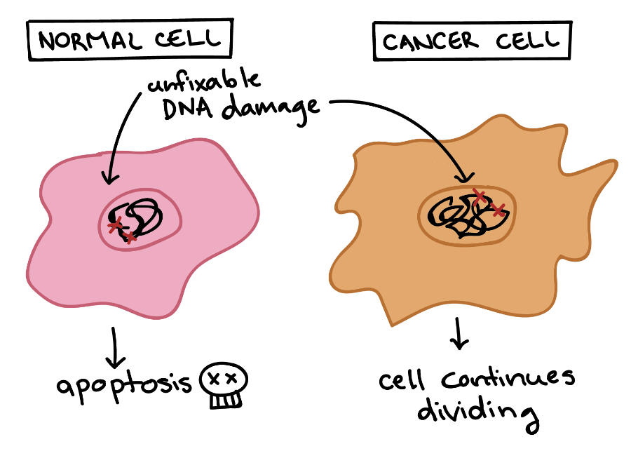
Cancer:
A disease of uncontrolled cell division

Slide 4
Cancer
Linked to changes in activity of cell cycle regulators
→ Cyclins, Protein Kinases, Growth Factors

Slide 5
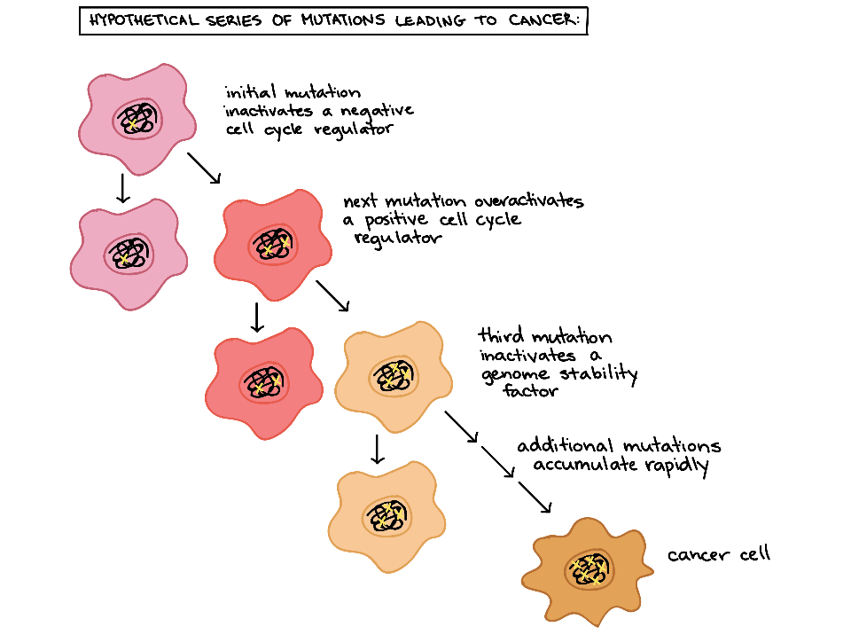

Slide 6
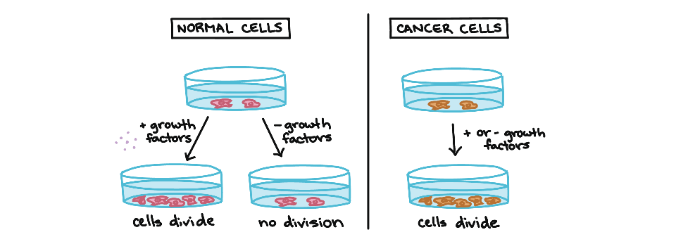
Cancer cells: make own growth factors OR follow a pathway GFs stuck “On” (even when no GF present)

Slide 7
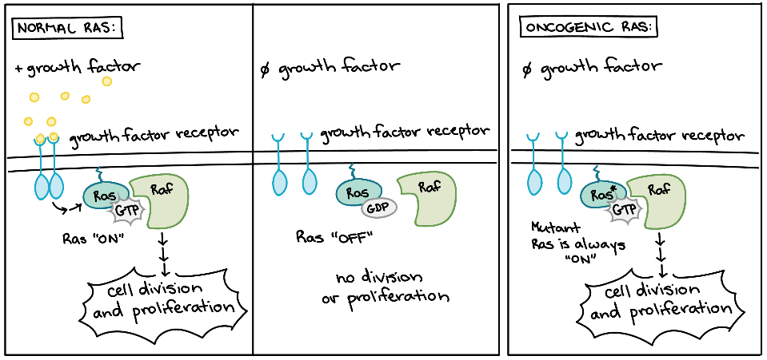

Slide 8
Changes in Regulators:
i) Overactivation of Positive regulators
→ become “oncogenic”
ii) Inactivation of Negative regulators
-tumor supressors are stopped

Slide 9
Traits of Cancer Cells
No density dependent inhibition
No anchorage dependence

Slide 10
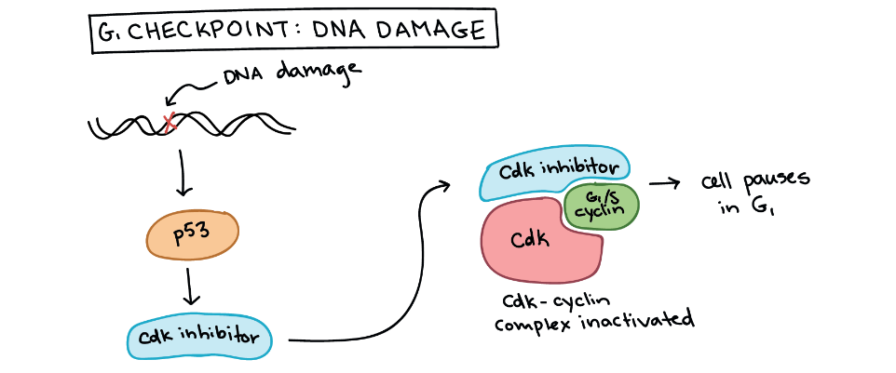
Ex: p53- Guardian of the Genome

Slide 11
Ex: P53- “Guardian of the Genome”
Tumor suppressor protein
Stops cell division at G1 checkpoint
Prevents damaged DNA from being passed on
Triggers CDK inhibitors or apoptosis

Slide 12
Today’s Mission:
Finish last day’s package if not done
Read pg 242-243 → make own notes on vocab
Practice→ Cell cycle handout
→ Online Progress Check open nmow

Slide 13
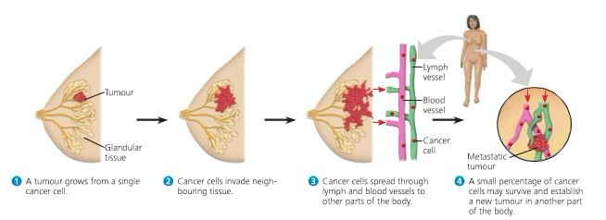
Metastasis of Breast Cancer

Slide 14
Breast Cancer Cells
Chemotherapy can be used to block the function of mutated signaling proteins (kinase-HER2 and Estrogen Receptor)
See Fig 12.21

