Slide 3
Rapid Review of H.W.
Answers are being given to your group but in a random assortment
Discuss with you team
Match the answers to each question

Slide 4
What does a plasma membrane look like?
Can you show me the following WITHOUT USING YOUR WORKSHEET”
Phospholipids
Integral proteins
Peripheral proteins
Glycolipids
Glycoproteins

Slide 5
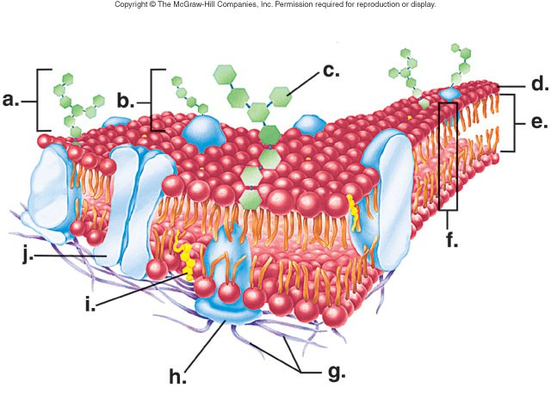
See page 68!
a.
b.
c.
d.
e.
f.
g.
h.
i.
j.

Slide 6
CELL MEMBRANE
a. glycolipid
b. glycoprotein
c. Carbohydrate chain
d. Hydrophilic head
e. Hydrophobic tail
f. Phospholipid Bilayer
g. Filaments of cytoskleton
h. Peripheral protein
i. Cholesterol
j. Integral Protein

Slide 7
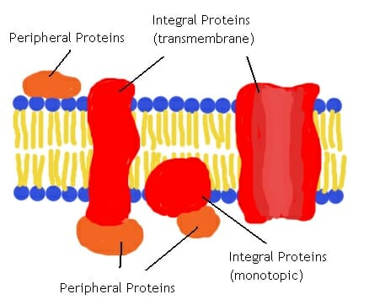
What is the difference between peripheral and integral proteins?

Slide 8
Integral Proteins
Embedded within the membrane
Hydrophobic parts hidden within bilayer
Hydrophilic parts on outside
Ex: glycoproteins→ cell to cell recognition

Slide 9
Integral proteins
Determine a membrane’s specific function
Many are involved in transport

Slide 10
Peripheral Proteins
On outside or inside surface of the membrane
Help with structural support & stability

Slide 11
Why is the plasma membrane like a mosaic?
Each cell has it’s own unique arrangement of many different proteins in it’s membrane!
Red blood cells have over 50 different plasma proteins!

Slide 12
What are some of the different proteins found in the cell membrane?

Slide 13
What are some of the diseases associated with faulty proteins?
PREDICT:
Diarrhea
Obesity
Cystic Fibrosis
Organ Rejection
Lack of growth hormone→ pygmies
See pg 70 for answers

Slide 14
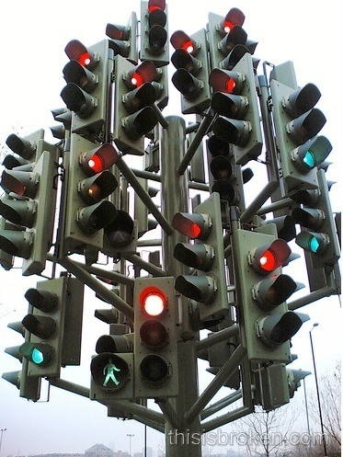
Transport Across the Membrane (Carrier Proteins, Endocytosis, Exocytosis)
Sec 4.4 -4.5, Pages 76- 79

Slide 15
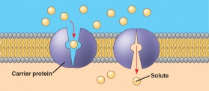
Sec 4.4 p 76 Carrier Proteins:
Specific proteins that combine with specific molecules to help them cross the cell membrane
Change shape when combining then return to initial shape

Slide 16
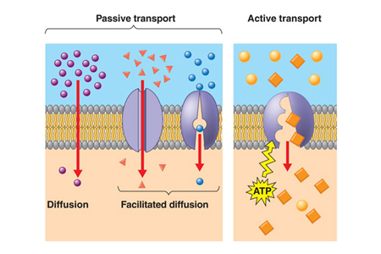

Slide 17
Many Proteins are involved in facilitated transport
a) Does facilitated transport require ATP?
No!
Ex: Channel & some Carrier proteins
b) Does it move molecules with or
Against the concentration gradient?
Moves with the concentration gradient c) What are some examples of molecules that use this?
Glucose, amino acids (carrier proteins) and water (channel proteins)

Slide 18
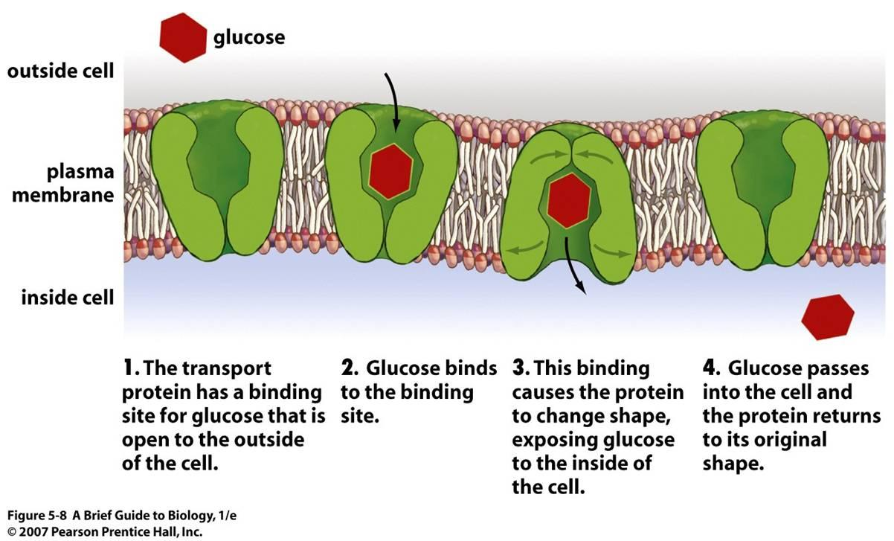
Examples of Facilitated Transport into Cells:
Glucose
→uses a carrier protein
→ No ATP
2. Some Amino Acids
3. Water
→ uses a channel protein

Slide 19
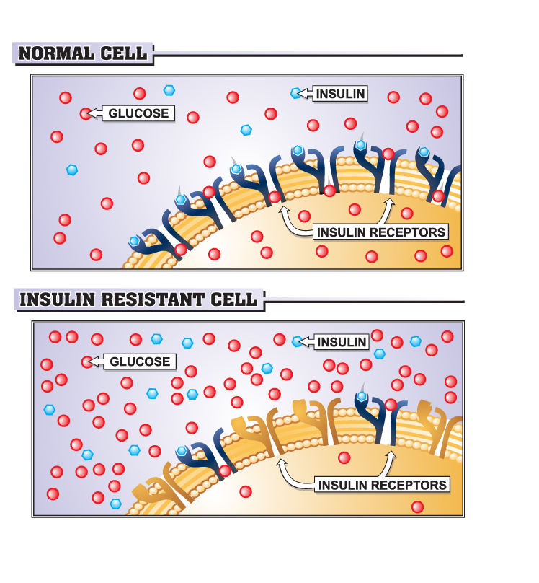

Slide 20
How does diabetes relate to the transport of glucose?
Insulin is a hormone that attaches to protein receptors on the cell membrane
This binding triggers more glucose carrier proteins to function
In some diabetes, “insulin insensitivity” results and the extra glucose carriers DO NOT appear
Glucose is NOT taken into the cell efficiently and blood sugar levels soar!

Slide 21
Summary of active transport
Does Active Transport require ATP
Yes!
b) Does active transport move molecules with or against the concentration gradient?
Against the gradient
c) What are some examples of molecules that use active transport?
Sodium ions (Na+) Potassium Ions (Kt) and Chloride Ions (Cl-)
Iodine (I-), Macromolecules (proteins, carbs etc)

Slide 22
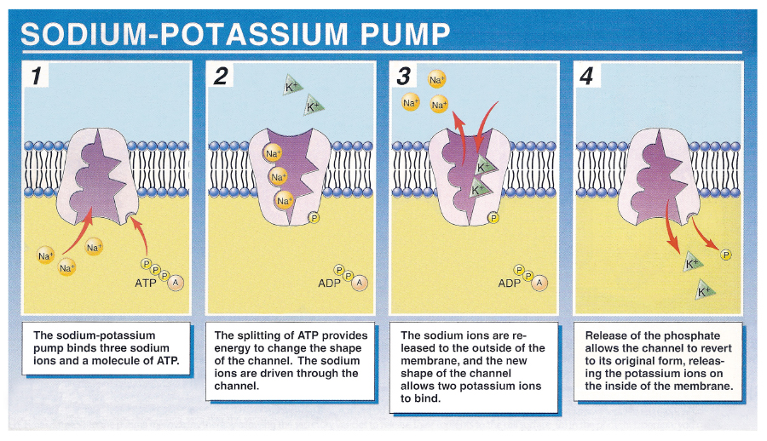
Examples of Active Transport into Cells
1) Ions (ex Na+ & K+)
moved against gradient using ATP
Sodium-potassium pump =common carrier protein in Nerve & Muscle Cells
Cells with “pumps” also have lots of mitochondria near their membranes

Slide 23
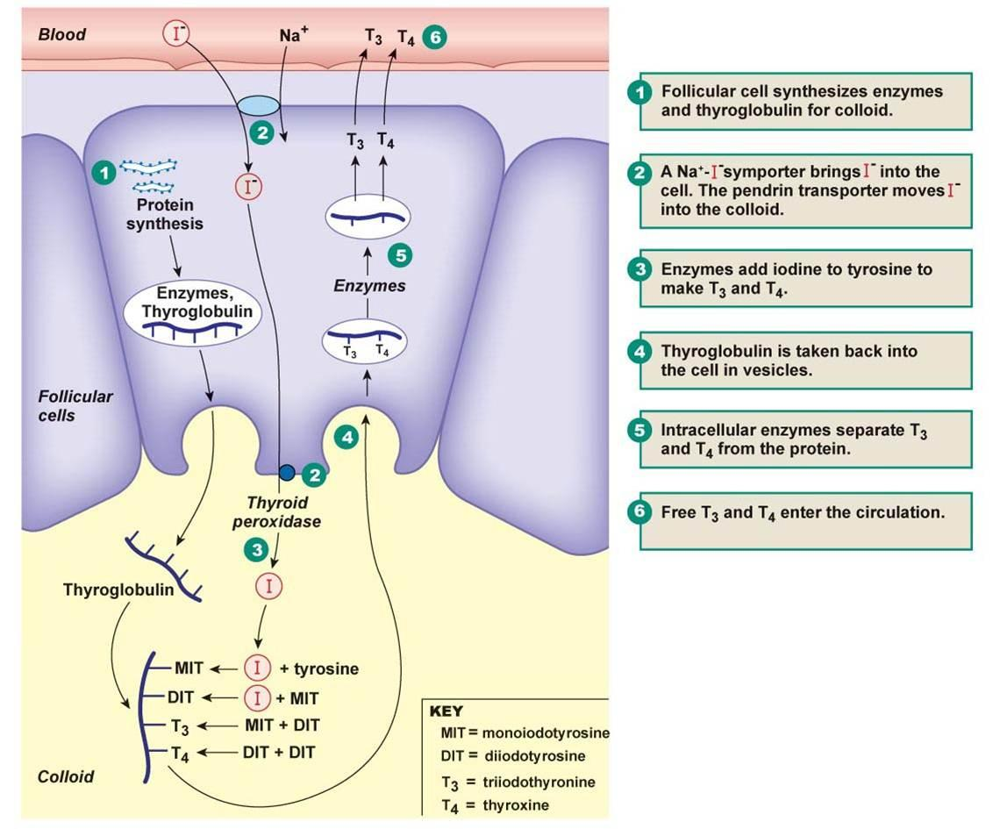
Examples of Active Transport into cells cont…
2) Other charged / polar molecules
-Iodine (I⁻) builds up in thyroid to make hormones
-Sodium (Na⁺) builds up in kidneys
3) Other Macromolecules
-nutrients in intestines
-other sugars and amino acids

Slide 24
In Class / Homework:
Finish the notes package on Active Transport
Finish the last page of package on “How are Vesicles involved in Transport Across the membrane?”

