Slide 1
How Are Vesicles Involved in Transport Across the Membrane?

Slide 2
Exo & Endocytosis both use vesicles to move macromolecules such as…
Polypeptides (PROTEINS)
Polysaccharides ( CARBOHYDRATES)
Polynucleotides (DNA / RNA)
ACTIVE TRANSPORT → Requires ATP

Slide 3
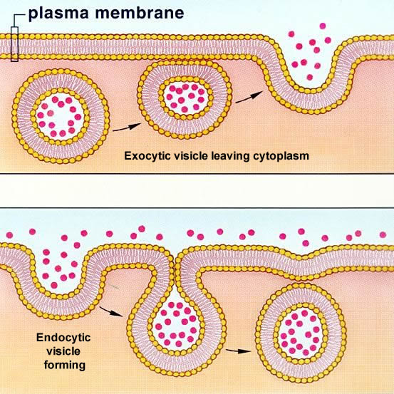
DoEs Transport via Vesicles Require Energy?

Slide 4
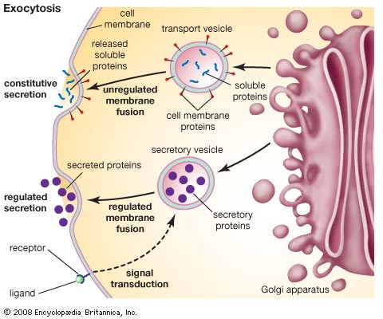
B. Transport by Vesicles Sec 4.5 p78-79
EXOCYTOSIS
export OUT of cell
using vesicles from Golgi

Slide 5
ENDOCYTOSIS
-Into cell, using vesicles
-Plasma Membrane folds inwards “enveloping” substances with it
3 types:
Phagocytosis
Pinocytosis
Receptor Mediated

Slide 6
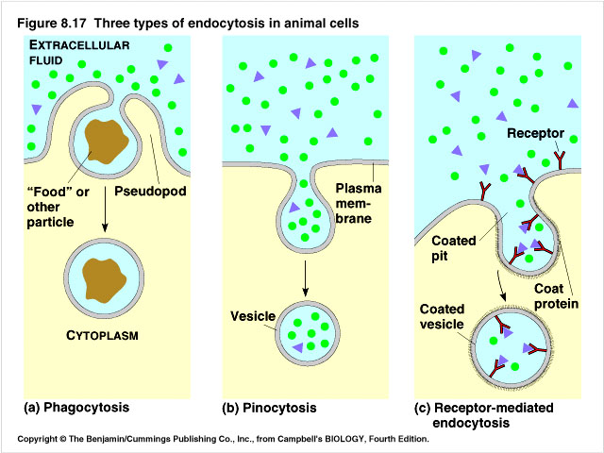
Imports food,
Large particles
Ex: Ameoba
Macrophage
Imports liquids,
Small particles
Ex: Blood Cells in kidney & intestines
vitamins, hormones
lipoproteins (cholesterol)
BIND to specific RECEPTOR
Forms a coated pit!

Slide 7
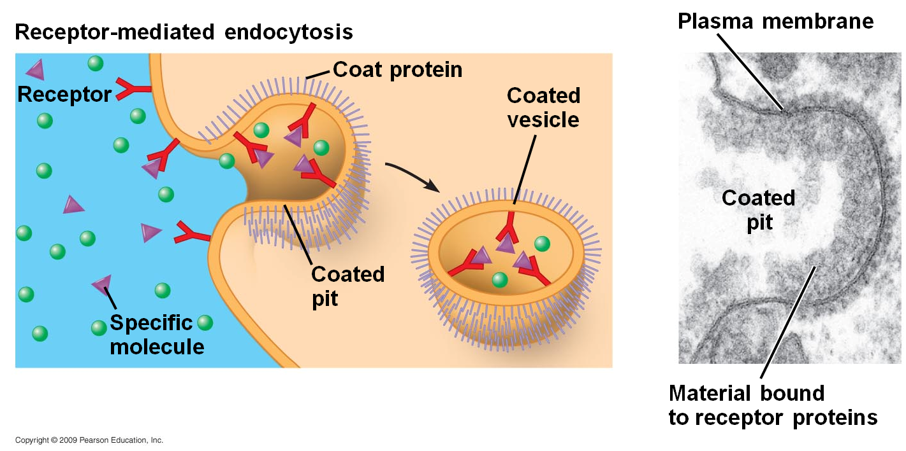

Slide 8
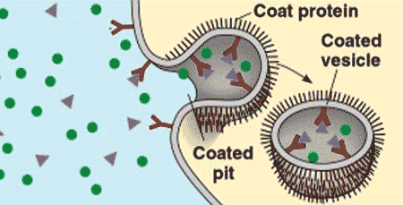
What is being shown?
KEY WORDS:
Endo- to enter the cell
Exo- to exit
Cytosis→ vesicles
Cell membrane
Protein Receptors
Solute
Concentrations
Active/Passive Transport?

Slide 9
Receptor Mediated Endocytosis BIG IDEAS
A form of pinocytosis→ uses vesicles & ATP
Very Specific
Involves vitamins, hormones, lipoproteins (LDL)→ binding to receptors→coated pit vesicle form
Used to move substances IN & to TRANSFER substances between cells (eg move from mother’s blood to baby’s blood at placenta)

Slide 10
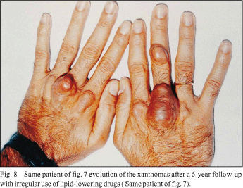
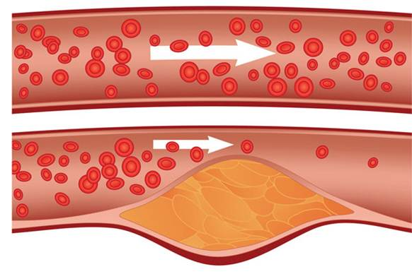
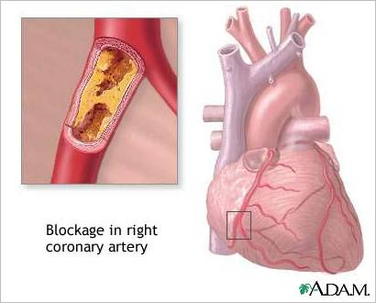
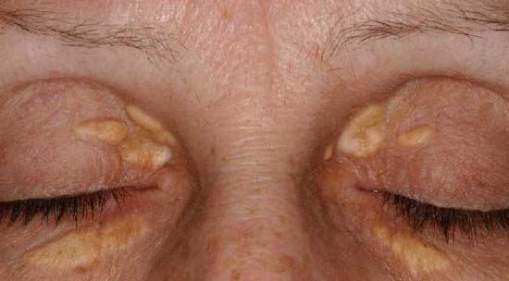
Hyper-Cholesterolemia

Slide 11
Hyper-Cholesterolemia
Genetic Disorder
Low density lipoproteins (LDLs) transport cholesterol in the blood
Reduced #/Defective LDL protein receptors on Plasma Membrane
Cholesterol can’t enter cells normally & builds up
RESULT: High Blood Pressure, Blocked arteries, Heart Attacks
REAL Life… My friend Kelly https://globalnews.ca/video/6108307/health-matters-inherited-high-cholesterol

Slide 12
Rapid Review Video & Practice
https://www.youtube.com/watch?v=Ptmlvtei8hw&t=345s
Link
See Learning Goals- review for Quiz next class on Plasma Membrane Structure, Function and Transport (Chap 4 except for Sec 4.3)
Practice Qs on Handout
At home: Do your Study Guide!

Slide 13
Name of Process | P- Passive? A- Active? | Direction | Requirements | Examples?
Diffusion | PASSIVE | High concentration to Low | Conc. Gradient Only | Gases- O₂ Small Lipid soluble Water (osmosis)
Facilitated Transport | PASSIVE | High Conc. To Low | Conc. Gradient & Channel or Carrier Protein | Some sugars ex) glucose Amino acids
Pump Proteins | ACTIVE | AGAINST Gradient | Carrier Protein & ATP | Other sugars, amino acids, ions
Exocytosis | ACTIVE | OUT of Cell | VESICLE fuses with P.M | Macromolecules
Endocytosis i) Phagocytosis | ACTIVE | Into Cell | Vacuole formation | Cells, Sub-cellular materials
ii) Pinocytosis | ACTIVE | Into Cell | Vesicle Formation | Smaller molecules, liquids
iii) Receptor Mediated | ACTIVE | Into Cell | Receptor Protein, PM to form vesicle | ex: hormones, vitamins LDL-cholesterol

