Slide 1
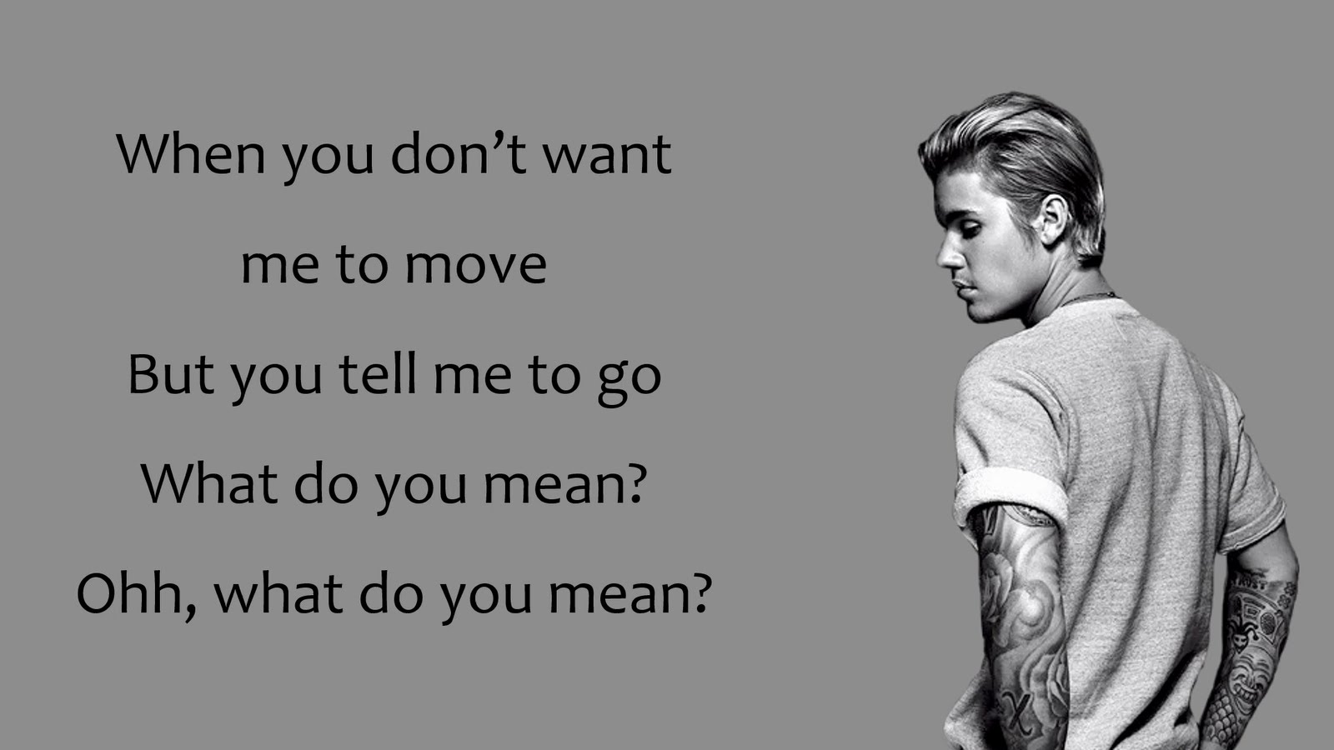
Do you want me to diffuse?

Slide 2
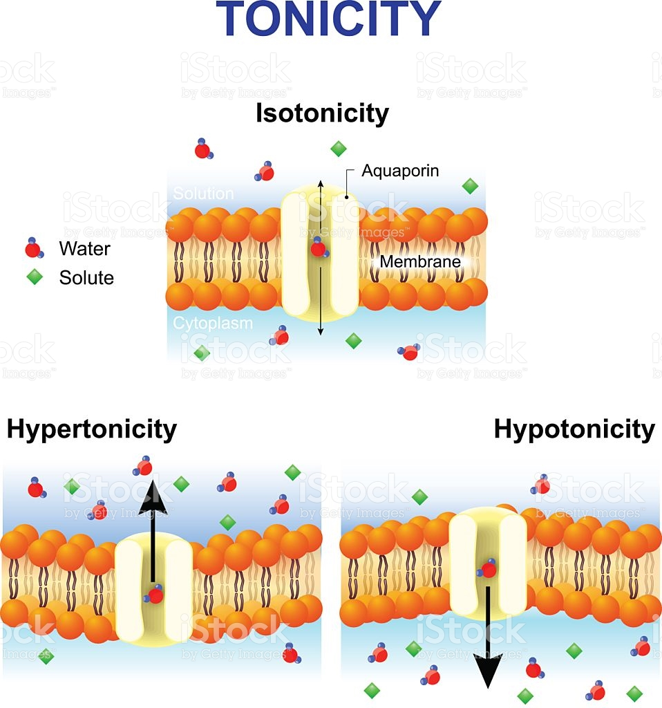
The song was never about Selina…
I’m trying to teach you TONICITY!

Slide 3
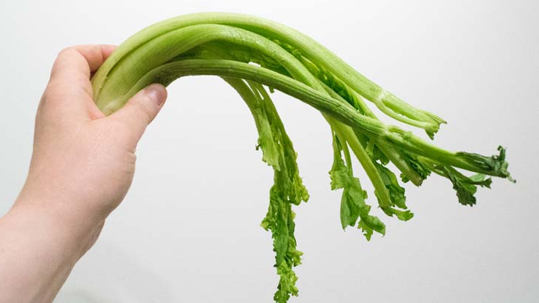
OSMOSIS & TONICITY
Sec 4.3
pg 74-75

Slide 4
Meet Tom…

Slide 5
Osmosis
Osmosis: The special name given to the diffusion of water
Definition: the movement of water from high to low concentration

Slide 6
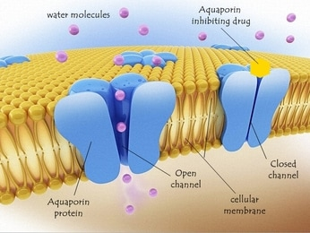
Passage of water across the membrane is believed to require special channel proteins called aquaporins

Slide 7
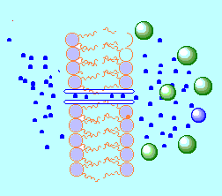
Label the following on the diagram:
phospholipid bilayer
water molecules
channel protein
direction of osmosis
- Solute molecules
- direction of osmosis.

Slide 8
Tonicity-
Refers to how the solute concentration affects the direction water will flow
3 terms to know:
Isotonic
Hypotonic
Hypertonic

Slide 9
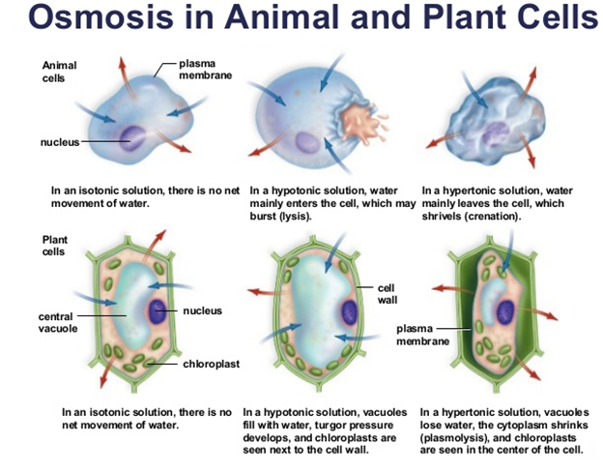

Slide 10
Isotonic Solutions
iso = “the same” & tonic = “solution”
Equal concentration of solute on outside &
On inside of cell
water moves into cell at equal rate to water moving out
cell stays the same, is at EQUILIBRIUM

Slide 12
Hypotonic Solutions
hypo = “lower”
LOWER solute concentration OUTSIDE cell
More water outside cell → water moves INTO cell
cell swells
LYSIS –bursting of cells may occur in animal cells
TURGOR PRESSURE - builds up in plant cells
→ Vacuole pushes outwards against cell wall

Slide 14
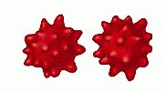
Hypertonic Solutions
hyper= “ higher”
HIGHER solute concentration outside of cell
water concentration is lower outside cell
net movement of water LEAVES cell
CRENATION occurs in animal cells
PLASMOLYSIS occurs in plant cells

Slide 15
Practice-
Read pg 74-75
Complete the table on the back of your handout
Try the multiple choice

Slide 16
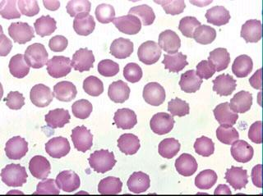

Slide 17
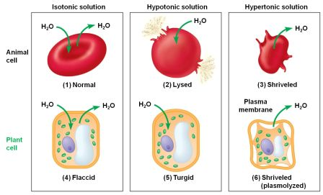

Slide 18
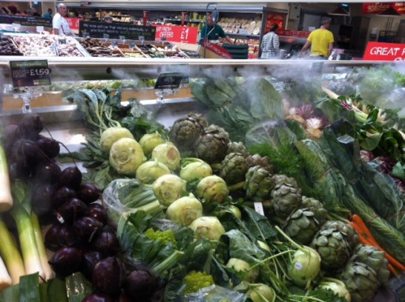
Extra Practice
Why are veggies sprayed with water at the grocery store?
Explain using tonicity vocab!

Slide 19
Osmosis & Tonicity Links
http://www.tvdsb.on.ca/westmin/science/sbi3a1/Cells/Osmosis.htm (tonicity)
http://ull.chemistry.uakron.edu/genobc/animations/collapse.mov (crenation)
Ameoba Sisters- https://www.youtube.com/watch?v=IaZ8MtF3C6M

