Slide 1
Rapid Review
Topic of Diffusion & Osmosis … ☺

Slide 2
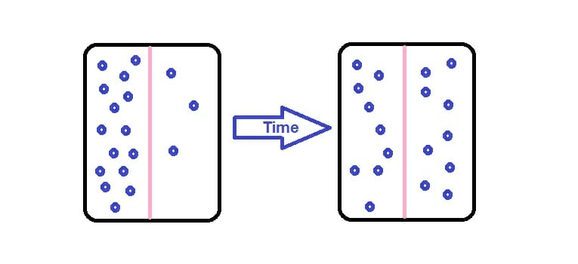
Key Points
Diffusion:
DOES NOT require energy (its passive)
Results in molecules moving from high concentration to low concentration
Occurs faster when molecules have higher kinetic energy

Slide 3
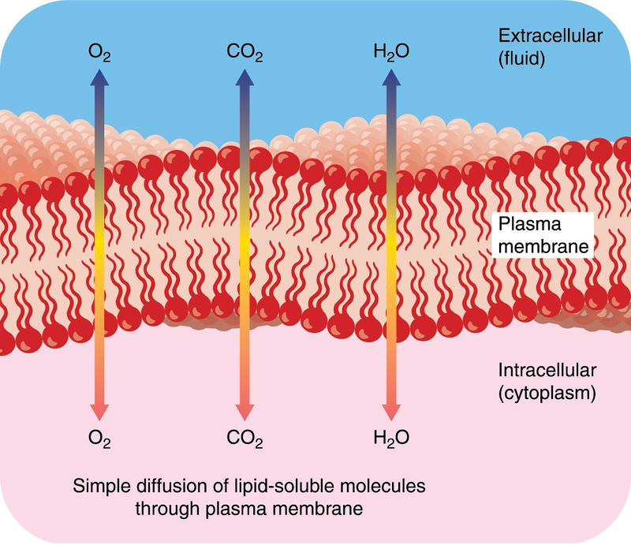

Slide 4
Key Points
Osmosis:
Water moves from high concentration to low
Solute concentration on either side of a membrane (tonicity) will determine direction water flows
Compared to the cell a solution can be hypotonic, isotonic or hypertonic

Slide 5
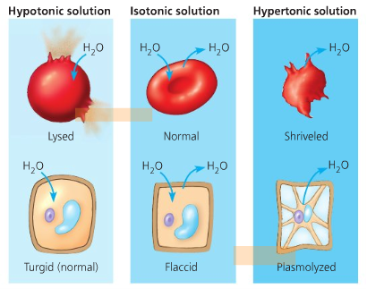

Slide 6
Group Practice Q:
How can tonicity help get this ring
off?

Slide 7
Record your ideas…

Slide 8
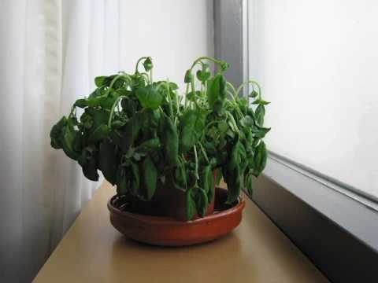
What led to this? Can tonicity save this plant? Explain using key vocab…
Hyper/hypotonic, turgor pressure, osmosis, plasmolysis

Slide 9
Record your ideas…

Slide 10
What is Water Potential?
https://www.youtube.com/watch?v=nDZud2g1RVY

Slide 11
Osmosis in plant cells is affected by both:
The solute concentration- tonicity inside the cell compared to outside the cell
Turgor Pressure- the force within the cell that pushes the cell membrane against the CELL WALL.
-a factor in plant, bacterial and fungal cells

Slide 12
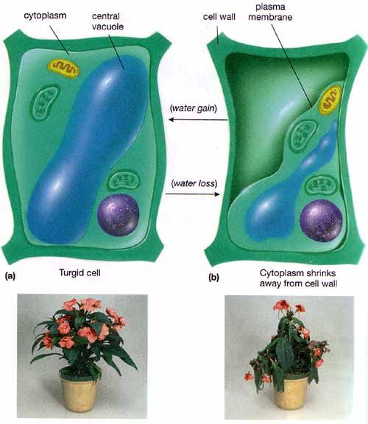

Slide 13
Water potential is a measurement that combines the effects of solute concentration and pressure
Water flows from regions of higher water potential to regions of lower water potential
Water Potential Equation: Ψ ₌ Ψ_{P +} Ψ_{S}

Slide 14
Ψ ₌ Ψ_{P +} Ψ_{S}
Pressure potential (Ψ_{P}) is the physical pressure on a solution
Turgor pressure is the push exerted by the plasma membrane against the cell wall
For water in an open system (Ψ_{P}) = 0
The solute potential (Ψ_{S}) of a solution is proportional to the number of dissolved molecules → osmosis
(Ψ_{S}) is also called osmotic potential
To find (Ψ_{S}) use the equation: Ψ_{S} = - iCRT

Slide 15
Ψ ₌ Ψ_{P +} Ψ_{S}
Ψ_{S} = - iCRT
i is the ionization constant
C is the molar concentration
R is the pressure constant (0.0831 liter bars/mole-K)
T is the temperature in K (273 + C°)

Slide 16
Bozeman Video on Water Potential
https://www.youtube.com/watch?v=nDZud2g1RVY

Slide 17
You try it…
1) Calculate Ψ of a 0.15M solution of of NaCl at atmospheric pressure (Ψ_{P} = 0) at 25 °C.
Note: NaCl breaks into 2 pieces so i = 2.
Equations:
Ψ ₌ Ψ_{P +} Ψ_{S}
Ψ_{S} = - iCRT
i is the ionization constant
C is the molar concentration
R is the pressure constant (0.0831 liter bars/mole-K)
T is the temperature in K (273 + C°)
Show your work:

Slide 18
You Try It…
2) You have a 0.15 M solution of sucrose at atmospheric pressure (Ψ_{P} = 0) at 25 °C. Calculate Ψ. Note: Sucrose doesn’t ionize so i=1
Equations:
Ψ ₌ Ψ_{P +} Ψ_{S}
Ψ_{S} = - iCRT
i is the ionization constant
C is the molar concentration
R is the pressure constant (0.0831 liter bars/mole-K)
T is the temperature in K (273 + C°)
Show your work:

Slide 19
Remember: Water will always move from higher potential (Ψ) to lower potential (Ψ)
You may need to use the equation to calculate (Ψ) and compare (Ψ) on either side of a membrane to predict which way it will flow
For pure water in an open system:
(Ψ_{P}) = 0 and (Ψ_{s}) = 0 so water potential (Ψ) is also = 0
If Molar Concentration is NOT GIVEN, you can find it for a cell by using a graph
When a cell is isotonic with it’s environment there will be zero % change in mass, the concentration of solute in this environment must be the same concentration of solute in the cell

Slide 20
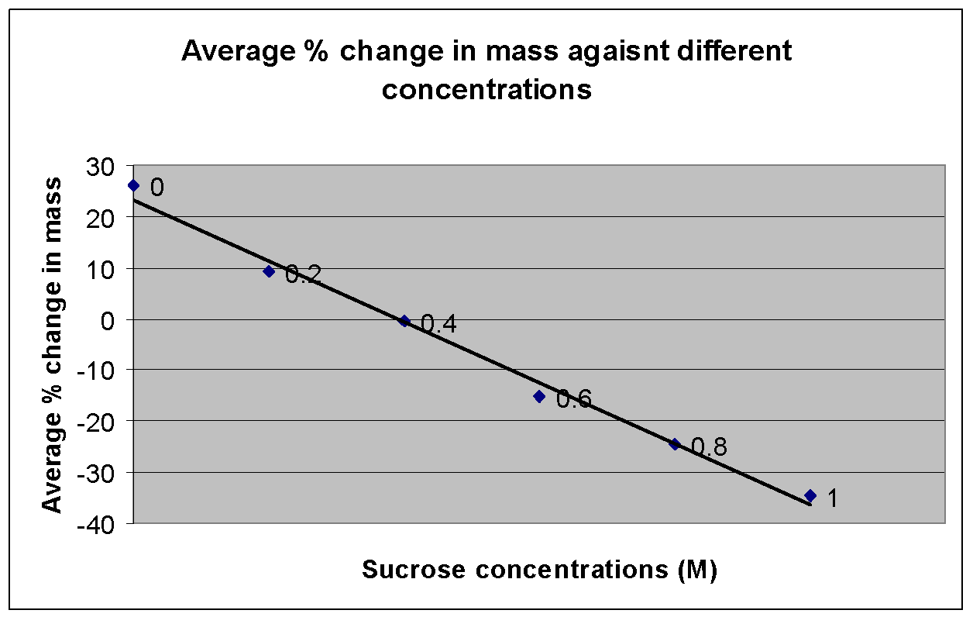
Apply the graph:
What is the molar concentration of sucrose in this plant?

Slide 21
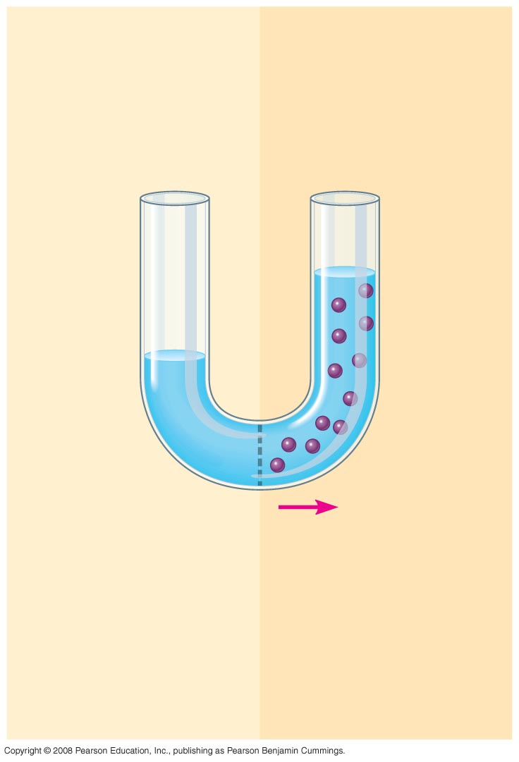
Fig. 36-8a
(a)
0.1 M solution
The addition of solutes reduces water potential
Pure water
H₂O
ψ_{P} = 0 ψ_{S} = 0
ψ_{P} = 0 ψ_{S} = −0.23
ψ = 0 MPa
ψ = −0.23 MPa
Notes:
Figure 36.8a Water potential and water movement: an artificial model

Slide 22
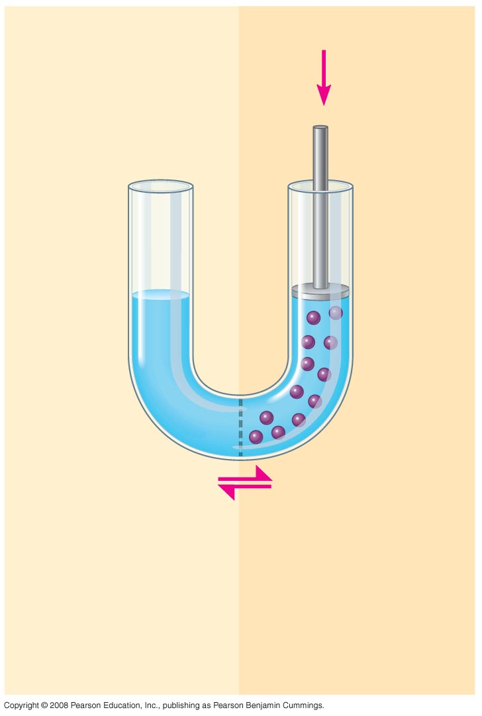
Fig. 36-8b
(b)
Positive pressure
Physical pressure increases water potential
H₂O
ψ_{P} = 0 ψ_{S} = 0
ψ_{P} = 0.23 ψ_{S} = −0.23
ψ = 0 MPa
ψ = 0 MPa
Notes:
Figure 36.8b Water potential and water movement: an artificial model

Slide 23
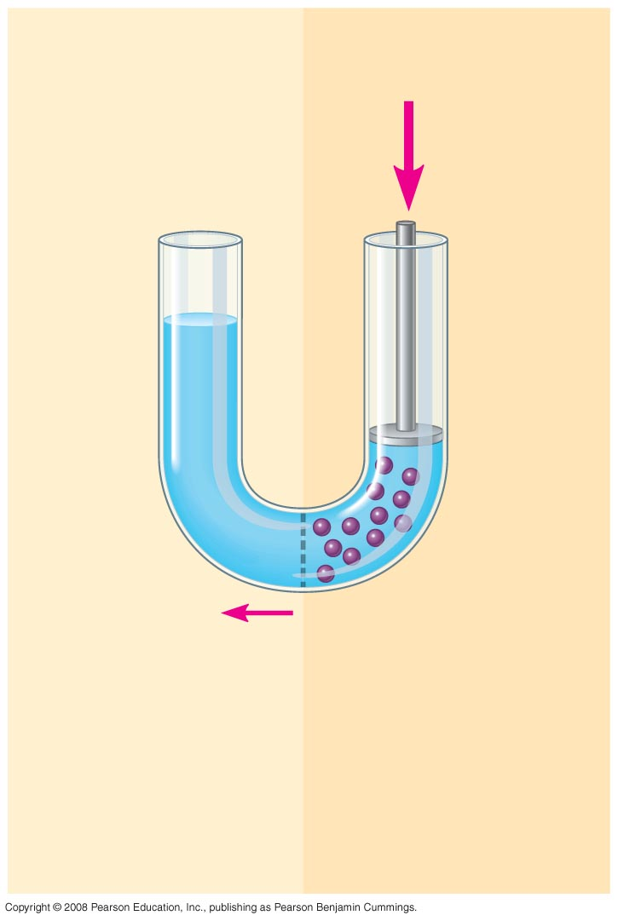
Fig. 36-8c
(c)
Increased positive pressure
Further Physical pressure increases water potential more
H₂O
ψ_{P} = 0 ψ_{S} = 0
ψ_{P} = ψ_{S} = −0.23
0.30
ψ = 0 MPa
ψ = 0.07 MPa
Notes:
Figure 36.8c Water potential and water movement: an artificial model

Slide 24
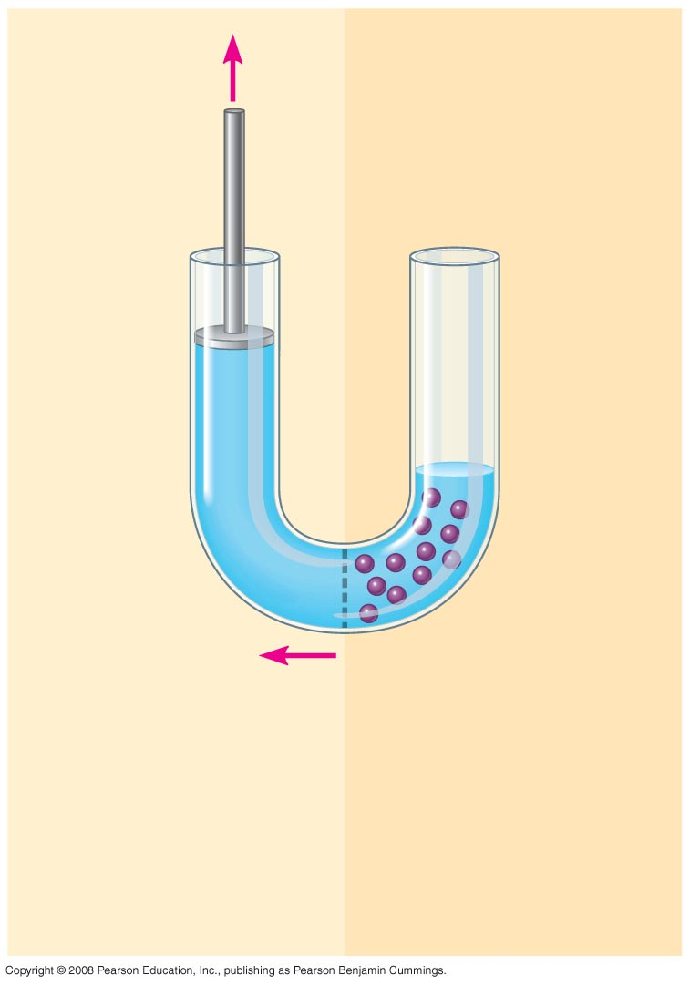
Fig. 36-8d
(d)
Negative pressure (tension)
Negative pressure decreases water potential
H₂O
ψ_{P} = −0.30 ψ_{S} =
ψ_{P} = ψ_{S} = −0.23
0
0
ψ = −0.30 MPa
ψ = −0.23 MPa
Notes:
Figure 36.8d Water potential and water movement: an artificial model

Slide 25
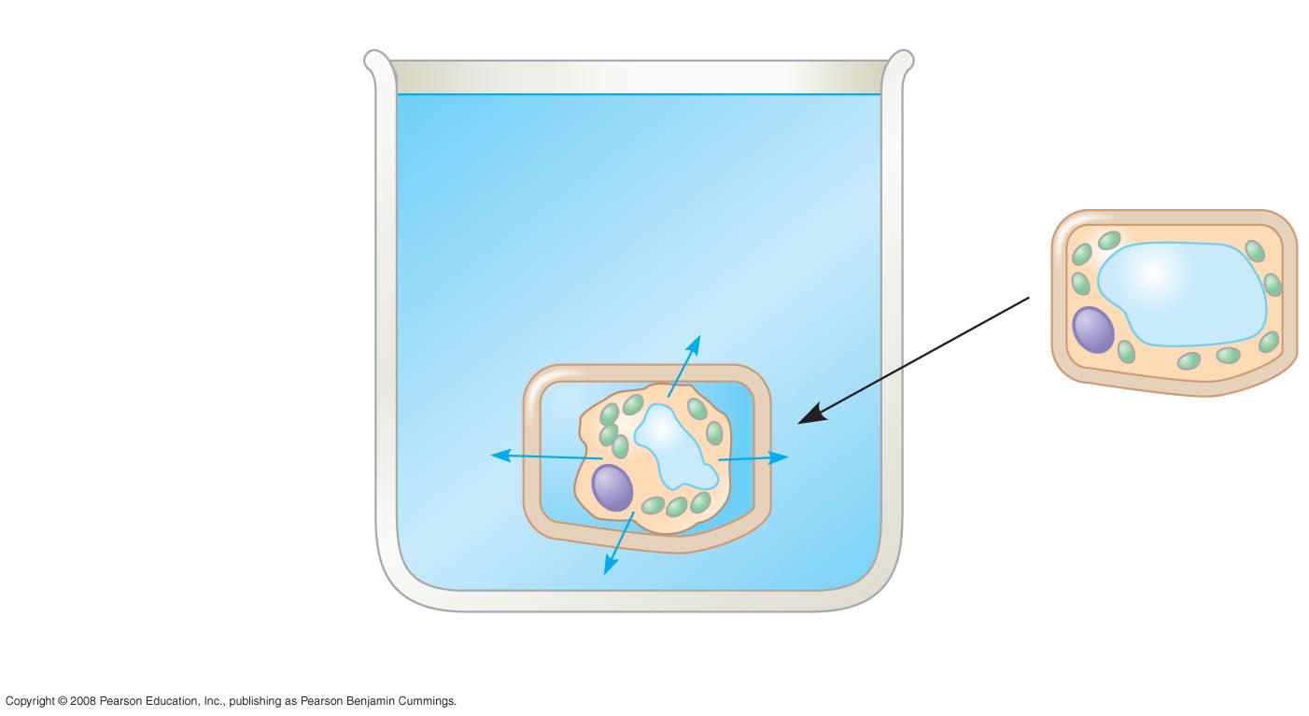
Fig. 36-9a
If a flaccid cell is placed in an environment with a higher solute concentration, the cell will lose water and undergo plasmolysis
Initial flaccid cell:
ψ_{P} = 0 ψ_{S} = −0.7
0.4 M sucrose solution:
ψ = −0.7 MPa
ψ_{P} = 0 ψ_{S} = −0.9
ψ = −0.9 MPa
Plasmolyzed cell
ψ_{P} = 0 ψ_{S} = −0.9
ψ = −0.9 MPa
(a) Initial conditions: cellular ψ > environmental ψ
Notes:
Figure 36.9 Water relations in plant cells

Slide 26
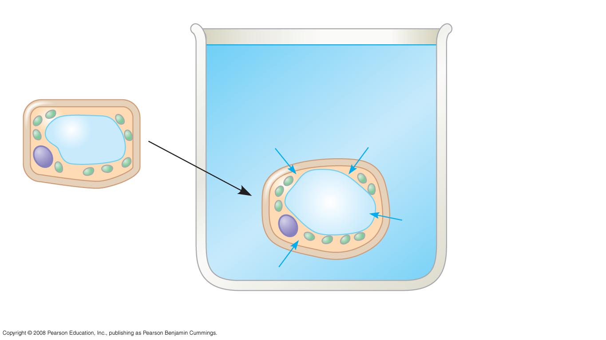
Fig. 36-9b
If the same flaccid cell is placed in a solution with a lower solute concentration, the cell will gain water and become turgid
Initial flaccid cell:
ψ_{P} = 0 ψ_{S} = −0.7
ψ = −0.7 MPa
Pure water:
ψ_{P} = 0 ψ_{S} = 0
ψ = 0 MPa
Turgid cell
ψ_{P} = 0.7 ψ_{S} = −0.7
ψ = 0 MPa
(b) Initial conditions: cellular ψ < environmental ψ
Notes:
Figure 36.9 Water relations in plant cells

Slide 27
Group Practice Q 1 Answer
Place the finger in a hypertonic solution (ex really really salty water compared to finger)
If concentration of solutes is made higher outside the finger, water will leave the finger by osmosis!
Water will flow from where there is more of it (high concentration inside the cells )to the outside where there is less water due to he hypertonic solution
This will cause fluid to leave the finger and it will shrink so the ring can be removed (without amputation!)

Slide 28
GROUP PRACTICE Q 2 ANSWER
What created this situation: Soil / air is hypertonic compared to the inside of the plant.
Water has left the plant’s cells and moved out
Plasmolysis is occurring- not enough turgor pressure on cell wall, so plant looks wilted because water has left cells and the cell membrane is no longer pushing up against the cell wall
Save a Plant Solution:
Spray with water so that water concentration on outside of cell will be higher than inside→ Create a hypotonic environment outside of cells
water will flow back into cells and plant will resume shape!
(hopefully its not too late!)

Slide 29
You try it KEY #1
1. Calculate Ψ of a 0.15M solution of of NaCl at atmospheric pressure (Ψ_{P} = 0) at 25 °C.
Note: NaCl breaks into 2 pieces so i = 2.
Ψ_{S} = - (2)(0.15mole/liter)(0.0831 liters bars/mole-K)(298 K)
Ψ_{S} = - 7.43 bars
Ψ = 0 + (-7.43 bars)
Ψ = -7.43 bars

Slide 30
You Try it KEY #2
1st use Ψ_{S} = - iCRT to calculate Ψ_{S} i = 1 (sucrose does not ionize) C = 0.15 mole/liter R = 0.0831 liter bars/ mole-K T = 25 + 273 = 298 K
Ψ_{S} = - (1)(.15M)(0.0831 liter bars/mole-K)(298 K) = -3.7 bars
2nd use Ψ ₌ Ψ_{P +} Ψ_{S} to calculate Ψ
Ψ ₌ Ψ_{P +} Ψ_{S} = 0 + (-3.7bars) = -3.7 bars

