Slide 1
Section 5.4- Proteins!
Page 77- 86

Slide 2
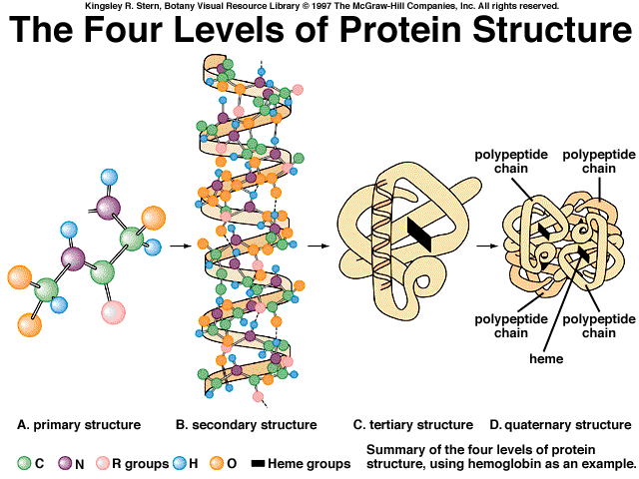

Slide 3
Level of Organization | Description of Shape | Type of Bond
Primary | Linear | Peptide bonds
Secondary | Alpha-helix or Pleated sheet | Hydrogen bonds
Tertiary | 3-D structure | Bonds between R groups: Can involve Hydrogen bonds, covalent, or ionic bonds or disulfide bonds all can occur
Quaternary | When 2 or more polypeptide chains join together | Bonds between R groups also! (many different kinds)

Slide 4
Concept Check 5.4 pg 86
1. If a protein is denatured it’s chemical bonds are slightly altered and it loses it’s shape. A loss of shape means a loss of function. For Example : Sickle Cell anemia, red blood cells are sickle shape instead of biconcave disks and can build up in vessels
2. Secondary Structure- hydrogen bonds between the amino acid chain
Tertiary structure involves interactions between the R groups of the amino acids (their side chains interact)
3. Valine, leucine and Isoleucine are all non polar and therefore Hydrophobic. This means these side chains would avoid interactions with water and likely these amino acids would be folded into the polypeptide chain away from the watery cell or tissue fluids

