Slide 1
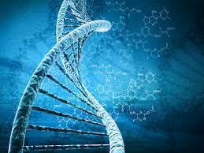
Nucleic Acids

Slide 5
Nucleic Acids Section 2.8 pg 40

Slide 6
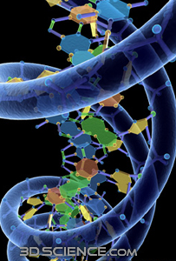
Function: to store, transmit & express hereditary information
Deoxyribonucleic acid- DNA
Provides the genetic code
Provides directions for it’s replication
Provides directions for Protein Synthesis

Slide 7
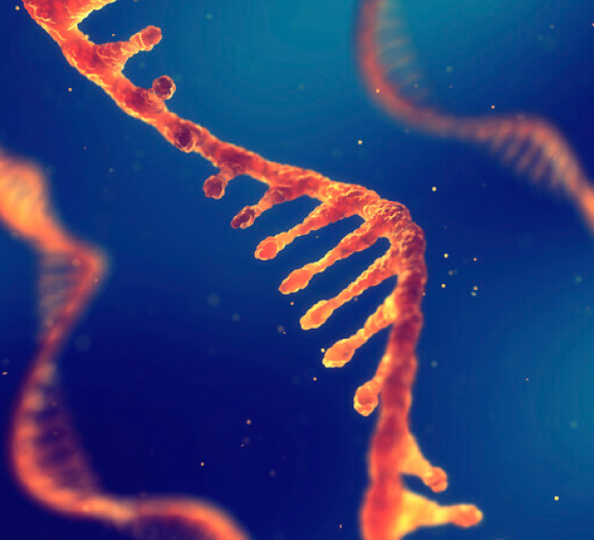
Ribonucleic Acid: RNA
Directs protein synthesis from DNA in the nucleus to ribosomes in the cytoplasm

Slide 8
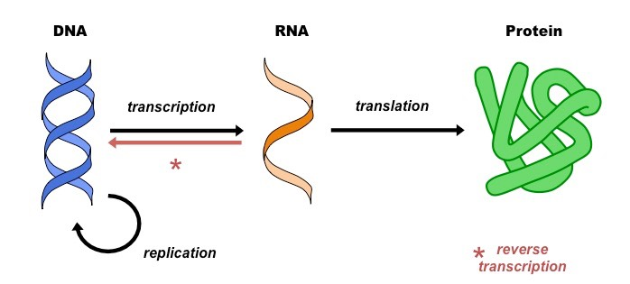
The central dogma of molecular biology

Slide 9
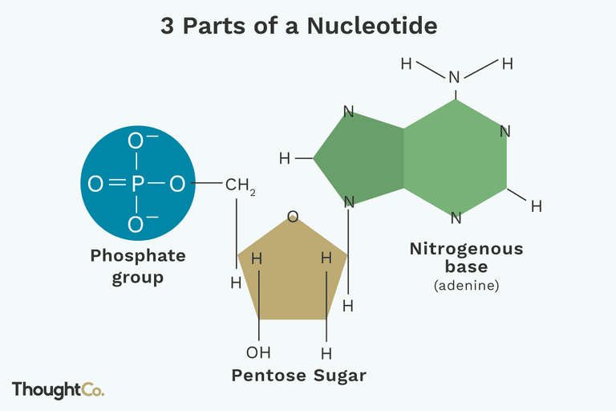
Nucleic acids are macromolecules
Monomer: nucleotide
Polymer: DNA, RNA

Slide 10
Types of Bases

Slide 11
Bases connect strands with Hydrogen bonds

Slide 14
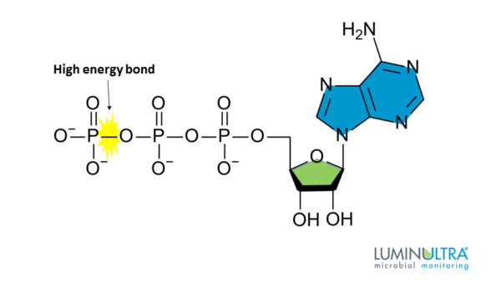
Atp: adenosine triphosphate
Structure:
Adenosine = Adenine (Nitrogenous Base) + Ribose ( sugar )
ATP = Adenosine + 3 phosphates
It’s a MONOMER!
Created from breakdown of glucose in food by cells
→ by Cellular Respiration !

Slide 15
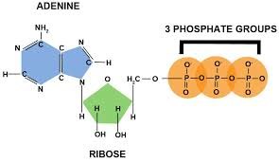
ATP: Adenosine triphosphate
Function:
Energy carrier in cells (supplies the energy needed for chem. rxns in cells)

Slide 16
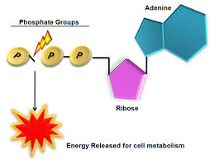
Function:
The bond between the ast two phosphate bonds are unstable
& high nergy bond that is easily broken by water
Makes Adenosine Diphosphate (ADP) + P & release E
Can be re-formed when another P is added

Slide 17
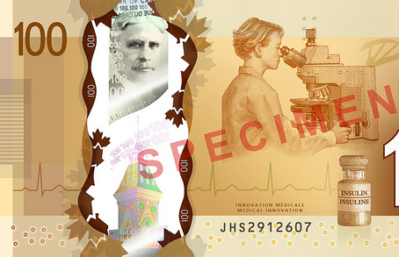
Atp is the energy currency of the cell
It’s a more “manageable” amount & form of Energy!
Used to power most molecular interactions!

Slide 18
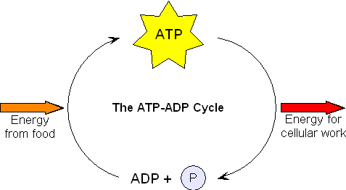
ATP is the energy source cells “spend” to…
transport molecules across the membrane
to build molecules
To contract muscles
To conduct nerve impulses etc!

