Slide 1
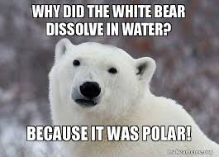

Slide 2
Rapid Review Mission
1) Get a whiteboard, pen and cloth
2) Divide the white board into 2 sections
3) Write the Meme # and the Q letter
4) 2 minute stations to record your connections / answers then rotate
Meme | Q

Slide 3
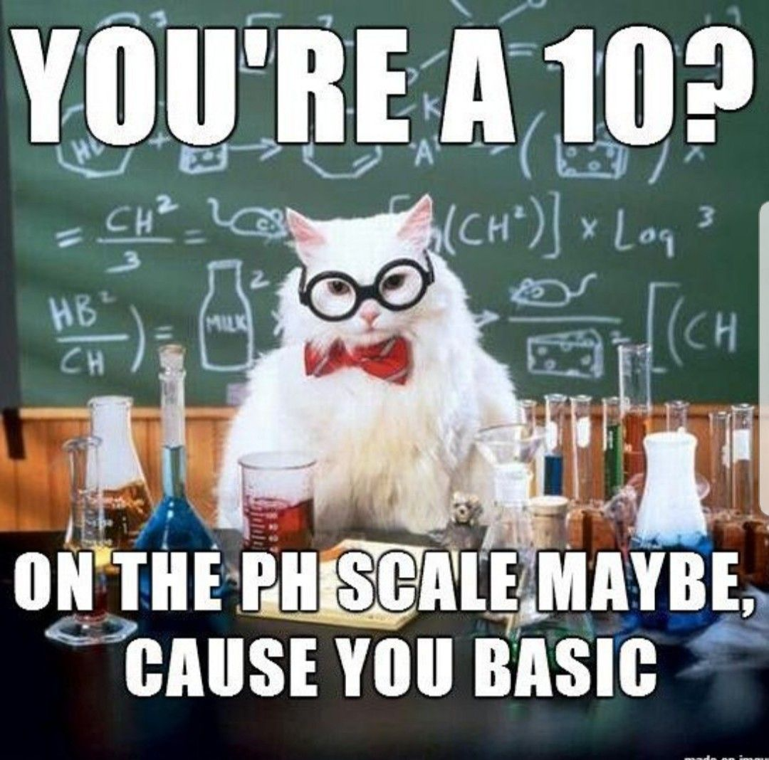

Slide 4
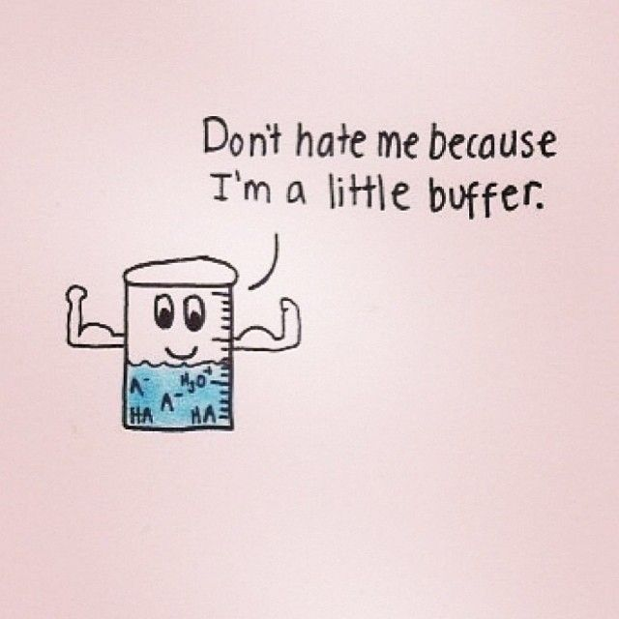

Slide 5
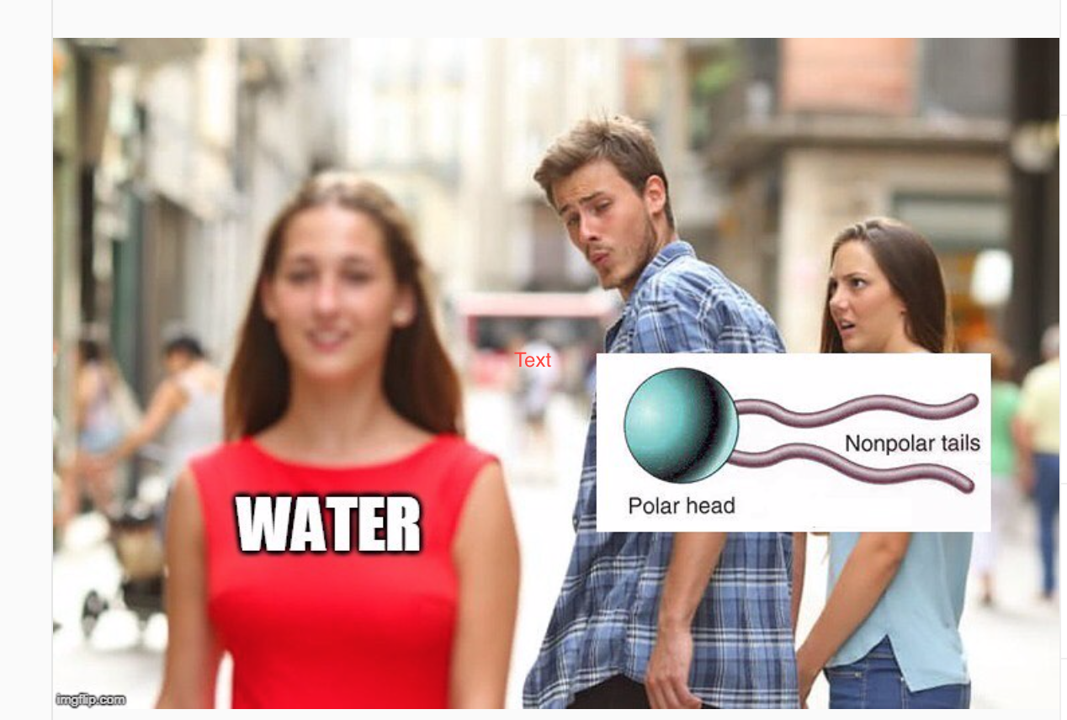

Slide 7
Word Bank
Homeostasis
Negative feedback
Positive Feedback
Endocrine System
Nervous System
Dynamic Equilibrium
Buffer
Carbonic acid
Bicarbonate
pH scale
Acidic
Basic
Polar
Electron Sharing
Covalent bond
Hydrogen Bond
Cohesion
Electronegative
Adhesion

