Slide 2
Connecting Carbon & Climate
Carbon is the molecule of life… will too much kill us?

Slide 3
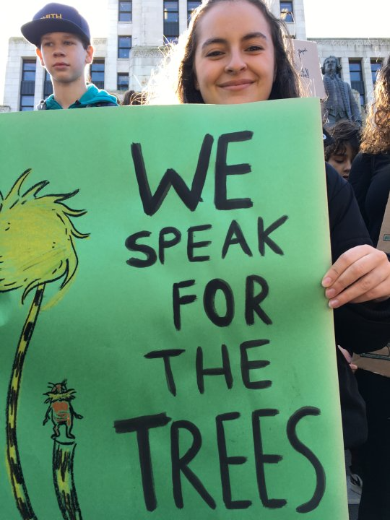
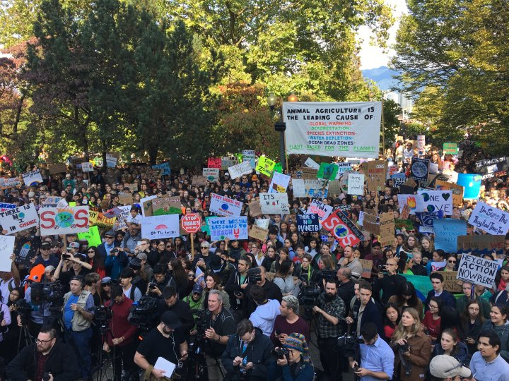
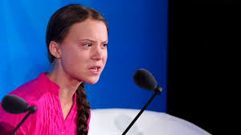

Slide 4
1) Connecting Climate Whiteboard Activity
TEN MINUTE TASK:
a) You and your team have been asked to explain to a grade 1 class a big question that they have:
What is the link between the carbon cycle and climate change?
You have each other, your whiteboard / pens & ten minutes to draw/label/ list a short, succinct answer
b) Food for thought- Add a quote from one of articles and your thoughts/ opinion about it to the bottom of your whiteboard
c) 2 min Group Rotations- visit two other groups and see if their explanations match your own ☺

Slide 5
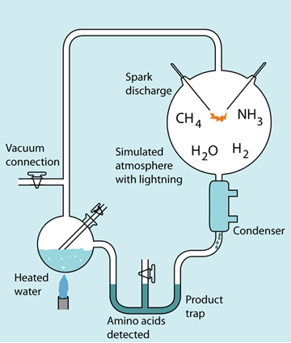
Sparking the Ingredients for Life…
How could life have begun from the molecules present on early Earth?

Slide 6
The Miller-Urey Experiment
Watch the video clip:
https://study.com/academy/lesson/stanley-miller-theory-experiment-apparatus.html

Slide 7
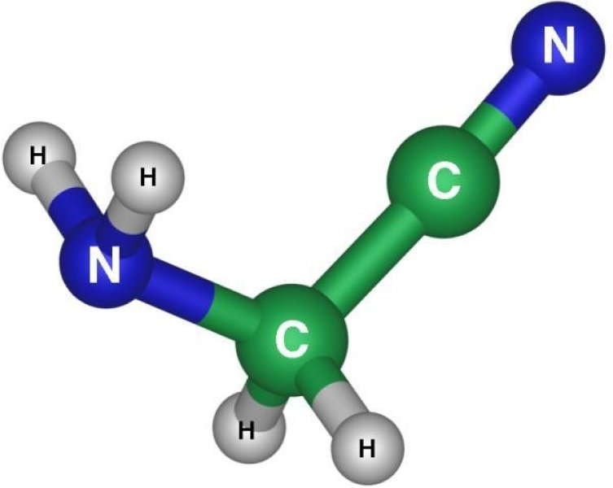
The Structure & Function of Large Biological Molecules
THE MOLECULES OF LIFE
Chap 5 pg 68

Slide 8
Today’s Mission
1) Read the handout about the Miller-Urey Experiment AND the back side introduction to organic molecules. Highlight the bold terms.
2) Start & Finish Chap Sections 5.1. 5,2.5.3
Read Section 5.1 and do the Concept Check Qs
Read Section 5.2 and complete the Carbohydrate table on the handout, also do the 5.2 Concept Check Qs
Read Section 5.3 and complete the Lipid Table, also do the 5.3 Concept Check Qs

