Slide 2
Last Class…
You wrote the “Quest” on homeostasis & water/acids/bases/ph Buffers
If not please come WEDNESDAY AFTER SCHOOL
You Read an Intro to Organic Molecules & did a word search ☺
If not please pick up a copy

Slide 3
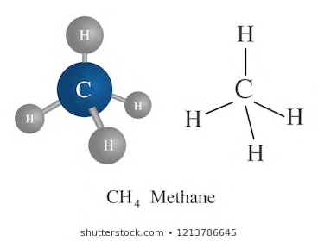
Sooo… What are organic molecules!?
Molecules made of Carbon
The molecules of life!

Slide 4
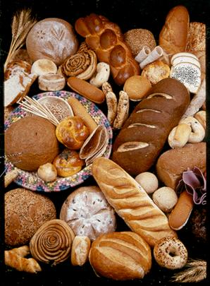
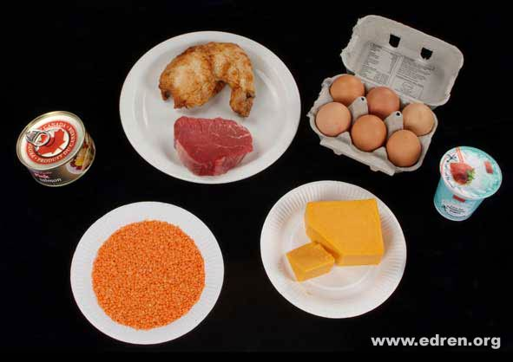
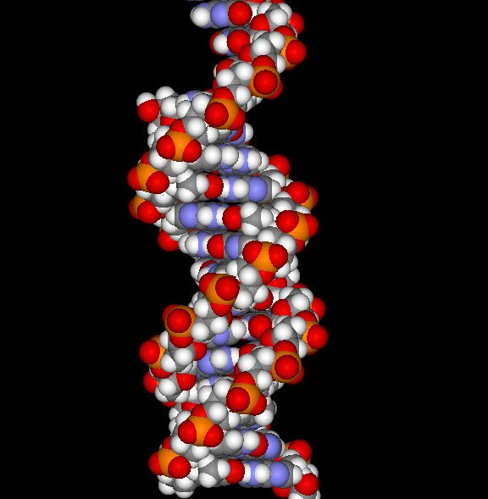
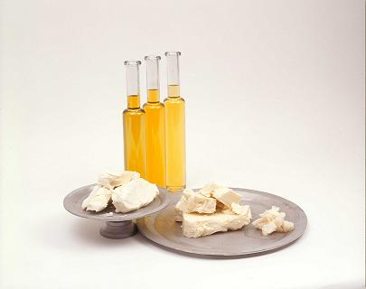
4 Major Classes of Organic Molecules:
1. Carbohydrates 2. Lipids 3. Proteins 4. Nucleic Acids
These are all examples of large macromolecules!
They are made up of smaller units called “monomers” that join together

Slide 5
How do macromolecules form?
Condensation (Dehydration) Synthesis reactions BUILD macromolecules by joining monomers and releasing water

Slide 6
Draw this diagram:

Slide 7
How do macromolecules break down?
Hydrolysis reactions- ADD WATER to break bonds and to separate large macromolecules into smaller units

Slide 8
Draw diagram:

Slide 9
Let’s take a closer look at the first group of macromolecules:
I) CARBOHYDRATES
Sugars!
BRAINSTORM- Why are sugars important?

Slide 10
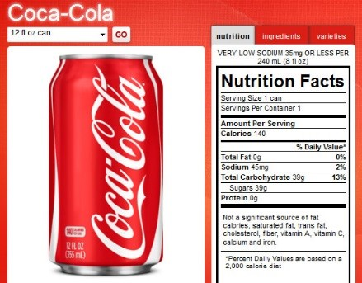
Did you know… this drink has 7 teaspoons of sugar!?

Slide 11
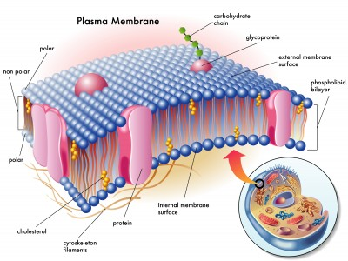
Did you know cell membranes use sugars for cell to cell recognition

Slide 12
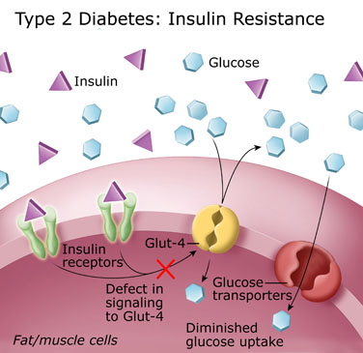
A sugary diet can lead to many health problems…

Slide 13
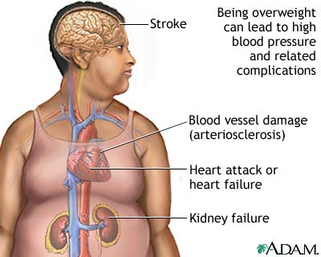
Obesity is on the rise…

Slide 14
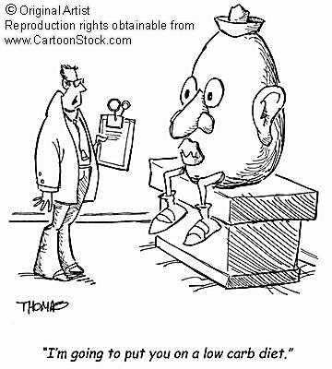
BREAKING NEWS:
G20 Leaders to Discuss SUGAR TAX!

Slide 15
Your Mission Today
Complete the handout on Carbohydrates
We will do the first few boxes together
Continue independently by reading Section 2.5 on Carbohydrates and Sec 2.6 on Lipids.
Complete both sides of the handout
On a separate page do the “Studying the Concepts Qs #10-13” from pg 43 in your textbook

Slide 16
I. Carbohydrates
GeneralFunction:
Quick, short term energy storage
Key Characteristics:
Molecules Involved:
Carbon, Hydrogen and Oxygen
Ratio of Molecules:
ratio of C:H:O is 1:2:1
General Molecular Formula:
generic equation for carbs C_{n}H_{2n}O_{n}

Slide 17
Simple Carbohydrates: Examples & Diagrams
-any 3 to 7 carbon in a molecule is a simple sugar called a monosaccharide.
Ex: Any Pentose (5-carbon sugar)
Deoxyribose→ found in DNA
Ribose → in RNA
Ex: Any Hexose (6 carbon sugar)
Glucose→ in blood, cell’s main energy source
Fructose→ in fruits, sweetest of monomers

Slide 18
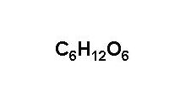
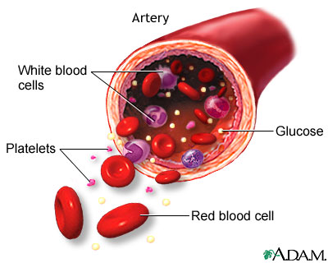
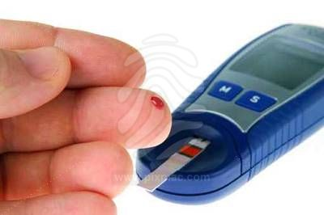
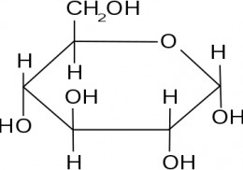
Glucose
Found in:
Blood
Used for:
Cell’s main energy
Source
Diagram:

Slide 19
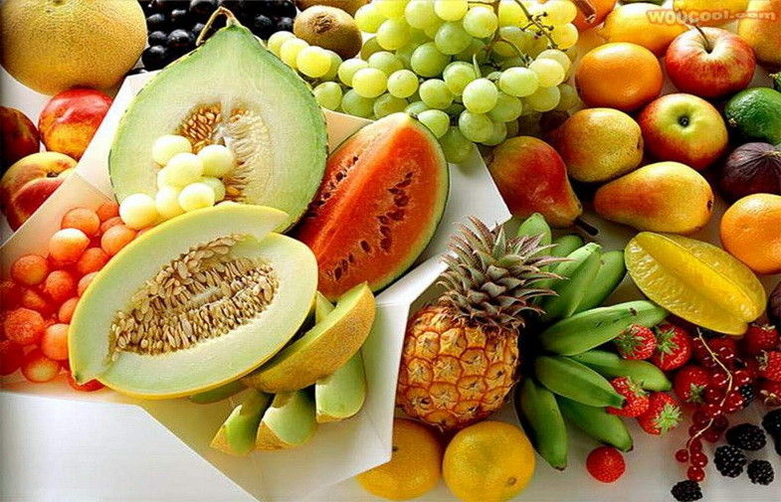
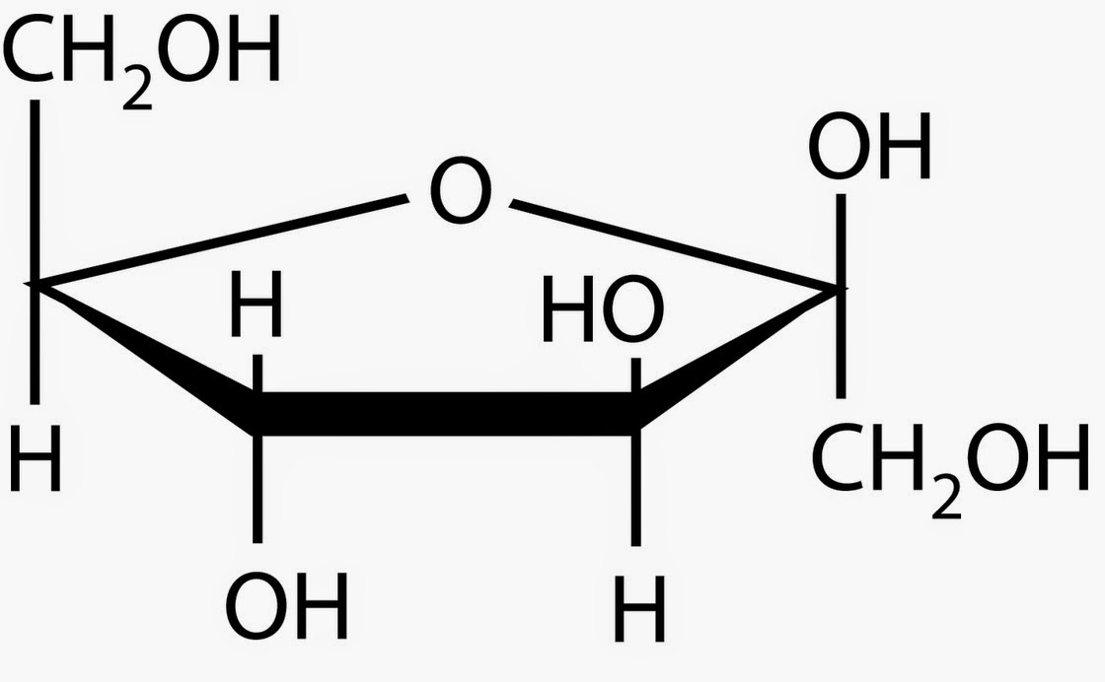
Fructose
Found in:
Fruits
Used for:
Quick energy
Diagram:

Slide 20
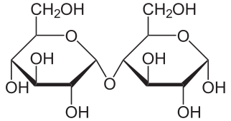
Maltose
Found in:
Not often in natural food sources, made when amylase breaks down starch
ex) carmelized glucose
Used for:
Energy
Diagram:

Slide 21
Continue independently by reading Section 2.5 on Carbohydrates and Sec 2.6 on Lipids.
Complete both sides of the handout
On a separate page do the “Studying the Concepts Qs #10-13” from pg 43 in your textbook

