Slide 1
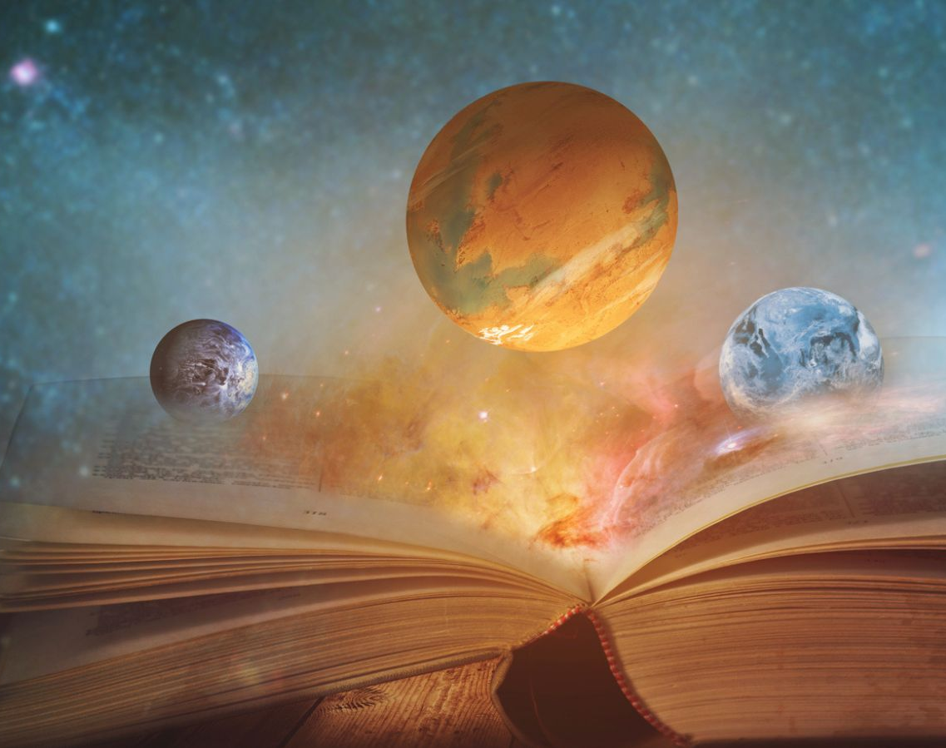
Creationism
By P. Martin

Slide 2
Purpose:
Make you aware of creationism
Tell you a little bit about it
Tell you about other theories

Slide 3
Some background:
different religions, different stories
"old view" and "modern view" creationists
so… creationist views differ a lot

Slide 4
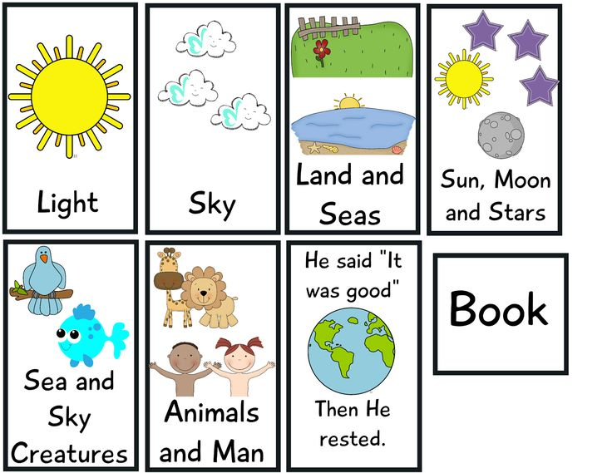

Slide 5
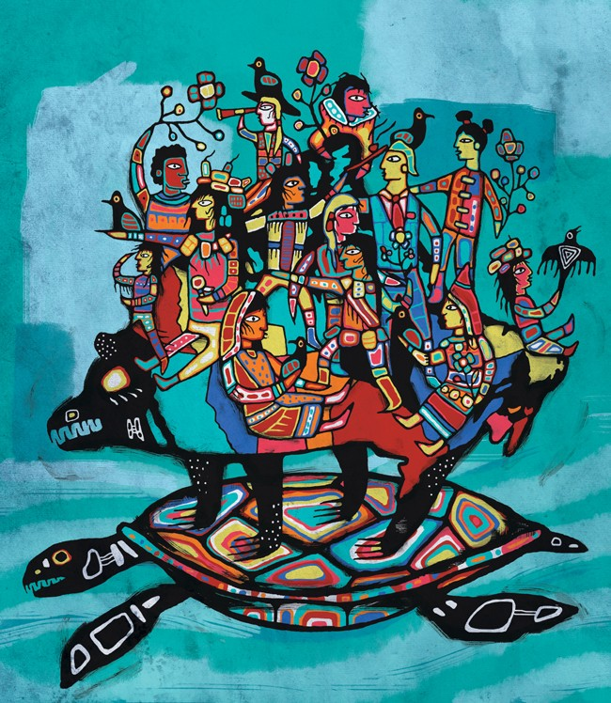

Slide 6
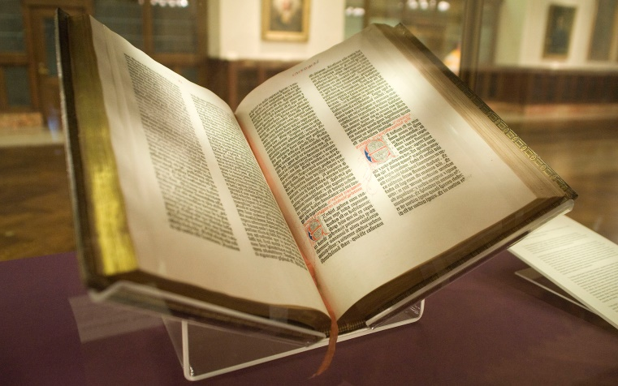
Creationism basics:
Usually based on religious beliefs (Christianity, Confucianism, Indigenous, others)
May be told in a book like the bible… god created the universe and life from nothing
Many different stories about creation of humans, earth, space bodies

Slide 7
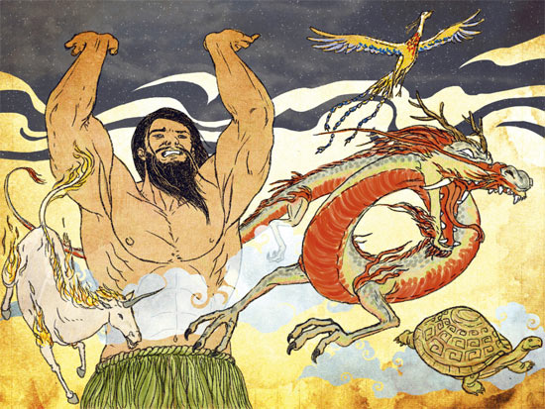

Slide 8
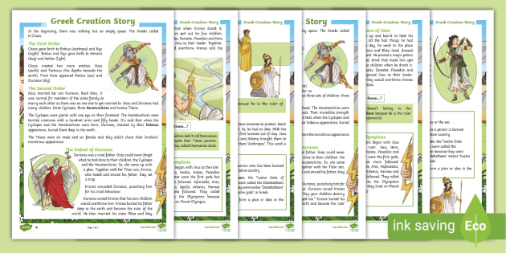

Slide 9
History of creationism:
idea has been around for thousands of years
in 1800’s, science started to challenge creationism (paleontology, geology, evolution)
today, people still argue about how life and the universe began

Slide 10
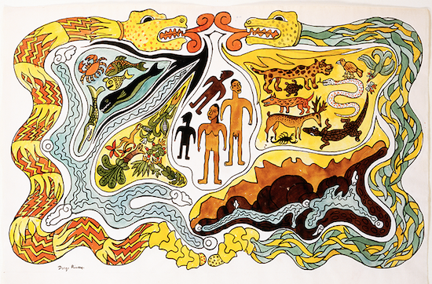
Mayan
Creation
Myth

Slide 11
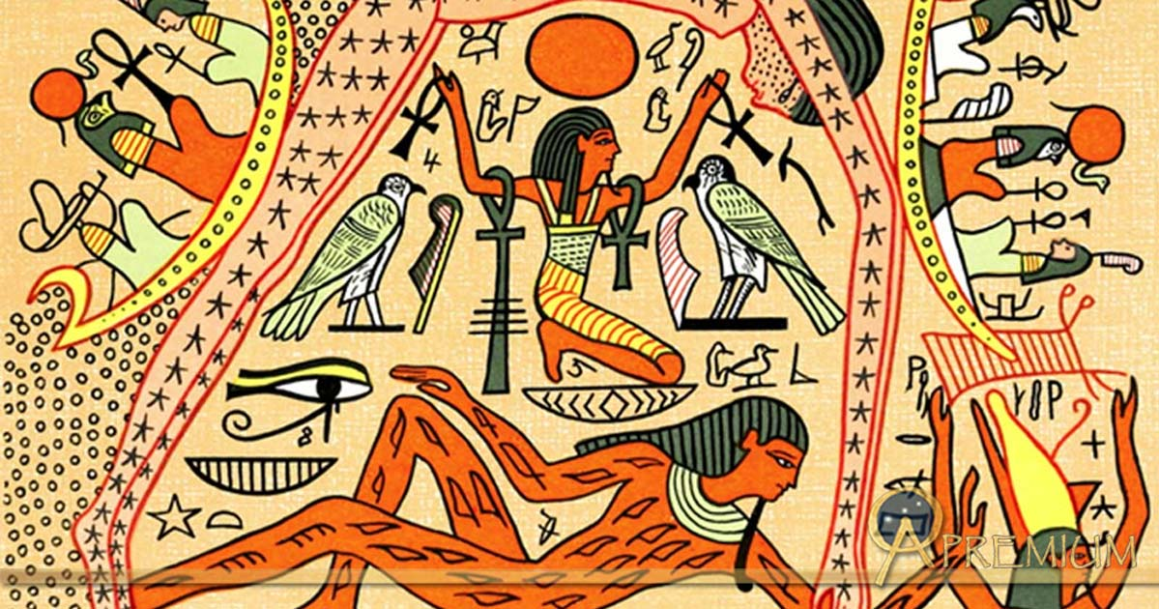

Slide 13
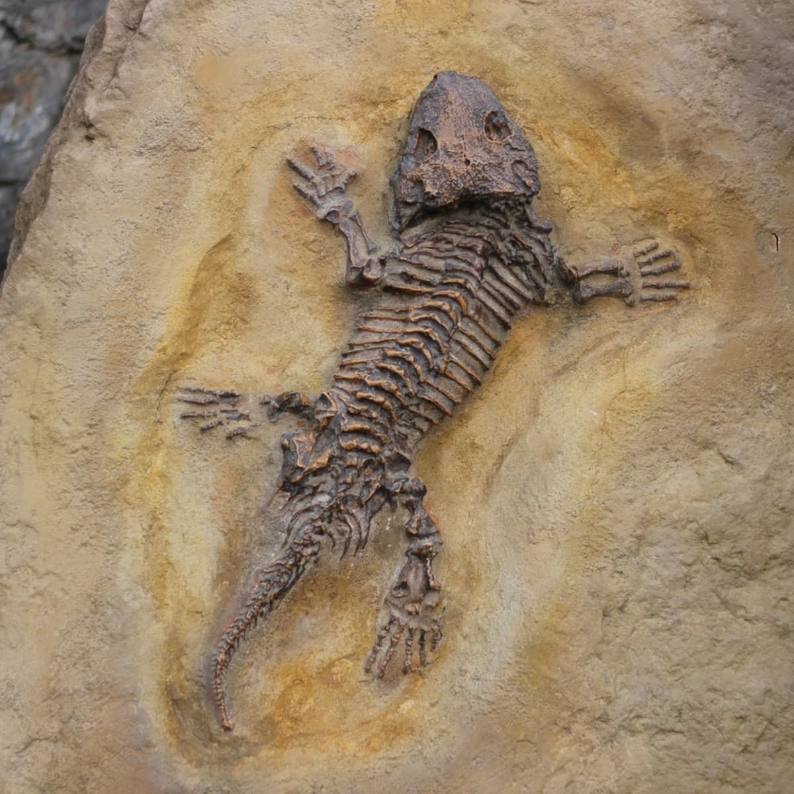
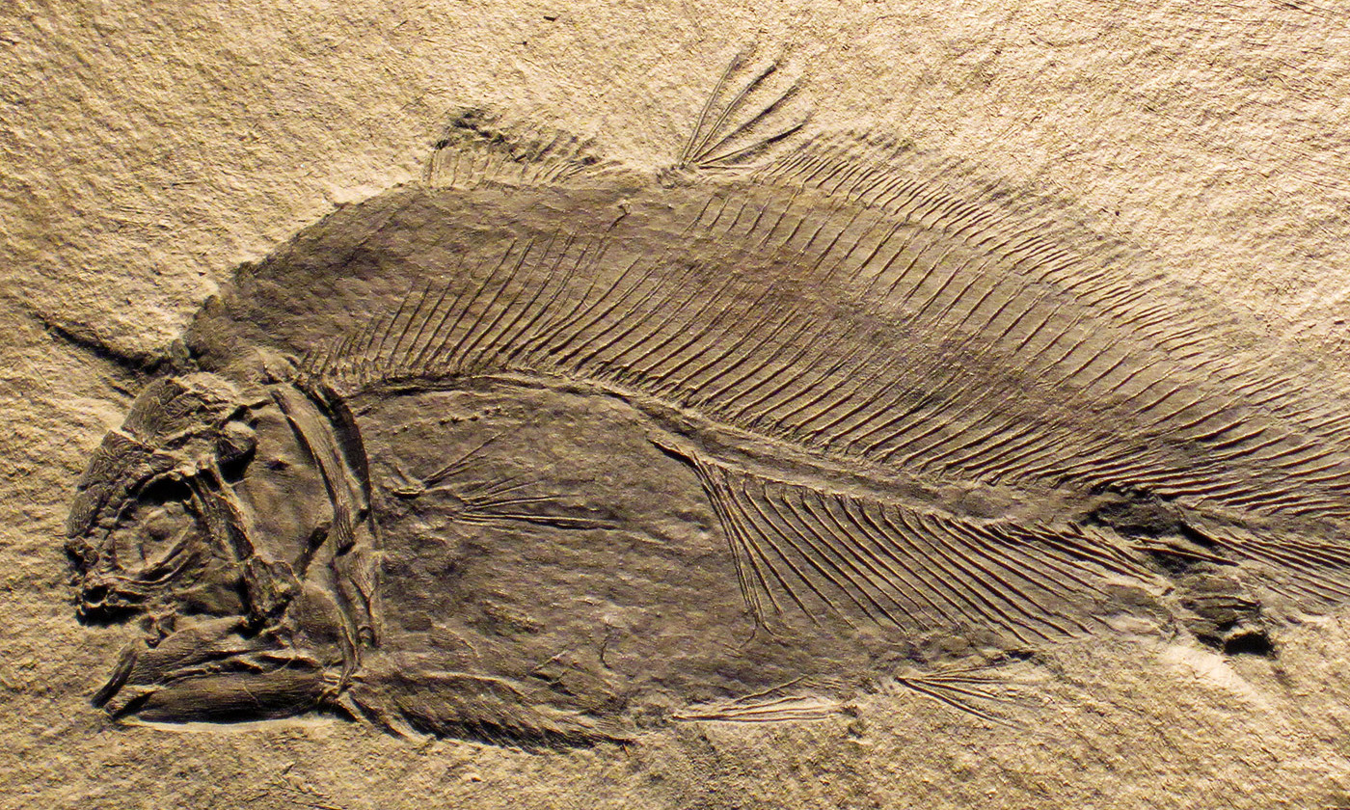
PaleontologyFossils

Slide 14
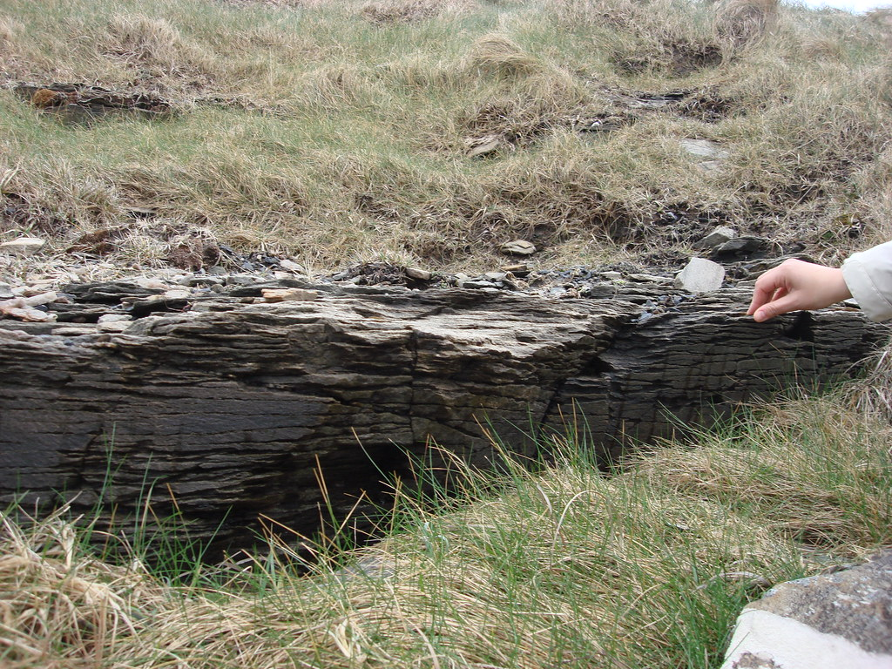
Geology
Layers
of rock

Slide 15
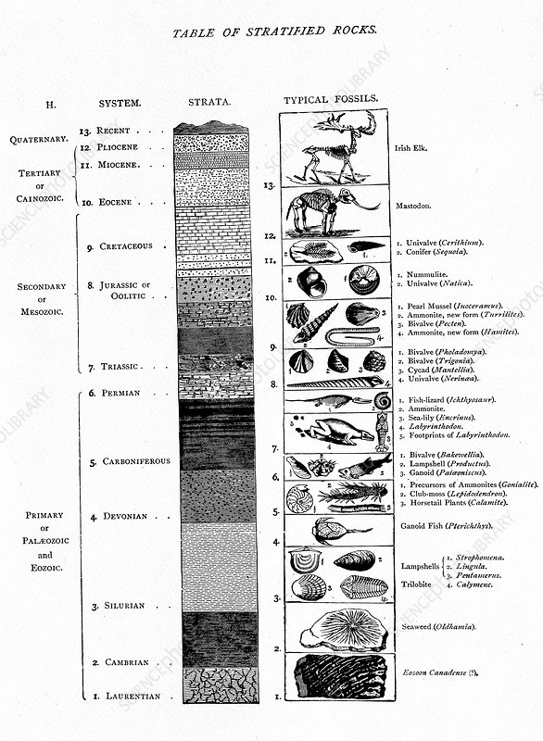
Geology
and
Paleontology

Slide 16
Scientists Geologists and Paleontologists
life began millions of years ago
living things changed over millions of years
fossils occurred naturally over millions of years
Creationists
creation took place thousands of years ago (old)
living things created in short time (old)
god created fossils at the same time (new)

Slide 17
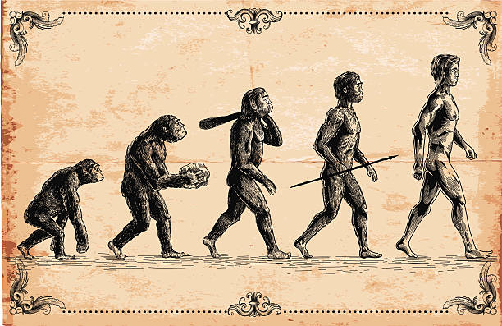
Theory of Evolution

Slide 18
Intelligent Design
more modern creationist idea
says creation very carefully planned
living organisms so complicated… can only be explained by intelligent designing

Slide 20
Final thoughts
people continue to debate how the universe and life began
listen to different stories… respect peoples’ right to believe what they will

