Slide 1
FLEXpectations!
FLEX Time for 2021-2022

Slide 2
What is it?
8:40-9:10 Monday-Friday except with extended FLEX on Collab Days (Beginning in October)
Flexible instructional time designed to support student success
This is your time. Use it wisely!

Slide 3
FLEXpectations
FLEX time is designed for student learning and therefore students should be focused on learning during FLEX
Students are expected to be purposeful and deliberate with their use of FLEX time
How will you use FLEX? Have a plan, bring all the learning materials needed
FLEX time is NOT "hang out" time. As students enter the building during FLEX time they should move to a learning space and will be asked to do so.

Slide 4
If a room is full students must go to a different classroom.
Students should only be meeting with teachers they have for Semester 1.
Students will be able to use the Library Learning Commons during FLEX time but must meet the expectations of the Learning Commons.
FLEX may be used to offer some assemblies or for
CLC and students will be expected to attend.

Slide 5
Only students currently enrolled in PHE will be able to use PHE spaces during FLEX.
PHE will post schedule of availability and specific sports that will take place during FLEX time.
PHE teachers will work through specific criteria with their classes
Students must wear non marking shoes at a minimum and follow PHE guidelines.

Slide 6
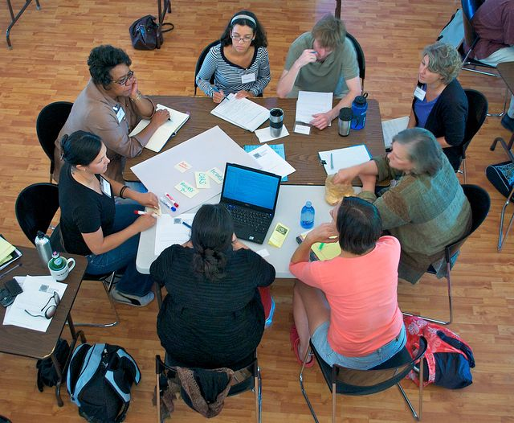
What CAN I DO FLEX time?
Get extra support from your current teachers
Extending your learning
Make up missed work and or assessments
Work on group projects, meet with clubs
MAKE GOOD DECISIONS and USE THIS TIME!

