Slide 1
Clinton Safety Guidelines
These guidelines have been put in place by
Provincial Health Officer
WCB
Worksafe
Ministry of Education
School District
Please follow these guidelines to keep everyone safe, including yourself

Slide 2
Before Coming to school People will ask you these questions . These questions will also be asked of your parents and teachers. *If anyone is presenting baseline symptoms such as seasonal allergies please contact administration for further guidance. If you Answer "Yes" to any of the following then you should Not be coming or at school
New Covid-19 Safety Regulations at School
Does the child have a cough?
Does the child have congestion?
Does the child have nasal drip?
Is the child experiencing nausea, vomiting and/or diarrhea?
Is anyone in your household ill?

Slide 3
If you have these symptoms you must stay home!
Congestion
Fever
Runny nose
Diarrhea
Vomiting
Cough
Nausea
Is anyone in our household ill?

Slide 4
Clinton Safety Guidelines 1. wash hands when you enter the building, before & after you eat, before you leave the building and in between transitions 2. keep your distance 2 meters apart/6 feet apart (everywhere, including the hallway) 3. refrain from walking around and touching items around the classroom (no use of the cloakroom, all student’s items are to be placed at student’s desk) 4. No adults (parents/grandparents/caregivers in the building)
New Covid-19 Safety Regulations at School

Slide 5
NEW COVID-19 SAFETY REGULATIONS AT SCHOOL
5. If you need help from your teacher keep your 2-meter distance
6. no group work, or pair work
7. work on your online assignments while you are at school, if you do not finish, complete your work at home –we will project the week at a glance in the classroom
8. bring your own charged devices (you will not be able to use devices in the building and photocopying is limited-due to touching of papers)
9. PPE masks are not required (according to Heath Authorities), but this is a personal choice

Slide 6
NEW COVID-19 SAFETY REGULATIONS AT SCHOOL
10. Water Bottle ( fountains will not be working), books and learning tools to be brought to school only that fits in your backpack.
11. Your class will have one entrance and exit plan, please remember to follow this procedure to minimize contact and social distancing requirements.
while lining up to go out and lining up to come into the school.
12. Outside Play – remember to social distance, that means although you want to get close to your friend to play, you need to stay 2 metres away while playing.
13 Signs around the school – Be aware of these signs, your teacher will go over them with you.

Slide 7
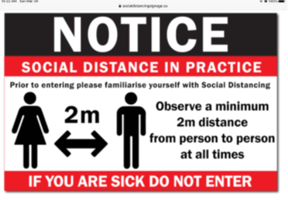
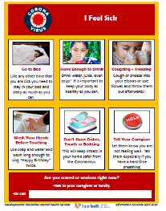
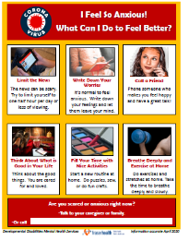
SAFETY REGULATIONS & Signs AT SCHOOL

Slide 8
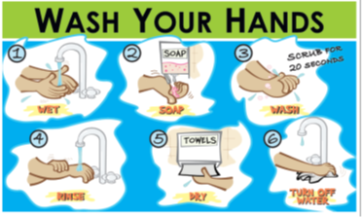
SAFETY REGULATIONS & Signs AT SCHOOL

Slide 9
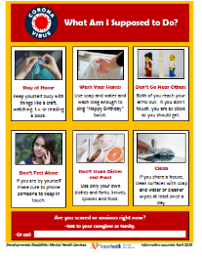
SAFETY REGULATIONS & signs AT SCHOOL

Slide 10
Please follow the new rules and signs
If you are unsure, ask your teacher for clarification

