Slide 1
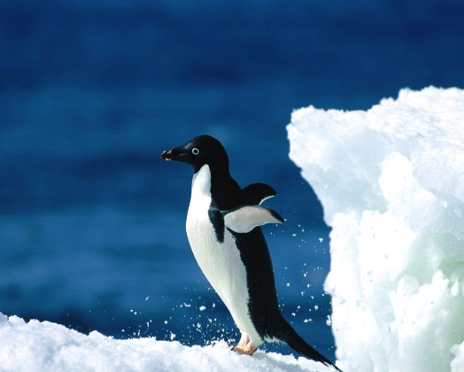
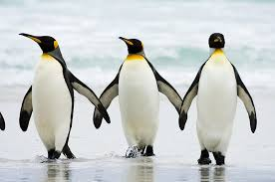
Penguins
Mini-presentation for Emergent Readers
By Sabrina Strauss Morgan

Slide 2
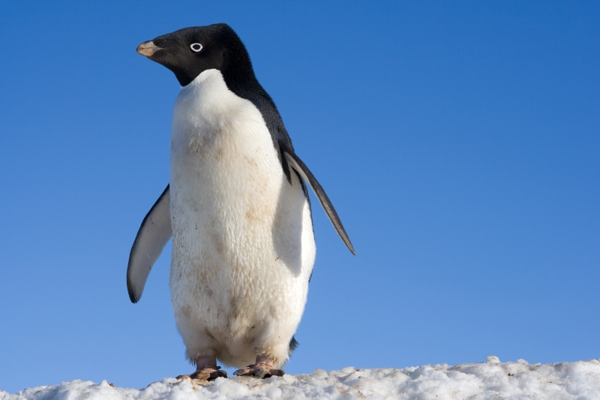
Penguins are birds.

Slide 3
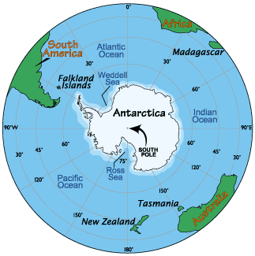
They live in the south part of our planet.

Slide 4
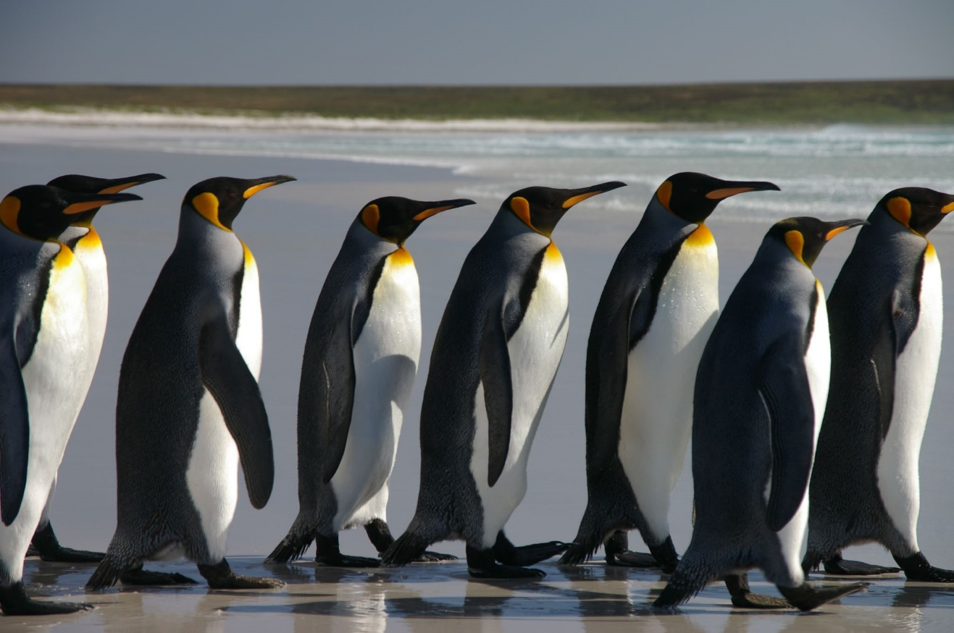
Penguins cannot fly.

Slide 5
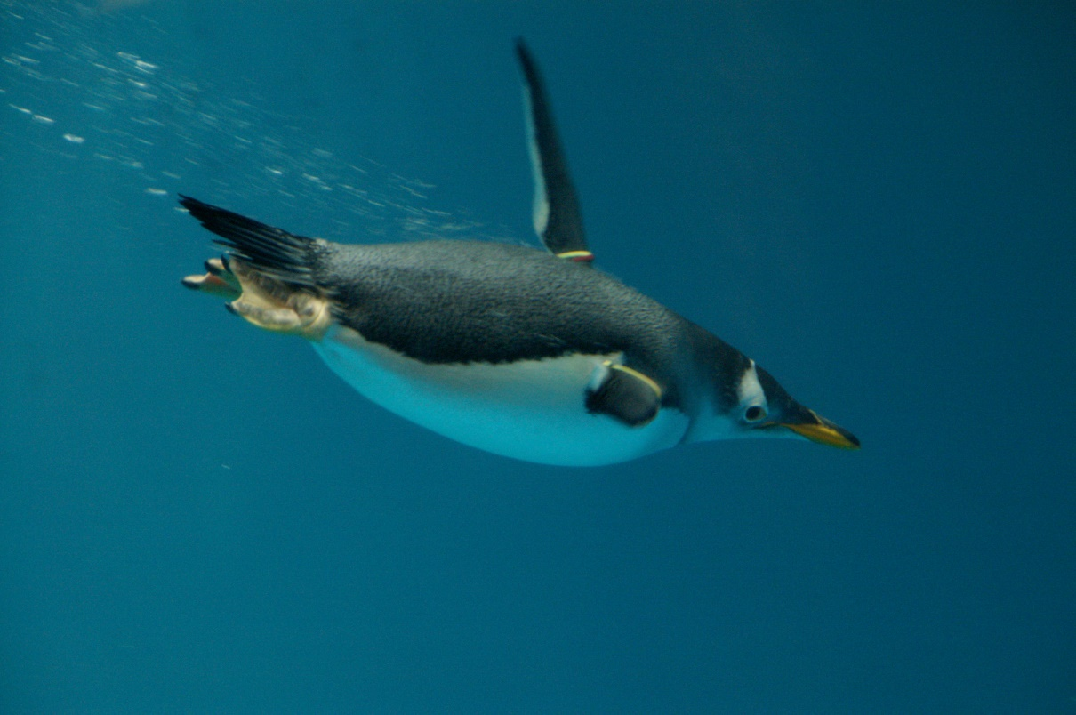
Penguins can swim in the water.

Slide 6
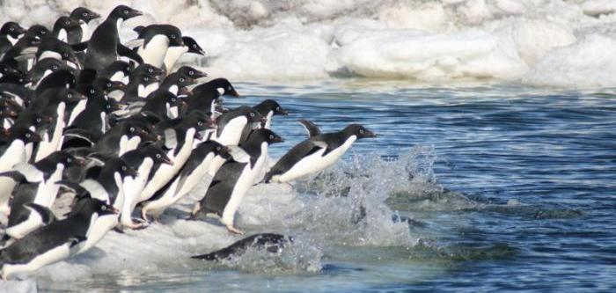
They hunt for food in the ocean.

Slide 7
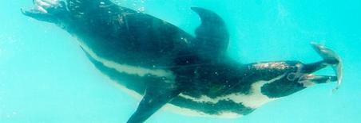
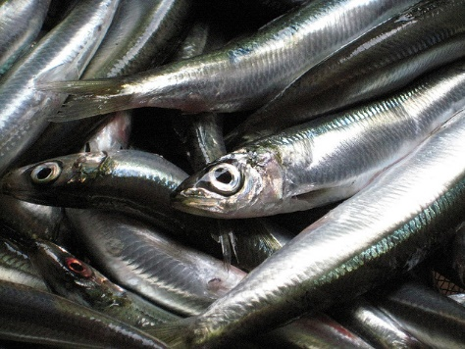
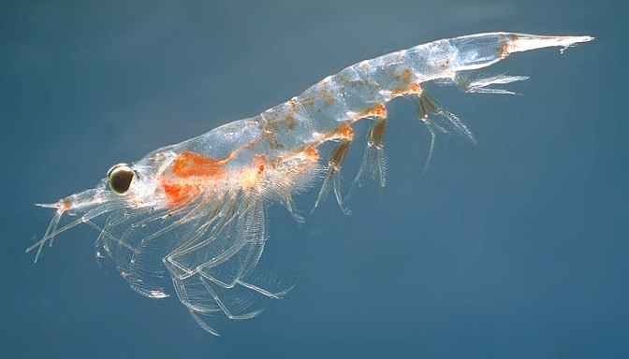
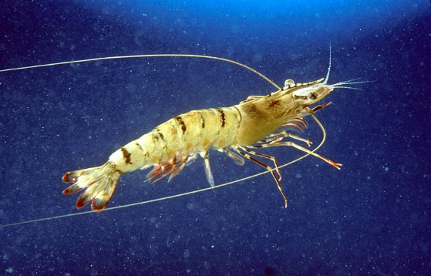
Penguins eat fish, krill and shrimp.
fish
krill
shrimp

Slide 8
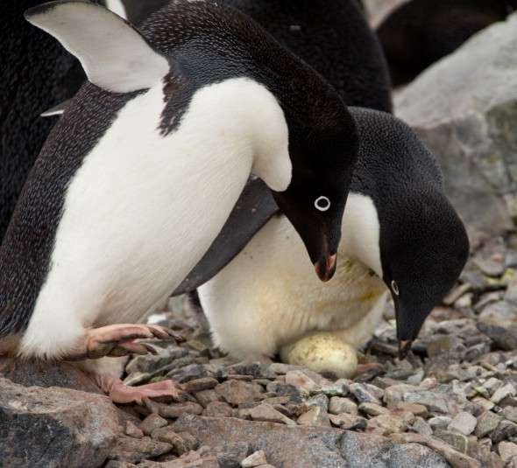
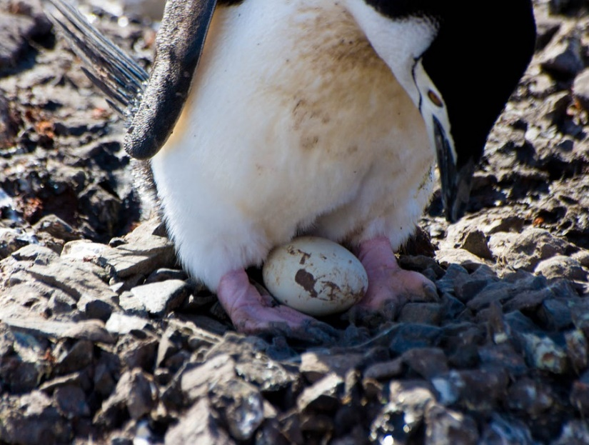
Penguins lay eggs.

Slide 9
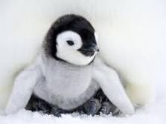
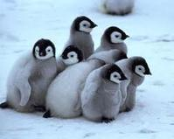
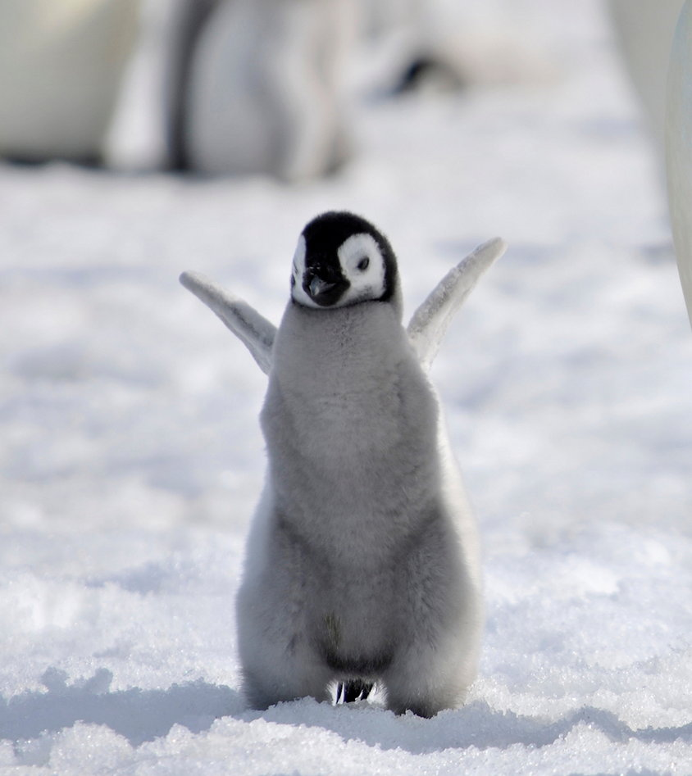
Baby penguins are called chicks.

Slide 10
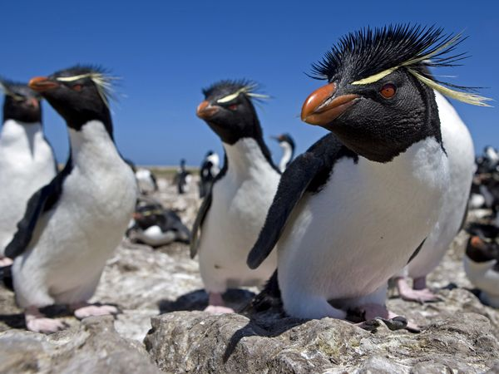
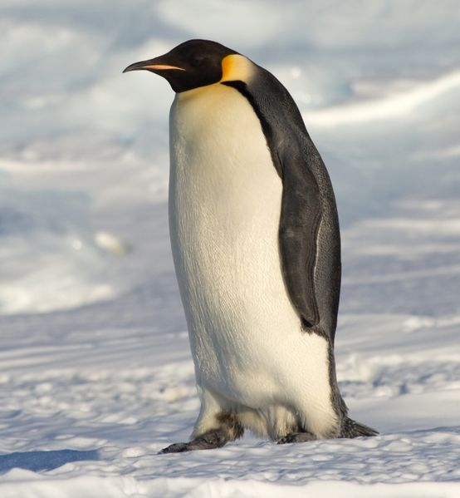
Emperor Penguins are the biggest penguin. They are almost 4 feet tall!
Rockhopper Penguins are small penguins. They jump, or hop, from rock to rock.

Slide 11
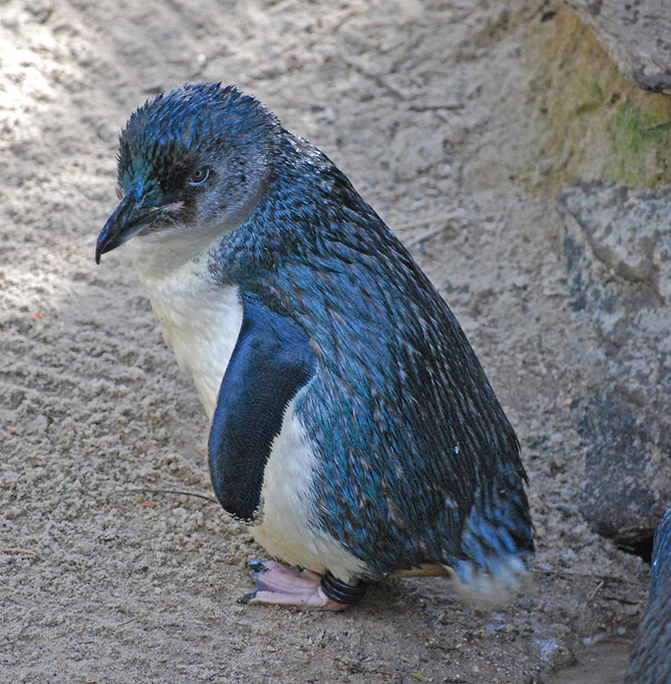
The Little Blue Penguin is the smallest penguin. Their feathers are a bluish color.
African Penguins live in South Africa. They make a sound like a donkey!

Slide 12
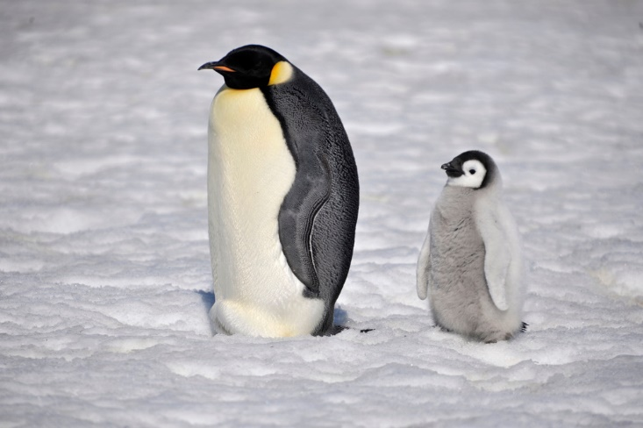
Thank you for watching!

