Slide 1
Culture: General Frameworks
Adapted from Heather Tobe (Douglas College)

Slide 2
Individualism vs Collectivism

Slide 3
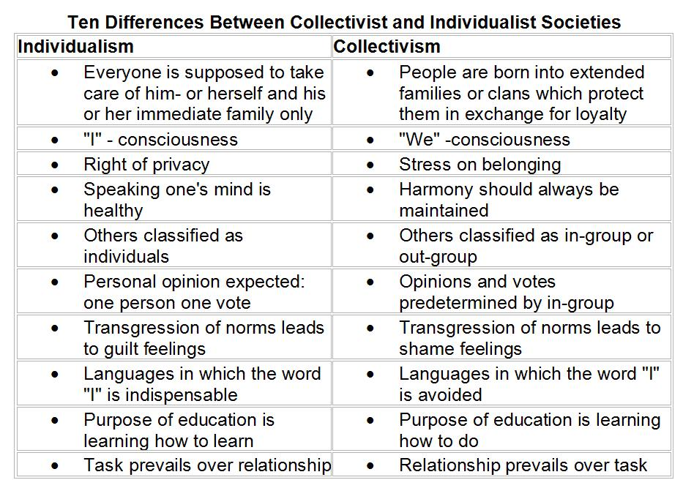
Collectivist
Vs.
Individualist

Slide 4
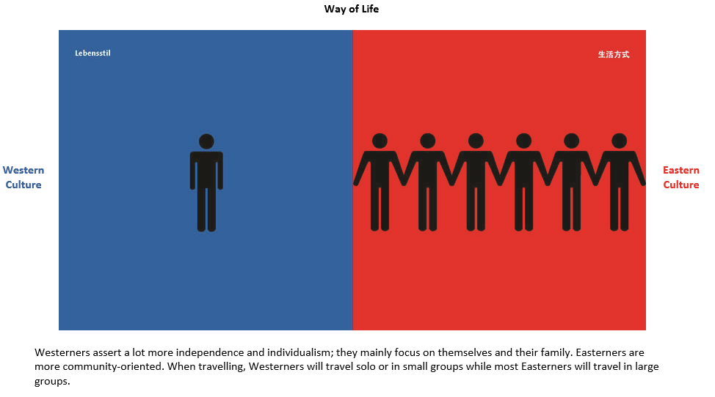
For example:

Slide 5
Linear Time vs Flexible Time and Cyclical Time
Linear Time
Time moves constantly forward; future is important
Schedules and punctuality is important
Time at work = success
Best to do one thing at a time
Flexible Time
Present more important than future
Do many things at the same time
Schedules and punctuality are not important
Use of time shaped by activity or people involved
Cyclical time = focus on things that happen over and over again

Slide 6
Monocrhonic
Vs.
Polychronic

Slide 7
Yang Liu, “East Meets West” Attitude towards punctuality

Slide 8
Egalitarian vs Hierarchy
Egalitarian (Low power distance)
People should be thought of as equals
People should direct their own choices and activities
Prefer less formality
People in power should be challenged
Hierarchy (High power distance)
People should take direction from above
Don’t challenge people in power
Prefer rules about behaviour and relationships

Slide 9
High Power Distance
Vs.
Low Power Distance

Slide 10
Yang Liu, “East meets West” The Boss

Slide 11
Yang Liu, “East Meets West” Complexity of self-expression

Slide 12
Indirect Communication vs Direct Communication
Indirect Communication
Context is very important
Communication through gesture, body language, implication
Prefer not to offend
Responsibility is with listener to understand
Direct Communication
Communication is through the words someone says
Context is not very important
Comfortable with bluntness/conflict
Responsibility is with speaker to be clear

Slide 13
Yang Liu “Connections and Contacts”

Slide 14
Relationship Focus vs Task Focus
Relationship
Trust is formed through relationship building
Greetings and social time comes before doing business
May not say “no”
Task
Trust is formed through success on a task
Success is measured through achievements
Social interactions not a big priority

Slide 15
Universalism vs Particularism
Universalism
The same rules should apply to everyone
Focus more on rules than relationships
A trustworthy person honours the rules
Particularism
Different people and relationships require different responses
Rules are thought of as flexible and changeable
There are several perspectives on reality or an event

Slide 16
Yang Liu “Independent vs Interdependent”

Slide 17
Any conclusions?
These frameworks are a part of shaping how people think and behave
There is lots of individual variation within cultures
To be good global citizens, we need to understand how people may behave and communicate differently depending on their culture of origin
Different frameworks probably have different strengths in different situations. Markus and Conner (in Clash) argue that we should all strengthen both our independent and interdependent selves, for different circumstances

Slide 18
Case Study – The Giver
The Giver is a childrens’ novel set in a dystopian future. According to the back of the book:
Jonas’s world is perfect. Everything is under control. There is no war or fear or pain. There are no choices. Every person is assigned a role in the community.
We will explore these cultural frameworks by discussing parts of the story – the values that Jonas’s community is formed based on, and the values that he learns about.

